Slide 1

Review Meet: Week 4
June 18th, 2021
Name: Rishabh Thapliyal
Mentor: Syed Faraz Ali & Mallikharjuna MV
Manager: Subhasish Misra

Slide 2
Agenda
Brief overview of previous week
Difference in distributions if-
  All the numbers are removed
  All the single and double character words are removed
Feature preprocessing
Voting classifier
Data augmentation
Way ahead

Slide 3
Recap
EDA
List of all stopwords and lemmatized words
Lemmatize only the words having more than 3 characters
Trust Factor calculation
Random forest: 85%
Logistic regression:89%
Condition: Stopwords removed, all words lemmatized, single character words removed
Divergence
Removing numbers
Removing 2-character words
Removing numbers and 2-character words

Slide 4
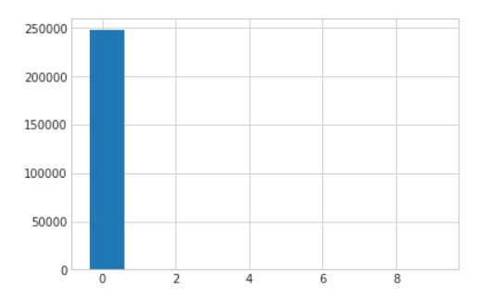
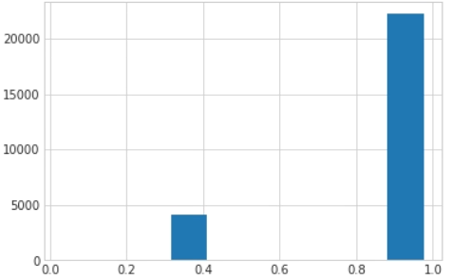
Comparing distributions: Numbers removed
Stopwords removed, lemmatize > 3, single char removed, noise words removed
Model = LR→ get the probability distributions
Arrange the rows in decreasing probabilities
Select top 3 for each row → Distribution-1
Stopwords removed, numbers removed, lemmatized > 3, single char removed, noise words removed
Model = LR → get the probability distributions using X_test_updated
Arrange the rows in decreasing probabilities
Select top 3 for each row → Distribution-2
Average KL divergence: 0.003
  Less than 0.1 for 99.3% of the data
Average KS pvalue: 0.9866
  More than 0.9 for 98.3% of the data
Conclusion:
The two distributions are not different; hence we can remove the numbers.
KS Test (Pvalue)
KL divergence

Slide 5
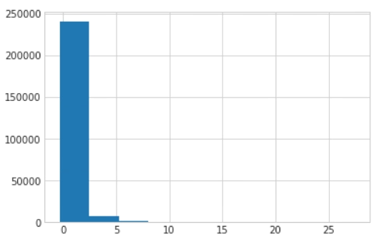
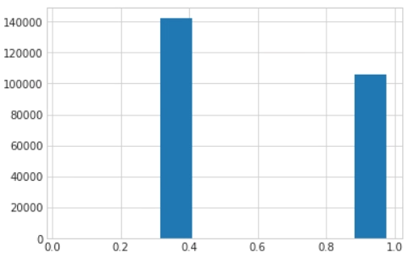
Comparing distributions: 2 char words removed
Stopwords removed, lemmatize > 3, single char removed, noise words removed
Model = LR→ get the probability distributions
Arrange the rows in decreasing probabilities
Select top 3 for each row → Distribution-1
Stopwords removed, lemmatized > 3, single char and 2 chars words removed, noise words removed
Model = LR → get the probability distributions
Arrange the rows in decreasing probabilities
Select top 3 for each row → Distribution-3
Average KL divergence: 0.334
  Less than 0.1 for only 59.6% of the data
Average KS pvalue: 0.60
  More than 0.9 for just 42.7% of data
Conclusion:
The 2 distributions are comparatively more similar. But as 2 char words are not making much sense, we will drop them.
KS Test (Pvalue)
KL divergence
Note: Convergence warning for Logistic Regression (max_iter = 5000)

Slide 6
Conclusion from previous activities
Remove numbers
Lemmatize words with > 3 chars
Remove 1 & 2 char words

Slide 7
Effect on Overall Trust Factor
 | Logistic Regression | Random Forest
Stop words removed, lemmatize all, single chars removed | 89% | 85%
lemmatize > 3, rest same as above | 83%
Stop words removed, lemmatize > 3, single char and double chars removed | 86.6%*
Few 2 char words which were earlier lemmatized and reduced to single char were getting removed, but which is not the case now.
On removing 2 char words, its not converging because of following classes:
*convergence warning
bp: baby peeled
va: value added
Class | Most imp feature | LR_Coefficient | No of data points
LETTUCE_LETTUCE BOATS | hg | 11.5505 | 1
HERBS_HERB THAI BASIL | og | 20.6661 | 3
CUT FRUIT PACKAGED_VA VEG | va | 20.4205 | 79
CARROTS_CARROT BABY WHOLE | bp | 21.3411 | 175

Slide 8
Feature cleaning
Spell check
flavrd-lord
Auto-correct
canela-camera
celery-every
Textblob
burger-burgher
Snowball Stemming
keylime-kylie
sunflwer-sunflower
caulicrmb-caulicrmb
stayman-starman
xref-ref
braeburn-rayburn
pinkldy-pinky
freshly : fresh
freshness : fresh
grilled : grill
grilling : grill
juice : juic
juicing : juic
berry : berri
beverage : beverag
blackberry : blackberri
aloe : alo
anise : anis
apple : appl
cauliflower : cauliflow
ccandy : ccandi
celery : celery
sunflower : sunflow
sunflwr : sunflwr
caramel-cartel
cartn-cart
carton-carbon
cashew-case
ccandy-candy
sleeved-sleeves
snacker-snake
snacking-stacking
spiced-spaced
spkl-spl
spmix-pmid
sprinkle-sprinkled
veggie-reggae
grilling-drilling
chickn-chicken
chilean-clean
chili-child
coconut-coronet
pumpkin-pushkin
quince-quincy
radish-ravish
raisin-raising
thai-that

Slide 9
Manually found incorrect features
Almd – almond
Bacn – bacon
Blu – blue
Bleu – blue
Blk - bulk
Cartn – carton
Ccandy – candy
Carn – carns
Chickn – chicken
Chili – chilies
Chnk – chnks
Choc – chocolate
Choppd – chopped
Clem – clems
Cob – cobb
Cocktail – cokcatail
Concord – concorde
Corrogated – corrugated
Crsp – crisp
Eng – English
Exp – express
Elevte – elevate
Flvrd – flavrd – flavoured
Juici – juicing – juice
Minneola- minneolas
Pinklady – pinkldy
Ref – reference
Sunflwer – sunflower
Superseedz – supersedes
Tov – tovs
Tropical – tropicals
These are the features which are coming in more than 10 data entries.
I would like to correct them by creating a dictionary and replacing these words with the correct spelling.

Slide 10
Voting classifier
A Voting Classifier is a machine learning model that trains on an ensemble of numerous models and predicts an output (class) based on their highest probability of chosen class as the output.
Hard Voting: The predicted output class is a class with the highest majority of votes.
  Classifier 1 = class B
  Classifier 2 = class A
  Classifier 3 = class B
    Output will be class B. In case of even no. of classifiers alphabetical order will be used.
Soft voting: In soft voting, the output class is the prediction based on the average of probability given to that class.
  Class A = (0.30, 0.47, 0.53) and Class B = (0.20, 0.32, 0.40)
  Output will be Class A as it has higher average
Model | CV score | Time
Voting (hard) | 0.984 | 9000 secs
Voting (soft) | 0.9839 | 11058 secs

Slide 11
Trust Factor calculations
Model | Stop words removed | Numbers removed | Lemmatized > 3 | Words < 3 char removed | Noise words removed | Spell correction | TF category | TF variety | Time taken
Voting (Hard, max iter= 5000) | Yes | Yes | Yes | Yes | Yes | No | 68.22 | 81.19 | 10981 secs, convergence warning
Voting (Hard, max iter=10000) | Yes | Yes | Yes | Yes | Yes | No | 67.42 | 79.02 | 19253 secs
Voting (Hard, max iter=10000) | Yes | Yes | No, ALL | Yes | Yes | No | 63.48 | 76.44 | 23009 secs, convergence warning
Voting (Hard, max iter=10000) | Yes | Yes | Yes | Yes | Yes | Snowball stemming | 68.24 | 77.66 | 22609 secs, convergence warning
LR (max iter = 5000) | Yes | Yes | Yes | Yes | Yes | No | 65.8 | 79.9 | 10000 secs, convergence warning
Voting (Hard, max iter=10000) | Yes | Yes | Yes | Yes | Yes | Manually created dictionary | 64.54 | 78.24 | 22807 secs, convergence warning
Voting (Soft, max iter= 5000) | Yes | Yes | Yes | Yes | Yes | No | 65.75 | 75.96 | 11086 secs, convergence warning
RF | Yes | Yes | Yes | Yes | Yes | Spell check | 65.57 | 75.47 | Spell check takes > 4hrs
RF | Yes | Yes | Yes | Yes | Yes | No | 67 | 75 | 90 secs
RF | Yes | Yes | Yes | Yes | Yes | Snowball stemming | 64.4 | 72.7 | 90 secs

Slide 12
Data Augmentation*
 | Pre-processing | Data augmentation | TF category | TF variety | Time
RF | Yes | Yes | 58.33 | 70.39 | 237 secs
Voting (hard) | Yes | in progress*
I have used Snorkel to model the data augmentation process by applying user defined transformation functions in sequence.
For any input data, example-
‘ENERGY ACAI BERRY JUICE SAM ENERGY JUICE PREMIUM BEVERAGE SUPER PREMIUM BEVERAGE NAKED BOLTHOUSE’
My function will randomly choose a word from this string and will look for its synonyms in WordNet. If synonym is found, then the word is replaced with the best synonym else nothing is returned.
I’m keeping the original data entry, and for every data entry I’m doing the above process 2 times.
The above string is changed to-
‘ENERGY ACAI BERRY JUICE SAM ENERGY JUICE PREMIUM BEVERAGE SUPER PREMIUM POTABLE NAKED BOLTHOUSE’
Size of training data is increased to approximately 3 times (129449).

Slide 13
Way ahead
Explore further in data augmentation-
  Synonyms for verbs
  Synonyms for adjectives
  Synonyms for nouns
Augment the classes with less data points.
Try ‘fast text’ model and compare with existing models.

