Slide 1

Review Meet: Week 5
June 25th, 2021
Name: Rishabh Thapliyal
Mentor: Syed Faraz Ali & Mallikharjuna MV
Manager: Subhasish Misra

Slide 2
Agenda
Brief recap of previous week
Progress made in this week
Difference in distributions
Data augmentation using snorkel
Way forward
Spell corrections
Voting classifier of RF and LR
FastText model

Slide 3
Recap
Comparing distributions
Removing numbers
Removing 2 char words
Data preprocessing
Spell check
Autocorrect
Snowball stemming
Textblob
Voting classifier model
Hard voting
Trust factor calculations
Soft voting
Hard voting model of RF & LR
TF category = 68.22 , TF variety = 81.19

Slide 4
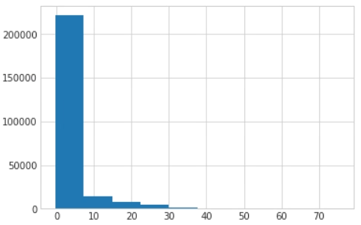
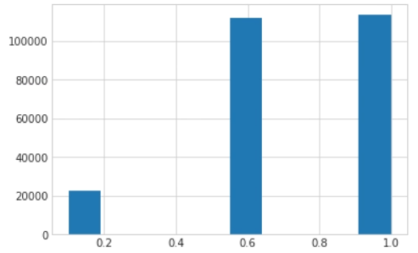
Comparing distributions: Numbers removed
Spell correction, Stopwords removed, lemmatize > 3, single char removed, noise words removed
Fit on model = LR(100)→ predict the probability distributions for X_test
Store the indexes for top 3 probabilities for each row
Only the values at those indexes → Distribution-1 (48197 x 3)
Spell correction, Stopwords removed, numbers removed, lemmatized > 3, single char removed, noise words removed
Model = LR(100)→ predict the probability distributions using X_test_updated
Only the values at the found indexes→ Distribution-2 (48197 x 3)
Average KL divergence: 2.36
  Less than 1 for 72.2% of the data
  Less than 10 for 92.2% of the data
Average KS pvalue: 0.737
  More than 0.6 for 45.6% of the data
  More than 0.5 for 90.1% of the data
KS Test (Pvalue)
KL divergence

Slide 5
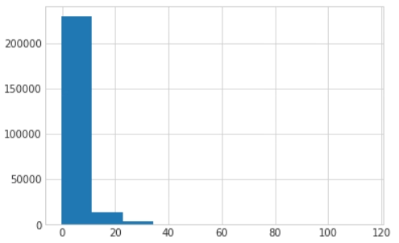
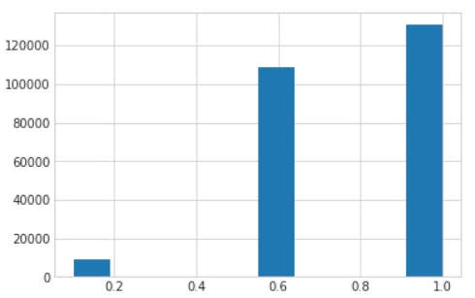
Comparing distributions: 2 char words removed
Spell correction, Stopwords removed, lemmatize > 3, single char removed, noise words removed
Fit on model = LR(100)→ get the probability distributions for X-test
Store the indexes for top 3 probabilities for each row
Only the values at those indexes → Distribution-1 (48197 x 3)
Spell corrections, Stopwords removed, lemmatized > 3, single char and 2 chars words removed, noise words removed
Fit on model = LR(100)→ get the probability distributions using X_test
Only the values at the found indexes→ Distribution-3 (48197 x 3)
Average KL divergence: 2.54
  Less than 1 for 69.6% of the data
  Less than 10 for 93.5% of the data
Average KS pvalue: 0.792
  More than 0.9 for 52.7% of data
  More than 0.5 for 96.4% of data
KS Test (Pvalue)
KL divergence

Slide 6
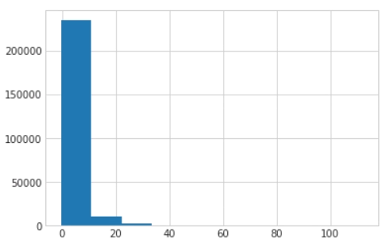
Comparing distributions: Numbers and 2 char words removed
Spell correction, Stopwords removed, lemmatize > 3, single char removed, noise words removed
Fit on model = LR(100)→ get the probability distributions
Store the indexes for top 3 probabilities for each row
Only the values at those indexes → Distribution-1 (48197 x 3)
Spell correction, Stopwords removed, numbers removed, lemmatized > 3, single char and 2 chars words removed, noise words removed
Fit on model = LR(100)→ get the probability distributions
Only the values at those indexes → Distribution-3 (48197 x 3)
Average KL divergence: 2.01
  Less than 1 for 71.1% of the data
  Less than 10 for 95.7% of the data
Average KS pvalue: 0.76
  More than 0.9 for 47.5% of data
  More than 0.5 for 93.9% of data
KS Test (Pvalue)
KL divergence

Slide 7
Spell corrections
My list
CHICKN → CHICKEN
Walmart’s list
Total words present in the list: 40,745
JUICI → JUICE
Total words I’ve found from eyeballing: 31
GARC → GARLIC
ALMOND → ALMONDS
Applied on
Train_df[‘FEAT1’], test_df[‘FEAT1’]
Before calculating trust factor, I’ll apply on predicted category and predicted variety.

Slide 8
Data Augmentation
Simple wordnet
Simple Walmart
Complex Walmart
Randomly choose a word in the sentence and look for its synonym in “Wordnet”. If found, then replace it otherwise return nothing.
Few issues- SAM: surface-to-air missile, Premium: Insurance Premium
Randomly choose a word in the sentence and look for its synonym. If that word is present in Walmart list, return its list of synonyms and replace with any of them randomly. If word not found in Walmart list, return nothing.
Set the ratio of verb, noun and adjectives.
If transformation function for verb is applied, then it will find all the verbs in the sentence, and randomly select any of them to look for synonym.
If the chosen verb is present in our Walmart list, then it is replaced with anyone of its synonyms, else if the verb is not present then return nothing.

Slide 9
FastText model
It is a library created by the Facebook for efficient learning of word representations and sentence classification.
Advantages over word2vec and Glove
  It can give the vector representations for the words not present in the dictionary. Eg- “stupedofanctabulouslyfantasti”
  It is extremely fast.
Preprocessing steps
Spell correction (manual & Walmart)
Stopwords and Numbers removed
Lemmatize words with chars more than 3
Remove words with 1 and 2 chars
Remove noise words
Model | Preprocessing | Data augmentation | Validation accuracy | TF category | TF variety
FastText | Yes | No | 93.50 | 71.84 | 68.42
FastText* | Yes | No | 98.92 | 72.02 | 69.66
FastText* | Yes | Yes, simple wordnet | Train data = 129552 | 99.64 | 68.35 | 68.37
FastText* | Yes | Yes, simple Walmart | Train data = 48412 | 98.66 | 70.02 | 69.29
FastText* | Yes | Yes, complex Walmart | (0.2,0.7,0.1) | Train data= 48298 | 98.95 | 70.45 | 71.58
* Refers to model after hyperparameter tuning; dim=55, lr=0.04, loss=softmax, epochs=47, ws=5,

Slide 10
Voting Classifier: Random forest and Logistic regression
Model | Preprocessing | Data augmentation | Cross Validation accuracy | TF category | TF variety
Voting Hard(10,000) | Yes, without spell correction | No | 98.43 | 67.42 | 79.02
Voting Hard(10,000) | Yes, without spell correction | Yes, simple wordnet | Train data= 129523 | 98.7 | 65.56 | 81.79
Voting Hard(100) | Yes | No |  | 69.13 | 76.87
Voting Hard(100) | Yes | Yes, simple wordnet | Train data = 129663 | 98.36 | 62.73 | 74.22
Voting Hard(100) | Yes | Yes, simple Walmart | Train data= 48412 |  | 70.58 | 80.7
Voting Hard(100) | Yes | Yes, complex Walmart | (0.2,0.7,0.1) | Train data=48295 |  | 72.2 | 72.77
Voting Hard(100) | Yes | Yes, complex Walmart | Only verbs | Train data= 48199 |  | 68.13 | 77.42
Voting Hard(100) | Yes | Yes, complex Walmart | Only nouns | Train data= 48310 |  | 70.16 | 79.56
Voting Hard(100) | Yes | Yes, complex Walmart | Only adjectives | Train data= 48197 |  | 68.27 | 77.91

Slide 11
Next steps
Test the performance of the model using the complete synonyms list.
Try out odd number of classifiers inside voting hard.
Can try some other ensemble models like boosting, stacking.
Try deep learning models.

