Slide 1

Review Meet: Week 6
July 5th, 2021
Name: Rishabh Thapliyal
Mentor: Syed Faraz Ali & Mallikharjuna MV
Manager: Subhasish Misra

Slide 2
Agenda
Brief recap of previous week
Progress made in this week
FastText model
Way forward
Voting hard (RF + LR + SVM)
ITEM1_DESC Mapping
Fuzzy match

Slide 3
Recap
Spell correction
Manual list
All correction list
Data augmentation
Wordnet
Walmart’s sample synonyms list
FastText model
TF category > TF variety
Autotuning of parameters
Voting hard classifier
TF category = 70.58
TF variety = 80.7

Slide 4
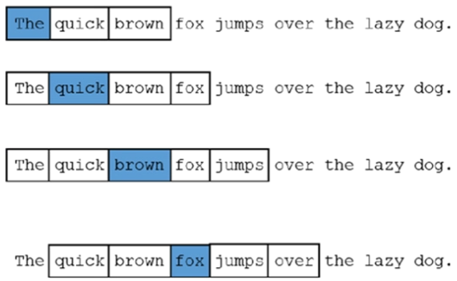
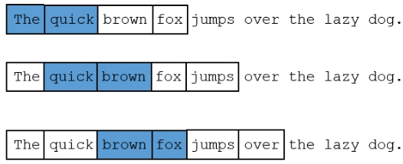
FastText - I
WordNGrams and ws
wordNgrams = 1
ws = 2
wordNgrams = 2
ws = 1

Slide 5
FastText - II
Minn and Maxn
Sentence
I love ML
Parameters
Minn = 2 and Maxn = 3
Transformed to
[<I, <I>, l>], [<l, <lo, lo, lov, ov, ove, ve, ve>, e>],[<M, ML, L>]
For the word love, its fasttext embedding = (emb(love) (as a complete word) + emb(<l)+emb(<lo)+....) / n
The embedding of the sentence will be the average of the embeddings of individual tokens.
FastText word vectors are built from vectors of substrings of characters contained in it. This allows to build vectors even for misspelled words or concatenation of words.
Example: ‘stupedofanctabulouslyfantastic’

Slide 6
FastText - III
Preprocessing → Data augmentation using sample Walmart synonyms list
Model | Lr | Loss | Dim | Ws/neg | WordNgram | Minn/maxn | TF category | TF variety
FastText | 0.085 | Softmax | 92 | 5 | 2 | 0/0 | 66.82 | 69.79
FastText | 0.085 | Softmax | 92 | 5 | 2 | 2/2 | 73.39 | 72.23
FastText | 0.085 | HS | 92 | 5 | 2 | 2/2 | 65.16 | 48.1
FastText | 0.084 | Softmax | 300 | 5 | 2 | 5/8 | 74.61 | 67.57
FastText | 0.084 | Softmax | 300 | 5 | 2 | 1/8 | 50.22 | 42.88
FastText | 0.1 | Softmax | 400 | 5 | 2 | 5/8 | 73.04 | 68.85
FastText | 0.1 | Softmax | 800 | 5 | 5 | 5/8 | 74.67 | 67.03
FastText | 0.1 | Softmax | 1000 | 5 | 2 | 5/8 | 73.41 | 67.26
FastText | 0.1 | Softmax | 1200 | 5 | 2 | 5/8 | 73.26 | 63.86
FastText* | 0.1 | Softmax | 92 | 10 | 2 | 5/10 | 68.15 | 68.39
FastText* | 0.1 | Softmax | 92 | 15 | 5 | 2/6 | 65.11 | 55.08
FastText* | 0.1 | Softmax | 92 | 1 | 2 | 5/8 | 68.66 | 66.48
FastText* | 0.1 | Softmax | 92 | 5 | 2 | 0/0 | 72.48 | 70.59
*represents oversampling; minCount = 1 for all
Notes:
turn n-gram embeddings completely off as well by setting them both to 0. This can be useful when the ‘words’ in your model aren’t words for a particular language, and character level n-grams would not make sense.

Slide 7
Voting Hard ( RF + LR + SVM)
With even number of classifiers, it was selecting based on alphabetical order, hence I wanted to include one more classifier as well.
Below are the trust factors for hard voting classifier using my top 3 models ( Random Forest, Logistic Regression and SVM)
Model | SVM parameters | TF category | TF variety
Voting hard (100) | Countvectorizer; kernel = linear | 72.42 | 73.56
Voting hard (100) | Tfidf; kernel = linear | 68.77 | 78.25
Voting hard (100) | Tfidf; kernel = rbf | 66.42 | 77.10

Slide 8
ITEM1_DESC mapping
TRAIN DATA
TEST DATA
ITEM1_DESC | TARGET
'RASPBERRY 12OZ' | X
'RASPBERRY 12OZ' | X
'APPLE KORU BULK' | Y
'APPLE KORU BULK' | Z
ITEM1_DESC | TARGET
'RASPBERRY 12OZ' | X
'RASPBERRY 12OZ' | X
'APPLE KORU BULK' | *by model prediction*
'APPLE KORU BULK' | *by model prediction*
No. of unique ITEM1_DESC that are common between train and test: 136
Total no. of test data predicted using mapping: 1750 (0.7% of the complete data)
Model | Preprocessing | Data augmentation (sample Walmart) | TF category | TF variety
Voting hard | Yes | Yes | 70.30 | 82.19
Voting hard | Yes | Yes | 70.98 | 80.91
Previous best with sample Walmart: 70.58, 80.7

Slide 9
Next steps
Fuzzy matching of FEAT1 of train and test data.
Data augmentation with complete synonyms list.
Try other models

