Slide 1




Track 2 – Genomics, Multi-Omics & Precision Health
11–12 December 2026 · NIELIT Guwahati, Gauhati University Campus
What Near-Perfect Accuracy Does and Does Not Show
Leakage, Equivalence, Conformal Reliability and Data Efficiency on the UCI TCGA Pan-Cancer RNA-Seq Dataset
Er. Rishabh Aryan
M.Tech (Artificial Intelligence and Data Science),
Department of Computer Science and Engineering,
Indian Institute of Information Technology, Bhagalpur (Bihar)
E-mail: rishabh.250201011@iiitbh.ac.in
ORCID ID: https://orcid.org/0009-0004-7595-9440
NIELIT Bio-AI Conclave 2026
Notes:
Good morning. I am Rishabh Aryan from IIIT Bhagalpur. This talk re-examines a popular benchmark for tumour-type classification from RNA-Seq data. Instead of proposing yet another model, I ask what the near-perfect accuracies reported on it can and cannot tell us: how much leakage matters here, whether any model is really better, and what the dataset can still say about reliability and data needs.

Slide 2
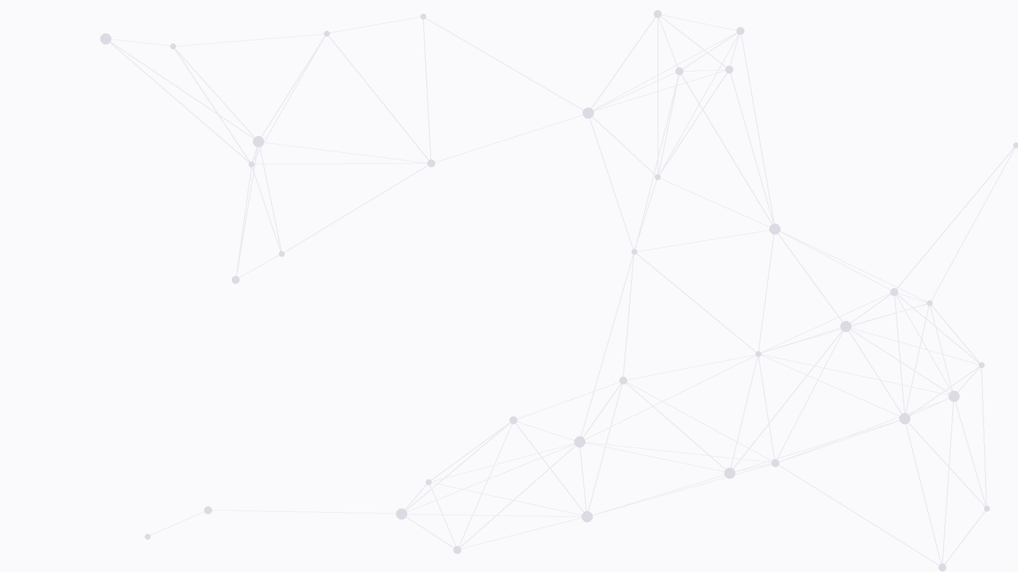


Outline
1. Introduction
Motivation, the UCI TCGA dataset, research questions
4. Results: Data and Genes
Learning curves, leakage vs n, selection stability
2. Methodology
In-fold pipeline, 7 classifiers + majority baseline, leakage audit
5. Discussion
Limitations of the dataset and the study
3. Results: Leakage and Models
Leakage audit, performance, equivalence, errors and reliability
6. Conclusion
Takeaways and future work
NIELIT Bio-AI Conclave 2026 · Track 2
2 / 16
Notes:
The talk has six parts: the motivation and dataset with three research questions; the leakage-free methodology; the leakage audit, performance, all pairwise comparisons, and the errors with a reliability analysis using conformal prediction; then how much data the task needs, how leakage grows as data shrink, and selection stability; the limitations; and the takeaways.

Slide 3
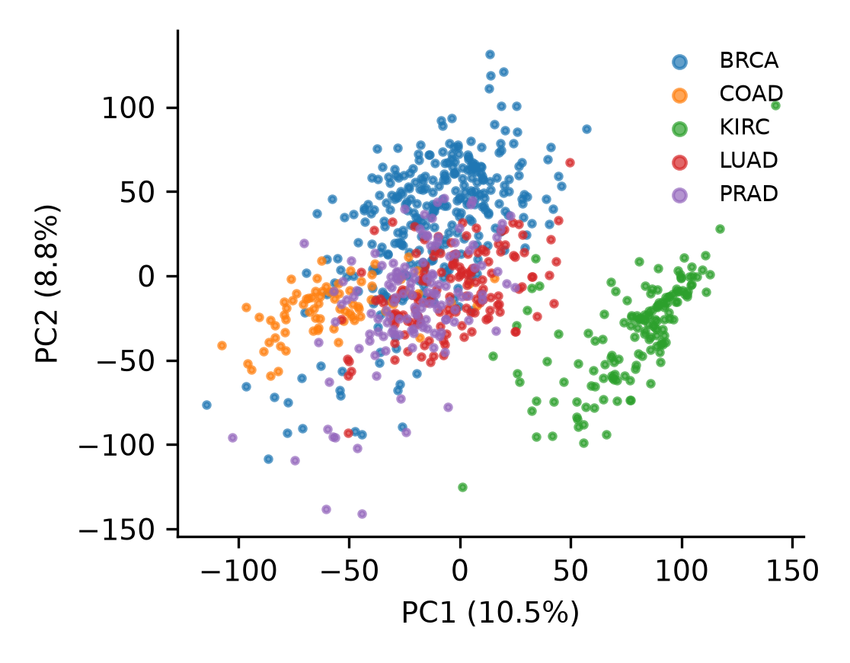
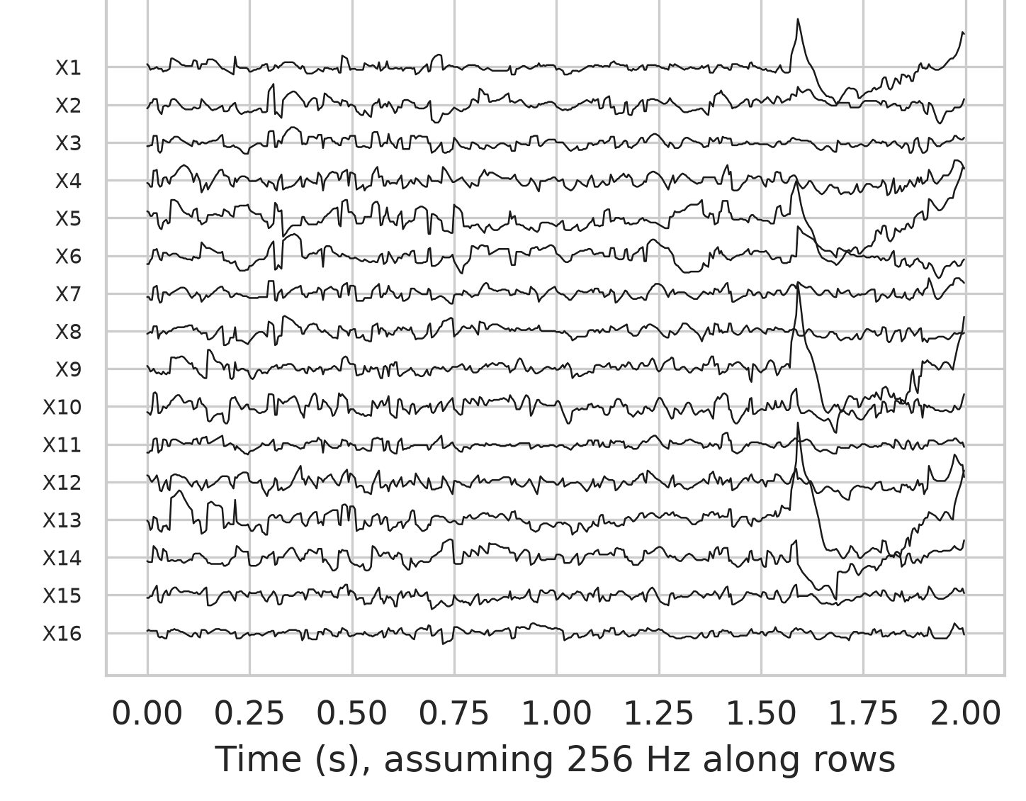
1. Introduction: Motivation
Tissue of origin guides cancer treatment, notably for unknown primaries [5].
Expression profiles carry a strong cell-of-origin signal [2].
On the UCI TCGA subset, 98–100% accuracy is routinely reported [1], [7].
Many studies select genes on all data and use no test [3], [6]: how much does it matter here?
Fig. 1. PCA of all expressed genes, 801 tumours, five types (visualisation only) [1].
NIELIT Bio-AI Conclave 2026 · Track 2
3 / 16
Notes:
Knowing where a tumour comes from guides treatment, and it is hardest for cancers of unknown primary site. Gene expression carries a strong cell-of-origin signal, as the TCGA PanCancer Atlas showed. The UCI subset of TCGA is a popular benchmark, and accuracies near one hundred per cent are routinely reported, often with genes selected on the full dataset and without any statistical test. That is a known source of bias in small studies, but nobody has measured how large it is on this dataset. The figure shows that even two principal components separate the five tumour types quite well; this is a visual only, not a classifier.

Slide 4
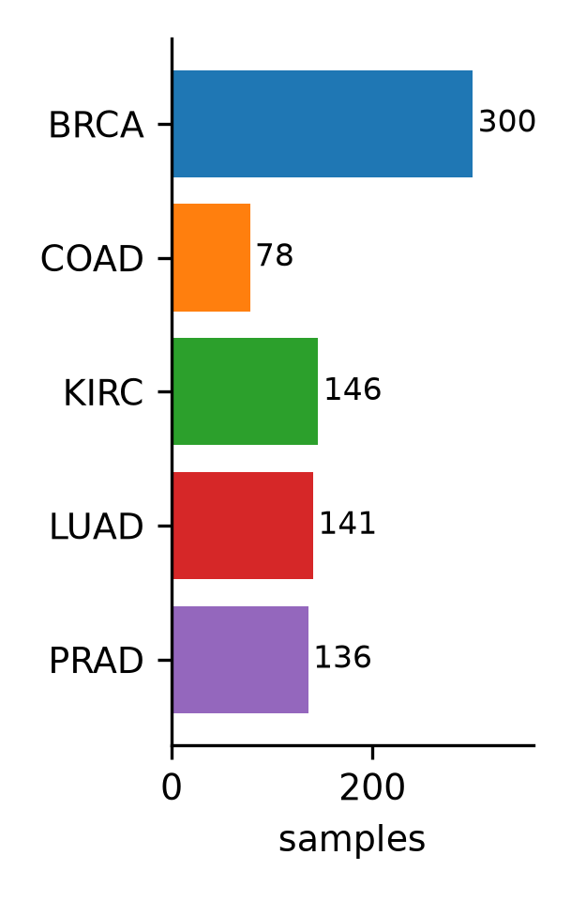
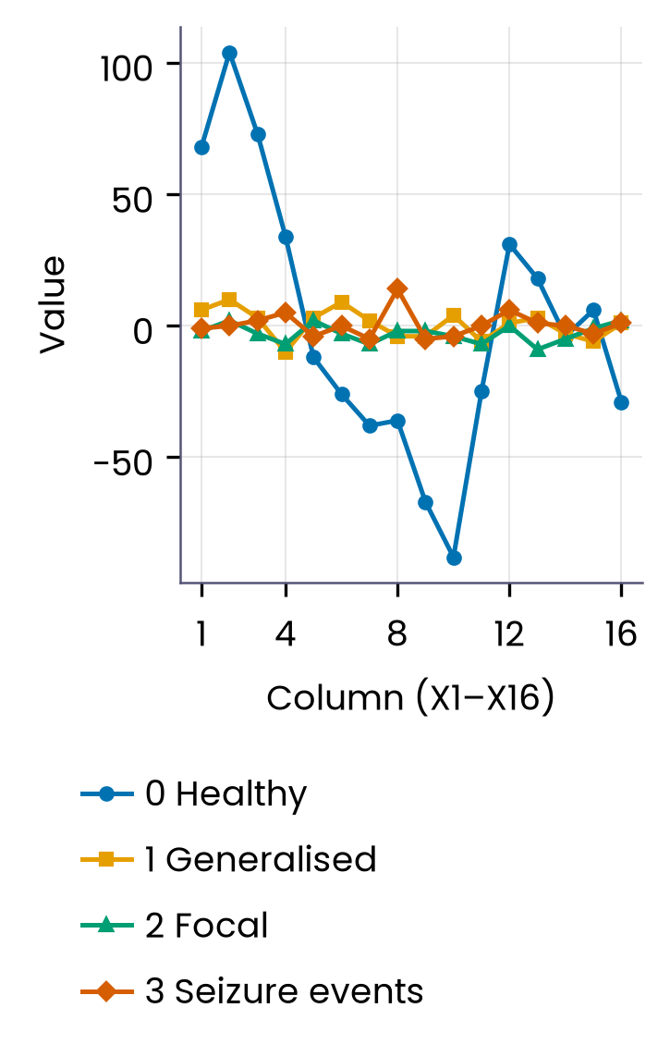
1. Introduction: The Dataset
UCI dataset 401 · TCGA RNA-Seq (HiSeq) · 801 tumours × 20,531 genes [1]
Classes
Values
BRCA 300, KIRC 146, LUAD 141, PRAD 136, COAD 78.
Already log-scaled (0–20.8); 267 genes constant; no missing values.
Gene names
Not included
Fig. 2. Samples per tumour type; COAD is the smallest class.
Dummy names gene_0 … gene_20530; no gene symbols released.
Clinical data, batch or site information, normal tissue labels.
NIELIT Bio-AI Conclave 2026 · Track 2
4 / 16
Notes:
The data are the UCI 'gene expression cancer RNA-Seq' set: 801 TCGA tumours of five types, with 20,531 expression values each. The classes are unbalanced; colon adenocarcinoma is the smallest with 78 samples. The values are already on a log scale, 267 genes are constant, and nothing is missing. Importantly, the genes are named gene_0 to gene_20530; the repository says these are dummy names, so no gene symbols are available, and I do not interpret individual genes biologically. There are no clinical or batch variables.

Slide 5
1. Introduction:
Research Questions
Common practice
Select genes on all 801 samples, then split.
Single split; winner declared without a test.
RQ1 How much does selecting genes on all data change accuracy here?
RQ2 Do any of seven classifiers differ, and which are equivalent?
RQ3 Calibrated, abstaining when unsure? How much data is needed?
This study
In-fold selection; leaky variant audited.
10×5 repeated CV, corrected CIs.
All 21 pairs, Holm, TOST, Bayesian.
NIELIT Bio-AI Conclave 2026 · Track 2
5 / 16
Notes:
I ask three questions. First, how much does selecting genes on the full data actually change accuracy on this dataset? Second, do any of seven standard classifiers really differ, and which ones can be shown to be equivalent? Third, applied here for the first time as far as I know: are the predictions reliable, meaning calibrated and able to abstain when unsure, and how much data does the task really need? Common practice selects genes on all samples and reports a single split; here selection happens inside each training fold, the leaky variant is run as a deliberate comparison, and all twenty-one pairs of classifiers are tested with Holm adjustment, equivalence tests and a Bayesian test.

Slide 6
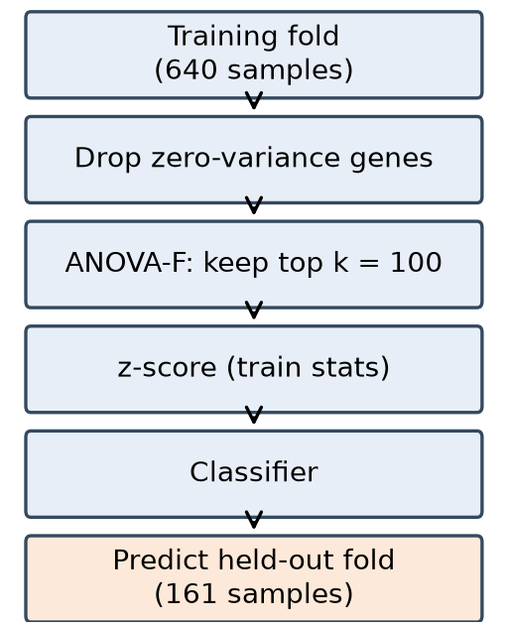
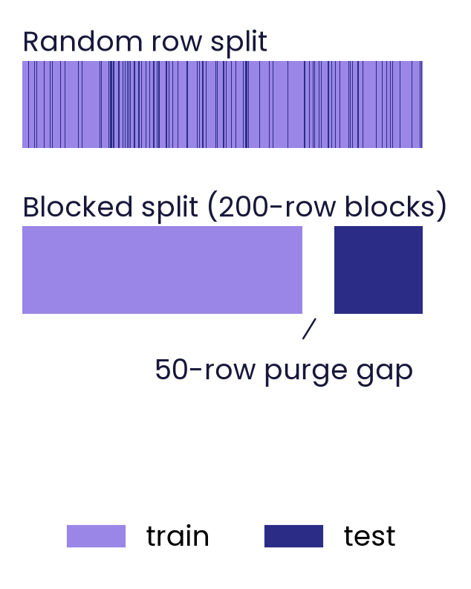
2. Methodology
Macro-F1 primary · identical splits for all models · no tuning
Pipeline
Models
Per training fold: drop constant genes, ANOVA top-100, z-score.
Softmax, ridge, linear SVM, naive Bayes, RF, LightGBM, MLP; majority baseline.
Fig. 3. Steps refitted inside every training fold.
Evaluation
Statistics
10×5 repeated stratified CV (50 folds); accuracy, macro-F1, ROC-AUC.
Corrected CIs [4]; all 21 pairs (Holm); TOST ±1 pt; Bayesian ROPE.
NIELIT Bio-AI Conclave 2026 · Track 2
6 / 16
Notes:
Every model is wrapped in a pipeline that is refitted on each training fold: constant genes are dropped, the one hundred genes with the highest ANOVA F-statistic are kept, and the data are standardised with training statistics only. I compare softmax regression, ridge, a linear SVM, Gaussian naive Bayes, a random forest, LightGBM and a small MLP, plus a majority-class baseline, all with fixed default settings. Evaluation is ten-times repeated stratified five-fold cross-validation, fifty folds, identical for every model. Confidence intervals and paired tests use the Nadeau–Bengio correction for overlapping training sets. All twenty-one pairs are tested with Holm adjustment, plus two one-sided equivalence tests with a one-point margin and a Bayesian correlated t-test.

Slide 7
3. Results: Leakage Audit (softmax accuracy)
Labels | n | Genes k | Leaky | In-fold
Real | 801 | 100 | 99.50% | 99.48%
Real | 801 | 10 | 95.22% | 92.32%
Permuted | 801 | 100 | 35.9% | 25.3%
Real | 60 | 100 | 99.9% | 99.3%
Permuted | 60 | 100 | 68.2% | 19.9%
Leaky: gene filter, ANOVA selection and scaling fitted on all samples before CV. Chance with permuted labels: 24% (n = 801), 20% (n = 60).
Real labels, n = 801: leakage changes accuracy ≤ 0.29 pt for k ≥ 20.
The bias shows only on permuted labels, strongly at n = 60 [3]: it hides behind the ceiling.
NIELIT Bio-AI Conclave 2026 · Track 2
7 / 16
Notes:
Here is the central finding. I ran the same pipeline twice: once with gene selection and scaling fitted on all samples before cross-validation, the leaky way, and once inside each fold. With real labels and all 801 samples, the two are practically identical: 99.50 versus 99.48 per cent with one hundred genes. Only with ten genes is the leaky estimate visibly higher, and even that is not significant. With shuffled labels the leaky pipeline does score above the in-fold one, and in small samples of sixty tumours it reaches about 68 per cent on pure noise, which is the classic Ambroise and McLachlan effect. So on this dataset leakage hides behind the ceiling: published accuracies are probably not much inflated, but an accuracy near one hundred per cent cannot show that a pipeline is clean. A permutation test can.

Slide 8
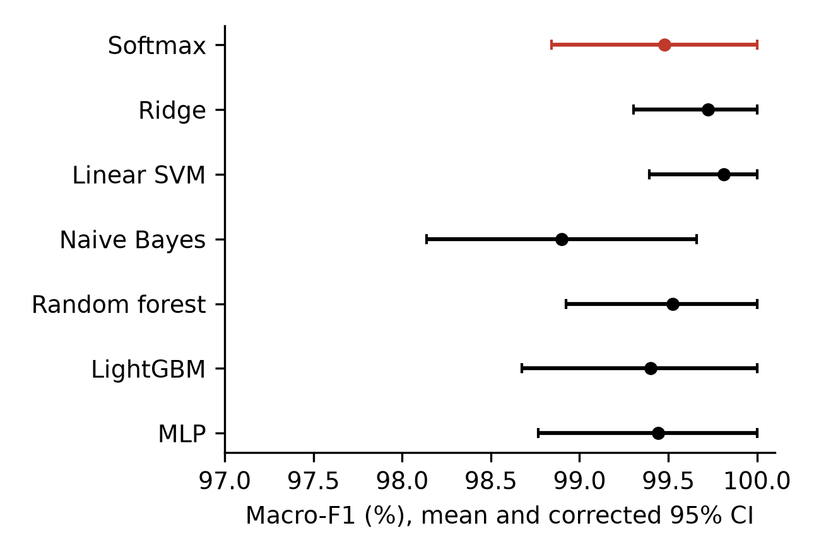
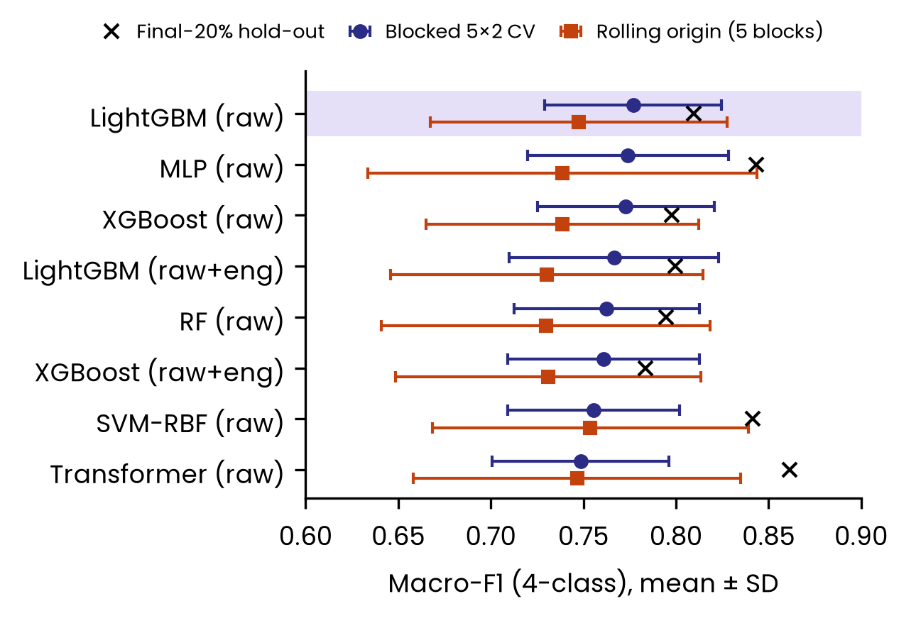
3. Results: Leakage-Free Performance
Model | Macro-F1, % | Errors / 801
Majority baseline | 10.90 | 501.0
Softmax | 99.48 | 4.2
Ridge | 99.73 | 2.6
Linear SVM | 99.81 | 1.5
Naive Bayes | 98.90 | 8.2
Random forest | 99.53 | 3.6
LightGBM | 99.40 | 4.5
MLP (64) | 99.44 | 4.3
Mean over 50 folds, top-100 genes. Errors: misclassified samples per repeat. ROC-AUC ≥ 0.9944 for all seven.
Fig. 4. Macro-F1 with corrected 95% CI; red: softmax regression.
NIELIT Bio-AI Conclave 2026 · Track 2
8 / 16
Notes:
All seven classifiers reach between 98.9 and 99.8 per cent macro-F1, against 10.9 per cent for the majority baseline. Linear SVM is highest at 99.81 per cent, about 1.5 errors out of 801 per repeat; softmax regression reaches 99.48 per cent with about 4.2 errors. Macro ROC-AUC is at least 0.9944 for every model, so it does not discriminate between them. One error costs about 0.6 point in a fold of 160, so the differences are a few samples.

Slide 9
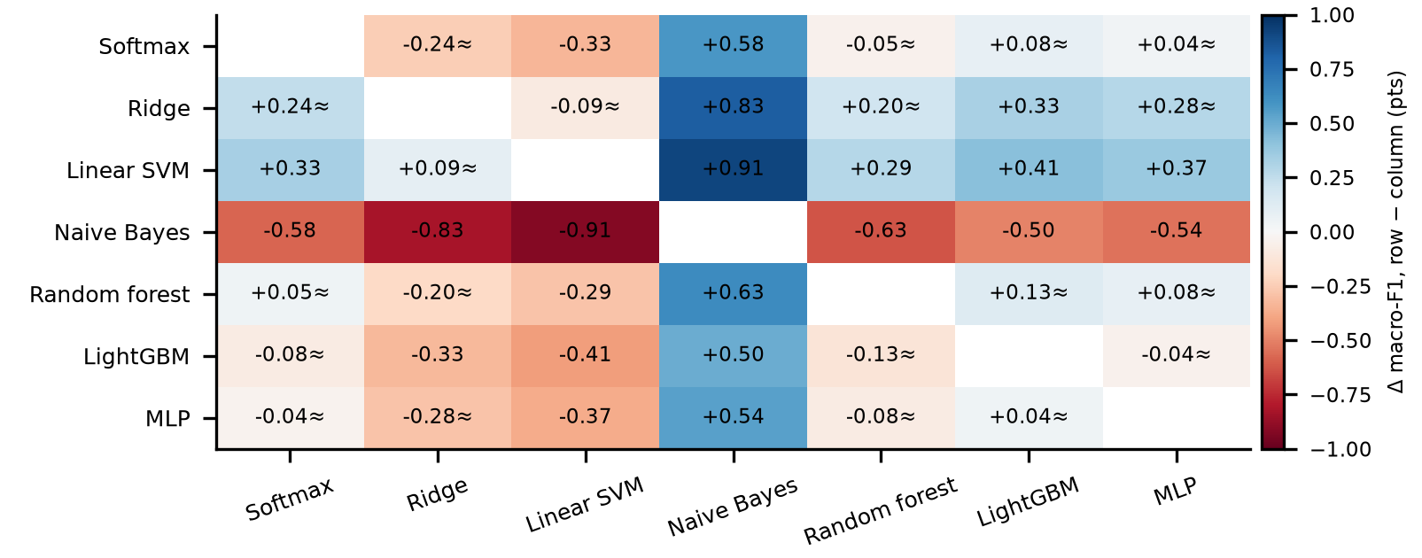
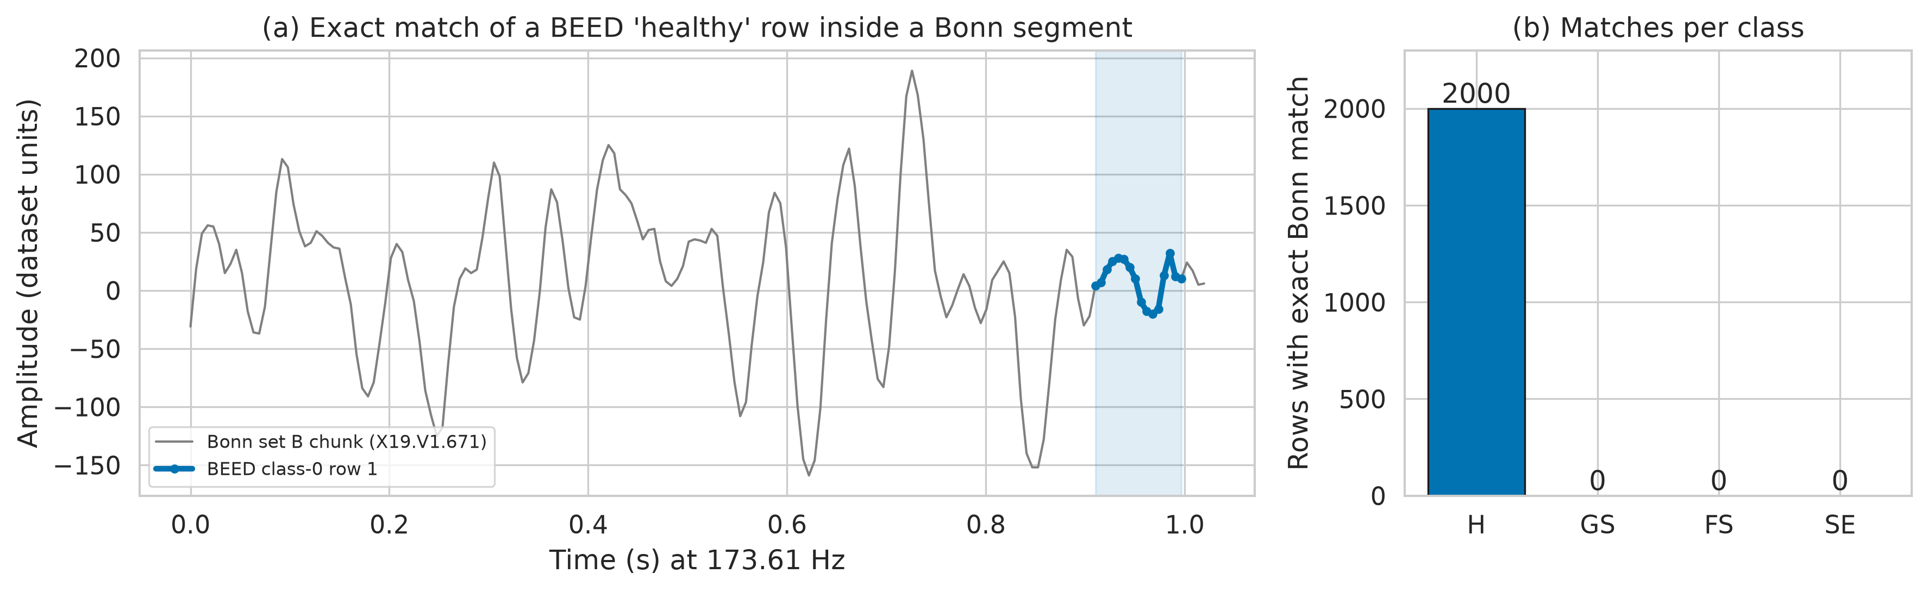
3. Results:
All Pairwise Comparisons
All 21
No pair significant; smallest Holm p = 0.66 (Linear SVM vs Naive Bayes).
TOST
10 of 15 pairs without naive Bayes equivalent within ±1 pt.
Power
Detectable difference (80% power): 0.5–1.4 pts.
Meaning
No winner; most pairs equivalent; naive Bayes probably slightly worse.
Fig. 5. Δ macro-F1 for all pairs (row − column); ≈ : equivalent within ±1 pt (TOST, Holm).
NIELIT Bio-AI Conclave 2026 · Track 2
9 / 16
Notes:
All models see the same fifty folds, so I compared every pair, twenty-one in total, with the corrected t-test and Holm adjustment. No pair differs significantly; the smallest adjusted p-value is 0.66. But no significant difference is not the same as no difference, so I also ran equivalence tests: 10 of the fifteen pairs that do not involve naive Bayes are equivalent within plus or minus one percentage point. Naive Bayes is probably slightly worse, but not significantly. The design can only detect differences of about 0.5 to 1.4 points, which is several samples per repeat. So the supported claim is no winner, with equivalence shown for most pairs; the remaining pairs are inconclusive, not different.

Slide 10
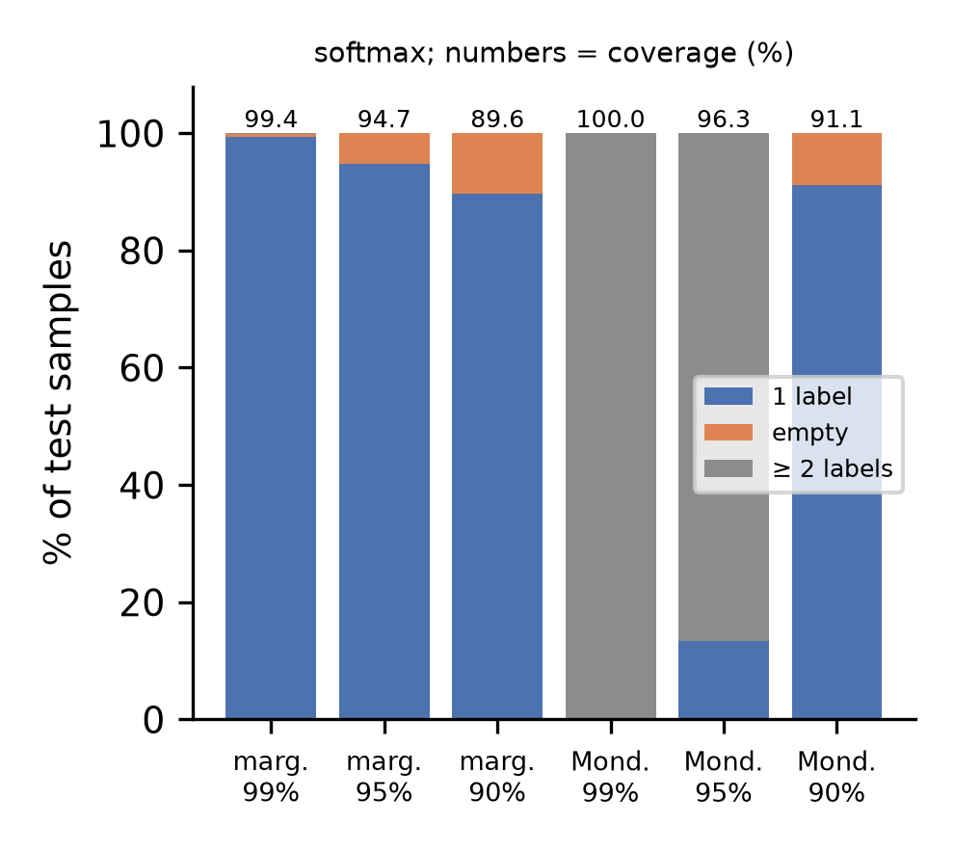
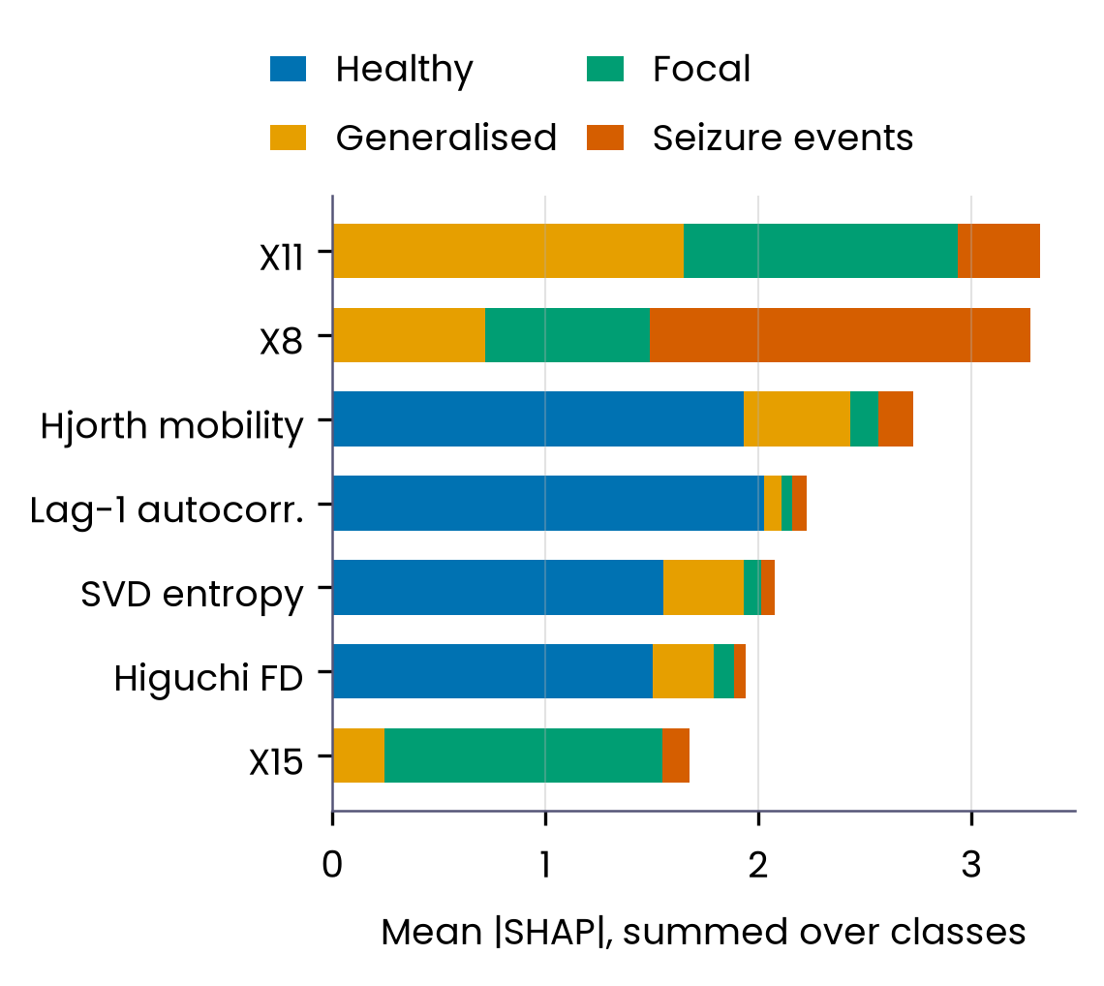
3. Results:
Errors and Reliability
Errors (softmax, 10 repeats)
42 errors in 8,010 predictions.
Most common: LUAD → BRCA (27), COAD → LUAD (8).
Calibration and conformal sets
ECE 0.47% vs 0.14% if calibrated: small, probably real.
99%: accepted error 0.18% (all: 0.51%); threshold 0.26%.
Hard LUAD flagged 18/30; Mondrian 99%: needs ≥ 99/class.
Fig. 6. Split-conformal set types, nested in 10×5 CV.
NIELIT Bio-AI Conclave 2026 · Track 2
10 / 16
Notes:
Softmax made 42 errors in 8,010 predictions, all from 5 samples; the three hard LUAD tumours have atypical expression profiles. Does the model know when it may be wrong? Its expected calibration error is 0.47 per cent, compared with about 0.14 per cent for a perfectly calibrated model with the same confidences, so the miscalibration is small and probably real, and it sits in the few low-confidence predictions. Split-conformal sets, calibrated inside each training fold, are valid on average, but at 90 and 95 per cent they reach coverage by returning empty sets, and fold coverage varies widely because only about 160 tumours are used for calibration. At 99 per cent, 99.4 per cent of samples get one label, and abstaining on the rest lowers the error among accepted predictions from 0.51% [0.42, 0.60] to 0.18% [0.10, 0.25]. A plain probability threshold does about as well, at 0.26 per cent, so what conformal adds is a threshold chosen with a coverage guarantee, not better error selection. The hard LUAD samples are flagged in 18 of their 30 appearances, about half. Class-conditional, Mondrian sets would need at least 99 calibration tumours in every class to work at 99 per cent; no class has that many here.

Slide 11
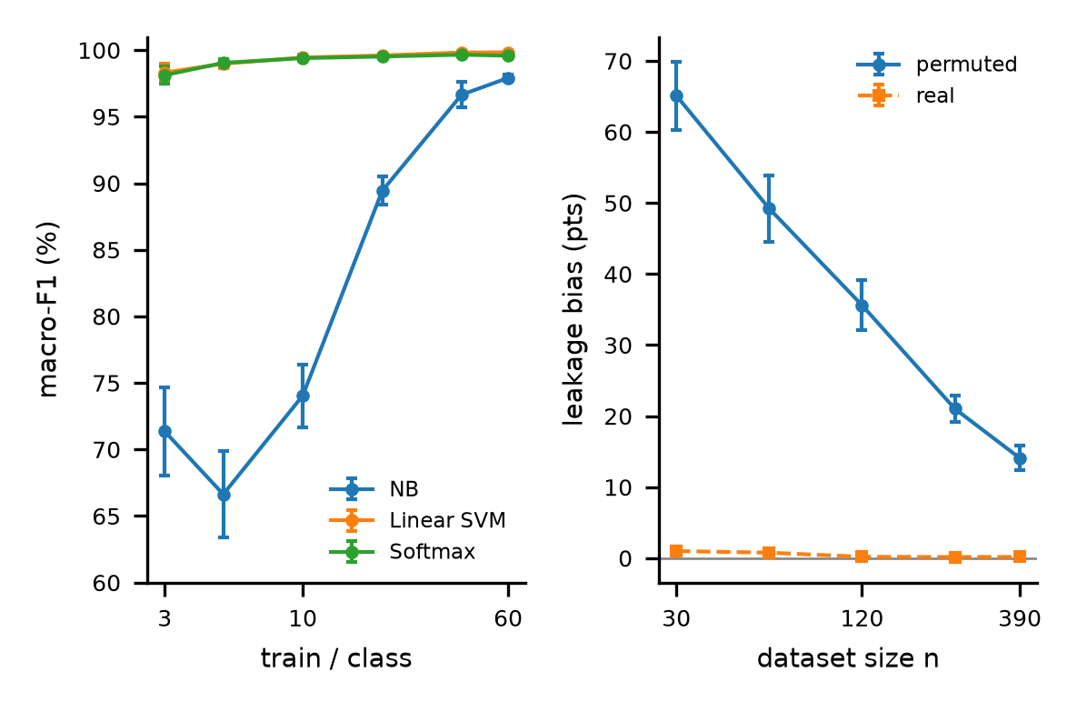
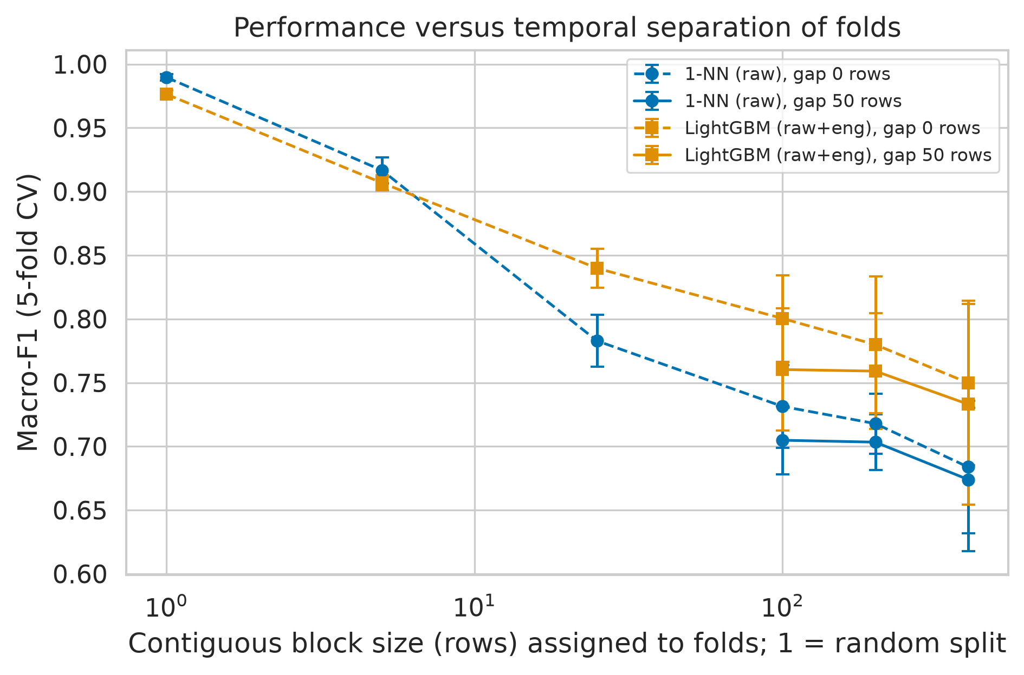
4. Results:
How Much Data?
Linear models: 99.4% macro-F1 (±0.2) with 10 tumours per class.
Learning
3 per class: macro-F1 softmax 98.1 ± 0.7%; naive Bayes 71.4%.
Fig. 7. Learning curves; leakage bias vs n (95% CI).
Leakage
Bias on noise: 65 ± 5 pts at n = 30, 14 ± 2 at n = 390 [9].
NIELIT Bio-AI Conclave 2026 · Track 2
11 / 16
Notes:
How much data does this task need? Very little. With three training tumours per class, softmax reaches 98.1 per cent macro-F1 on a held-out fold, and with ten per class 99.4 per cent, plus or minus 0.2; naive Bayes needs far more. The right panel links this to the leakage audit: on shuffled labels, leaky selection inflates accuracy by 65 ± 5 points at thirty samples but 14 ± 2 at three hundred and ninety, while with real labels the gap stays near zero, and with ten genes it even turns slightly negative. This is the behaviour Vabalas and colleagues described in simulations, and learning curves for expression data go back to Mukherjee and colleagues; what is new here is only the numbers for this dataset. When ten tumours per class reach the ceiling, selection bias has no room to show.

Slide 12
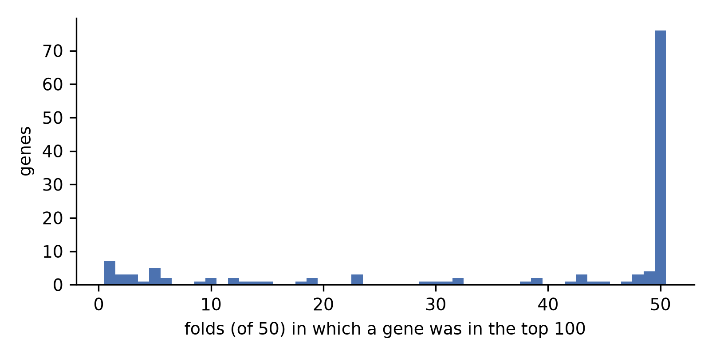
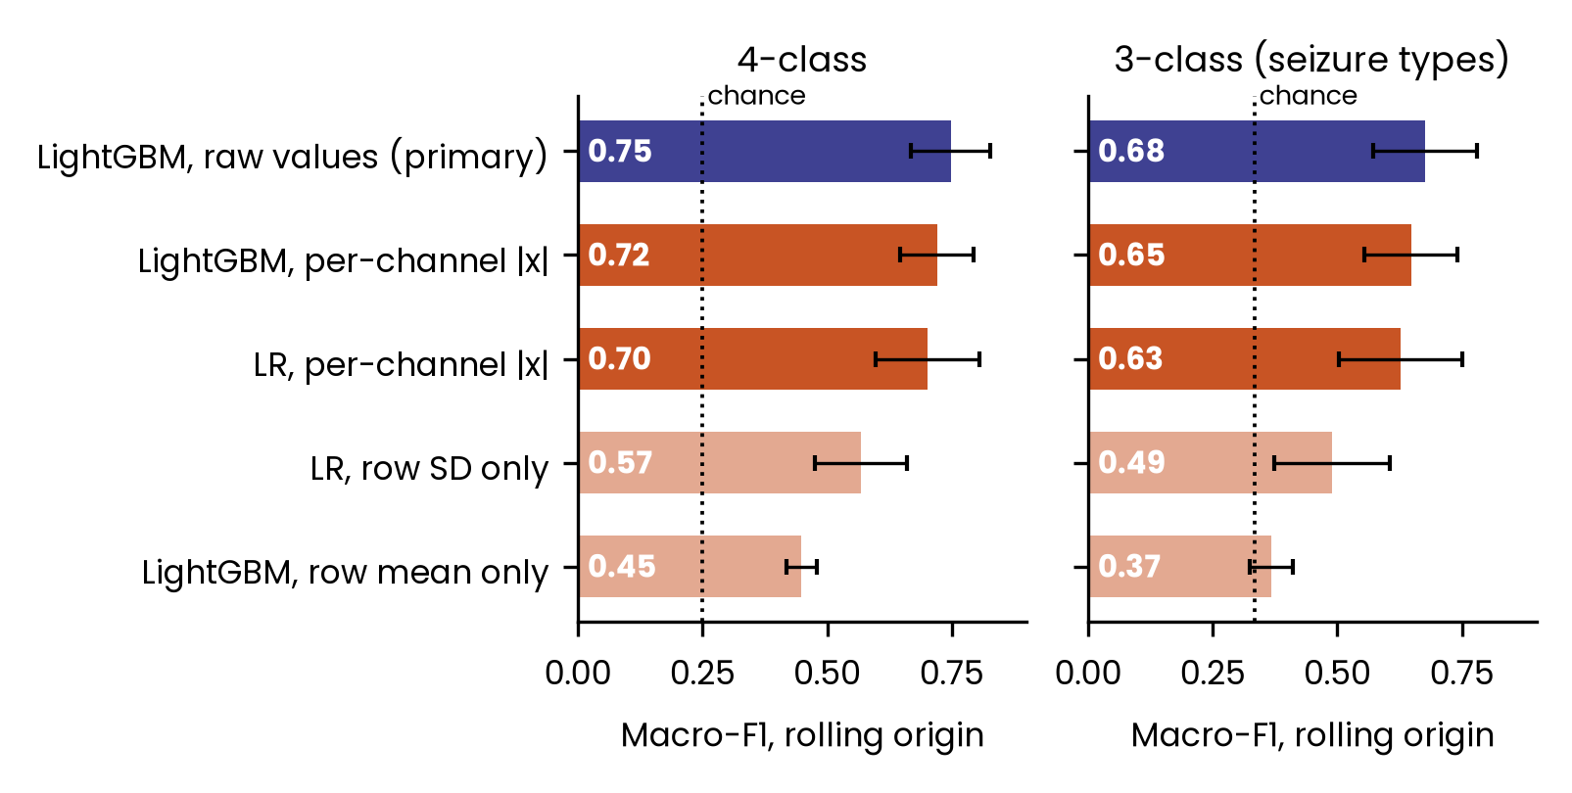
4. Results:
Selection Stability
Ever
133 genes entered the top 100 in some fold.
Always
76 genes in all 50 folds; 85 in ≥ 90%.
Overlap
Jaccard 0.87; Nogueira Φ = 0.93.
vs [8]
Sirohi: RF panel, Jaccard 0.32. Stability is method-dependent.
Fig. 8. How often each gene was in the top 100 across 50 training folds.
NIELIT Bio-AI Conclave 2026 · Track 2
12 / 16
Notes:
Across the fifty training folds, 133 genes entered the top one hundred at least once, and 76 were chosen every time. The average overlap between two folds' selections is a Jaccard index of 0.87, and the chance-corrected Nogueira stability is 0.93. A recent study by Sirohi on a larger TCGA extract found a 75-gene random-forest panel much less stable, Jaccard 0.32; the methods differ, so the lesson is that stability depends on the pipeline and should be measured. The genes here have dummy names, so I make no biological claims about them.

Slide 13
Data
5. Discussion:
Limitations
n = 801, single source, five types; no metadata.
Global profile statistics differ by class.
What remains valid
Leakage size, equivalence and stability on this dataset, within TCGA, five tissues.
Methods
No external cohort or metastatic samples.
Tests approximate for bounded fold scores.
Audit covers selection, not SMOTE or PCA.
NIELIT Bio-AI Conclave 2026 · Track 2
13 / 16
Notes:
What remains valid is the size of the leakage effect, the equivalence of the models and the selection stability, on this dataset, within TCGA, for five well-separated tissues. The dataset is small and single-source with no clinical, batch or gene-symbol information, and even simple global statistics of each profile predict the cancer type about half the time, so classes differ in overall profile properties too. I did not test an external cohort or metastatic samples. The statistical tests are approximate because fold scores are bounded at one hundred per cent, and the audit covers gene selection and scaling, not oversampling or PCA.

Slide 14
6. Conclusion: Takeaways and Future Work
Takeaways
Future work
At n = 801, leaky selection barely changes accuracy.
Map gene indices to symbols via the original annotation.
No model significantly better; 10/15 pairs equivalent (±1 pt).
External, non-TCGA validation cohorts.
99% conformal abstention: accepted error 0.18% (threshold-like).
The full 33-type TCGA problem.
Near-100% here proves neither a clean pipeline nor a better model.
Metastatic and unknown-primary samples.
NIELIT Bio-AI Conclave 2026 · Track 2
14 / 16
Notes:
To conclude: on this dataset at full size, selecting genes on all the data barely changes accuracy; the bias only shows with shuffled labels or small samples. All seven models reach 98.9 to 99.8 per cent macro-F1, none is significantly better, and 10 of the fifteen pairs without naive Bayes are demonstrably equivalent within one point. The reliability analysis shows small and probably real miscalibration, and 99 per cent conformal sets let the model abstain on under one per cent of samples while cutting the error among accepted predictions to 0.18 per cent, much as a probability threshold would; ten tumours per class are enough, which explains why leakage cannot show. So a near-perfect score here proves neither that a pipeline is clean nor that a model is better; use permutation and equivalence tests. Next steps are mapping gene indices to symbols, external validation, the full 33-type problem, and metastatic samples.

Slide 15
References
[1] Fiorini S. Gene expression cancer RNA-Seq [dataset]. UCI Machine Learning Repository. 2016. doi:10.24432/C5R88H.
[2] Hoadley KA, et al. Cell-of-origin patterns dominate the molecular classification of 10,000 tumors from 33 types of cancer. Cell. 2018;173:291–304.
[3] Ambroise C, McLachlan GJ. Selection bias in gene extraction on the basis of microarray gene-expression data. PNAS. 2002;99:6562–6566.
[4] Nadeau C, Bengio Y. Inference for the generalization error. Machine Learning. 2003;52:239–281.
[5] Pavlidis N, Pentheroudakis G. Cancer of unknown primary site. Lancet. 2012;379:1428–1435.
[6] Kapoor S, Narayanan A. Leakage and the reproducibility crisis in machine-learning-based science. Patterns. 2023;4:100804.
[7] Nitta Y, Borders M, Ludwig SA. Analysis of gene expression cancer data set: classification of TCGA pan-cancer HiSeq data. IEEE Big Data 2021:4745–4752.
[8] Sirohi I. High classification accuracy does not guarantee a stable gene signature. NHSJS. 2026.
[9] Vabalas A, et al. Machine learning algorithm validation with a limited sample size. PLOS ONE. 2019;14:e0224365.
NIELIT Bio-AI Conclave 2026 · Track 2
15 / 16
Notes:
These are the works cited on the slides; the paper has the full list.

Slide 16
THANK YOU
FOR YOUR ATTENTION
Questions?
Er. Rishabh Aryan
M.Tech (Artificial Intelligence and Data Science), Department of Computer Science and Engineering
Indian Institute of Information Technology, Bhagalpur (Bihar)
E-mail: rishabh.250201011@iiitbh.ac.in
ORCID ID: https://orcid.org/0009-0004-7595-9440
NIELIT Bio-AI Conclave 2026 · Track 2
16 / 16
Notes:
Thank you for your attention. I am happy to take questions.

