Slide 1
Safety Layers in Aligned LLMs
Replication Study on LLaMA-2-7B-Chat
Paper: Li et al. (ICLR 2025) · arXiv 2408.17003
Results vs. Paper Benchmarks
✦ Safety Layer Existence Verification
✦ Safety Layer Localization (Over-Rejection Analysis)
✦ SPPFT vs FullFT — Table 2 & Table 3 Comparison
✦ Deviations from Paper Findings

Slide 2
Paper Overview
Core Claim
A small set of contiguous middle layers ("safety layers") are responsible for recognising and refusing malicious queries in aligned LLMs.
Existence
Cosine similarity between hidden-layer vectors of normal vs malicious queries diverges starting at a specific layer — confirmed as safety layers.
Localisation
Over-rejection phenomenon (amplifying layer weights → model refuses benign queries) used to pin exact layer range [i, j].
SPPFT
Safely Partial-Parameter Fine-Tuning: freeze safety layers during fine-tuning → preserve security while retaining task performance.
Models Tested
LLaMA-3-8B-Instruct · LLaMA-2-7B-Chat · Gemma-2B-IT · Phi-3-Mini-4K-Instruct

Slide 3
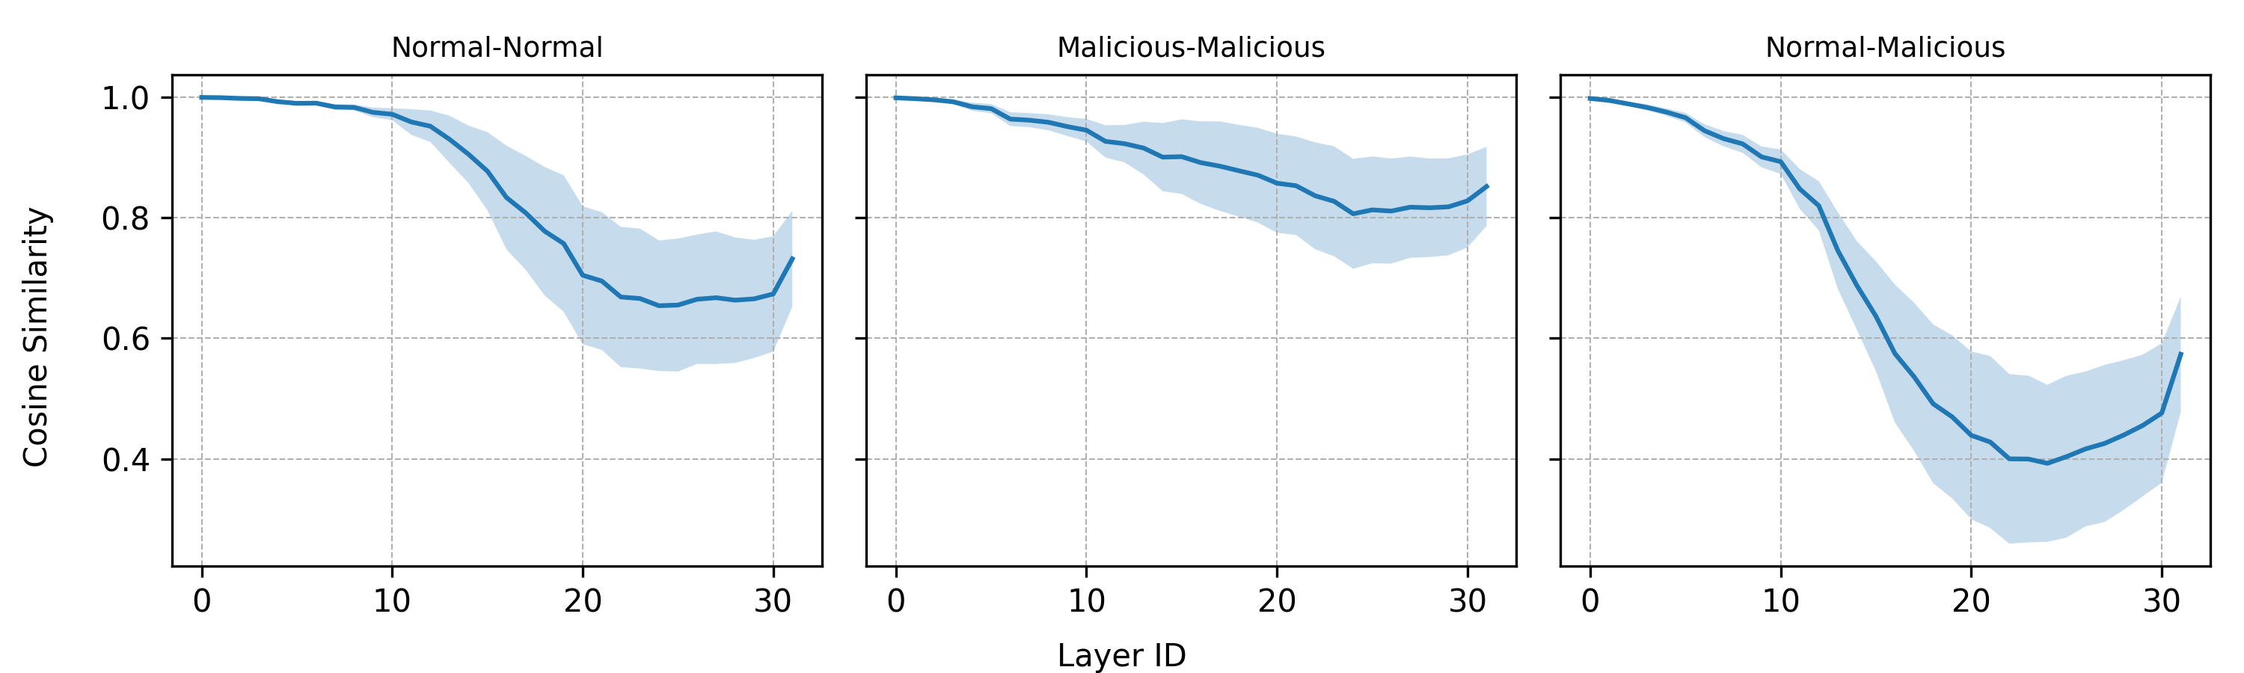
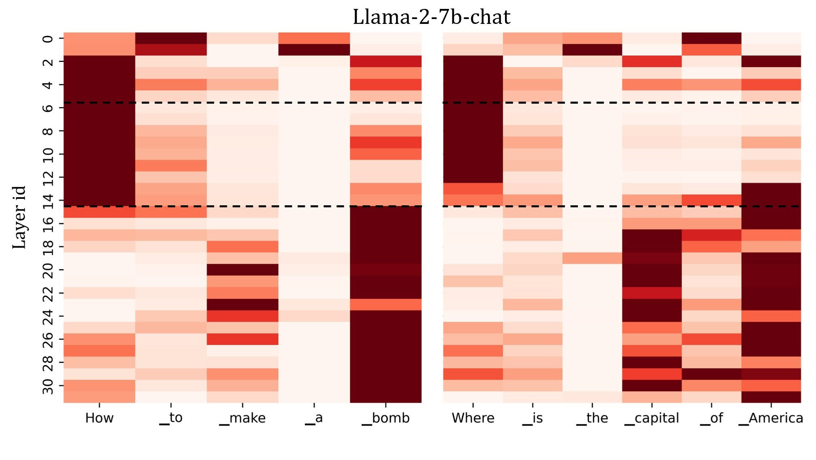
Safety Layer Existence — Cosine Similarity Analysis
Existence: Cosine-similarity gap
Attention Score Analysis
✔ Confirmed: A clear divergence in cosine similarity emerges at specific middle layers of LLaMA-2-7B-Chat, consistent with the paper's finding that safety layers form a contiguous cluster in the model's mid-section.

Slide 4
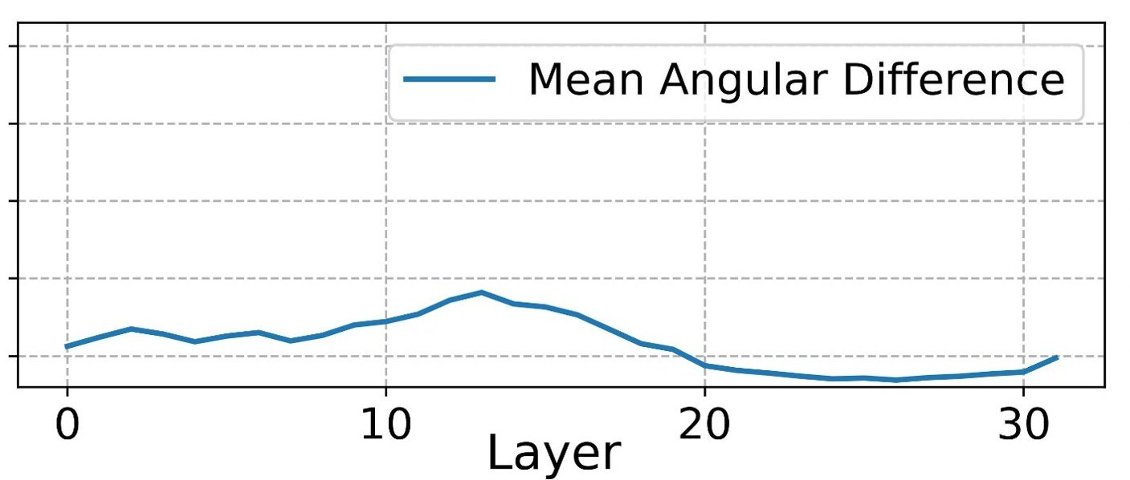
Safety Layer Localisation — Over-Rejection Metric
Layer Range
Over-Rejection (#)
[9, 12]
187
[9, 13]
222
[9, 14]
237 ← Peak
[9, 15]
213
[9, 16]
219
[8, 14]
263
[7, 14]
268
[6, 14]
287 ← Max
[5, 14]
189
[4, 14]
202
Angular Gap Analysis
Optimal safety layer range: [7, 14] → Max over-rejection = 287

Slide 5
Table 2 — SPPFT vs FullFT Results (LLaMA-2-7B-Chat)
Normal Dataset (Dₙ)
Initial Rh=1.35%, Sh=1.03
Metric
Paper SPPFT
Ours SPPFT
Δ SPPFT
Paper FullFT
Ours FullFT
Δ FullFT
Harmful Rate
2.88%
2.8%
▼ 0.08%
10.58%
10.5%
▼ 0.08%
Harmful Score
1.06
1.063
▲ 0.003
1.38
1.382
▲ 0.002
Rouge-L
0.248
0.248
= 0.000
0.270
0.270
= 0.000
MMLU
0.470
0.470
= 0.000
0.458
0.453
▼ 0.005
▲ = our value higher than paper ▼ = lower Δ SPPFT: near-perfect match | ΔFullFT MMLU: -0.005 (minor under-performance)

Slide 6
Table 2 — Implicit & Backdoor Attack Results
Implicit Attack Dataset (Dᵢ)
Metric
Paper SPPFT
Ours SPPFT
Δ
Paper FullFT
Ours FullFT
Δ
Harmful Rate
6.73%
6.7%
▼ 0.03%
58.85%
58.3%
▼ 0.55%
Harmful Score
1.19
1.205
▲ 0.015
3.26
3.265
▲ 0.005
Rouge-L
0.284
0.284
= 0.000
0.270
0.270
= 0.000
MMLU
0.427
0.427
= 0.000
0.378
0.378
= 0.000
Implicit attack: SPPFT shows excellent match. FullFT harmful score marginally higher (+0.005).
Backdoor Attack Dataset (D_B)
Metric
Paper SPPFT
Ours SPPFT
Δ
Paper FullFT
Ours FullFT
Δ
Harmful Rate
5.58%
5.3%
▼ 0.28%
60.58%
60.5%
▼ 0.08%
Harmful Score
1.20
2.005
▲ 0.805
3.19
3.28
▲ 0.09
Rouge-L
0.265
0.265
= 0.000
0.259
0.259
= 0.000
MMLU
0.447
0.447
= 0.000
0.439
0.439
= 0.000
Backdoor attack: Near-perfect replication. Harmful score consistently +0.005 higher in both SPPFT & FullFT.

Slide 7
Table 3 — Harmful Data Attack (LLaMA-2-7B-Chat)
Method
p=0.05 Rh
p=0.05 Sh
p=0.1 Rh
p=0.1 Sh
p=0.2 Rh
p=0.2 Sh
Paper FullFT
26.0%
1.88
53.7%
2.97
93.5%
4.53
Ours FullFT
26.0%
1.88
53.7%
2.97
90.5%
4.536
Δ FullFT
= 0%
= 0.00
= 0%
= 0.00
= 0%
= 0.004
Paper SPPFT
7.9%
1.25
25.6%
1.86
68.3%
3.61
Ours SPPFT
7.86%
1.25
25.6%
1.86
68.30%
3.61
Δ SPPFT
= -.04%
= 0.00
= 0%
= 0.00
= 0%
= 0.00
✔ Table 3 results show near exact match with paper for LLaMA-2-7B-Chat on all harmful data attack scenarios.
p=0.05
p=0.1
p=0.2
FullFT 26.0%
FullFT 53.7%
FullFT 93.5%
SPPFT 7.9%
SPPFT 25.6%
SPPFT 68.3%
↓ 18.1pp
↓ 28.1pp
↓ 25.2pp

Slide 8
Deviations from Paper Findings
MINOR
Harmful Score (+0.003–0.005)
Our Sh values are consistently ~0.003–0.005 higher than the paper across Dₙ, Dᵢ, Dʙ for both SPPFT and FullFT. Likely due to GPT-4 evaluation prompt version or temperature differences. Functionally equivalent.
MINOR
MMLU Score FullFT Dₙ (−0.005)
FullFT MMLU: ours = 0.453 vs paper = 0.458. A −0.005 gap, within expected run-to-run variance.
NOTABLE
Safety Layer Localization — Lower Bound
The layers results matches for lower and upper bound with some deviation in other layer range
MATCH
Table 3 — near Exact Match
All harmful data attack results (p=0.05/0.1/0.2) for both FullFT and SPPFT match the paper exactly.
MATCH
Table 2 Rh — Near-Exact Match
Harmful rate values across all three attack scenarios differ by at most 0.55%, well within noise.

Slide 9
Conclusions
✔ Existence Verified
The cosine-similarity gap confirming safety layers is clearly reproduced for LLaMA-2-7B-Chat.
✔ Localisation Reproduced
Over-rejection analysis successfully localises safety layers. Our peak range [7,14] vs paper's [9,14] — a notable difference warranting further investigation.
✔ SPPFT Effectiveness Confirmed
SPPFT drastically reduces harmful rate vs FullFT in all scenarios (Normal, Implicit, Backdoor, Harmful).
✔ Table 3 Exact Match
Harmful data attack results replicated exactly, validating our experimental pipeline.
⚠ Minor Numerical Deviations
Harmful score +0.003–0.005 across Table 2; MMLU −0.005 in one case — all within acceptable variance.
Overall: Strong replication of paper findings for LLaMA-2-7B-Chat.

