Slide 1
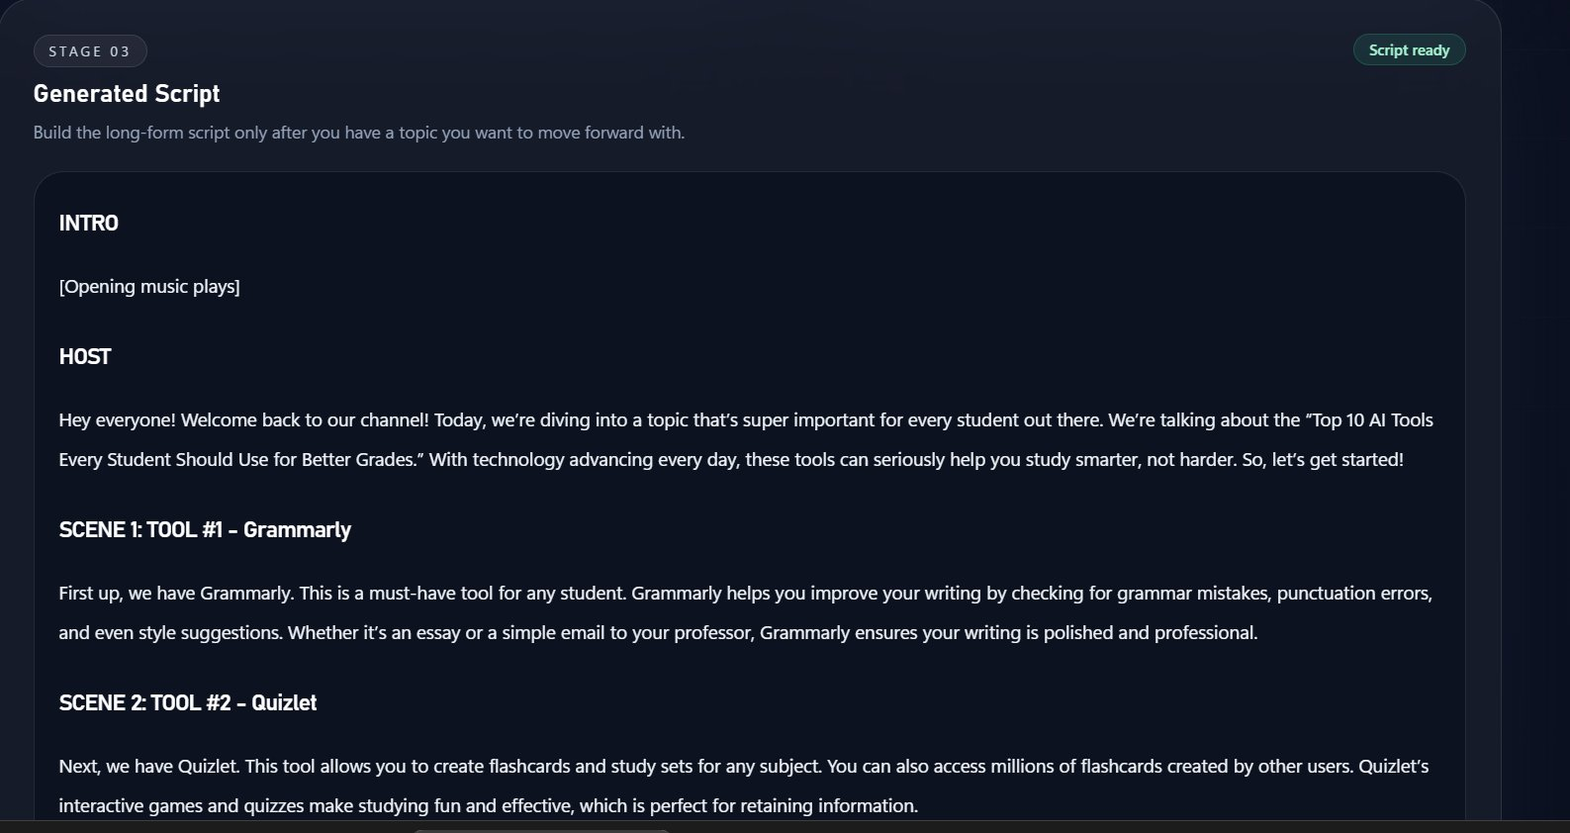
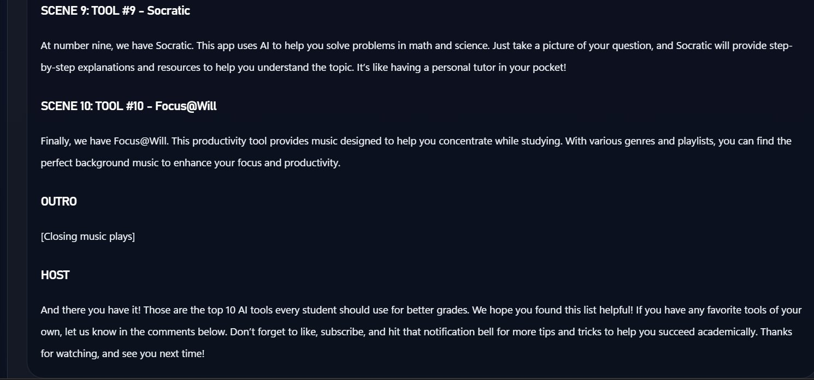
THE PROBLEM
The blank page
is costing creators
hours every week.
Content creation is broken before the camera even turns on.
5+ hours per video lost to ideation & scripting
⏱
📉
🔁
Manual Brainstorming
Creative Block
Inconsistent Output
Key insight: The bottleneck isn't recording — it's the blank page.
AI Creator Copilot

Slide 2
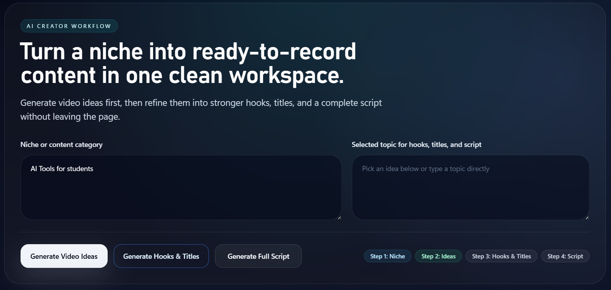
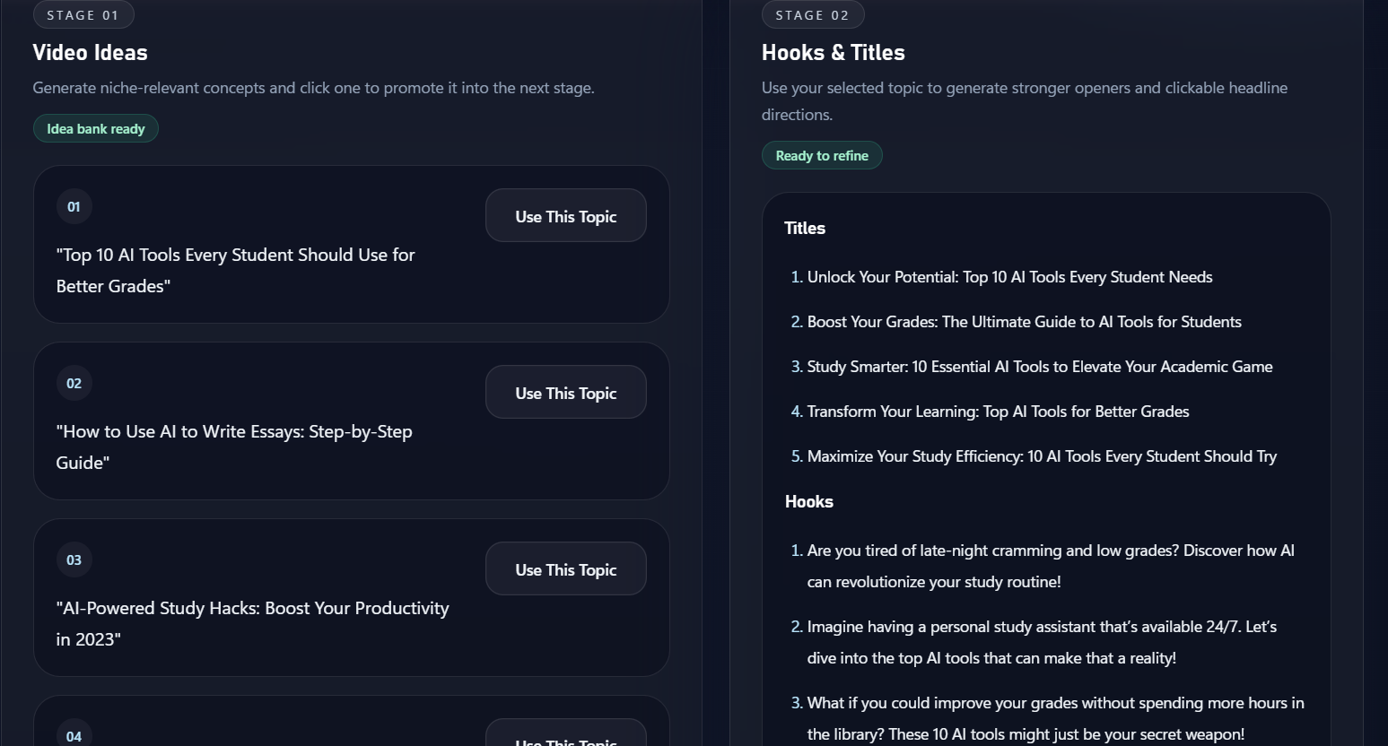
PRODUCT WORKFLOW
One workspace.
Idea to script.
4-stage AI pipeline that eliminates the blank page problem.
01
Niche Input
Define your content category
02
Video Ideas
AI generates 5+ targeted topics
03
Hooks & Titles
Clickable openers & headlines
04
Full Script
Production-ready long-form copy

Slide 3
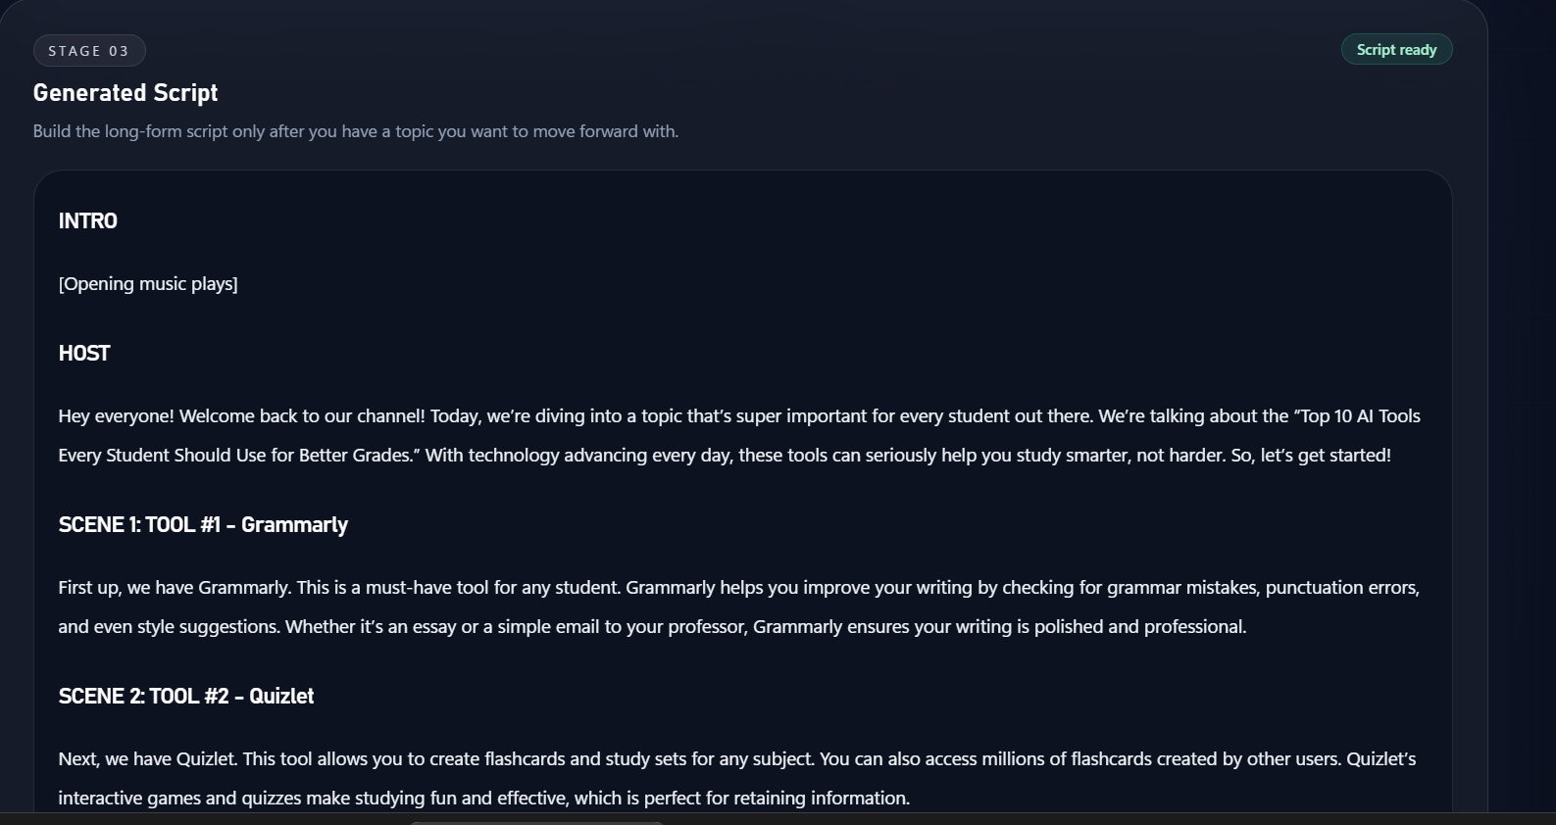
TECH STACK
Built in 48 hours.
Modern AI application tooling, end-to-end.
Backend
Frontend
→ FastAPI — high-performance API layer
→ Next.js — responsive web UI
→ LangChain — LLM orchestration
→ Component-driven architecture
→ OpenAI API — content generation
→ Clean 4-stage workflow UX
Development
→ Codex-assisted development
→ Rapid iteration & testing
→ Fully integrated pipeline
Live MVP — Working Demo

Slide 4
MVP STATUS & USERS
MVP STATUS
Built, integrated,
and demo-ready.
✓
Frontend integrated
✓
Backend integrated
✓
Full workflow functional
WHO WE'RE BUILDING FOR
✓
Demo-ready
🎥 Solo Creators
📚 Educational YouTubers
Reduce ideation time by 80%
Consistent, structured scripts
NEXT STEPS
🎓 Student Creators
📝 Content Teams
01
Improve output quality & prompt engineering
Low learning curve, fast results
Parallel workflow generation
02
Add creator analytics & performance tracking
03
Support short-form (Reels / Shorts) workflows
Rishabh Rajput • OpenAI Builders Hackathon 2026 • GitHub: github.com/Rishabh150102

