Slide 1

AI Diabetes Predictor
By : Rishabh Ranjan Singh, Class 9, DAV Public School, Sec-14, Gurugram

Slide 2
Problem Statement
Increase in Diabetes patients.
Stressed and un-balanced life style has led to abnormal functioning of the pancreatic activities leading to imbalance of insulin in the body.
Due to the decrease in Insulin in the body the chances of Diabetes increases.

Slide 3
Proposed Solution
An AI Diabetes Predictor has been made.
It would predict the chance of a person of suffering from diabetes in future.
And then would give various tips to the person about their health.
This would shorten up the process of predicting the diabetes which is usually done through normal blood testing etc.

Slide 4
Technology Used
I used all the techniques that I learnt during my AI4 Youth journey.
It includes Artificial Neural Network, K-Nearest Neighbor, Decision Tree.
It also tells the accuracy.

Slide 5
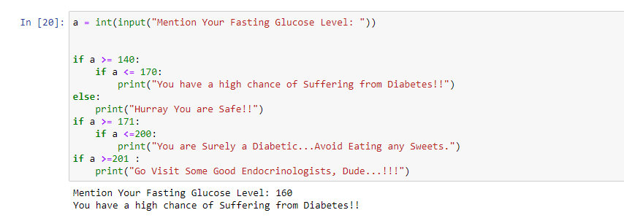
Working Demo

Slide 6
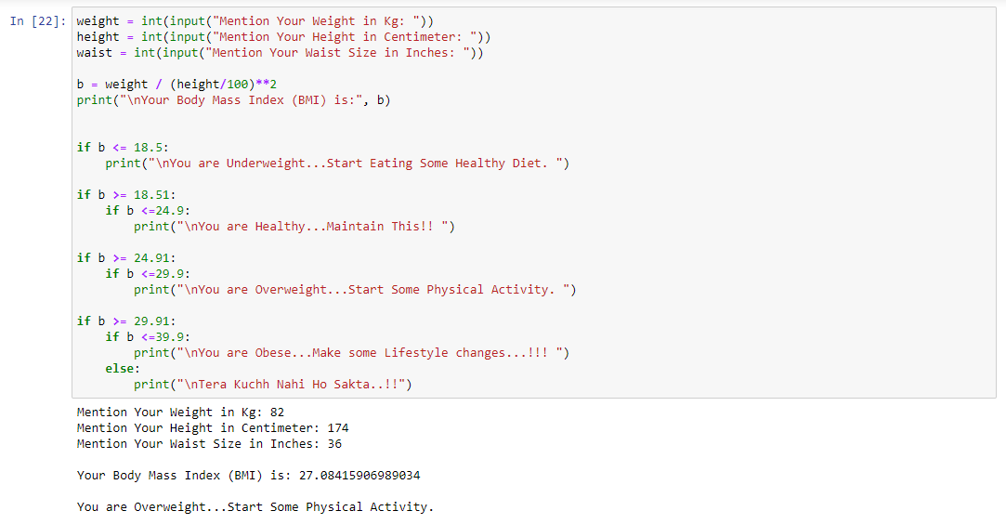
Working Demo

Slide 7
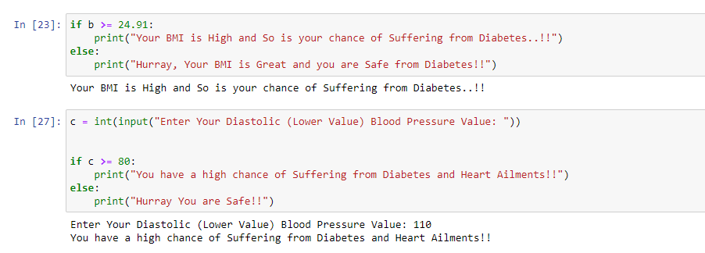
Working Demo

Slide 8
Overall Journey
It was awesome and I absolutely loved it.
I would like to thank the teachers and mentors from Intel as well as my fellow colleagues for helping and assisting me throughout this journey.
I loved this journey very much and got to learn a lot more things I could ever imagine.
I hope that advancement in AI would further assist the man kind for predicting much more complicated scenarios in near future.

