Slide 1
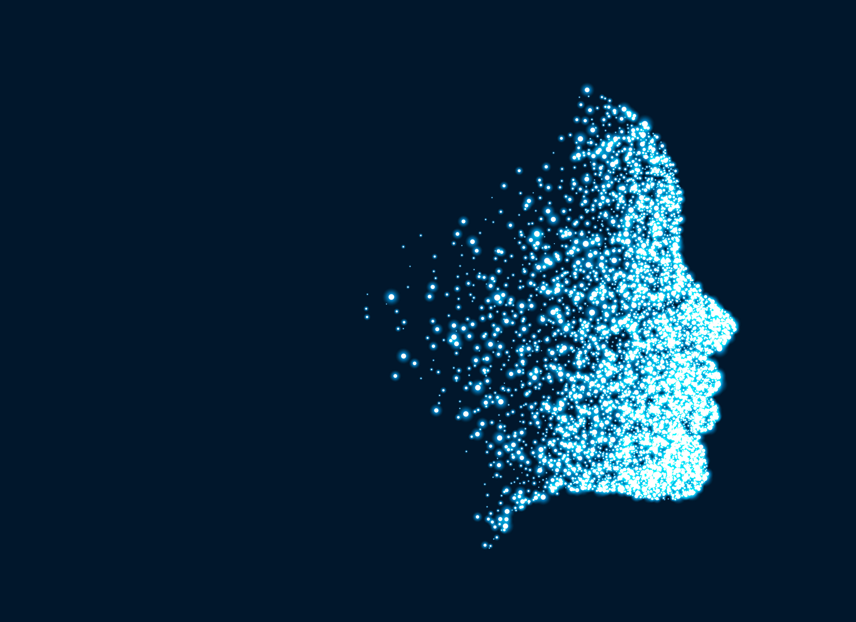

Introduction to python
Rishabh , AI Club, NIT Calicut

Slide 2
But , why python !!
Its user friendly , very easy to understand and popular too.(syntax are easy to understand)
It’s a high level language. And an object oriented programming language as well
More intuitive than other languages (in terms of modules , libraries, packages or augmentation)

Slide 3
Content of this session :
Strings
Variables, comments, datatypes(integers, floating point numbers, complex, strings)
Operators
Lists, tuples, dictionaries(maps)
Functions
Libraries, modules
Order can vary

Slide 4
Strings – printing and commenting
Printing something in python is done by using the print function.(“ ” for strings)
Commenting is done to increase readability and to explain our code.
When you comment a line the interpreter skips that part , (execution is not performed for that part)
Using # symbol you can comment out your line of code.
For multiline string we use (“ “ “ ) a space is there after every double coot.

Slide 5
Basic in-built functions
Len() - function is an inbuilt function in Python programming language that returns the length of the string.
find( ) function returns the index value of the given data that is to found in the string. If it is not found it returns -1. One can also input find( ) function between which index values it has to search.
index( ) works the same way as find( ) function the only difference is find returns '-1' when the input element is not found in the string but index( ) function throws a Value Error
capitalize( ) is used to capitalize the first element in the string.
lower( ) converts any capital letter to small letter.
upper( ) converts any small letter to capital letter.
endswith( ) function is used to check if the given string ends with the particular character(s) which is given as input.
count( ) function counts the number of char in the given string. The start and the stop index can also be specified or left blank

Slide 6
Variables and datatypes -
Python is Dynamically Typed Language i.e. the type of variable is checked during run-time.
Variables in Python refer to a value. Variables store this value and can be called upon any time during the code.
Some of the datatypes in python are -
  str
  int
  float
  bool

Slide 7
Things to do with variables -
Casting – set to a data type
Type of variables - to know he type of variables used
Many to one and one to many - in terms of setting values
Adding variables – ‘ + ’ is used directly
Global variables, local variables , global keyword - types

Slide 8
Operators – for carrying out mathematical operations
Addition Operator (+)
Subtraction Operator (-)
Multiplication Operator (*)
Division Operator (/)
Modulus Operator (%)
Exponentiation Operator (**)
Remainder (//)

Slide 9
Data Structures in Python – there are 4 types of basic data structures
Lists – []
Tuples – ( )
Dictionaries { “ ” : “ ”}
Set {}
These differ on mutability and order.

Slide 10
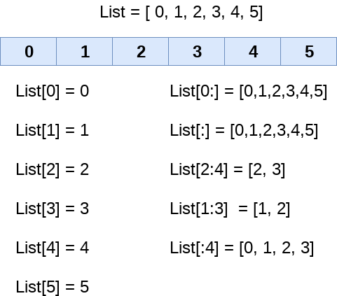
Lists -
A list in Python is a heterogeneous container for items.(different data types )
It is mutable - it is possible to reassign and delete individual items as well.
[ and ] are used to define list.
We can use built-in methods like - pop(), append(), remove(), reverse(), etc.

Slide 11
Tuples -
A tuple in Python is a heterogeneous container for items.
It is immutable - it NOT is possible to reassign and delete individual items as well.
( and ) are used to define tuple.
Hence functions like append , insert , remove etc. wont work
Generallly tuples are used when you want a colectionds

Slide 12
Sets
A set, in Python, is just like the mathematical set.
It does not hold duplicate values and is unordered.
It is mutable.
{ and } are used to define set.
We cannot use indexing to access or delete any element of set as it is unordered.
We can use built-in methods like - add(), pop(), remove(), discard(), etc.
remove() raises an error if element to be removed is not present in the set whereas discard() does not raise error even if element to be discarded is not present.

Slide 13
Dictionaries
A Python dictionary holds key-value pairs.
It is similar to real world dictionary which holds word-meaning pairs.
{ and } are used to define dictionary.
Dictionaries are mutable.
Dictionaries cannot have two items with the same key
We can use built-in methods like - get(), pop(), keys(), update(), etc.

Slide 14
Control statements -
Control statements include if, elif , and else.
They are used to introduce logic to our program,
Generally these are mathematical logic but other form of logics can also be present
In python some useful conditions from mathematics are :
Equals: a == b
Not Equals: a != b
Less than: a < b
Less than or equal to: a <= b
Greater than: a > b
Greater than or equal to: a >= b

Slide 15
Some other useful points in control statements -
There are other reserved words used in python with if else statements
For e.g. – in , and , is , or etc.
They are used with different context.
in – generally used to have a check of something , can be a text or a number
Or & and are very clear.
is - generally used with ‘and’ and used for checking multiple conditions at a time.

Slide 16
Loops in python : used generally for repetitive tasks to save time and error.
Python has two primitive loop commands:
while loops
for loops
With the while loop we can execute a set of statements as long as a condition is true.
A for loop is used for iterating over a sequence
A for lop in python works differently than other programming language
works more like an iterator method as found in other object-orientated programming languages.

Slide 17
Useful functions with loops
Break - With the break statement we can stop the loop even if the while condition is true:
Continue - With the continue statement we can stop the current iteration, and continue with the next:
Else -With the else statement we can run a block of code once when the condition no longer is true:

Slide 18
Functions in python -
A function is a block of code which only runs when it is called.
You can pass data, known as parameters, into a function.
A function can return data as a result.
Functions can be useful when you want to execute a small task repetitively for certain part in your code.
A fun usually starts with “def”

Slide 19
Something extra just to be ahead :
Input() – using the input function you can take input from the user
Can be any data type.
Modules are just like a file , containing functions which can be used again and again
For e.g. import random will import random module which contains functions like randint etc.
Lambda : Lambda functions can have any number of arguments but only one expression
Basically a nameless function and can be used for many purposes.

Slide 20
Resources to check :
Kaggle --- https://www.kaggle.com/
Git , GitHub -- https://github.com/
Andrew ng course on machine learning -- https://www.coursera.org/instructor/andrewng

Slide 22
More about strings
Strings have index and in python index starts from 0.
You can call your your index using print func.

