Slide 1

TweetPress
News Recommendation System
Group 52
Kartik Jain
Uttkarsh Singh
Darsh Parikh
Manas Agarwal
Rishabh Oberoi

Slide 2
Problem Statement
Reading the news online has exploded as the web provides access to millions of news sources worldwide. The sheer volume of articles can be overwhelming to readers.
A key challenge of a news service website is to help users find news articles that match their interests.
Twitter for many people is their main news source. Twitter shows us trending news based on the demographics and trends.
The problem of this type of recommendation is that the recommendations are not personalised to user.
Personalised News Recommendation is advantageous to both users and the news service, as the user can quickly find what he or she needs, and this helps the news service retain and increase the customer base.

Slide 3
Proposed Solution
Creating a personalised news recommendation system that considers users' interests based on their tweets and recommends relevant articles. Most users use Twitter to get daily updates on what is happening, and our model helps them get personalised news articles that they might like or might be looking for. For the model, we consider different factors like keyword extraction, similarity matching and sentiment analysis. Based on all the above mentioned, we shortlist the list of relevant news articles for an user and show him the top ‘k’ relevant articles of both parity to produce a non-polarised results.

Slide 4
Novelty
The novelty of our project lies in creating a personalized news recommendation system that takes into account the user's interests based on their tweets and recommends relevant articles. For, the model implementation we use different information retrieval techniques. Most users use Twitter to get daily updates on what's going around and our model helps them to get personalised news articles that they might like or might be looking for based on their tweets. We also use keyword extraction, similarity matching and sentiment analysis to shortlist the list of relevant news articles for a user and show him the top ‘k’ relevant articles of both parities to produce non-polarised results.

Slide 5
Related Work
The paper titled ”Discovering significant news sources in Twitter”proposes a method to discover significant news sources on Twitter. The authors highlight the importance of identifying reliable and trustworthy news sources on Twitter, given the abundance of information available on the platform. They have made a framework which downloads a list of news-related relevant tweets from twitter, extracts URLs associated with those tweets and infers the significance of those URLs in Twitter.They collected tweets using the REST and Streaming API of Twitter, and then extracted URLs from these tweets. Further, the tweets have been ranked based on relevancy. They used a threshold of 15.
Comprehending and summarizing extensive texts can be challenging due to the ever-increasing volume of information. To address this issue, keyword extraction systems are necessary to automate the process of generating keywords because large amounts of text often lack descriptive terms. The paper titled "YAKE! Keyword extraction from single documents using multiple local features" presents an unsupervised automated keyword extraction approach known as YAKE that is not reliant on the dataset or its description. By utilizing statistical data and local text features like term frequencies, the authors can identify significant keywords without requiring a corpus.

Slide 6
Related Work
In their paper, Bordoloi et al. presented a modified graph-based approach called KWC for automatic keyword extraction from a Twitter corpus. Their approach used various graph measures, including frequency, centrality, position, strength of the neighbors, and others, to assign weights to nodes in the graph. The control flow of their method included data preprocessing, textual graph representation, collective node-weight assignment, and keyword extraction. The nodes in the graph were tokens, and an edge was created between two tokens if they co-occurred within the same tweet. The graph was weighted according to co-occurrence frequency, and the nodes were weighted based on important graph measures such as term frequency and selectivity centrality. Keyword extraction was performed using NE-Rank and degree centrality, and the best n keywords were outputted. Bordoloi et al.'s method outperformed several existing graph-based methods and could be useful for our project, which involves extracting keywords for a given set of tweets for a hashtag.
In their paper, Krestel et al. conducted a study where they developed models to suggest relevant tweets for news articles, and evaluated their effectiveness through user feedback. To identify tweets that contained similar content to the articles, they used language and topic models to compare word and concept overlap. They then combined these similarity scores with other tweet features such as recency and popularity, using logistic regression and boosting. For language modeling, they used a document likelihood model to determine the likelihood that a tweet was generated from a news article, rather than a query likelihood model. Additionally, to prevent duplicate tweets in the final ranking, they excluded tweets that had a high word overlap with tweets that were already included in the set of recommended tweets.

Slide 7
Methodology
We take TwitterID, Number of News articles (X), the Weighting Scheme and the Keyword Extraction Method from the user. After applying the models based on the weighting scheme mentioned by the user we give the output as top X articles. If the user has chosen a keyword extraction method then we use that specific method and sentiment analysis to retrieve X different news articles of both similar opinion as the user (according to the user's tweets) and X news articles of the opposite opinion.

Slide 8
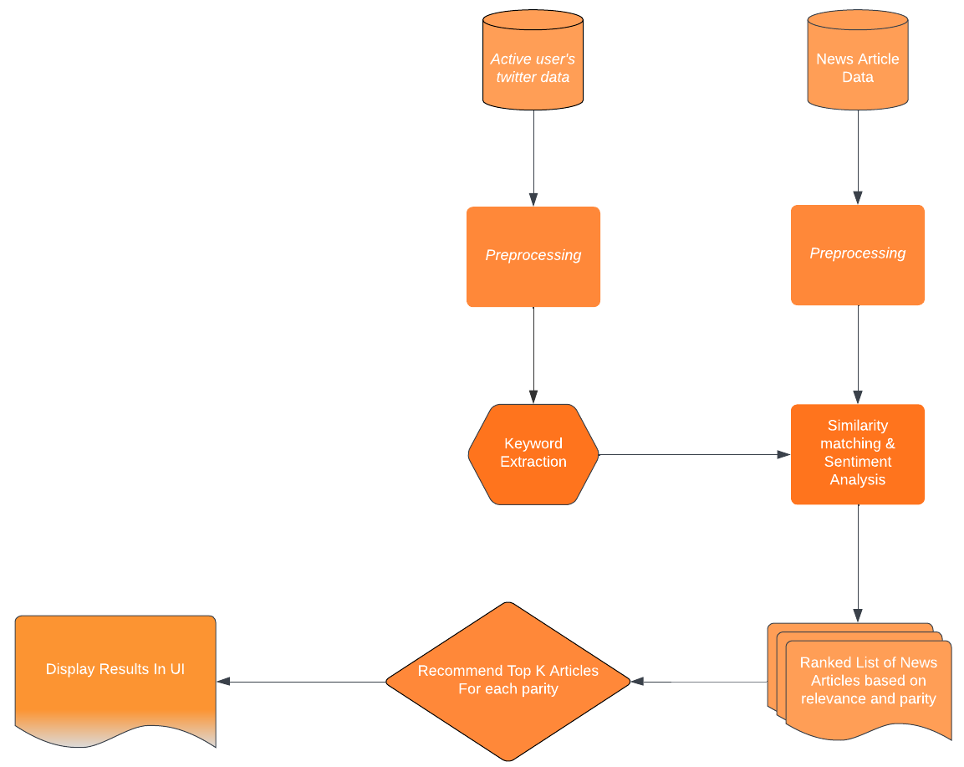
Workflow of our Model

Slide 9
Evaluation Metrics
TF-IDF similarity matching: TF-IDF is a statistical measure that helps determine the significance of a term in a document or corpus. Five different TF-IDF matrices are created using five different weight calculation methods.
a. The first method is Binary weighting where term frequency is either 1 or 0, depending on whether the term is present in the document or not.
b. The second method is Raw Count, which uses the number of times the term appears in the document.
c. The third method is Term Frequency, which normalizes the raw count of a term by the sum of the raw count of all terms in the document.
d. The fourth method is Log Normalization, which takes the logarithm of (1+raw count of the term).
e. Finally, the fifth method is Double Normalization, which uses the formula 0.5+0.5(raw count of the given term/ maximum raw count in the document).
Cosine Similarity: Cosine similarity is a widely used method in natural language processing to determine the similarity between two texts, regardless of their length and size.

Slide 10
Keyword Extraction And Sentiment Analysis
We used the following Keyword Extraction methods along with sentiment analysis:
RAKE(Rapid Automatic Keyword Extraction): This algorithm is not specific to any particular domain and is based on the observation that natural language has many unnecessary words, such as stopwords and punctuation, that do not contribute much to the meaning and context of the text. To extract the candidate keywords, these extra words are removed and the remaining words are assigned a score based on their degree and frequency in a co-occurrence graph.
YAKE(Yet Another Keyword Extractor): This method is a simple and automated way to extract keywords from text, using statistical features. It is independent of the language and the corpus of the text being analyzed. Furthermore, it can identify the important keywords in a single document.
KeyBERT: BERT is a type of transformer model that is capable of transforming phrases and documents into vectors that represent their meaning. KeyBERT is a straightforward and user-friendly technique for extracting keywords from text, which relies on BERT-embeddings and cosine similarity to identify the most relevant sub-documents within a larger document. By leveraging BERT, KeyBERT can generate document-level representations that facilitate the extraction of meaningful keywords.
Textacy: It provides several algorithms for extracting important words or phrases from text, such as the TextRank and SingleRank algorithms, and supports multiple languages. It also offers tools for preprocessing text and filtering out unwanted words. Overall, Textacy's keyword extraction module can help simplify the task of identifying important topics in large volumes of text data.

Slide 11
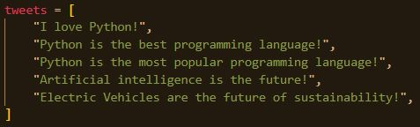
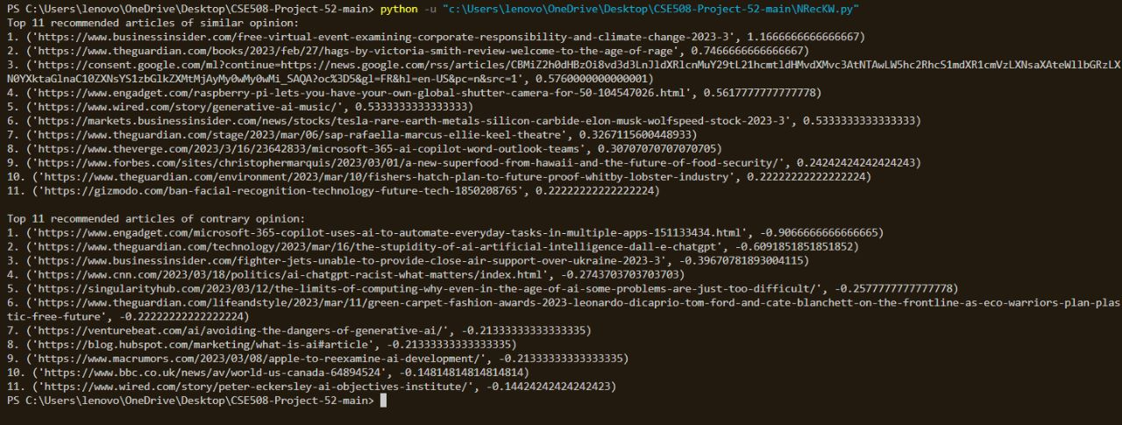
Sample of Keyword Extraction and Sentiment Analysis

Slide 12
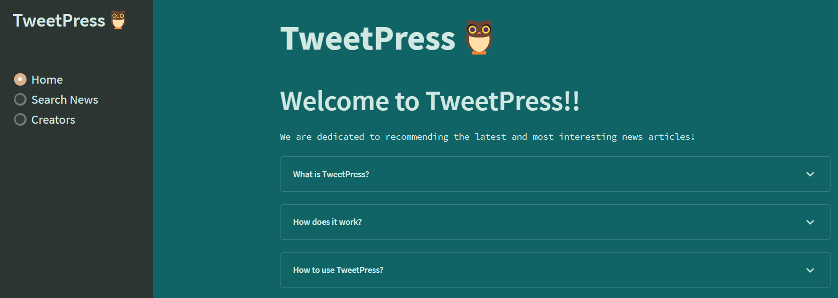
User Interface

Slide 13
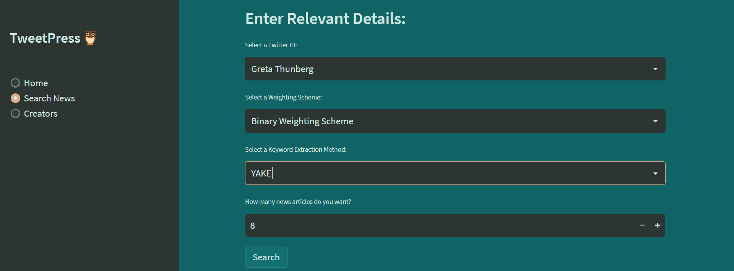
Query Format
Example 1: Suppose I want to search news articles based on Greta Thunberg’s tweets. I will select her Twitter ID, choose a weighting scheme (here Binary Weighting Scheme), then choose a Keyword Extraction Method and then the number of News Articles I want to see. After entering the details I will click on the search button to get the output.

Slide 14
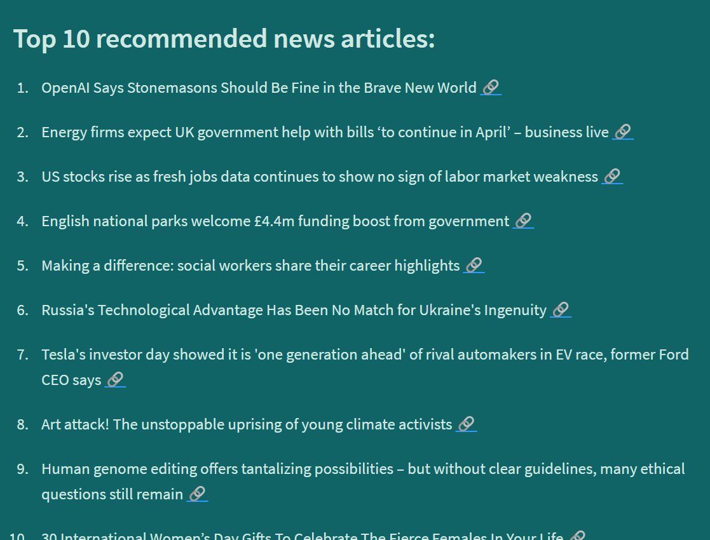
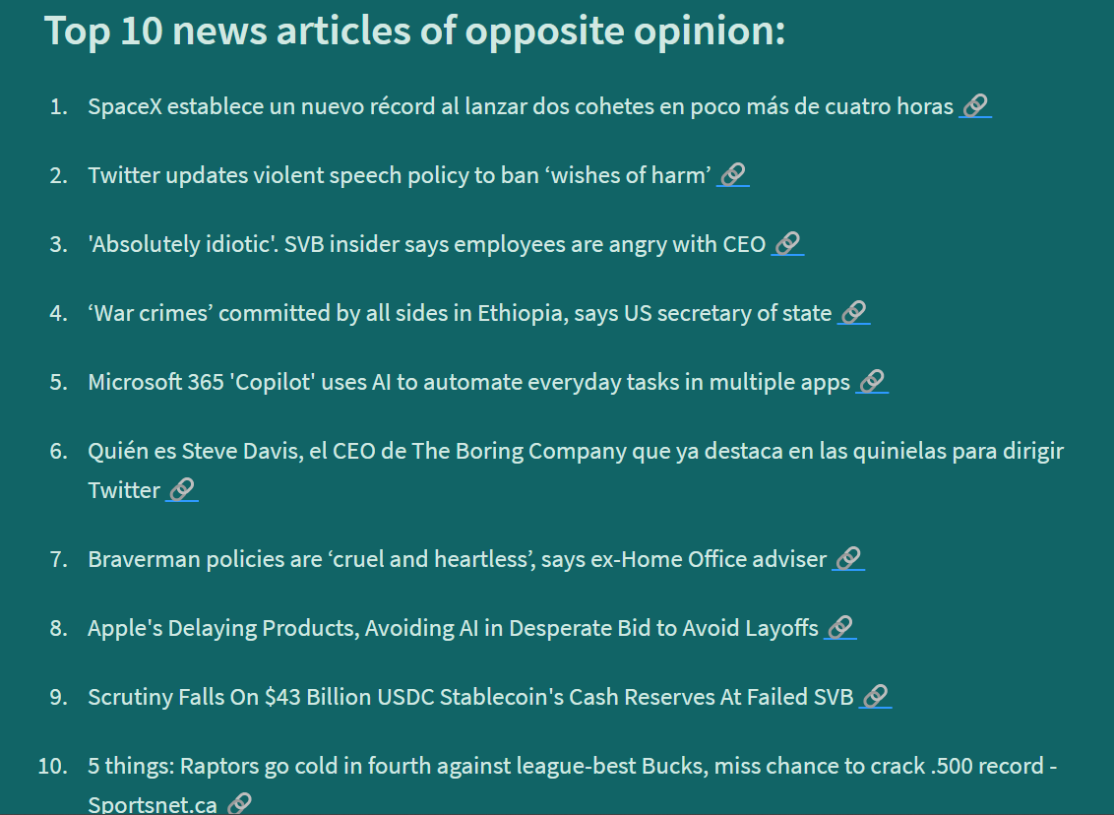
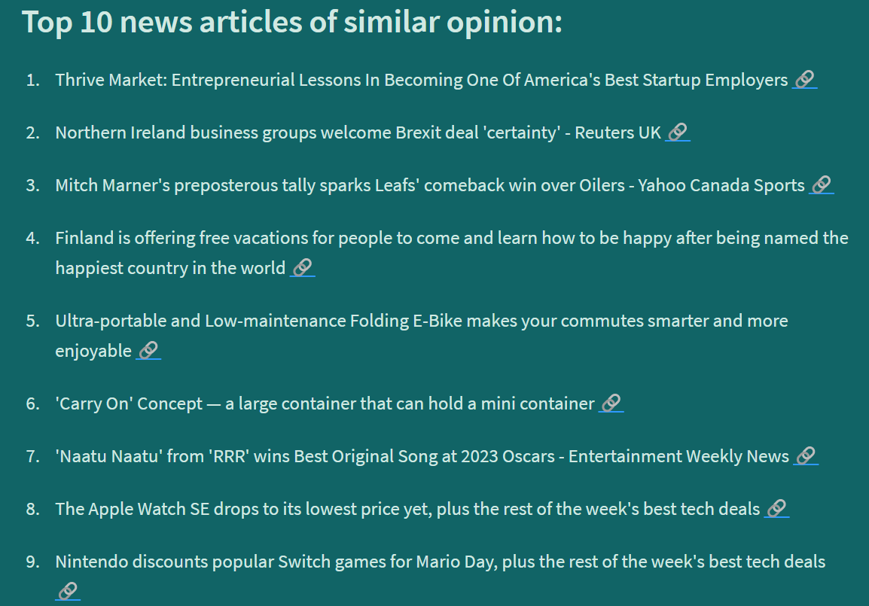
Output Format

Slide 15
Evaluation and Results
Weighting Scheme | Binary TF | Raw Count | Term Freq | Log Normal | Double Normal
Precision | 0.8 | 0.5 | 0.5 | 0.7 | 0.5
Weighting Scheme | Binary TF | Raw Count | Term Freq | Log Normal | Double Normal
Precision | 0.5 | 0.5 | 0.6 | 0.5 | 0.4
Narendra Modi
Greta Thunberg
Weighting Scheme | Binary TF | Raw Count | Term Freq | Log Normal | Double Normal
Precision | 0.6 | 0.6 | 0.7 | 0.6 | 0.6
Weighting Scheme | Binary TF | Raw Count | Term Freq | Log Normal | Double Normal
Precision | 0.5 | 0.7 | 0.7 | 0.7 | 0.6
Sundar Pichai
Samay Raina
Weighting Scheme | Binary TF | Raw Count | Term Freq | Log Normal | Double Normal
Precision | 0.6 | 0.8 | 0.8 | 0.7 | 0.8
Virat Kohli

Slide 16
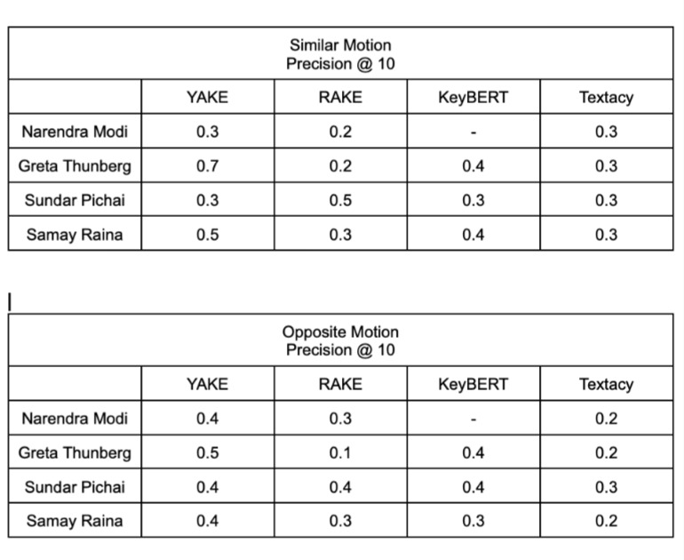
Evaluation and Results

Slide 17
Future Work
Current Saved model takes time to run.
Online Saving of the tf-idf matrix will help query to run faster.
Dynamic Website where the user can directly enter their user-id and they can get their recommended news articles.
Use demographic data (metadata) to recommend articles to users with non-existent twitter activity.(Cold start problem)
Scalability

Slide 18
Future Work
Use personal.ai to create online personality of user (after due consent) or use their existing personal.ai to get data from social media (twitter, instagram, etc.). Use this to recommend news articles based on multi-sourced information.
AutoGPT (LLM + autonomous learning) for better recommendation.
Future Technology

Slide 19
Thank You!
We will open it up for Questions.

