Slide 1



Datacamp: W1 Team update
GOAL: Bringing Data Science Education to Secondary Schools in India for Zero Cost with Machine Learning
TASK 6: Eastern Sector of India
Liang Chao, Product Manager
2022-07-08

Slide 2
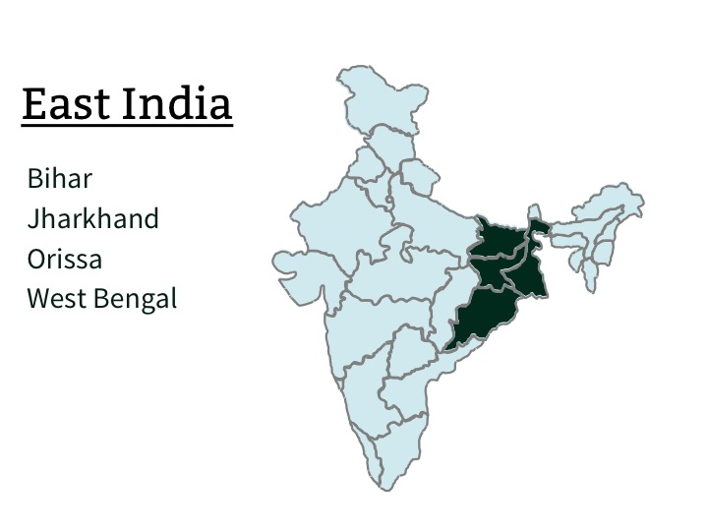
TEAM MEMBERS
Shreyasi Chandra(Leader)
Rishabh Kumar Addya (Co-Leader)
Souvik kumar Das
Sambit Kumar Barik
Vinayak Modgil
Shivam Negi
Njoki Mwihaki
Nijaguna Darshan
Naftal Rainer
Mohit Mishra
Akshaya Ravi
Alsawy Mohamed

Slide 3
The Project Objectives:
Identify and gather all Indian secondary schools to spread the importance of having data science in schools’ curriculum.
Collaborate on creating a robust Google Sheet spreadsheet that contains essential information about secondary school in India by September 1, 2022. The spreadsheet should present at minimum these two essential data into two separate columns:
School name
Email domain
Additionally, the list could include:
Main email contact
School website link
Address
City
Province
Postcode
Telephone number
Schools with their own unique email domains should be prioritized in their own list. Information on schools that don’t have their own email domain can be gathered on a separate sheet but are not high priority.

Slide 4
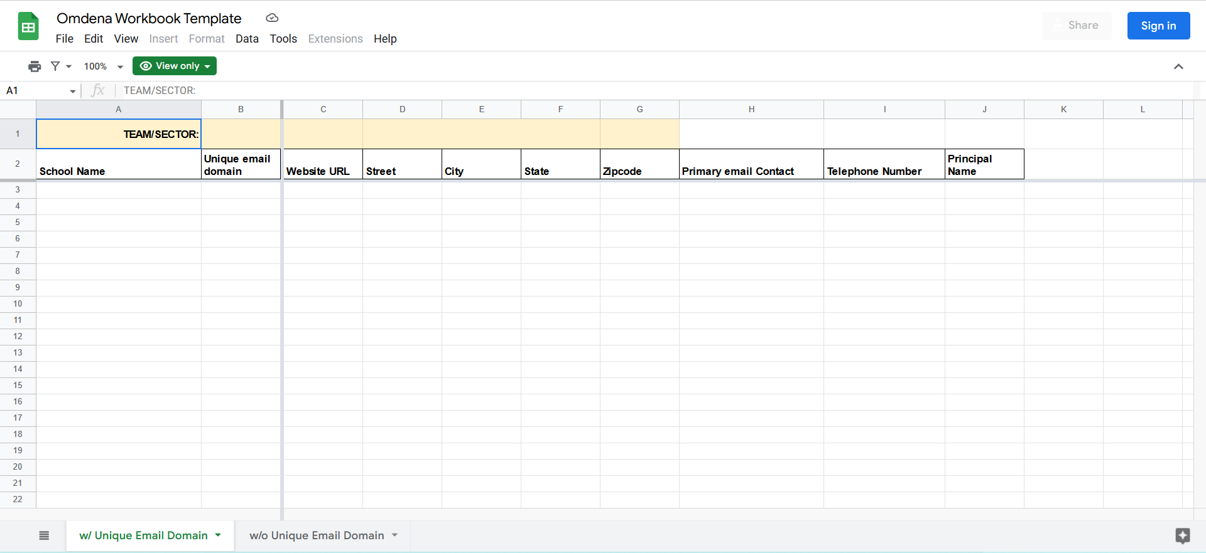
Sample Worksheet:

Slide 5
Week -1 (Jul 01– Jul 07)
The steps we are following from Day-1:
1. Identify the states falls under the east region of India.
2. Conducted a meeting to divide the task between the collaborators.
3. Discuss about the what process we have to followed to find the high schools name and their respective emails.
4. About 1-2 days we research about the state and the high schools..
5. Try to find out the website where we can get maximum number of information.
6. Share all the website links, csv, pdf files in the slack channel so that others also followed the same.
7. Try to figure out which web scrapping tools(Web email extractor, python library(Beautiful Soup, Selenium) is suitable.
8. Try to separate the emails in two parts – with unique domain and without unique domain as mentioned by project manager. (In progess)

Slide 6
Reference Link:
The csv file link:
https://github.com/Rishabh5174/omdena_project/blob/17eac23968ea07cb72ab618208db6664d167ff47/high%20school_india.csv
The other website link such as :
https://cbse.directory/school-in-odisha
https://study4sure.com/institutes/schools/odisha/
https://wbbse.wb.gov.in/Web/SchoolDirectory?l=NvIA4/0JZGMsvPnDuBDEBA==
https://targetstudy.com/school/schools-in-bihar.html
https://targetstudy.com/school/schools-in-jharkhand.html

Slide 7
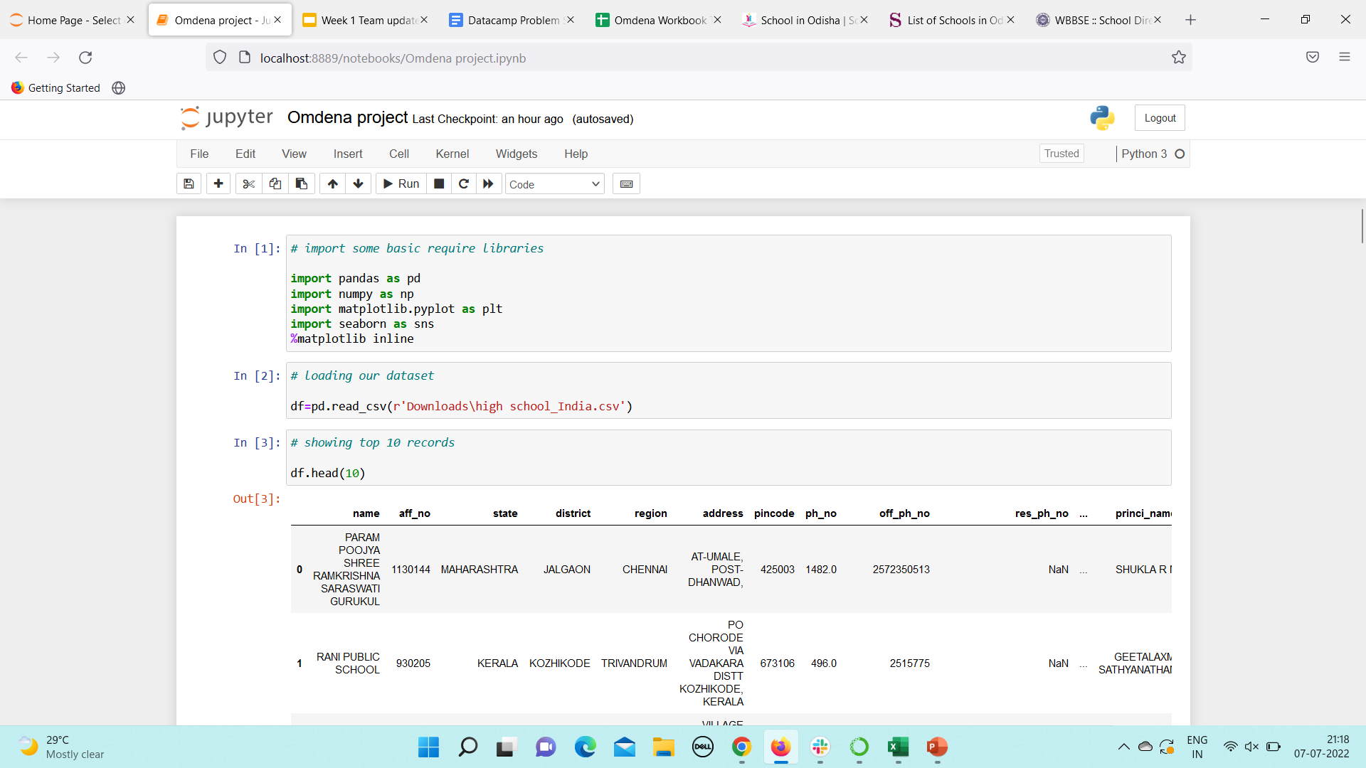
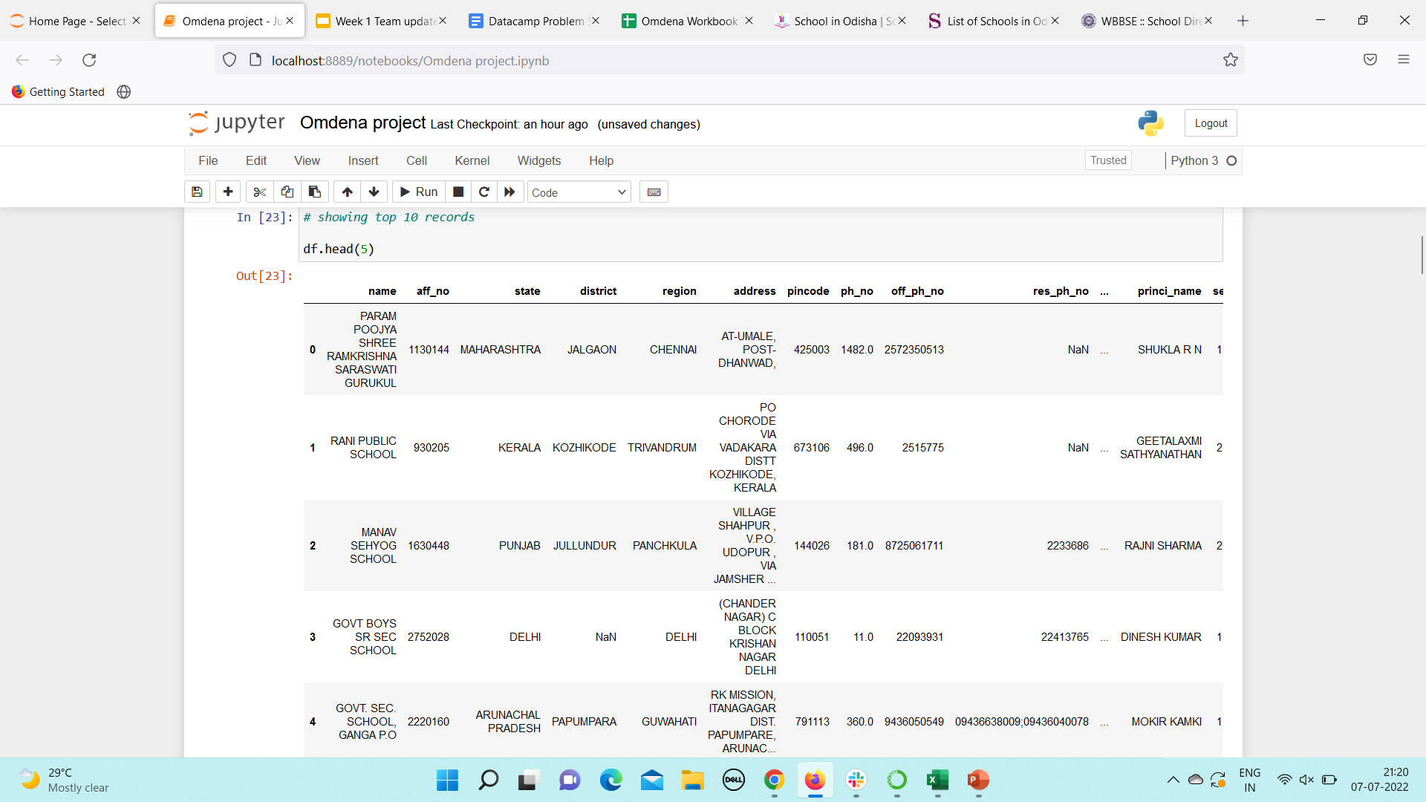
Snapshot of the project work:

Slide 8
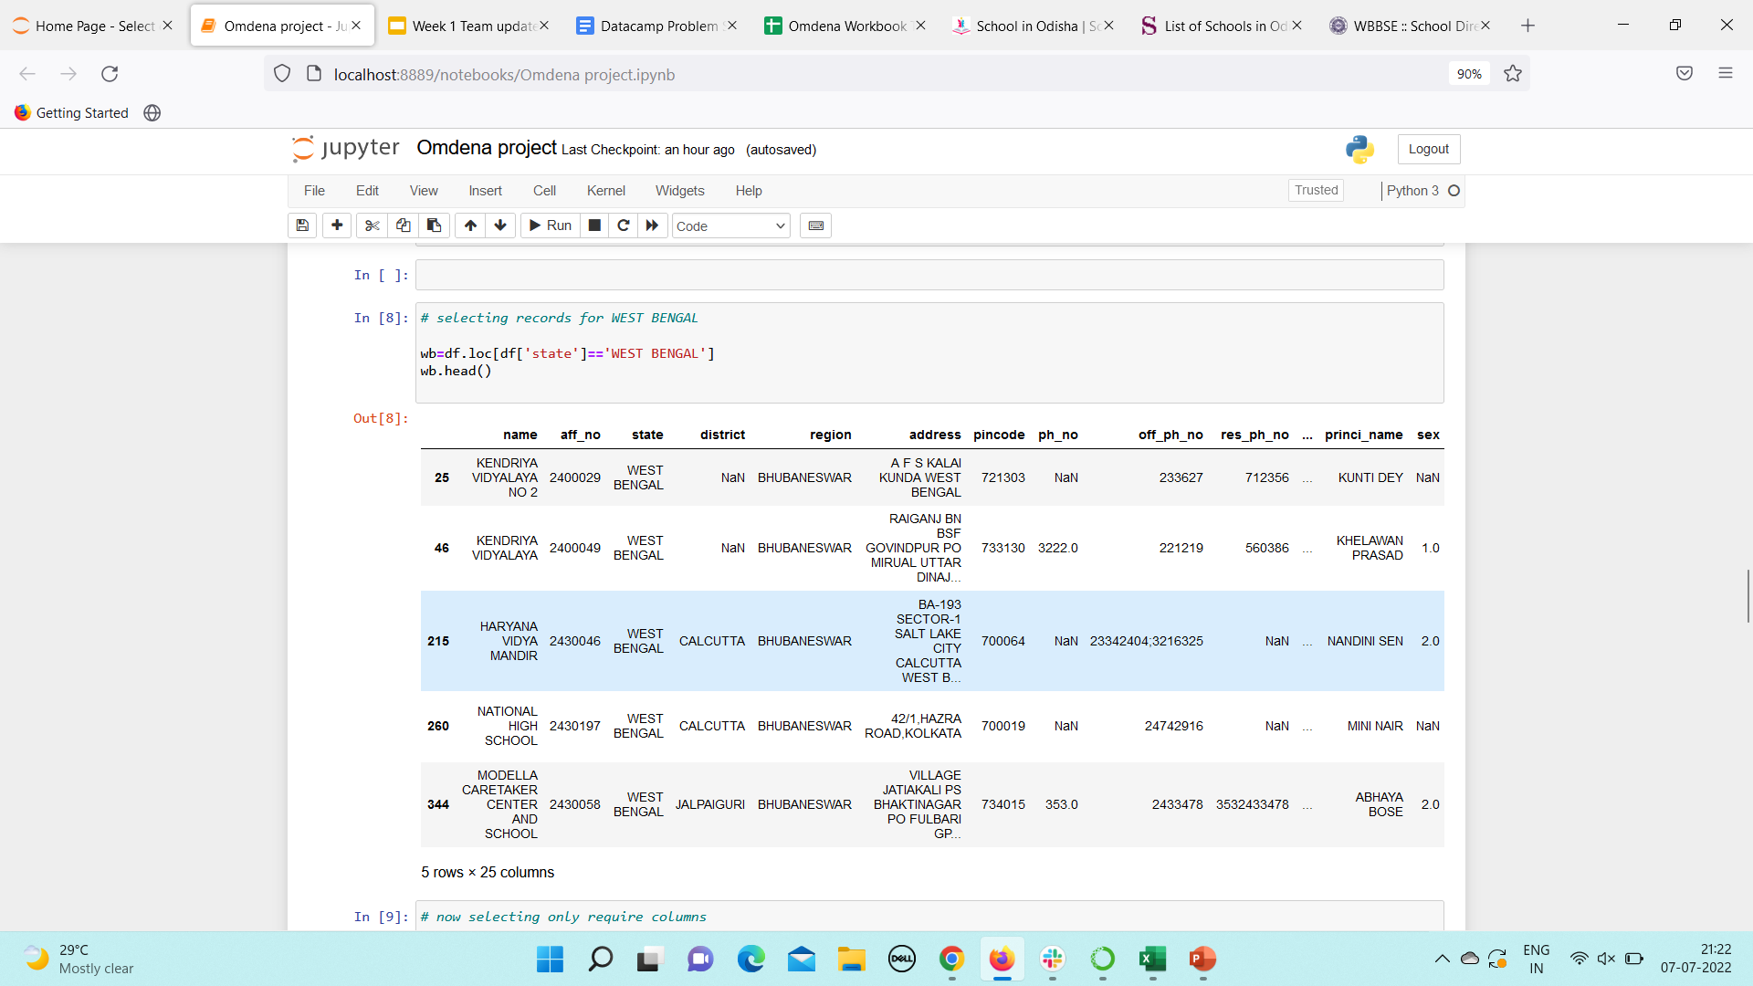
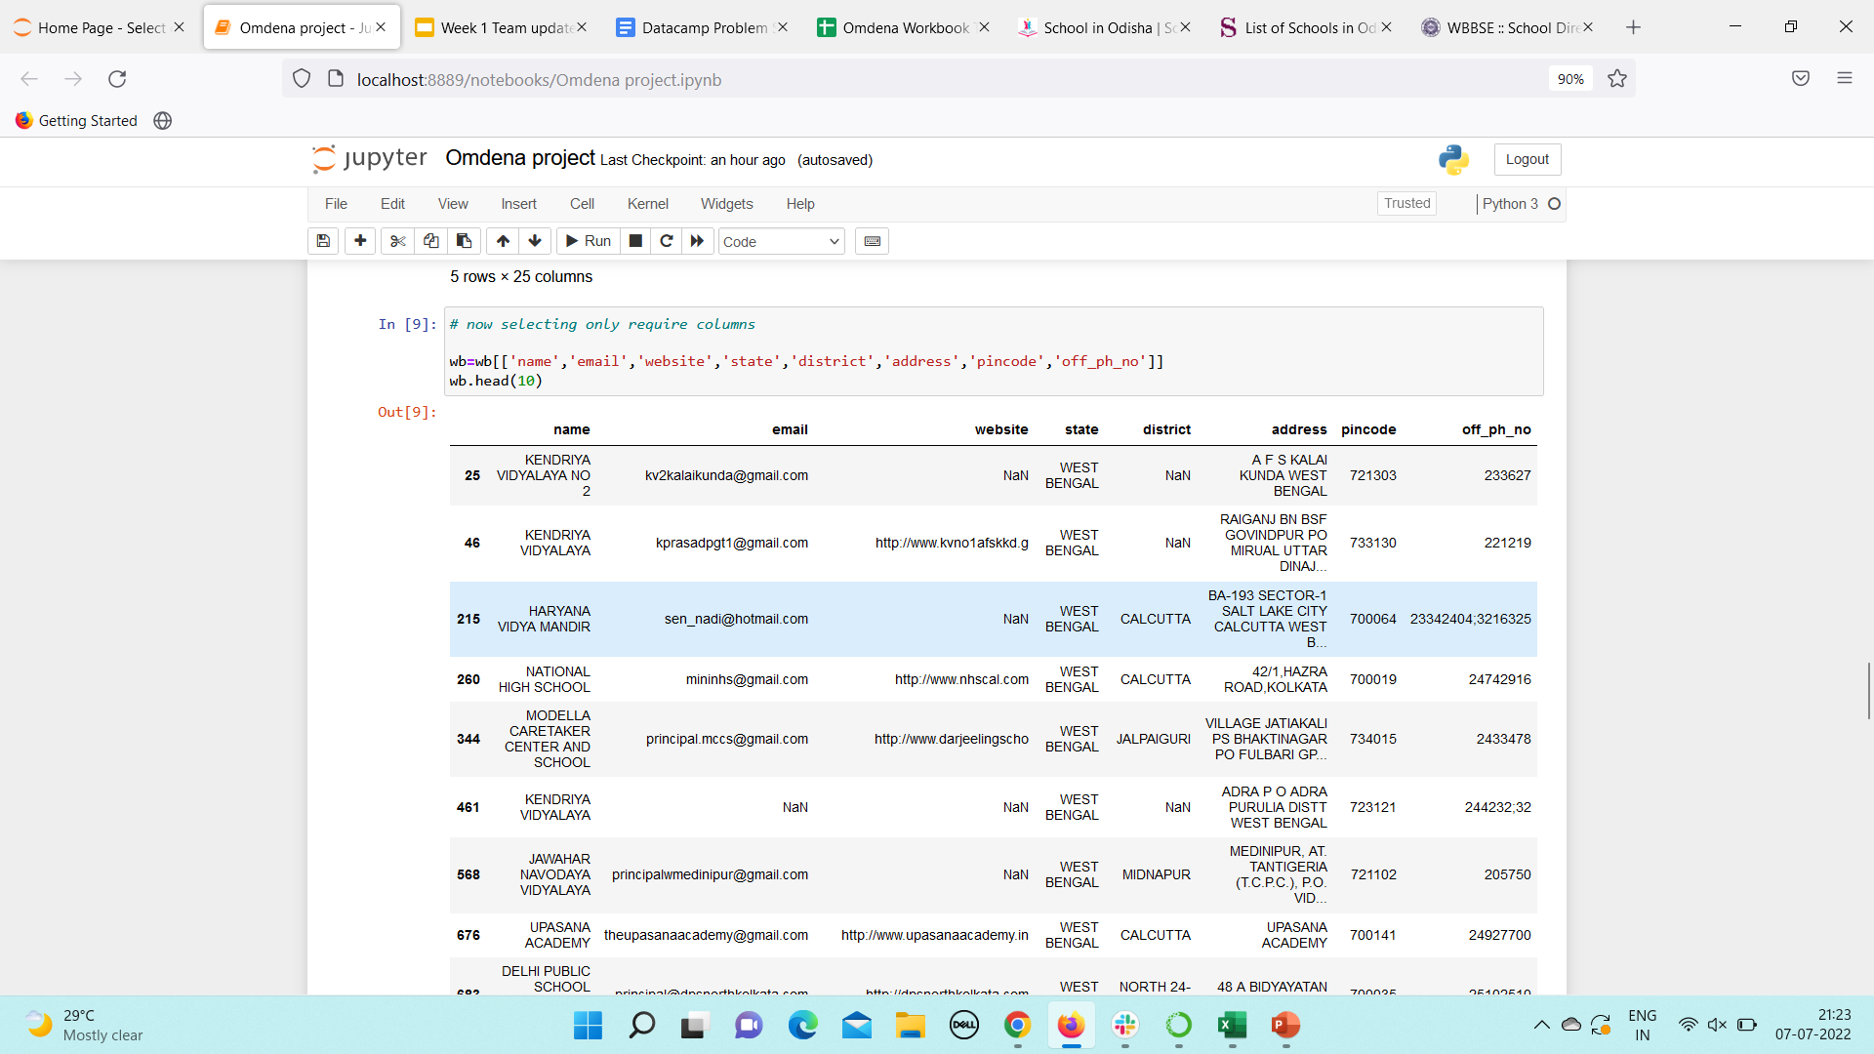
Snapshot of the project work: (continued….)

Slide 9
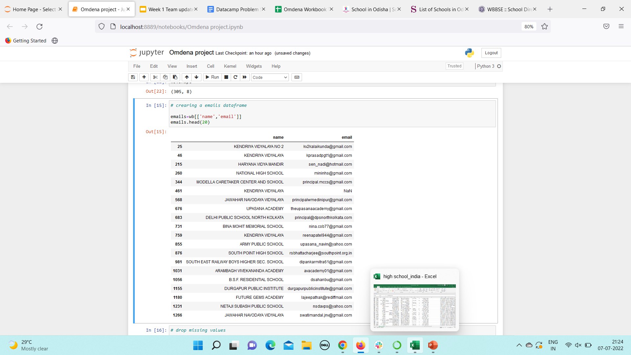
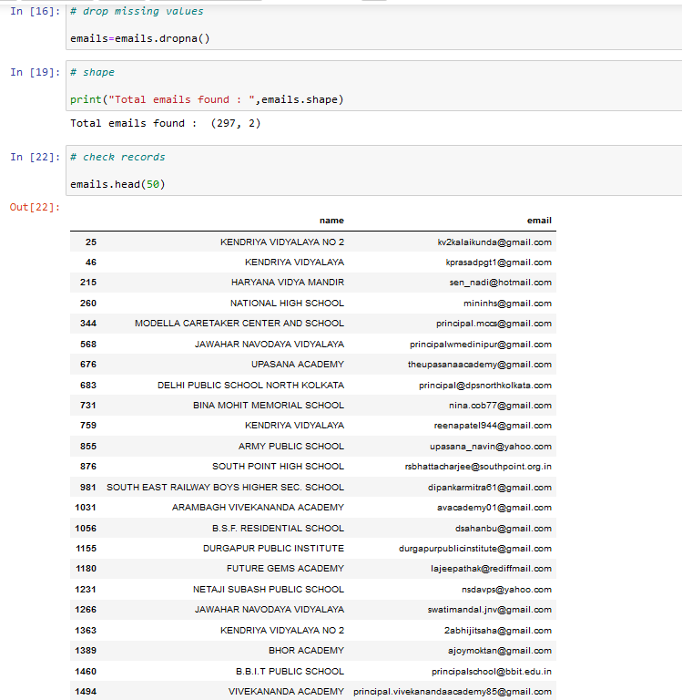
Snapshot of the project work: (continued….)

Slide 11
Upcoming week planning:
Try to collect all the schools and emails from each state of each region.
Try to separate the unique domain and non-unique domain emails.
Will the data into the given google worksheet.

Slide 12
Thank You

