Slide 1
War of Neighbourhoods: Toronto v/s Vizag

Slide 2
Problem
Searching the possibilities of replicating the real estate investment model of Toronto in Vizag by comparing the neighbourhoods of both cities.

Slide 3
Interest
This project will highlight the investor opportunities with increased scope of attracting real estate investors in Vizag which can help Vizag to realize its ambitious economic growth goals while preserving and enhancing livability for the benefit of local citizens.

Slide 4
Data Requirements
Following datasets have been used in the project:
· Postal Codes of Visakhapatnam. Data has been scraped and cleaned from Yo!Vizag — City’s Exclusive Magazine and Portal using Beautiful Soup and pandas libraries and saved in .csv format.
· Foursquare API to get the most common venues of given boroughs of Visakhapatnam and Toronto respectively.
· Visakhapatnam and Toronto Wikipedia Pages have been scraped and cleaned for creating Word clouds.
· Zip codes of Toronto. Data has been downloaded in .csv format from https://datasf.org/and cleaned using pandas.

Slide 5
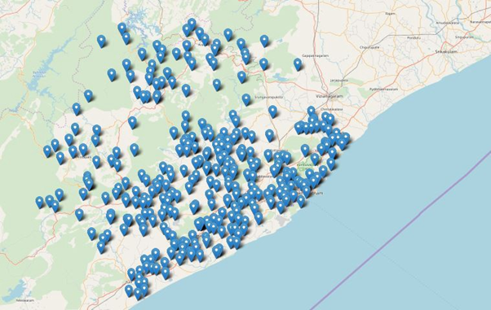
Map of Vizag City

Slide 6
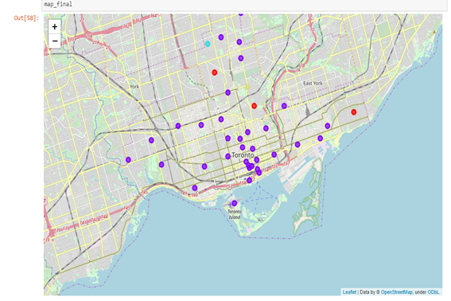
Map of Toronto City

Slide 7
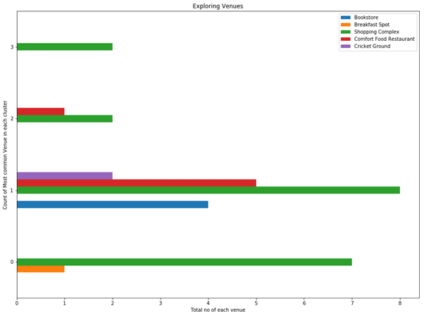
Data Analysis

Slide 8
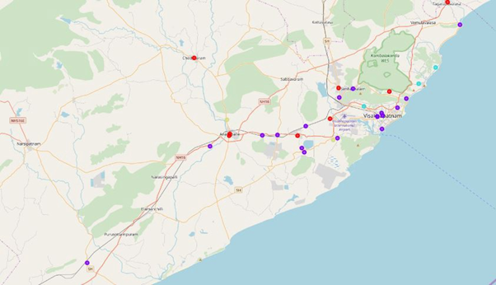
Data Analysis

Slide 9
Discussion and results
1. The neighbourhoods of both cities have shown multiple similarities in terms of nearby facilities availability.
2. Educational Institutions data can be explored further.
3. Business investor looking for real estate investment can further explore areas/neighborhoods in cluster 1 of Visakhapatnam as these are the areas having the highest development with restaurants, breakfast spots, shopping complex etc. as compared to the places in other clusters.

Slide 10
Result
The data can be used to compare the neighbourhood of both cities and can help investors to find appropriate opportunities of real estate investments in Vizag.

Slide 11
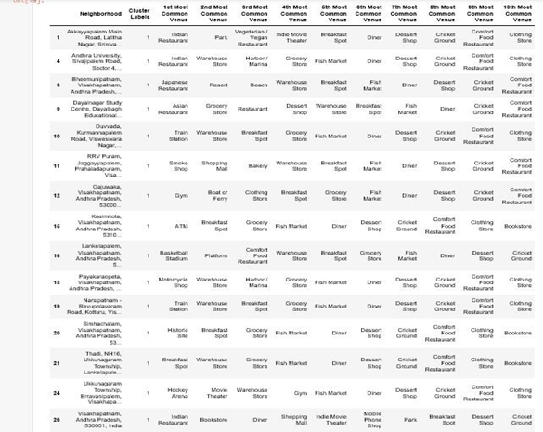

Slide 12
Thank You!!

