Slide 1
Spring Testing

Slide 2
Test Driven Development
TDD starts with developing test for each one of the features.
The test might fail as the tests are developed even before the development.
Development team then develops and refactors the code to pass the test.
  test-first as part of extreme programming concepts.
Unit tests can be written after, during, or even before coding.
  test-driven development: Write tests, then write code to pass them.

Slide 3
Development Process
Add a Test
Run all tests and see if the new one fails
Write some code
Run tests and Refactor code
Repeat

Slide 4
Context of Testing
Valid inputs
Invalid inputs
Errors, exceptions, and events
Boundary conditions
Everything that might break

Slide 5
Testing Tools -JUNIT
JUnit is a unit testing framework designed for the Java
JUnit has played an important role in the development of test-driven development frameworks.
It is one of a family of unit testing frameworks which is collectively known as the xUnit that originated with SUnit.
JUnit is linked as a JAR at compile-time and can be used to write repeatable tests

Slide 6
Testing Tools - Mockito
Mockito is designed as a open source testing framework for Java which is available under a MIT License.
Mockito allows programmers to create and test double objects (mock objects) in automated unit tests

Slide 7
What is unit testing?
Unit
  A Method , a class, a package, or a subsystem.
Can Test :
  an entire object
  part of an object – a method or some interacting methods
  interaction between several objects
Helps discover failures in the logic and improve the quality of their code.
Used to ensure that the code work as expected in case of future changes.

Slide 8
When to Write Test
During Development
To add new functionality
When adding new features,
During Debugging
While a defect is discovered in code to demonstrates the defect.
write unit tests to thoroughly test a single class
write tests as develop (even before you implement)
write tests for every new piece of functionality
Notes:
Bei Test-getriebener Entwicklung wird - wie der Name schon sagt - die Entwicklung durch automatisierte Tests getrieben, indem neuer Code nur dann geschrieben wird, wenn ein automatisierter Test fehlgeschlagen hat. Die Entwickler müssen Tests schreiben, bevor sie die Implementierung schreiben.

Slide 9
Installation
Download latest version of JUnit jar file from http://www.junit.org.
Downloaded Jar File is placed in the classpath
Can Create a Stand Alone Java Application to Execute the tests
Can Also use Popular IDE Like Eclipse, NetBeans to run tests

Slide 10
Fixtures
Fixed state of a set of objects used as a baseline for running tests.
Used to ensure that a well known and fixed environment to run tests so that results are repeatable.
Earlier Version of Junit the Fixtures are created with the following Methods
setUp()
  method which runs before every test invocation.
tearDown()
  method which runs after every test method.

Slide 11
Annotations
@Test – mark a method as test
@BeforeClass – run once before all tests
@AfterClass – run once after all tests
@Before – called before every testX()
@After – called after every testX()
Can have as many @Before and @After methods
  Order of execution is not predefined.

Slide 12
Example
  import static org.junit.Assert.*;
  import org.junit.*;
  public class TestLifeCycle {
  @BeforeClass
  public static void setUpBeforeClass() throws Exception {
  System.out.println("Called Once Before Class");
  }
  @AfterClass
  public static void tearDownAfterClass() throws Exception {
  System.out.println("Called After All Tests are Completed");
  }
  @Before
  public void setUp() throws Exception {
  System.out.println("Called Before Each Test Method");
  }

Slide 13
Testing with Mock Objects
A mock object is an object created to stand in for an object that your code will be collaborating with.
Can call methods on the mock object, which will deliver results as set up by tests.
Created by using the MockObjects library
EasyMock to generate the mock object at runtime

Slide 14
Need for Mock Objects
Help keep design decoupled
Check code’s usage of another object
Defer having to write a class
Test components in isolation from the rest of the system
Promote interface-based design

Slide 15
State Based Testing
MockUp apis are categorized as State Based testing
The mocks are not dependent on the behavior of the test class.
They are defined independently and work the same in any case
Used for test of object with complex interaction

Slide 16
Controller
  @RestController
  public class WelcomeController {
  @GetMapping("/hello")
  public String getMessage() {
  return “Hello”;
  }
  }

Slide 17
Mocking
MockMVC
  Part of Spring MVC test framework
  Used for testing the controllers explicitly starting a Servlet container.
SpringRunner
  Alias for SpringJUnit4ClassRunner.
  Provides functionality of the Spring TestContext Framework to standard JUnit tests
@Mock – creates mocks
@InjectMocks – creates objects and inject mocked dependencies

Slide 18
Test Case
  @RunWith(SpringRunner.class)
  public class HelloResourceTest {
  private MockMvc mockMvc;
  @InjectMocks
  private WelcomeController helloResource;
  @Before
  public void setUp() throws Exception {
  mockMvc = MockMvcBuilders.standaloneSetup(helloResource)
  .build();
  }

Slide 19
Test Case
  @Test
  public void testHelloWorld() throws Exception {
  mockMvc.perform(get("/hello"))
  .andExpect(status().isOk())
  .andExpect(content().string("hello"));
  }
}

Slide 20
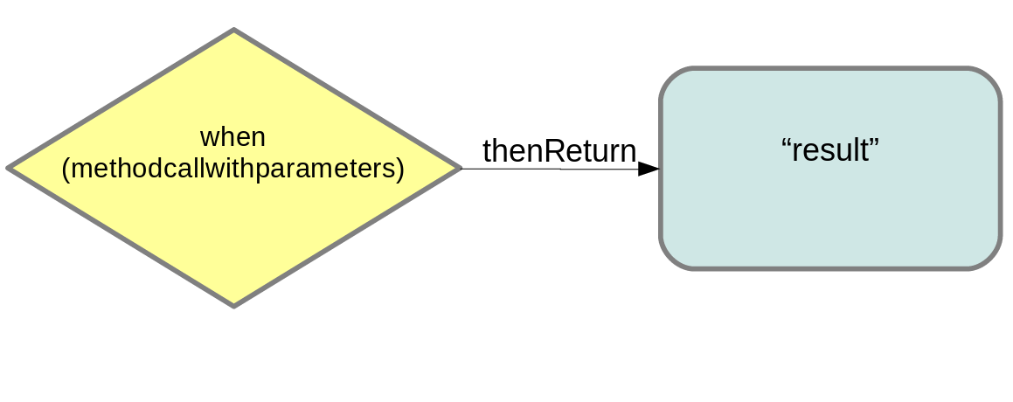
When Then
Mocks can return different values depending on arguments passed into a method.
The when(…​.).thenReturn(…​.) method chain is used to specify a return value for a method call with pre-defined parameters.

Slide 21
Verify the Calls on Mock
Mockito keeps track of all the method calls and their parameters to the mock object.
verify()
  Can be used on the mock object to verify that the specified conditions are met.
  Can verify that a method has been called with certain parameters.
  Does not check the result of a method call, but it checks that a method is called with the right parameters.

Slide 22
Service
  @Service
  public class HelloService {
  public String greet() {
  return "Unit Testing";
  }
  }

Slide 23
Test Conditions
  @Before
  public void setUp() throws Exception {
  mockMvc = MockMvcBuilders.standaloneSetup(helloResource)
  .build();
  }
  @Test
  public void testHelloWorld() throws Exception {
  when(service.greet()).thenReturn("hello");
  mockMvc.perform(get("/hello"))
  .andExpect(status().isOk())
  .andExpect(content().string("hello"));
  verify(service).greet();
  }

Slide 24
Controller With Service Injection
  @RestController
  public class WelcomeController {
  @Autowired
  private HelloService service;
  @GetMapping("/hello")
  public String getMessage() {
  return this.service.greet();
  }
  }

Slide 25
Test with Service Mock
  public class HelloResourceTest {
  private MockMvc mockMvc;
  @InjectMocks
  private WelcomeController helloResource;
  @Mock
  private HelloService service;

