Slide 1

Medical Chatbot
Team Name : Team-RGS
Name | System ID
Rishabh Kushwaha | 2022448095
Gaurav Kumar pal | 2022003691
Sachin Kumar | 2022582528

Slide 2
Medical Chatbot Using RAG for Reliable Health Information
Objective: To develop a Retrieval-Augmented Generation (RAG)–based medical chatbot that delivers accurate, safe, and reliable health information.
Goal: Combine retrieval (via Pinecone) and generation (via Gemini) for fact-grounded, context-aware responses
Why RAG?
Reduces hallucinations
Provides context-grounded answers
Enhances reliability in medical communication

Slide 3
Dataset Description
Dataset Used: MedQuAD (Medical Question Answering Dataset) – via Hugging Face (lavita/MedQuAD)
13,000+ medically verified QA pairs
Covers 47 health topics and multiple medical domains
Sources: NIH, MedlinePlus, Genetic and Rare Diseases Info Center, etc.
Ideal for factual retrieval and context enrichment

Slide 4
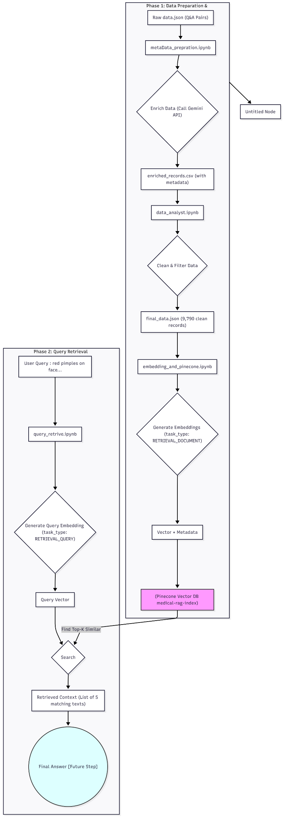
WorkFlow Diagram

Slide 5
Methodology
1. Data Preparation & Indexing Workflow
Data Loading: Imported lavita/MedQuAD dataset from Hugging Face
Cleaning & Normalization: Removed duplicates and irrelevant tags; Standardized text formatting (lowercase, punctuation fixes)
Metadata Enrichment: Added disease name, category, and source for filtering in Pinecone
Embedding Generation: Used Gemini Embedding Model (models/gemini-embedding-001) to convert QA pairs into dense vectors
Vector Indexing: Stored embeddings and metadata into Pinecone vector database
Verification & Testing: Queried index using query_retrive.ipynb to validate retrieval quality

Slide 6
2. Data Preparation & Indexing
Notebook: metaData_prepration.ipynb & data_analyst.ipynb
Step 1: Load and Parse raw Q&A data (data.json)
Step 2: Generate metadata with Gemini (category, entities, keywords, safety level)
Step 3: Consolidate question and answer into a single combined_text
Step 4: Clean, remove errors, and finalize dataset (data.json)
Step 5: Save enriched dataset (enriched_records.csv)

Slide 7
3. Embedding and Indexing
Notebook: embedding_and_pinecone.ipynb
Load finalized dataset
Initialize Pinecone index (dimension = 3072)
Generate embeddings using models/gemini-embedding-001
task_type="RETRIEVAL_DOCUMENT" for document embeddings
Upsert embeddings and metadata (ID, category, keywords) into Pinecone
Verify successful upload of ~9,790 records

Slide 8
4. Query Retrieval (Online Pipeline)
Notebook: query_retrive.ipynb
Step 1: Receive user query
Step2: Embed query using same Gemini model
task_type="RETRIEVAL_QUERY" for optimized search
Step 3: Search Pinecone index (cosine similarity)
Step 4: Retrieve top-k results (context blocks)
Step 5: Forward retrieved text to Gemini for final response generation

Slide 9
5. Technologies Used:
Gemini 2.5 Flash: Metadata generation + response synthesis
Gemini Embedding Model: High-quality embeddings (3072-dimension vectors)
Pinecone: Vector indexing and similarity search
Streamlit: Interactive chatbot frontend
Hugging Face: Source for MedQuAD dataset
Outcome: A robust, accurate, and safe medical chatbot capable of context-aware answers.

Slide 10
Live Demo
GitHub Repo like : https://github.com/Rishabh9559/medicalChatbot
Live Demo link : https://medicalchatbot-esmujoxhxhfvc3zt4fex4b.streamlit.app

