Slide 1

OPTION STRATEGIES

Slide 2
What are Options?
Options are financial derivatives that give the buyers the right, and the sellers, the obligation to buy or sell an underlying asset at an agreed upon price and date.
Call options are most profitable when a trader thinks that the market is bullish; while the Put options are most profitable when a trader thinks that the market is bearish.

Slide 3
What are Option Strategies?
Option Strategies are the simultaneous, and often mixed, buying or selling of one or more options that differ in one or more of the options’ variables.
Option strategies allow the traders to profit from movements in the underlying asset depending upon the market sentiment.

Slide 4
What we will be learning today-
Straddle
Strangle
Strip
Strap
Bull call spread
Bear Put spread

Slide 5
Straddle
A Straddle is basically an option strategy in which a combination of a Call and a Put option is traded which are
- AT THE SAME STRIKE PRICE
-DEALING WITH THE SAME UNDERLYING ASSET
-HAVING THE SAME EXPIRY DATE
There are two positions that a trader can have when dealing with a Straddle:
1) Long straddle
2) Short straddle.

Slide 6
Long straddle
A Long straddle is used when the trader thinks that the underlying stock will experience a significant volatility i.e. Bullish Market.
Long straddle option strategy is a limited risk, unlimited profit strategy.
The profit potential is the same, no matter in which direction the asset moves.

Slide 7
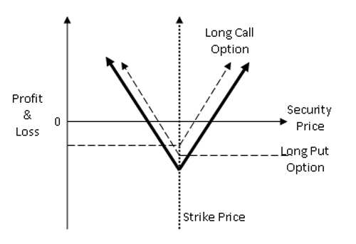
Long straddle payoff diagram

Slide 8
Example for long straddle-
Suppose a stock ‘XYZ’ is trading at Rs. 40 in June.
And a trader is interested in trading 100 shares of such stock.
Assume that the options trader buys a JUL 40 Call (having a premium of Rs. 60) and a JUL 40 Put (having a premium of Rs. 70)
Case-1) The stock price rises to Rs. 50
Case-2) The stock price falls to Rs.30
Case-3) The stock price remains at Rs. 40

Slide 9
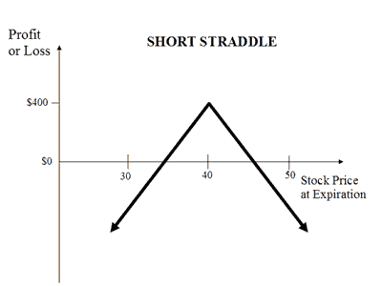
Short Straddle

Slide 10
Strangle
A Strangle is an option strategy which is a combination of a Call and a Put option which are traded at-
-DIFFERENT STRIKE PRICES
-DEALING WITH THE SAME UNDERLYING ASSET
-HAVING THE SAME EXPIRY DATE
A Strangle is a good strategy to invest in when the trader expects large modifications in the price of the stock, but does not know the direction in which the price will move.

Slide 11
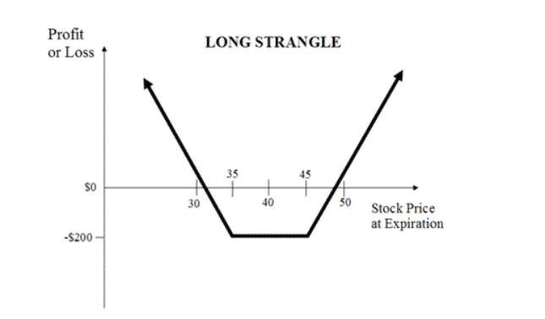
Long Strangle Payoff diagram

Slide 12
Long Strangle example
Lets say that STARBUCKS is trading at US $50 per share.
A trader is interested in 100 shares of STARBUCKS.
He enters a Strangle strategy by buying-
1. One Call option at the strike price of $52, and having a premium of $3 per share.
2. One Put option at the strike price of $48, and having a premium of $2 per share.
(Expiration date of both these options is in JULY)

Slide 13
Example continued..
At the end of JULY,
Case-1) Price of stock is $40
Case-2) Price of stock is $55
Case-3) Price of stock is $50

Slide 14
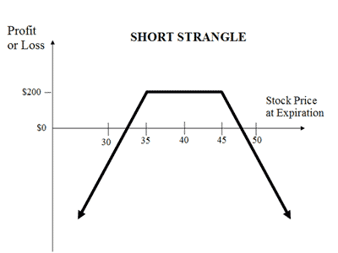
Short Strangle

Slide 15
Strip
A Strip is a slightly modified version of a Straddle. A strip is a combination of one call and two put options bought at-
-SAME STRIKE PRICE
-DEALING WITH THE SAME UNDERLYING ASSET
-HAVING THE SAME EXPIRY DATE
The Strip is a bearish market neutral strategy providing double the profit potential on downward price movement as compared to the upward price movement.

Slide 16
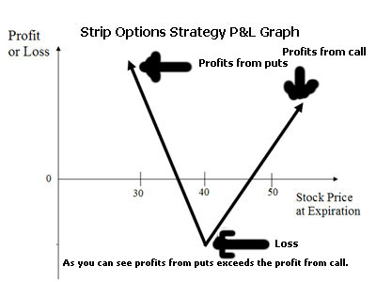
Strip Payoff Diagram

Slide 17
Strip Example
Suppose a stock XYZ is trading at $40, and a trader is interested in 100 such shares.
The trader buys one ATM Jul 40 call option (whose premium is $2) and two ATM Jul 40 put options. (whose premium is $2 each)
Consider the following scenarios at the end of July,
Case-1) XYZ is trading at $50
Case-2) XYZ is trading at $30
Case-3) XYZ is trading at $40 (no change)

Slide 18
Strap
A strap is an options strategy that deals with a combination of one put and two calls that are bought at-
-SAME STRIKE RATE
-DEALING WITH SAME UNDERLYING ASSET
-HAVING THE SAME EXPIRY DATE
A Strap is generally bought by a trader when he expects a significant increase in the price of the stock but is unsure of its direction, in a fairly bullish market.

Slide 19
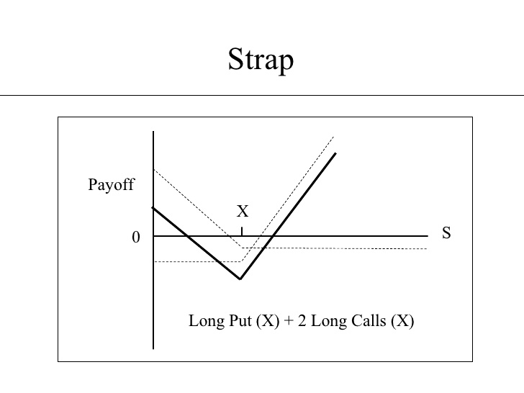
Strap Payoff Diagram

Slide 20
Strap Example
Suppose a stock ABC is trading at $80, a trader is interested in such 50 shares.
The trader enters a Strap strategy by purchasing
1) One ATM Jul 80 Put option (Premium= $2)
2) Two ATM Jul 80 Call options (Premium=$3 each)
Calculate the net profit/loss for the following scenarios-
Case-1) ABC is trading at $92 at the end of July.
Case-2) ABC is trading at $75 at the end of July.
Case-3) ABC is trading at $80 itself

Slide 21
What is a Spread?
A spread is a trading strategy that involves taking a position in two or more calls or two or more puts.
Spread strategies help in limiting losses of owning a particular stock, but they also cap the gains.
Types of spread strategies:
1) Bull Call Spread
2) Bear Put Spread
3) Butterfly Spread
4) Calendar Spread
etc.

Slide 22
Bull Call Spread
A bull call spread is an option strategy used when a trader is betting that a stock will have a limited increase in its price.
It provides a limited range where the trader can make profit.
CONSTRUCTION:
A bull call spread consists of one long call with a lower strike price and one short call with a higher strike price.

Slide 23
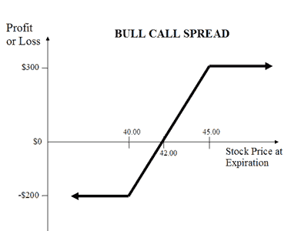
Profit is limited if the stock price rises above the strike price of the short call
Potential loss is limited if the stock price falls below the strike price of the long call (lower strike).

Slide 24
Example
PQR is trading at $42 in the market.
A trader is interested in 100 such shares.
A trader enters a bull call spread by buying-
1) Buying one JUL 40 call for $300
2) Selling one JUL 45 call for $100
Calculate profit in the following scenarios-
Case-1) PQR closes at $46 at expiration
Case-2) PQR closes at $38 at expiration.

Slide 25
Bear Put Spread
The bear put spread option trading strategy is employed when the options trader thinks that the price of the underlying asset will go down moderately in the near term.
CONSTRUCTION:
Bear put spreads can be implemented buy buying a higher strike Put option and selling a lower strike Put option.

Slide 26
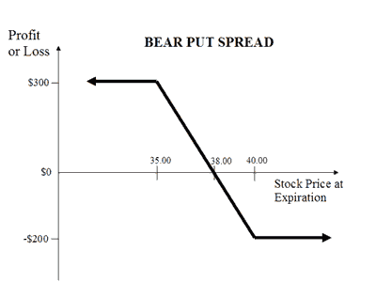
To reach maximum profit, the stock price of the purchased put option needs to close below the strike price.
If stock price rises above the sold put option, then the bear put will suffer a maximum loss equal to the debit taken while putting on the trade.

Slide 27
Example
PQR is trading at $38 in the market.
A trader is interested in 100 such shares.
A trader enters a bull call spread by buying-
1) Buying one JUL 40 put for $300
2) Selling one JUL 35 put for $100
Calculate profit in the following scenarios-
Case-1) PQR closes at $34 at expiration
Case-2) PQR closes at $42 at expiration.

