Slide 1
STEGANOGRAPHY
BY,
RISHABH BAGUL
SHUBHAM KOTHAWADE
VEDHAS KHARCHE
ANIKET NEEMA

Slide 2
INTRODUCTION
With cryptography there are obvious visual clues, obfuscated data or merely a password entry screen.
However, with Steganography the user can send the image to multiple recipients without them even
realising that the image contains hidden data, and only the intended
recipient can be made aware of this contents and the means of how
to extract said data.

Slide 3
A NOVEL APPROACH
We have tried to add more layers of security by:
1) Storing the data in some pattern in image (like ap , gp or any other).
2) Diffie hellman algorithm for key exchange
3) Rsa algorithm for cryptography
4) Masking to remove salt-pepper noise

Slide 4
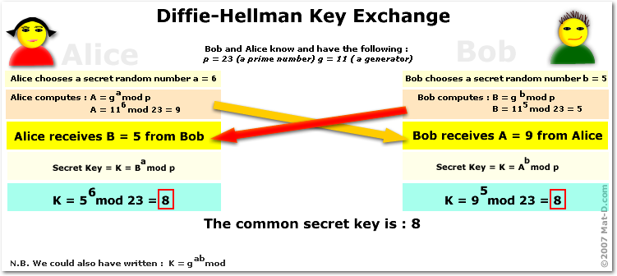
DIFFIE HELLMAN

Slide 5
WHY ITS HARD FOR INTRUDER TO GET KEY
Diffie hellman is based on discrete logarithmic problem
b^{x} = A mod p
knowing values of b,a,p its computationally difficult to get value for x
x denotes x th bit in image to insert a bit of secret message from
lsb.

Slide 6
MAKING IT CRYPTO+STEGNO(RSA)
After inserting secret bits in image bits , we encrypt the bit string to add third layer of security
Strength of algorithm lies in finding private key from public key
Because its based on multiplicative inverse property.

Slide 7
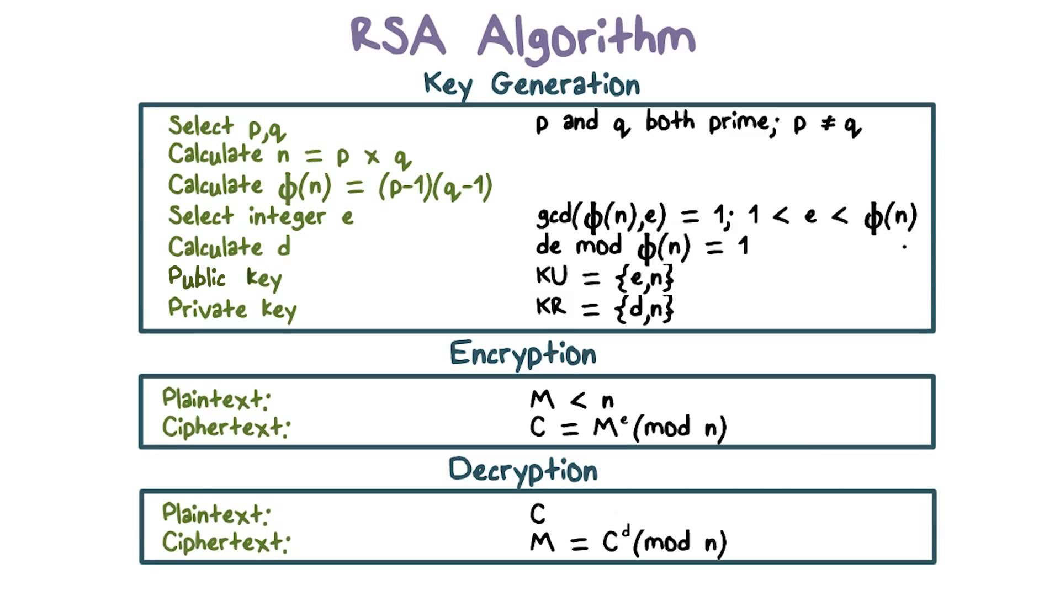

Slide 8

MASKING
Masking and filtering techniques hide information by marking an image in a manner similar to paper
watermarks. Because watermarking techniques are more integrated into the image,
they may be applied
without fear of image destruction from lossy compression. By covering, or
masking a faint but
perceptible signal with another to make the first non-perceptible, we exploit the fact that the human visual
system cannot detect slight changes in certain temporal
domains of the image.

Slide 9
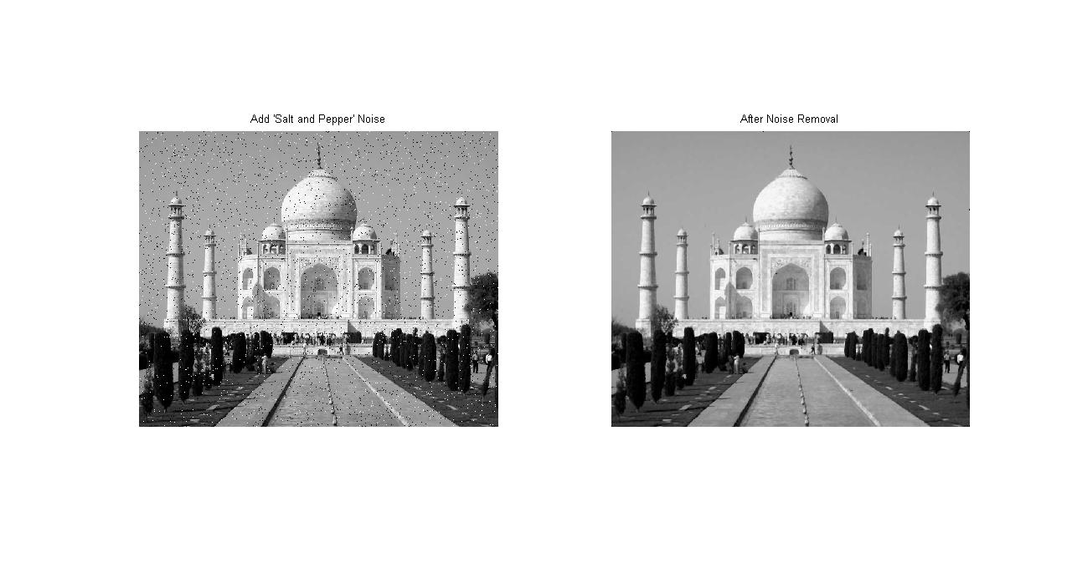

Slide 10
TKINTER (GUI)
TKINTER IS THE PYTHON BINDING TO THE TK-GUI TOLLKIT.
IT IS THE STANDARD PYTHON INTERFACE TO THE TKGUI TOLLKIT AND
IS PYTHONS DE FACTO STANDARD GUI.
THINTER IS INCLUDED WITH STANDARD LINUX ,MICROSOFT WINDOWS AND
MAC-OSX INSTALLS OF PYTHON.
FREE SOFTWATE RELEASE UNDER A PYTHON LICENSE.

Slide 11
ADVANTAGES OF TKINTER
ACCESSABLITY
PORTABLITY
AVAILABLITY
LAYERED APPROACH
CROSS PLATFORM
EXTENSIBLITY

Slide 12
FUTURE SCOPE
1) Improved resistance to analysis:
AS stega media gets more sophisticated its resistance to being
Analysed or recognized will improve
2) Higher encoding density
The ability to hide huge amounts is another logical area for interest
Currently stego can use only a certain amount of data bits in a host file without degrading the file to the point where its obvious that stego is being used

Slide 13
CONCLUSION
“YOU never know if a message is hidden “ this is the dilemma that empowers steganography.
Even though proved superior to cryptography , its role must be to supplement cryptography.
Hence cryptography and steganography together can unlock a new world of hiding data .

Slide 14
THANK YOU !!

