Slide 1

American Sign Language Detection Design and Implementation
Rishabh Malik, Aleena Varghese
Group 3
Applications of Artificial Intelligence, University of SanDiego
AAI-521: Applied Computer Vision for AI
Haisav Chokshi

Slide 2
Team Collaboration
Data Preprocessing
Exploratory Data Analysis
Model Selection
Model Evaluation
Demo
Conclusion
Abstract

Slide 3
Team Collaboration
Team Member 1 (Rishabh Malik) | Team Member 2 (Aleena Varghese)
1. Verify class distributions and identify potential issues (e.g., bad data, inconsistencies). 2. Handle outliers, bad data removal, and ensure cropping consistency. 3. Fine-tune the extracted features and test on subsets of the data. 4. Train and validate the model on the training dataset. 5. Evaluate performance using real-world test images and refine the model. 6. Optimize camera feed processing for better latency and performance in real-time detection. 7. Document testing, evaluation, and live integration results. 8. Review and finalize the report and record the presentation video. | 1. Analyze the dataset structure and characteristics. 2. Perform image resizing, normalization, and augmentation during preprocessing. 3. Implement feature extraction using pre-trained CNNs (e.g., ResNet, MobileNet). 4. Develop the model architecture for static ASL recognition. 5. Test the model on the given test dataset. 6. Document preprocessing, feature extraction, and model development steps. 7. Draft the technical report and prepare presentation visuals.

Slide 4
Data Preprocessing
Objective: Prepare dataset for model training and ensure consistency
Steps:
Image Resizing: Standardize all input images to a consistent size.
Normalization: Normalize pixel values to range [0,1] for model efficiency
Data Augmentation: Applied techniques like rotation, flipping, and scaling to increase dataset size
Splitting Dataset: Divided into training and testing data (Training: 80%, Testing: 20%) because original test dataset we had only one image per class

Slide 5
Exploratory Data analysis
Dataset Overview:
29 classes representing ASL alphabets (A-Z) and additional classes (SPACE, DELETE, NOTHING)
178447 training images with varying quality and conditions
29 test images used for final evaluation
Challenges:
Inconsistent lighting and backgrounds in images
Imbalanced class distribution for some letters
Solutions:
Employed data augmentation to address variability and balance the dataset

Slide 6
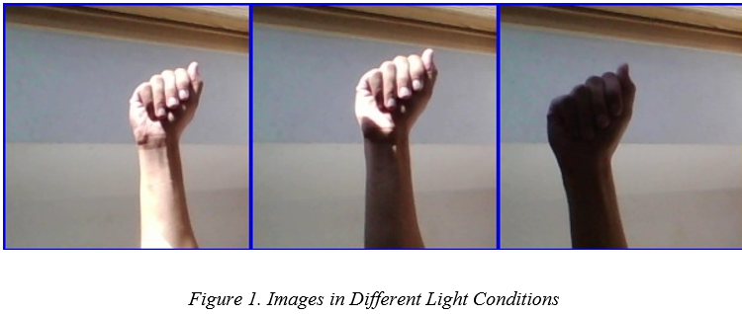
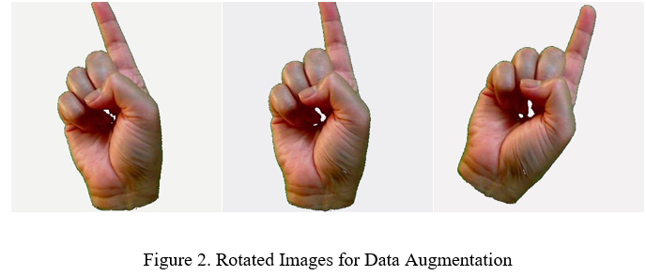

Slide 7
Model Selection
Initial Exploration: Tried different models for optimal performance
Convolutional Neural Networks (CNNs): Basic architectures (VGG16, ResNet50)
EfficientNet-B0: Chosen model for its efficiency and performance
Why EfficientNet-B0:
High accuracy (98%) in image classification tasks
Efficient and lightweight, suitable for limited resources
Model Configuration:
Trained on the prepared dataset using transfer learning with pre-trained weights

Slide 8
Model Evaluation
Metrics:
Accuracy: Achieved 98% accuracy on the test dataset
Loss Curve: Monitored training and validation loss over epochs
Accuracy Curve: Plot showing increasing model accuracy with each epoch
Results:
EfficientNet-B0 performed exceptionally well, demonstrating robust generalization

Slide 9
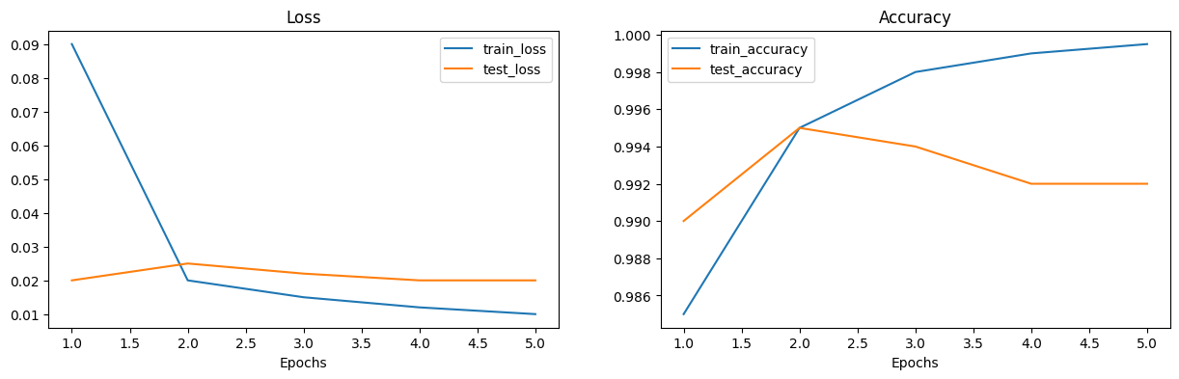
Model Evaluation

Slide 10
Demo
Interface Overview:
Simple web-based UI developed using Flask
Users can upload images of ASL signs for classification
Model processes the image and returns predicted sign (e.g., "A" for the letter A)

Slide 11
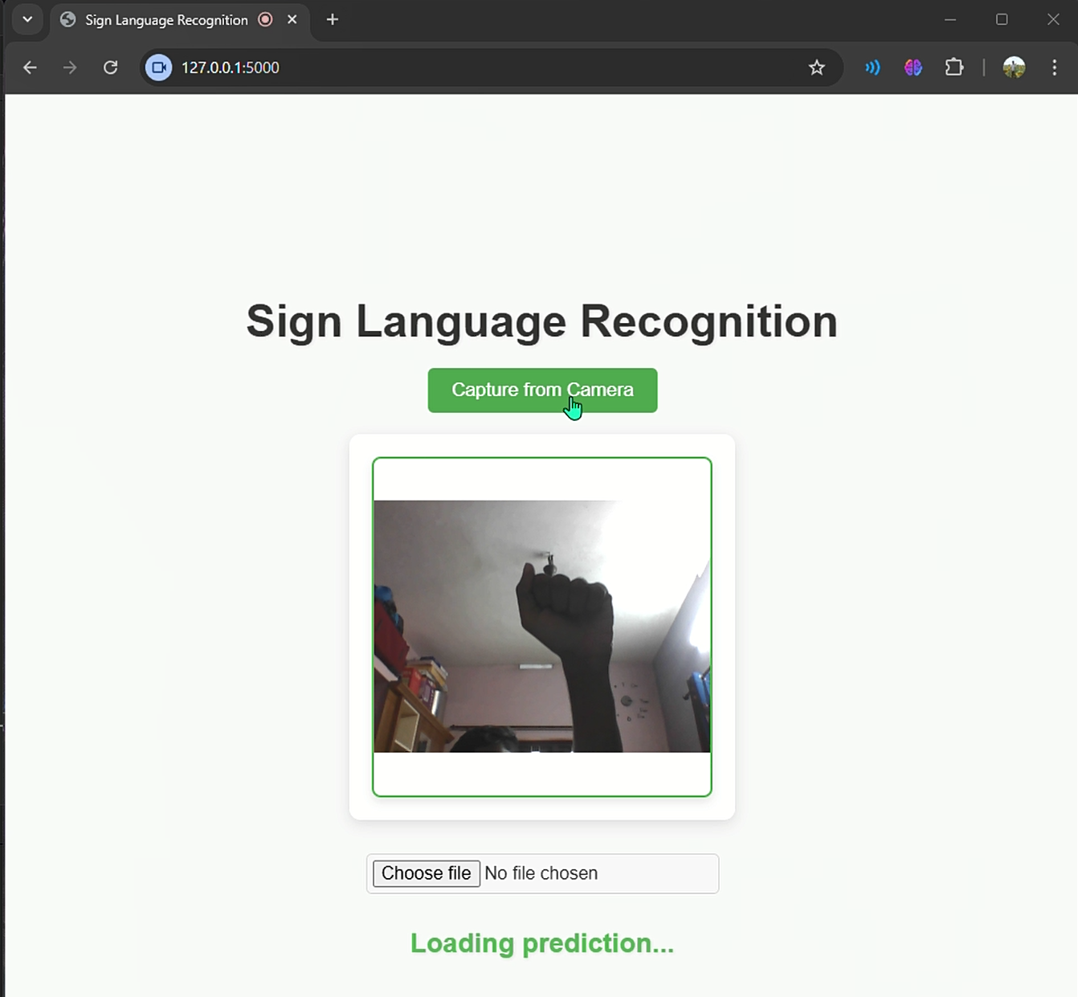
User Interface

Slide 12
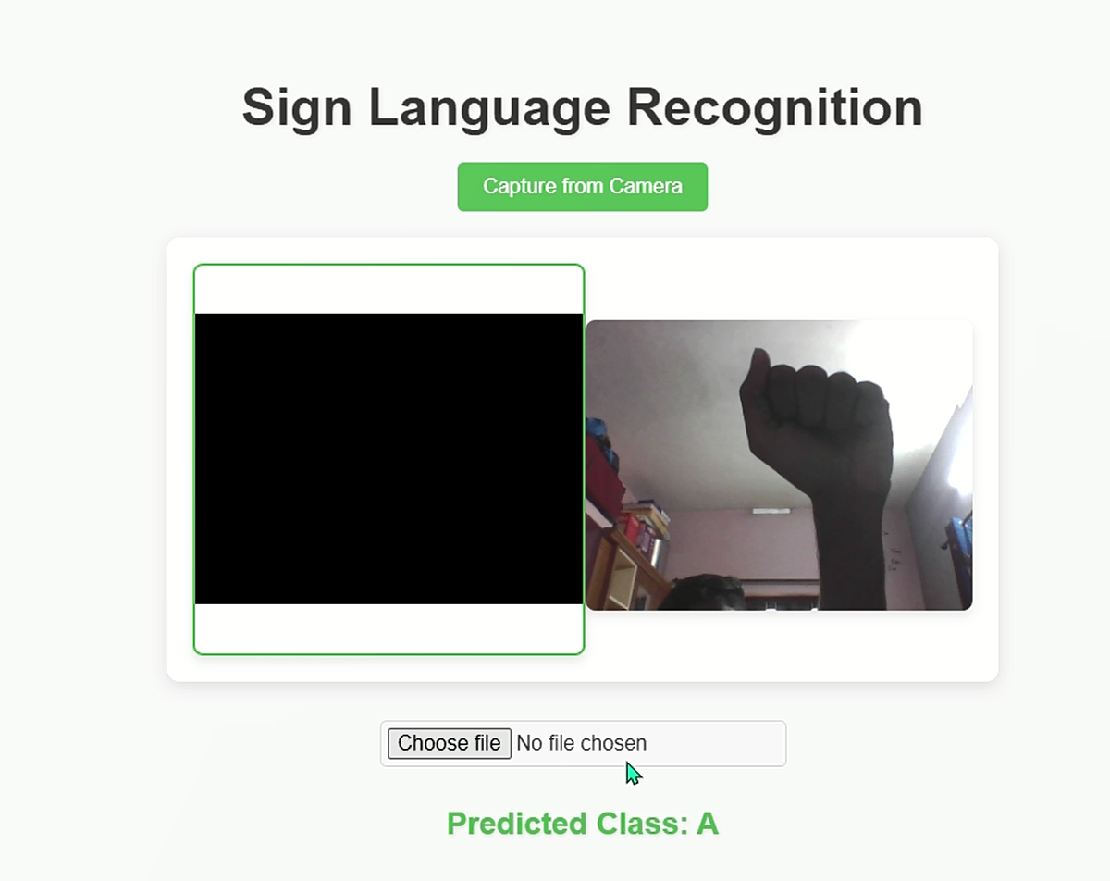
User Interface

Slide 13
Conclusion
Achievements:
Successfully built and deployed an ASL recognition system
Achieved 98% accuracy on ASL hand sign classification
Challenges:
Variability in dataset and real-time detection issues
Future Work:
Explore live feed detection and real-time classification
Further optimize model for even better accuracy and efficiency

Slide 14

Thank You

