Slide 1
The Project
The superstore dataset is imported into SAS environment.
Predictive analytics techniques are used on this datset with target class as profit
The model is built, implemented and then analyzed.

Slide 2
Project Goals
To import dataset
To transform variables
To apply modelling
Run various models or predictive analysis
Compare the models and find the best model

Slide 3
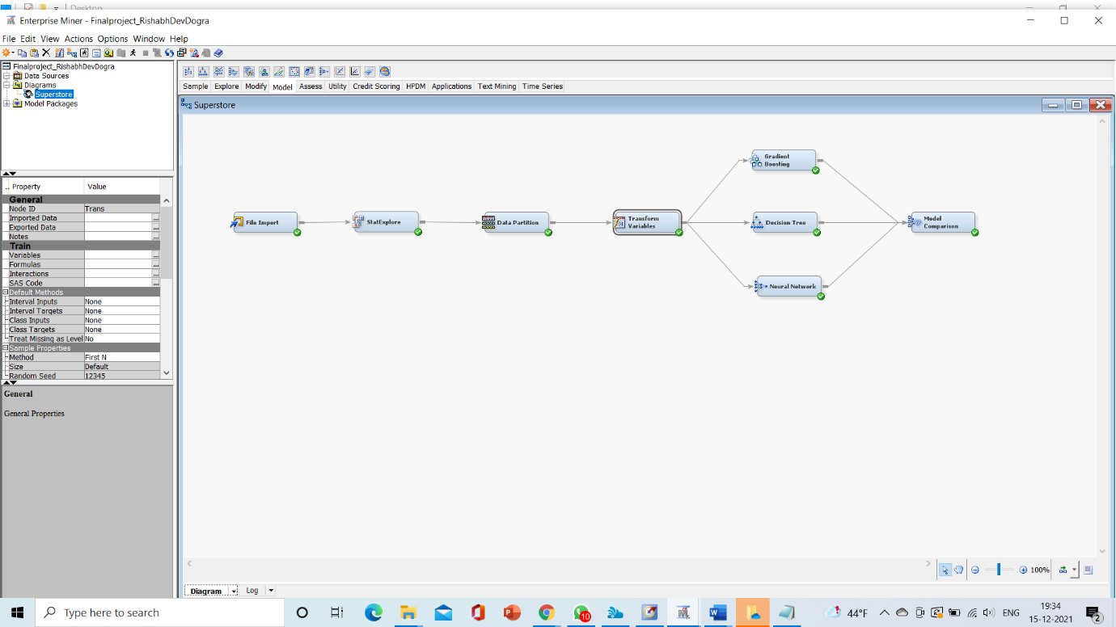
Building Model

Slide 4
Predictive Analysis
Gradient Boosting
Decision Trees
Neural Networks

Slide 5
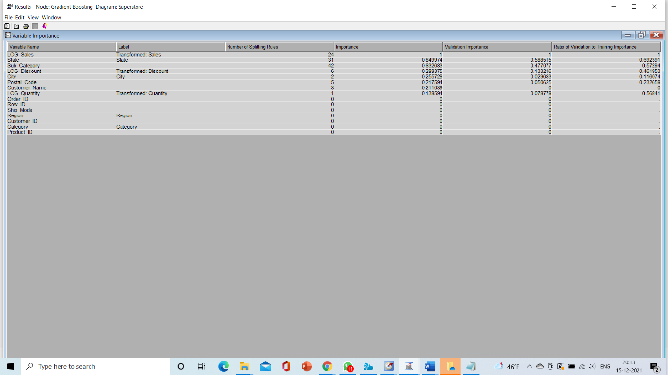
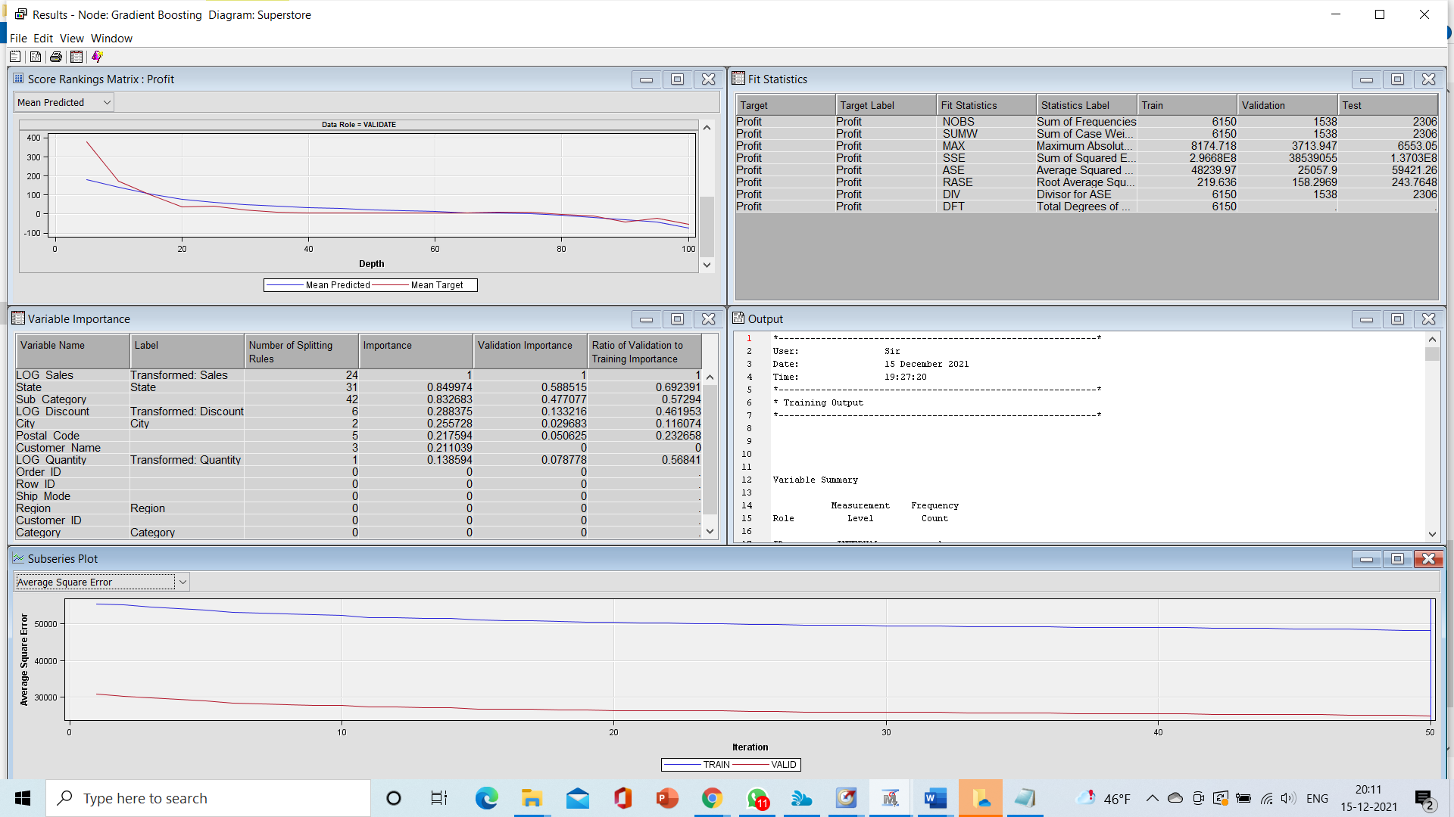
Gradient Boosting

Slide 6
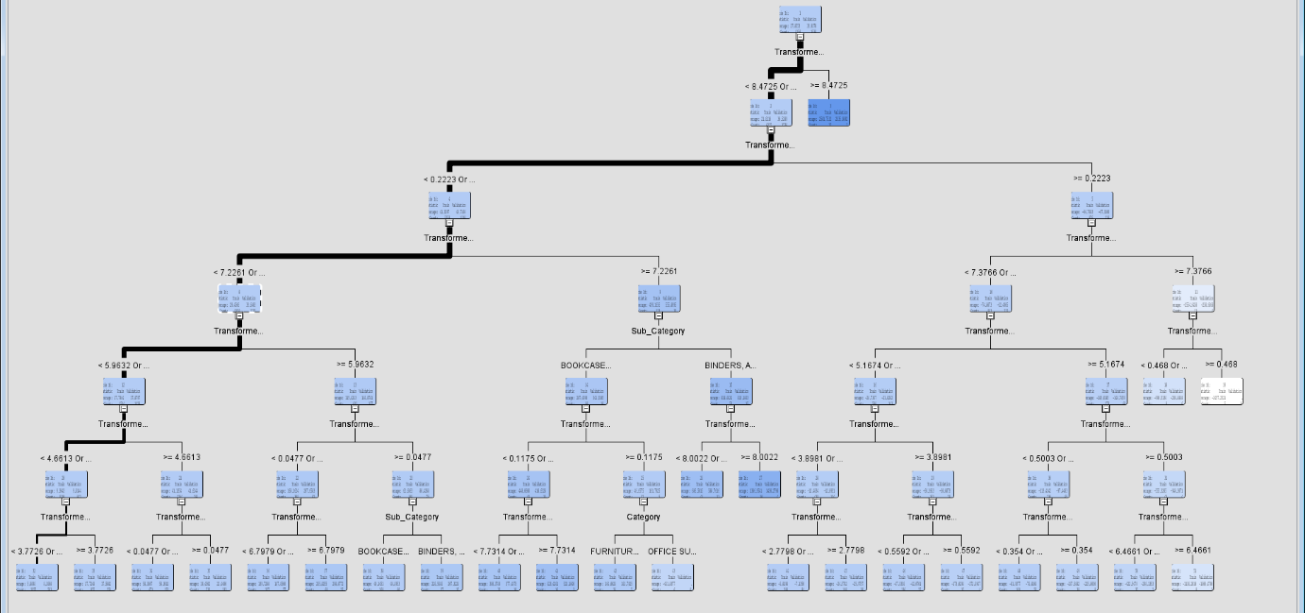
Decision Trees

Slide 7
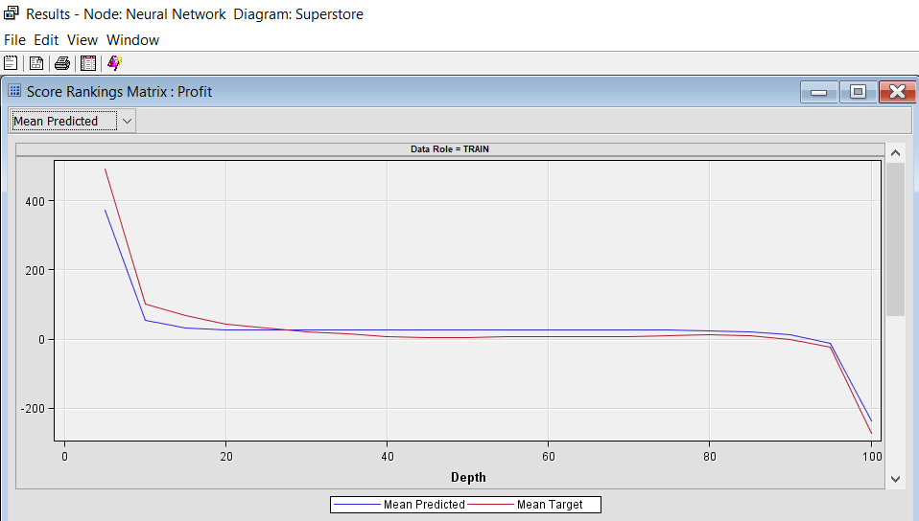
Neural Network

Slide 8
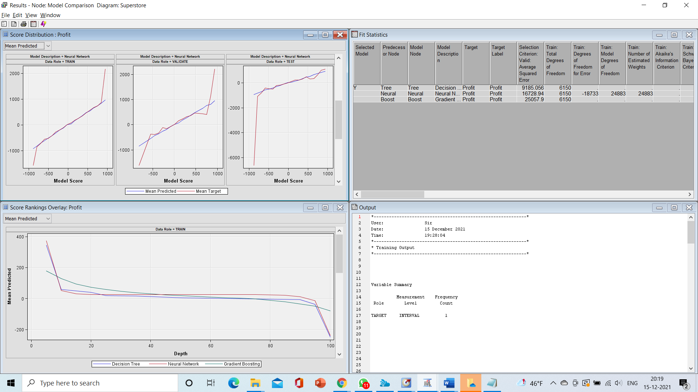
Model Comparison

Slide 9

Conclusion
The Decision tree approach is superior based on the data given as compared to gradient boosting and neural networks.

