Slide 1

Computer Graphics and Multimedia
Introduction

Slide 2
Introduction to COMPUTER GRAPHICS
Computer Graphics involves display, manipulation and storage of pictures and experimental data for proper visualization using a computer.
Typical graphics system comprises of a host computer with support of fast processor, large memory, frame buffer and
Display devices (color monitors),
Input devices (mouse, keyboard, joystick, touch screen, trackball)
Output devices (LCD panels, laser printers, color printers. Plotters etc.)
Interfacing devices such as, video I/O, TV interface etc

Slide 3
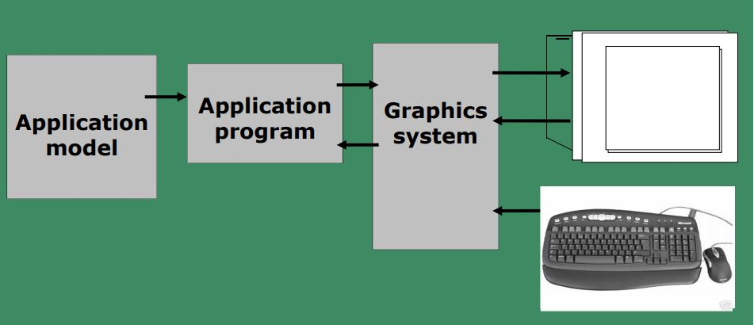
Conceptual framework for interactive graphics

Slide 4
Typical applications areas are
GUI
• Scientific Visualization
• Office automation
• Desktop publishing
• Web/business/commercial publishing and advertisements
• CAD/CAM design (VLSI, Construction, Circuits)
• Scientific Visualization

Slide 5
Entertainment (movie, TV Advt., Games etc.)
• Virtual reality
• Process Monitoring
• Digital Image Processing
• Education and Training
• Simulators
• Cartography
• Multimedia

Slide 6
Pixel
Pixel is shortened forms of picture element. Each screenpoint is referred to as pixel.

Slide 7
BitMap
Frame Buffer is often referred to as bitmap

Slide 8
Resolution
The Maximum Number point that can be displayed without overlap on a monitor is referred to as resolution

Slide 9
Persistence
The time is takes the emitted light from the screen to decayone tenth of its original intensity is called a persistence

Slide 10
Aspect Ratio
The ratio of vertical points to the horizontal points of the screen

Slide 11
CRT DISPLAY DEVICES
Examples of Computer Graphics Devices:
CRT, EGA/CGA/VGA/SVGA monitors
Plotters
data matrix, laser printers,
Films, flat panel devices, Video digitizers, scanners,
LCD panels, keyboard,
joystick, mouse, touch screen, track ball, etc.
The most commonly used display device is the
CRT monitor

Slide 12
Types of CRT display devices
• DVST (Direct View Storage Tube)
• Calligraphic or Random Scan display system
• Refresh or raster scan display system

Slide 13
DVST - Direct View Storage Tube
• Storage Tube – it is a CRT with a long persistence phosphor
• Provides flicker-free display
• No refreshing necessary
• A slow-moving electron beam draws a line on the screen
• Screen has a storage mesh in which the phosphor is embedded
• Image is stored as a distribution of charges on the inside surface of the screen
• Limited interactive support

Slide 14
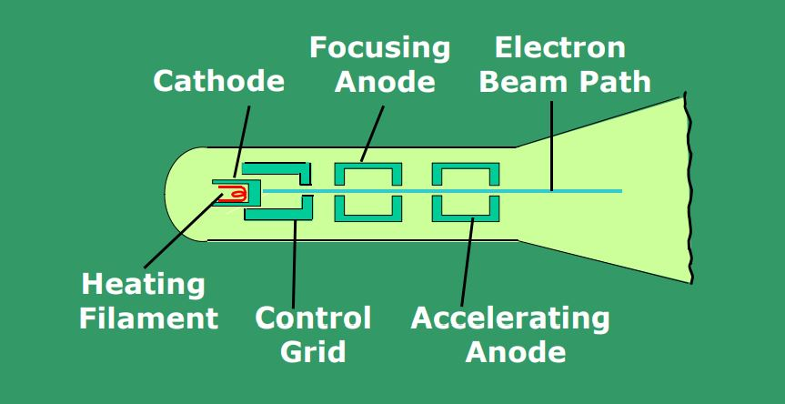
Operation of an electron gun with an accelerating anode

Slide 15
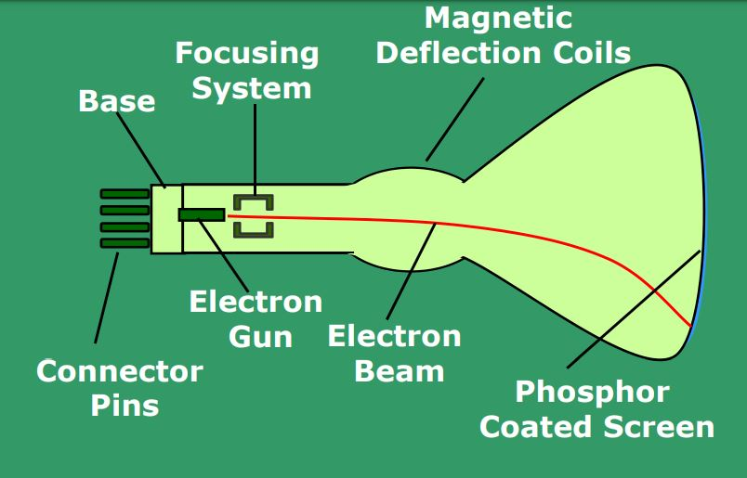
Basic design of a Magnetic deflection CRT

Slide 16
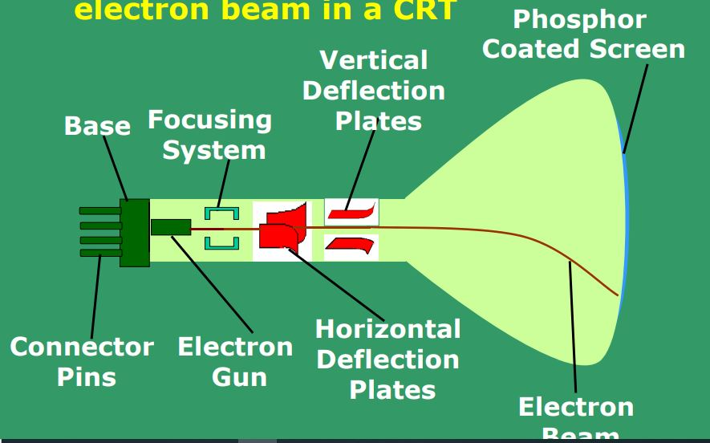
Electrostatic deflection of the electron beam in a CRT

Slide 17
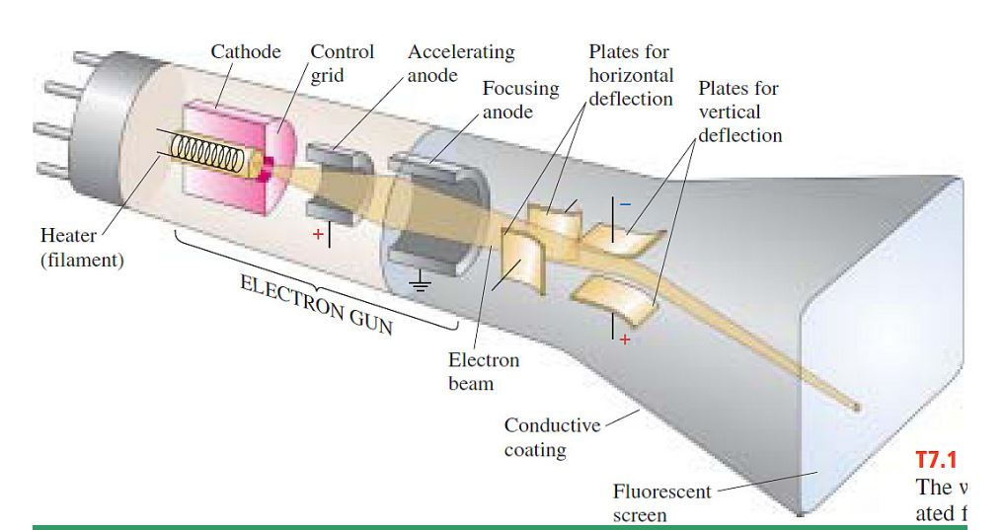

Slide 18
Drawbacks
Modifying any part of the image requires redrawing the entire modified image
• Change in the image requires to generate a new charge distribution in the DVST
• Slow process of drawing – typically a few seconds are necessary for a complex picture
• Erasing takes about 0.5 seconds. All lines and characters must be erased
• No animation possible with DVST

Slide 19
Calligraphic or Random Scan display system
Also called Vector, Stroke, Line drawing displays
• Characters are also made of sequences of strokes (or short lines)
• Vectored – electron beam is deflected from end-point to end-point
• Random scan - Order of deflection is dictated by the arbitrary order of the display commands
• Phosphor has short persistence – decays in 10-100 μs

Slide 20
Calligraphic or Random Scan display system (contd.)
The display must be refreshed at regular intervals – minimum of 30 Hz (fps) for flicker-free display
Refresh Buffer – memory space allocated to store the display list or display program for the display processor to draw the picture
The display processor interprets the commands in the refresh buffer for plotting
The display processor must cycle through the display list to refresh the phosphor
The display program has commands for point- , line–, and character plotting

Slide 21
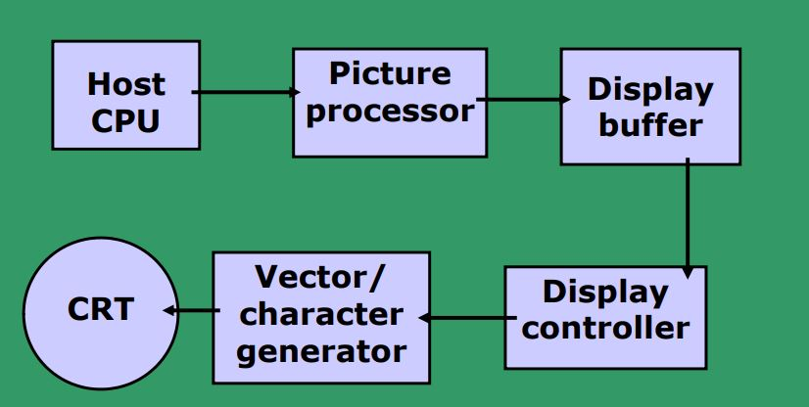
Conceptual block diagram of calligraphic refresh display - I

Slide 22
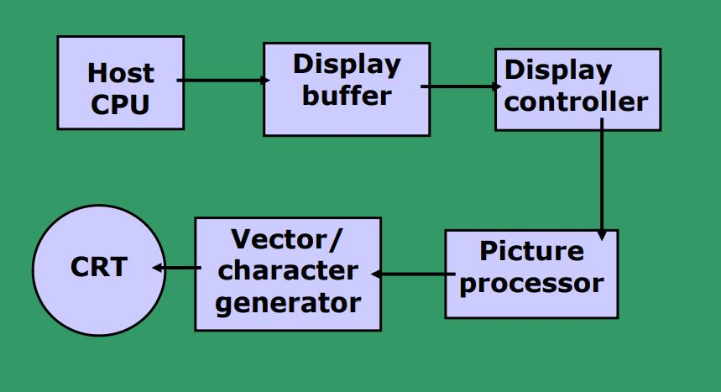
Conceptual block diagram of calligraphic refresh display - II

Slide 23
Calligraphic or Random Scan display system (contd.)
The display processor sends digital and point coordinate values to a vector generator
The vector generator converts the digital coordinate values to analog voltages for the beam-deflection circuits
The beam-deflection circuits displace the electron beam for writing on the CRT’s phosphor coating
Recommended refresh rate is 40 – 50 Hz.
• Scope of animation with segmentation – mixture of static and dynamic parts of a picture

Slide 24
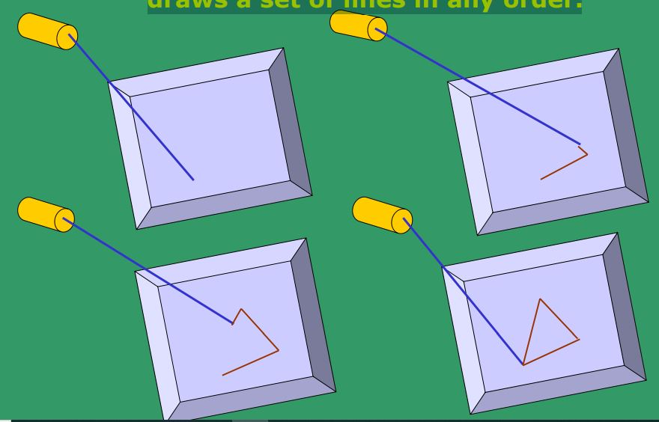
Random-scan display system draws a set of lines in any order.

Slide 25
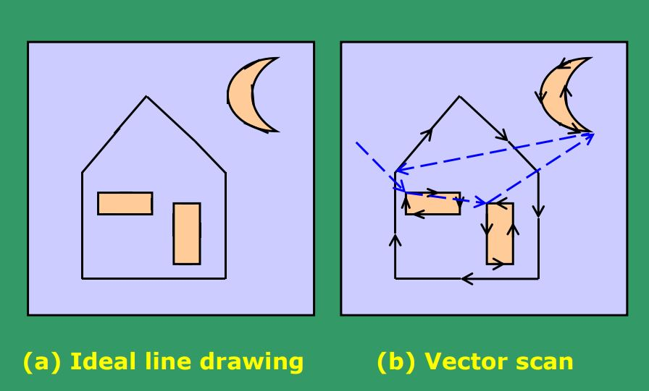

Slide 26
Calligraphic or Random Scan display system (contd.)
• Phosphor’s Fluorescence is the light emitted as electrons (unstable) lose their excess energy while the phosphor is being struck by electrons
• Phosphorescence is the light given off by the return of the relatively more stable excited electrons to their unexcited state once the electron beam excitation is removed
• Phosphor’s persistence is defined as the time from the removal of excitation to the moment when phosphorescence has decayed to 10% of the initial light output (decay is exponential). - long persistence : several seconds - short persistence : 10-60 μ s (common in modern displays)

Slide 27
Refresh or raster scan display system
Used in television screens
Unlike DVST and random-scan which were line-drawing devices, refresh CRT is a point-plotting device
Raster displays store the display primitives (lines, characters, shaded and patterned areas) in a refresh buffer
Refresh buffer (also called frame buffer) stores the drawing primitives in terms of points and pixels components

Slide 28
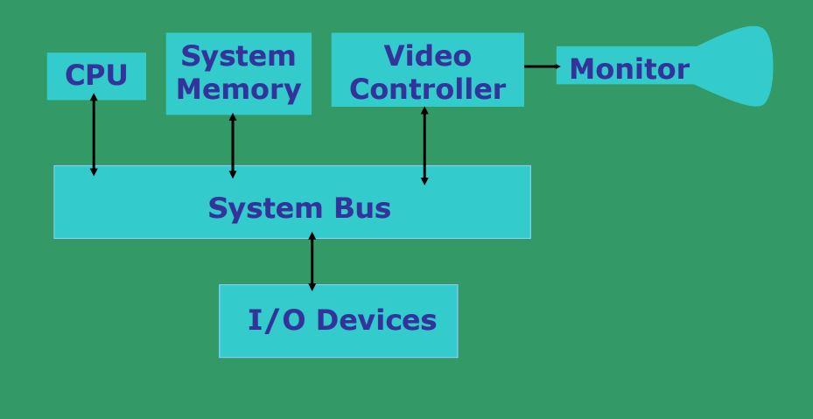
Architecture of a simple raster graphics system

Slide 29
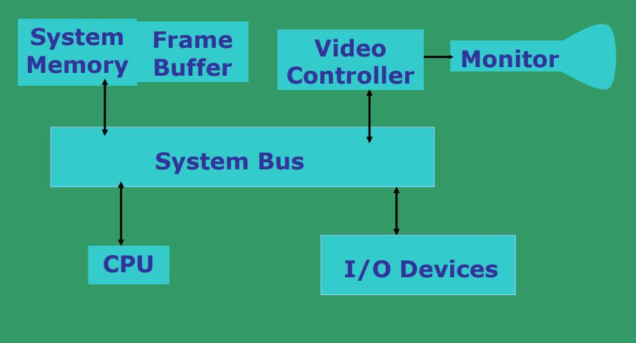
Architecture of a raster system with a fixed portion of the system memory reserved for the frame buffe

Slide 30
Refresh and raster scan display system
Entire screen is a matrix of pixels
Each pixel brightness can be controlled
Refresh buffer can be visualized as a set of horizontal raster lines or a row of individual pixels
Line cannot be drawn directly from one point to another
Each point is an addressable point in screen and memory
This causes the effect of ‘aliasing’, ‘jaggies’ or ‘staircase’ effect
Refresh/Frame buffer is also called Bit-plane

Slide 31
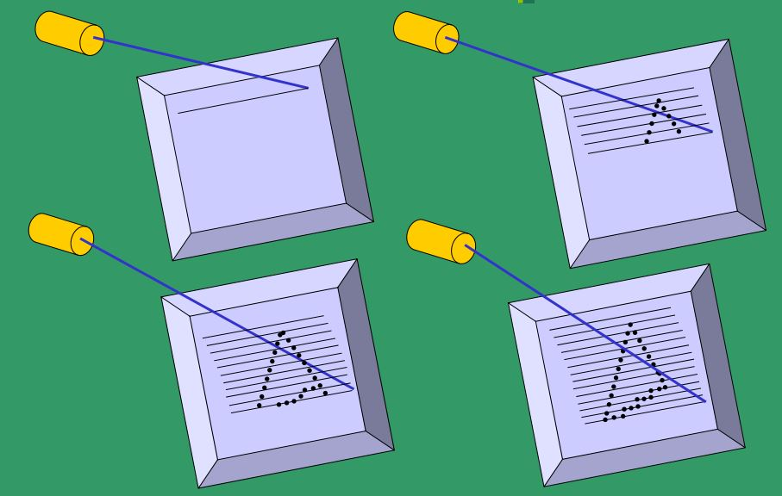
Raster-scan display system draws a discrete set of points

Slide 32
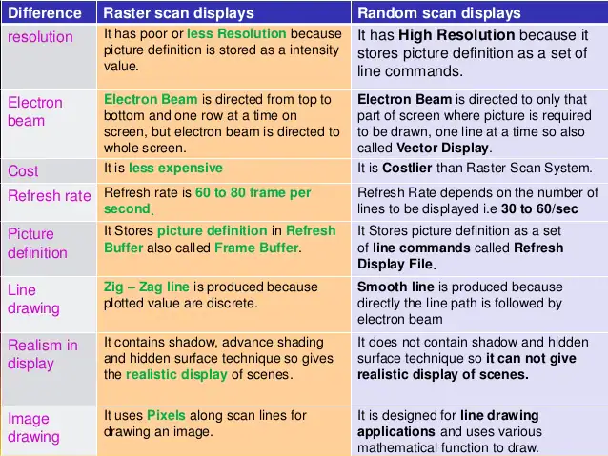
Difference Between Raster and Random

