Slide 1


Occupancy Plane Learning for 3D Human Reconstruction from RGB-D Images
Presented by: Viktor B. Ladics, Jon Vincent Medenilla, Rishabh Garg

Slide 2

Organization
Introduction
Model Architecture
Implementation
Results
Discussion
Questions
GRAINGER ENGINEERING

Slide 3
Introduction: 3D Human Reconstruction
3D Human Reconstruction
Process of reconstructing the 3D shape of a human
Applications
AR/VR content creation
image/video editing
virtual try-on
Focus on single-view RGB-D reconstruction
Existing Solutions
Template-based models
use human body shape as prior
Non-parametric models
use an implicit function to predict human body shape
task formulated as a per-point classification
GRAINGER ENGINEERING

Slide 4
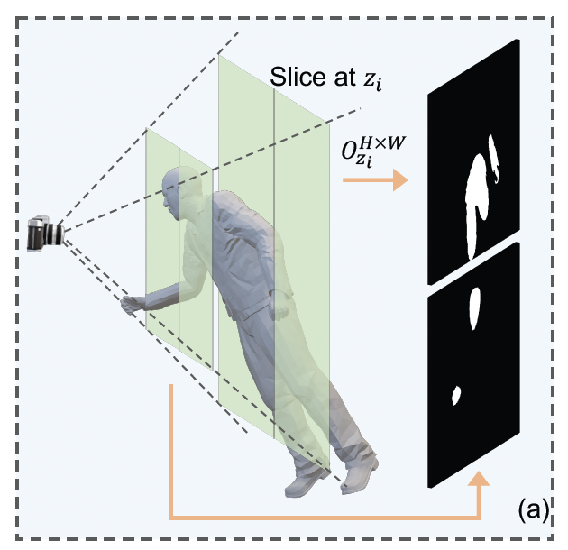
Introduction: Occupancy Planes
What they are
representation is multiple image-like planes
fronto-parallel manner through camera’s view frustrum
images are binary
1 if pixel is inside the person
0 if pixel not inside the person
Benefits
More flexible than classical voxel pixel representation
Model benefits from correlations between predictions of neighboring locations
Zhao et al, 2022 Green planes show slicing planes resulting in the black and white occupancy planes
GRAINGER ENGINEERING

Slide 5
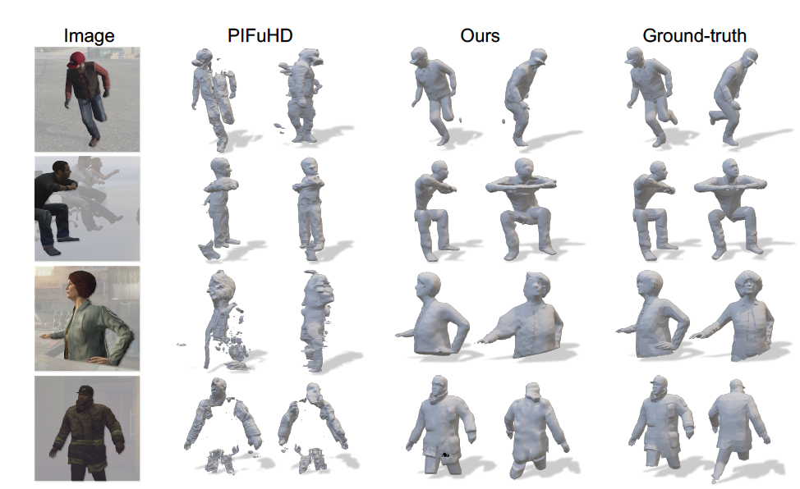
Model Inputs and Outputs
Follow implementation proposed by Zhao et al. [1]
Inputs:
RGB image
Depth image
Set of depth values
Output
one occupancy plane per depth value
Training Resources
Mask highlighting person of interest
Intrinsic camera parameters
Mesh representing the ground truth reconstruction
Zhao et al [1], 2022 input images, comparison of ground-truth reconstruction and solutions
[1] Zhao, X., Hu, Y. T., Ren, Z., & Schwing, A. G. (2022). Occupancy Planes for Single-view RGB-D Human Reconstruction. arXiv preprint arXiv:2208.02817.
GRAINGER ENGINEERING

Slide 6

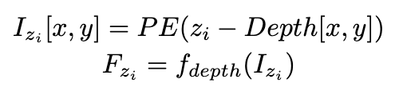

Model Architecture
RGB Image Processing
add single channel edge image feature
add feature where each pixel is distance to visibility mask’s boundary
Feature Pyramid Network
simple CNN
Depth Image Processing
subtract depth image from depth of interest
positional encoding
simple CNN
Combining Features
concatenate features
simple CNN
GRAINGER ENGINEERING

Slide 7
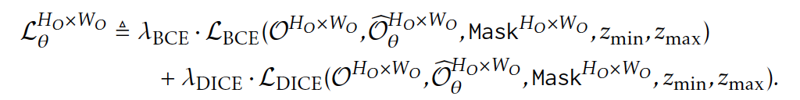
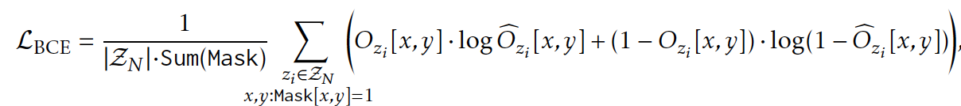
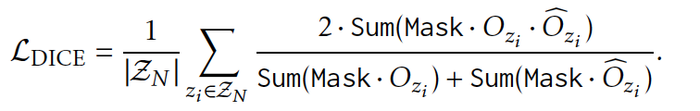
Losses
parameters for all networks are optimized collectively
consider loss at the final resolution and the intermediate resolution
use both DICE loss and BCE loss
equal weighting
have high and low resolution occupancy plane prediction
GRAINGER ENGINEERING

Slide 8
Experimentation
357 images from S3D dataset built on the game GTA-V
Provide masks, depths, and ground-truth meshes
80%-20% split between training and validation
Sampled 5 depths randomly per input image
Trained on Kaggle, 2 Tesla 4 GPUs
3 epochs for a total runtime of 6.5 hours
Measured average training loss per input
Measured loss for each validation image
GRAINGER ENGINEERING

Slide 9
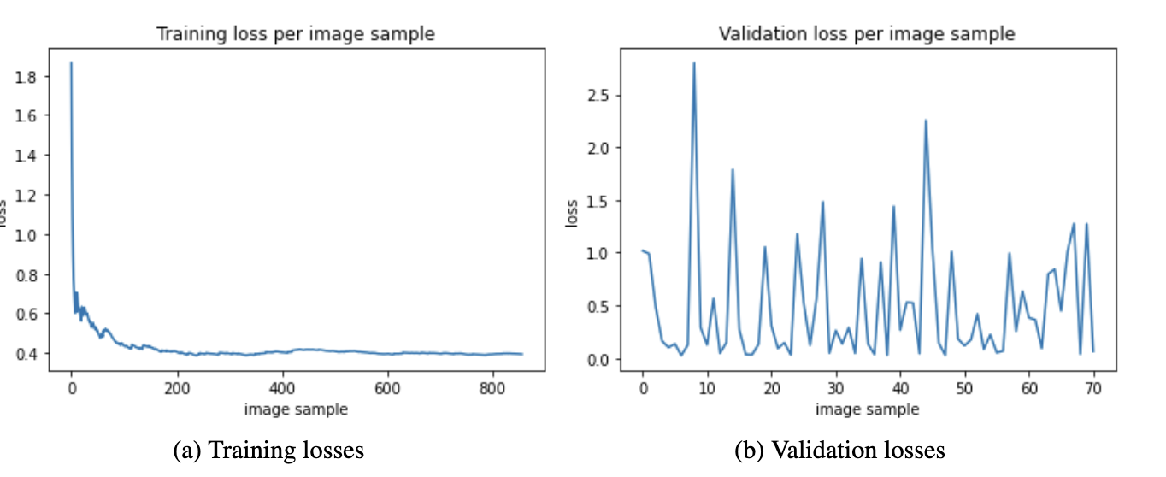
Results
GRAINGER ENGINEERING

Slide 10
Discussion
Observations
training loss converges quickly
further training does not decrease loss
validation loss is high
validation loss has high variation
Improvements
more training
optimizing code to reduce runtime per image
increasing number of depths sampled from image
e.g. increase from 5 to 10
decrease learning rate
GRAINGER ENGINEERING

Slide 11
Next Steps
With these occupancy planes, algorithms such as the marching cube algorithm can be used to generate the full reconstruction
Investigate the use of more complex CNNs for processing both the RGB and depth feature
Instead of CNN-based methods, explore GAN-based or Diffusion-based models as the main structure of reconstruction
GRAINGER ENGINEERING

Slide 12
Questions
GRAINGER ENGINEERING

