Slide 1
GECO: evidence, intervention and recovery
RESEARCH QUESTION
A reproducible simulation and methods study
Corrected prediction · matched comparisons · a measurable saline rig
IEEE-style research seminar | team and author details to be completed
GECOv6 | Nonclinical research | SIMULATION / METHODS | 1 / 49
Notes:
S01 — GECO: evidence, intervention and recovery
Evidence class: SIMULATION / METHODS
Supported claim IDs: Source-derived explanation
Open with the practical question: when a system reports that it delivered something, what evidence would persuade us? GECOv6 is a research package, not an approved medical device. All numerical units are research model units. The IIT Patna rig is a proposal pending construction and measurement.
Source locators:
04_PAPER/GECOv6_MANUSCRIPT.md
Source SHA-256:
04_PAPER/GECOv6_MANUSCRIPT.md 787d1d5372ebdf4ec8a88e0d3f7ac37c5cd61f3d8ccf2c786519027e72fb1c7c
Critical limit: numerical findings depend on explicit model assumptions; conceptual geometry is not as-built. No physical performance or clinical safety is established.

Slide 2
The motivating question
WHY THIS TOPIC
A permitted command and an accepted command do not prove fluid reached the outlet.
A monitor can reduce unwanted delivery while also interrupting wanted delivery.
The study measures both sides of intervention, including return to service.
GECOv6 | Nonclinical research | SIMULATION / METHODS | 2 / 49
Notes:
S02 — The motivating question
Evidence class: SIMULATION / METHODS
Supported claim IDs: Source-derived explanation
Explain the three verbs: request, permit and emit. They name different events. Then explain the tradeoff in ordinary language: stopping a malfunction can help, but a stop that lasts too long also has a cost. Do not suggest the simulations establish patient benefit.
Source locators:
04_PAPER/GECOv6_MANUSCRIPT.md
Source SHA-256:
04_PAPER/GECOv6_MANUSCRIPT.md 787d1d5372ebdf4ec8a88e0d3f7ac37c5cd61f3d8ccf2c786519027e72fb1c7c
Critical limit: numerical findings depend on explicit model assumptions; conceptual geometry is not as-built. No physical performance or clinical safety is established.

Slide 3
The evidence boundary
WHY THIS TOPIC
Observation
CGM or replay
Requested amount
control policy
Authorized amount
local decision
Received report
monitor input
Measured evidence
balance indication
Emitted amount
actuator output
Each link has its own value, timestamp, authority and possible failure.
GECOv6 | Nonclinical research | SIMULATION / METHODS | 3 / 49
Notes:
S03 — The evidence boundary
Evidence class: SIMULATION / METHODS
Supported claim IDs: Source-derived explanation
Trace the six boxes in order. A digital acknowledgment belongs near authorization; it must not be used as a substitute for emitted fluid. The experiment distinguishes local mass evidence from the network report, which matters when only the report is masked.
Source locators:
04_PAPER/GECOv6_MANUSCRIPT.md
Source SHA-256:
04_PAPER/GECOv6_MANUSCRIPT.md 787d1d5372ebdf4ec8a88e0d3f7ac37c5cd61f3d8ccf2c786519027e72fb1c7c
Critical limit: numerical findings depend on explicit model assumptions; conceptual geometry is not as-built. No physical performance or clinical safety is established.

Slide 4
The contribution to test
CONTRIBUTION
An auditable chain from observations and commands to measurement and response.
A comparison that matches what each practical method can observe and control.
A release that preserves failures, censored recovery and model-domain violations.
GECOv6 | Nonclinical research | SIMULATION / METHODS | 4 / 49
Notes:
S04 — The contribution to test
Evidence class: SIMULATION / METHODS
Supported claim IDs: Source-derived explanation
The contribution is the accountable method and evidence separation. Prior work already includes insulin safety monitors, physiological models and gravimetric pump assessment. Do not claim the first digital twin, first safety monitor or first mass-sensing pump.
Source locators:
04_PAPER/GECOv6_MANUSCRIPT.md
Source SHA-256:
04_PAPER/GECOv6_MANUSCRIPT.md 787d1d5372ebdf4ec8a88e0d3f7ac37c5cd61f3d8ccf2c786519027e72fb1c7c
Critical limit: numerical findings depend on explicit model assumptions; conceptual geometry is not as-built. No physical performance or clinical safety is established.

Slide 5
What each evidence source can establish
EVIDENCE
Evidence | Supported use | Current limit
Supplied participant records | Internal forecast comparison | Previously exposed; not external validation
New synthetic trajectories | Paired intervention experiments | Depend on plant and actuator assumptions
Native rig animation | Explain proposed components and measurements | Conceptual, not an as-built rig
Future saline measurements | Physical measurement and stopping estimates | IIT Patna measurement pending
GECOv6 | Nonclinical research | SIMULATION / METHODS | 5 / 49
Notes:
S05 — What each evidence source can establish
Evidence class: SIMULATION / METHODS
Supported claim IDs: Source-derived explanation
Keep these four evidence classes separate throughout the talk. The new simulated parameter vectors were unexamined before execution, but their physiological model structure is not independent clinical evidence.
Source locators:
04_PAPER/GECOv6_MANUSCRIPT.md
Source SHA-256:
04_PAPER/GECOv6_MANUSCRIPT.md 787d1d5372ebdf4ec8a88e0d3f7ac37c5cd61f3d8ccf2c786519027e72fb1c7c
Critical limit: numerical findings depend on explicit model assumptions; conceptual geometry is not as-built. No physical performance or clinical safety is established.

Slide 6
Corrections before new experiments
METHODS
Problem | Repair | Validation
Uncertain covariance and gaps | Joseph update, finite and PSD guards, gap reset | Focused failure and timing tests
Prediction choice | Causal mechanistic, persistence and trend candidates | Fit/tune/test separation
Calibration path | One frozen runtime configuration; explicit failures | Configuration and execution receipts
Response accounting | Previous inputs; interval timing; actual emitted input | Independent trace recomputation
GECOv6 | Nonclinical research | SIMULATION / METHODS | 6 / 49
Notes:
S06 — Corrections before new experiments
Evidence class: SIMULATION / METHODS
Supported claim IDs: Source-derived explanation
Describe what changed without calling the earlier numerical findings reliable. No predicted or authorized dose substitutes for the emitted input to the plant. Calibration infeasibility is a result to report, not a threshold to silently force.
Source locators:
04_PAPER/GECOv6_MANUSCRIPT.md
Source SHA-256:
04_PAPER/GECOv6_MANUSCRIPT.md 787d1d5372ebdf4ec8a88e0d3f7ac37c5cd61f3d8ccf2c786519027e72fb1c7c
Critical limit: numerical findings depend on explicit model assumptions; conceptual geometry is not as-built. No physical performance or clinical safety is established.

Slide 7
Calibration and causal prediction
METHODS
Chronological fit
first 50%
Tune candidate
next 25%
Freeze choices
parameters + threshold
Report failures
no silent exclusions
Compare shared pairs
same due timestamps
Test once
last 25%
Only information available at the prediction origin can enter that forecast.
GECOv6 | Nonclinical research | SIMULATION / METHODS | 7 / 49
Notes:
S07 — Calibration and causal prediction
Evidence class: SIMULATION / METHODS
Supported claim IDs: Source-derived explanation
Parameter fitting uses the first chronological half; tuning uses the next quarter. The last quarter is an internal held-out segment of already supplied records. Forecasts are compared on identical due pairs. Offline interpolation upstream in supplied preprocessing limits strict claims about raw-data causality.
Source locators:
03_EXPERIMENTS/filter_calibration/AGGREGATE_RESULTS.json
04_PAPER/GECOv6_MANUSCRIPT.md
Source SHA-256:
03_EXPERIMENTS/filter_calibration/AGGREGATE_RESULTS.json 1b6a4899b849bdc64f3341a80d66f3e09c6fc63ab78122353818544f43deb1ec
04_PAPER/GECOv6_MANUSCRIPT.md 787d1d5372ebdf4ec8a88e0d3f7ac37c5cd61f3d8ccf2c786519027e72fb1c7c
Critical limit: numerical findings depend on explicit model assumptions; conceptual geometry is not as-built. No physical performance or clinical safety is established.

Slide 8
Thirty-minute prediction error
PREDICTION RESULTS
31 participants; 77,110 shared pairs. Lower is better. Medians weight participants equally.
GECOv6 | Nonclinical research | SIMULATION / METHODS | 8 / 49
Notes:
S08 — Thirty-minute prediction error
Evidence class: SIMULATION / METHODS
Supported claim IDs: Source-derived explanation
Embedded chart values are rounded to 6 decimalplaces from the linked exact source; labels display 1 decimal. The selected model was trend for 30 participants and persistence for 1; none selected the mechanistic predictor. A median of selected participant errors is not the same as selecting the best method on the final test set.
Source locators:
03_EXPERIMENTS/filter_calibration/AGGREGATE_RESULTS.json
Source SHA-256:
03_EXPERIMENTS/filter_calibration/AGGREGATE_RESULTS.json 1b6a4899b849bdc64f3341a80d66f3e09c6fc63ab78122353818544f43deb1ec
Critical limit: numerical findings depend on explicit model assumptions; conceptual geometry is not as-built. No physical performance or clinical safety is established.

Slide 9
Prediction findings and limits
PREDICTION RESULTS
Finding | Estimate | Interpretation
Selected − persistence RMSE | −4.14 mg/dL; 95% CI −5.02 to −3.33 | Paired participant bootstrap
Mechanistic versus persistence | Worse in 28 of 31 participants | Added structure did not ensure accuracy
Test union alarm burden | 13 of 31 exceeded 1 episode/day | Tune budget did not generalize to all
Record disposition | 31 evaluated; 2 excluded; 1 failed | Negative insulin entries caused explicit failure
GECOv6 | Nonclinical research | SIMULATION / METHODS | 9 / 49
Notes:
S09 — Prediction findings and limits
Evidence class: SIMULATION / METHODS
Supported claim IDs: Source-derived explanation
Bootstrap intervals describe variation across these participants, not an external population guarantee. The median empirical 95% forecast coverage was 95.82%, ranging 87.50–98.92%. Good median coverage conceals poor coverage for individual participants.24/31 fits approached parameter bounds; do not infer physiological identifiability.
Source locators:
03_EXPERIMENTS/filter_calibration/AGGREGATE_RESULTS.json
04_PAPER/GECOv6_MANUSCRIPT.md
Source SHA-256:
03_EXPERIMENTS/filter_calibration/AGGREGATE_RESULTS.json 1b6a4899b849bdc64f3341a80d66f3e09c6fc63ab78122353818544f43deb1ec
04_PAPER/GECOv6_MANUSCRIPT.md 787d1d5372ebdf4ec8a88e0d3f7ac37c5cd61f3d8ccf2c786519027e72fb1c7c
Critical limit: numerical findings depend on explicit model assumptions; conceptual geometry is not as-built. No physical performance or clinical safety is established.

Slide 10
What this says about the model
PREDICTION RESULTS
The mechanistic model was less accurate than persistence for most supplied participants.
The corrected pipeline therefore permits a simpler predictor selected before testing.
This is a limit of this model, implementation and dataset combination; it is not a verdict on every physiological model.
GECOv6 | Nonclinical research | SIMULATION / METHODS | 10 / 49
Notes:
S10 — What this says about the model
Evidence class: SIMULATION / METHODS
Supported claim IDs: Source-derived explanation
This is the plain-language answer to whether the model is “good.” A scientifically defensible model earns its role through comparison. Here the forecast evidence favors a trend or persistence fallback. Avoid referring to a vague “Jacob model”; distinguish the supplied mechanistic predictor from its numerical Jacobian.
Source locators:
03_EXPERIMENTS/filter_calibration/AGGREGATE_RESULTS.json
04_PAPER/GECOv6_MANUSCRIPT.md
Source SHA-256:
03_EXPERIMENTS/filter_calibration/AGGREGATE_RESULTS.json 1b6a4899b849bdc64f3341a80d66f3e09c6fc63ab78122353818544f43deb1ec
04_PAPER/GECOv6_MANUSCRIPT.md 787d1d5372ebdf4ec8a88e0d3f7ac37c5cd61f3d8ccf2c786519027e72fb1c7c
Critical limit: numerical findings depend on explicit model assumptions; conceptual geometry is not as-built. No physical performance or clinical safety is established.

Slide 11
Matched intervention experiments
METHODS
Shared reference
request tape
Same meals + noise
paired seed
Practical methods
equal observations
Excess + deficit
interruption + recovery
Emitted amount
drives plant
Same local rules
equal stop authority
Oracle uses evaluator-only fault timing and is reported as a privileged benchmark.
GECOv6 | Nonclinical research | SIMULATION / METHODS | 11 / 49
Notes:
S11 — Matched intervention experiments
Evidence class: SIMULATION / METHODS
Supported claim IDs: Source-derived explanation
The primary request tape is generated in a clean reference run and replayed into each arm. This isolates intervention under a common demand. Feedback-stopping sensitivity is separately reported. Practical methods share observation channels and local cutoffs; the oracle is deliberately privileged and cannot be treated as an implementable competitor.
Source locators:
04_PAPER/GECOv6_MANUSCRIPT.md
Source SHA-256:
04_PAPER/GECOv6_MANUSCRIPT.md 787d1d5372ebdf4ec8a88e0d3f7ac37c5cd61f3d8ccf2c786519027e72fb1c7c
Critical limit: numerical findings depend on explicit model assumptions; conceptual geometry is not as-built. No physical performance or clinical safety is established.

Slide 12
The primary experiment
METHODS
Design choice | Frozen specification
Physiological plants | GECO original five-state; original Hovorka 2004 equations
Test units | 24 parameter vectors × 2 noise seeds per plant
Duration and disturbances | 48 h at 5 min; fault 12–14 h; eight conditions
Primary comparisons | Six response arms; 4,608 runs
Stop-model sensitivity | 576 runs; 5,184 completed in total
GECOv6 | Nonclinical research | SIMULATION / METHODS | 12 / 49
Notes:
S12 — The primary experiment
Evidence class: SIMULATION / METHODS
Supported claim IDs: Source-derived explanation
The Hovorka implementation retains the published unclipped endogenous glucose production expression and logs domain failures. The48 runs per condition/arm are 24 parameter vectors each paired over 2 seeds. Confidence intervals resample parameter vectors after averaging paired seeds.
Source locators:
04_PAPER/GECOv6_MANUSCRIPT.md
Source SHA-256:
04_PAPER/GECOv6_MANUSCRIPT.md 787d1d5372ebdf4ec8a88e0d3f7ac37c5cd61f3d8ccf2c786519027e72fb1c7c
Critical limit: numerical findings depend on explicit model assumptions; conceptual geometry is not as-built. No physical performance or clinical safety is established.

Slide 13
Faults and observation assumptions
METHODS
Condition | Injected change | Evidence retained
Excess / stuck-on | Actuator input doubled / added emission | Local and reported balance
Occlusion | No emission in fault window | Commands and local balance
Biased / missing CGM | +40 mg/dL / absent report | Mass evidence and local rules
Combined excess + bias | Excess with +25 mg/dL CGM bias | Local and reported mass
Masked network report | Combined fault; report substituted | Independent local mass remains
GECOv6 | Nonclinical research | SIMULATION / METHODS | 13 / 49
Notes:
S13 — Faults and observation assumptions
Evidence class: SIMULATION / METHODS
Supported claim IDs: Source-derived explanation
The factor 2 is applied before quantization, gain, noise and dribble, so do not say exactly twice the emitted dose. Masked network reports do not compromise the independent local mass cutoff. This makes the model of remaining trusted evidence narrower than total sensor compromise.
Source locators:
04_PAPER/GECOv6_MANUSCRIPT.md
Source SHA-256:
04_PAPER/GECOv6_MANUSCRIPT.md 787d1d5372ebdf4ec8a88e0d3f7ac37c5cd61f3d8ccf2c786519027e72fb1c7c
Critical limit: numerical findings depend on explicit model assumptions; conceptual geometry is not as-built. No physical performance or clinical safety is established.

Slide 14
The six primary response arms
METHODS
Arm | Monitor | Return to service
Full, manual | Mass CUSUM + physiological residuals | Scheduled manual release
Full, supervised | Same full detector | Probe and probation
Simple, manual | Instantaneous absolute mass residual | Scheduled manual release
Simple, supervised | Same simple detector | Probe and probation
Sham / oracle | Local rules only / known fault timing | Matched local rules / privileged timing
GECOv6 | Nonclinical research | SIMULATION / METHODS | 14 / 49
Notes:
S14 — The six primary response arms
Evidence class: SIMULATION / METHODS
Supported claim IDs: Source-derived explanation
Full and simple differ in temporal aggregation as well as physiological input. Their difference alone cannot identify the incremental value of physiology. The separate exploratory fasting supplement adds a mass-CUSUM-only arm to address this component question.
Source locators:
04_PAPER/GECOv6_MANUSCRIPT.md
Source SHA-256:
04_PAPER/GECOv6_MANUSCRIPT.md 787d1d5372ebdf4ec8a88e0d3f7ac37c5cd61f3d8ccf2c786519027e72fb1c7c
Critical limit: numerical findings depend on explicit model assumptions; conceptual geometry is not as-built. No physical performance or clinical safety is established.

Slide 15
Response and recovery states
METHODS
Running
normal authorization
Trip decision
end of interval
Latched
minimum 30 min
Probation → running
six capped intervals
Supervised probes
three capped amounts
Scheduled check
every 120 min
No catch-up delivery. Manual release and supervised recovery are separate comparisons.
GECOv6 | Nonclinical research | SIMULATION / METHODS | 15 / 49
Notes:
S15 — Response and recovery states
Evidence class: SIMULATION / METHODS
Supported claim IDs: Source-derived explanation
Trip timing is measured at the end of the triggering interval; stop effect is at the next interval in the primary model. Cooldown starts at that interval boundary. Supervised checks require current CGM and six quiet local readings; probe aggregate mass must meet the specified tolerance. The state before emission determines latch exposure. Guards remain active throughout probation.
Source locators:
04_PAPER/GECOv6_MANUSCRIPT.md
Source SHA-256:
04_PAPER/GECOv6_MANUSCRIPT.md 787d1d5372ebdf4ec8a88e0d3f7ac37c5cd61f3d8ccf2c786519027e72fb1c7c
Critical limit: numerical findings depend on explicit model assumptions; conceptual geometry is not as-built. No physical performance or clinical safety is established.

Slide 16
Outcomes that a stop can hide
METHODS
Outcome | Definition | Reason to retain
Stepwise excess | Sum max(emitted − clean, 0) | Extra delivery cannot cancel a deficit
Stepwise deficit | Sum max(clean − emitted, 0) | A long stop remains visible
Longest interruption | Positive request; zero emission | Duration matters beyond total dose
Recovery onset / confirmation | First six good intervals / confirmation 30 min later | No single ambiguous recovery time
Censored recovery / domain flags | Retain failed outcomes and denominators | Failures remain in the denominator
GECOv6 | Nonclinical research | SIMULATION / METHODS | 16 / 49
Notes:
S16 — Outcomes that a stop can hide
Evidence class: SIMULATION / METHODS
Supported claim IDs: Source-derived explanation
All research-U quantities are simulated model amounts, not clinical dosing recommendations. The simulated reference is a clean model trajectory; in the physical work it must be replaced or qualified by a measured reference with an uncertainty budget.
Source locators:
04_PAPER/GECOv6_MANUSCRIPT.md
Source SHA-256:
04_PAPER/GECOv6_MANUSCRIPT.md 787d1d5372ebdf4ec8a88e0d3f7ac37c5cd61f3d8ccf2c786519027e72fb1c7c
Critical limit: numerical findings depend on explicit model assumptions; conceptual geometry is not as-built. No physical performance or clinical safety is established.

Slide 17
Primary experiment outcome
PRIMARY RESULTS
5,184 runs completed without execution exceptions.
The full monitor did not show consistent superiority to the simpler monitor.
Independent review checked every full trace and recomputed core outcomes; all domain violations were retained.
GECOv6 | Nonclinical research | SIMULATION / METHODS | 17 / 49
Notes:
S17 — Primary experiment outcome
Evidence class: SIMULATION / METHODS
Supported claim IDs: Source-derived explanation
Execution success means the specified software ran; it does not mean the model was physiologically valid.2,108 of 4,608 main runs had domain violations, all in the Hovorka branch. This is a central limitation, not a footnote.
Source locators:
03_EXPERIMENTS/comparative_study/ARM_SUMMARIES.json
03_EXPERIMENTS/comparative_study/PAIRED_PARAMETER_UNIT_CI.json
04_PAPER/GECOv6_MANUSCRIPT.md
Source SHA-256:
03_EXPERIMENTS/comparative_study/ARM_SUMMARIES.json 38f6b259f02d10e76d015815b47b3b710d713451649d4904d818e17c939beb7f
03_EXPERIMENTS/comparative_study/PAIRED_PARAMETER_UNIT_CI.json a3b601d26949969c2675e0e5461db7a1bb3f4351252533ec44e124b01f269dd2
04_PAPER/GECOv6_MANUSCRIPT.md 787d1d5372ebdf4ec8a88e0d3f7ac37c5cd61f3d8ccf2c786519027e72fb1c7c
Critical limit: numerical findings depend on explicit model assumptions; conceptual geometry is not as-built. No physical performance or clinical safety is established.

Slide 18
Selected paired contrasts
PRIMARY RESULTS
Full supervised − simple supervised | Mean difference | 95% paired CI
Original: stuck-on excess | +0.13745 research U | +0.10044 to +0.17445
Hovorka: stuck-on excess | +0.08458 research U | +0.04229 to +0.12688
Hovorka: occlusion deficit | +1.13031 research U | +0.13982 to +2.37804
Positive means more excess or deficit for the full monitor. Hovorka results are validity-limited.
GECOv6 | Nonclinical research | SIMULATION / METHODS | 18 / 49
Notes:
S18 — Selected paired contrasts
Evidence class: SIMULATION / METHODS
Supported claim IDs: Source-derived explanation
These are parameter-vector paired bootstrap contrasts, averaged across the 2 seeds before resampling. They illustrate the central non-superiority finding; the full paper and machine-readable table contain every prespecified contrast. Hovorka comparisons cannot support credible clinical benefit because domain checks failed.
Source locators:
03_EXPERIMENTS/comparative_study/PAIRED_PARAMETER_UNIT_CI.json
Source SHA-256:
03_EXPERIMENTS/comparative_study/PAIRED_PARAMETER_UNIT_CI.json a3b601d26949969c2675e0e5461db7a1bb3f4351252533ec44e124b01f269dd2
Critical limit: numerical findings depend on explicit model assumptions; conceptual geometry is not as-built. No physical performance or clinical safety is established.

Slide 19
Physiological validity audit
PRIMARY RESULTS
Branch | Clean practical comparison | Interpretation
Original model | 0/48 clean trips for full and simple | No glucose-domain failure; action clamps remain
Original Hovorka equations | 44/48 clean runs had negative EGP | Clean baseline already outside valid domain
Hovorka clean trips | Full 2/48; simple 0/48 | False intervention did not disappear
Main Hovorka traces | 2,108/2,304 had negative EGP | Intervention benefit claims are restricted
GECOv6 | Nonclinical research | SIMULATION / METHODS | 19 / 49
Notes:
S19 — Physiological validity audit
Evidence class: SIMULATION / METHODS
Supported claim IDs: Source-derived explanation
EGP is endogenous glucose production. Negative EGP in the retained equations is a physiological-domain violation. The original branch also reaches remote-action clamps, which must be disclosed. We preserve all traces and do not delete problematic units to produce a favorable claim.
Source locators:
03_EXPERIMENTS/comparative_study/ARM_SUMMARIES.json
04_PAPER/GECOv6_MANUSCRIPT.md
Source SHA-256:
03_EXPERIMENTS/comparative_study/ARM_SUMMARIES.json 38f6b259f02d10e76d015815b47b3b710d713451649d4904d818e17c939beb7f
04_PAPER/GECOv6_MANUSCRIPT.md 787d1d5372ebdf4ec8a88e0d3f7ac37c5cd61f3d8ccf2c786519027e72fb1c7c
Critical limit: numerical findings depend on explicit model assumptions; conceptual geometry is not as-built. No physical performance or clinical safety is established.

Slide 20
A separate validity and component check
EXPLORATORY SUPPLEMENT
Exploratory follow-up after the primary model-domain failures.
New fasting parameter vectors and noise seeds; actuator-aware basal compensation.
Full, simple, mass-CUSUM-only and sham arms isolate a narrower component question.
GECOv6 | Nonclinical research | SIMULATION / METHODS | 20 / 49
Notes:
S20 — A separate validity and component check
Evidence class: SIMULATION / METHODS
Supported claim IDs: Source-derived explanation
Clearly distinguish this post-primary protocol from the originally frozen experiment. It removes meals and compensates the nominal actuator mapping analytically. It is not an external cohort, therapy validation or a retrospective repair of primary results. The final results slide is generated only from reviewed supplemental output.
Source locators:
04_PAPER/GECOv6_MANUSCRIPT.md
Source SHA-256:
04_PAPER/GECOv6_MANUSCRIPT.md 787d1d5372ebdf4ec8a88e0d3f7ac37c5cd61f3d8ccf2c786519027e72fb1c7c
Critical limit: numerical findings depend on explicit model assumptions; conceptual geometry is not as-built. No physical performance or clinical safety is established.

Slide 21
Fasting supplement: validity and false stops
EXPLORATORY SUPPLEMENT
Finding | Locked exploratory result
Execution | 2,048/2,048 completed; no failed runs
Physiological checks | 0 domain-invalid and 0 negative-EGP runs
Original clean trips | Full, mass-CUSUM and simple:3/32 each
Hovorka clean trips | Full 3/32; mass-CUSUM and simple 2/32
Interpretation | Declared screens passed; false stops remain
GECOv6 | Nonclinical research | SIMULATION / METHODS | 21 / 49
Notes:
S21 — Fasting supplement: validity and false stops
Evidence class: SIMULATION / METHODS
Supported claim IDs: Source-derived explanation
Post-primary exploratory design; 16 new test parameter vectors per plant,2 new noise seeds,8 conditions and 4 supervised arms. Analytically selected actuator-aware fasting commands avoid the primary meal-driven domain failures. This does not validate meal responses or actual physiology. No unit or unsuccessful result was excluded. The original family still recorded 18,648 remote-action clamp slots, including 51 in clean runs; passing the screen is not physiological validation.
Source locators:
03_EXPERIMENTS/supplement_fasting/RESULT_SUMMARY.json
03_EXPERIMENTS/supplement_fasting/ARM_SUMMARIES.json
Source SHA-256:
03_EXPERIMENTS/supplement_fasting/RESULT_SUMMARY.json c6038a02f3ebb96a71cfb0149bd52fce91de5346a849852272ce28872bdc41a5
03_EXPERIMENTS/supplement_fasting/ARM_SUMMARIES.json 57c3ad8f02c60542cb08b677aa0176615847f88f6dd05887494130946009d8da
Critical limit: numerical findings depend on explicit model assumptions; conceptual geometry is not as-built. No physical performance or clinical safety is established.

Slide 22
Full versus mass CUSUM: benefits and costs
EXPLORATORY SUPPLEMENT
Full − mass-CUSUM only | Mean difference | 95% paired CI
Original: combined excess+bias excess | −0.07073 research U | −0.09821 to −0.04298
Hovorka: combined excess+bias excess | −0.04187 research U | −0.07946 to −0.00952
Original: bias-only deficit | +1.33868 research U | +0.71855 to +2.10441
Hovorka: bias-only deficit | +0.39818 research U | +0.20601 to +0.60903
Exploratory fasting comparison. Less excess under a combined fault; more deficit under biased CGM.
GECOv6 | Nonclinical research | SIMULATION / METHODS | 22 / 49
Notes:
S22 — Full versus mass CUSUM: benefits and costs
Evidence class: SIMULATION / METHODS
Supported claim IDs: Source-derived explanation
These contrasts compare the added physiological rule together with its separately clean-calibrated threshold: full 2.8330 versus mass-only 2.5291. They do not isolate physiology at an identical numerical threshold. The full detector can gain sensitivity when observations support it and incur costs when CGM is biased. These four examples do not replace the complete six-contrast table and all 8 condition results.
Source locators:
03_EXPERIMENTS/supplement_fasting/PAIRED_PARAMETER_UNIT_CI.json
Source SHA-256:
03_EXPERIMENTS/supplement_fasting/PAIRED_PARAMETER_UNIT_CI.json a64855864224d4aab0d918a740a11d21e9d7f6fef477db51714ed4dafc8fa52f
Critical limit: numerical findings depend on explicit model assumptions; conceptual geometry is not as-built. No physical performance or clinical safety is established.

Slide 23
Reading the simulation movies
RESULT PLAYBACK
Each frame advances through the saved five-minute samples; no synthetic intermediate measurements.
Full and simple monitors share the request tape, noise and reference.
State, emission, excess, deficit and model-domain flags remain visible.
GECOv6 | Nonclinical research | SIMULATION / METHODS | 23 / 49
Notes:
S23 — Reading the simulation movies
Evidence class: SIMULATION / METHODS
Supported claim IDs: Source-derived explanation
The ten cases were selected before outcome inspection: first test vector 08, seed 1103, five conditions, two plants. They are demonstrations of trace interpretation rather than a representative statistical sample. The primary estimates use all paired runs.
Source locators:
04_PAPER/GECOv6_MANUSCRIPT.md
Source SHA-256:
04_PAPER/GECOv6_MANUSCRIPT.md 787d1d5372ebdf4ec8a88e0d3f7ac37c5cd61f3d8ccf2c786519027e72fb1c7c
Critical limit: numerical findings depend on explicit model assumptions; conceptual geometry is not as-built. No physical performance or clinical safety is established.

Slide 24
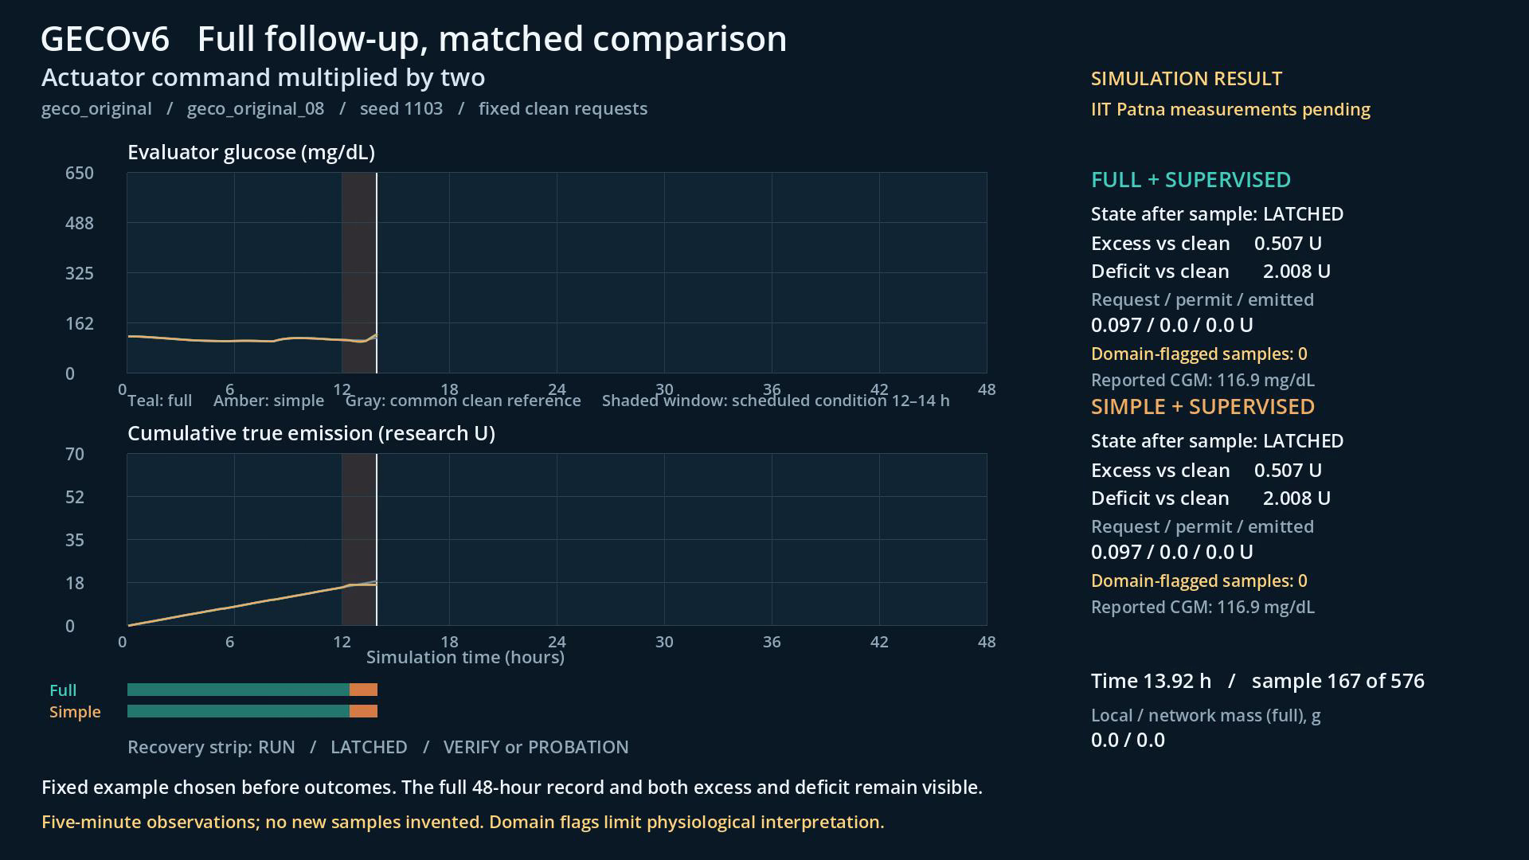
Doubled actuator input: original model
RESULT PLAYBACK
PLAY: TAB, THEN ENTER
Play with Tab, then Enter. Numerical playback only; all displayed quantities come from the frozen trace.
GECOv6 | Nonclinical research | SIMULATION / METHODS | 24 / 49
Notes:
S24 — Doubled actuator input: original model
Evidence class: SIMULATION / METHODS
Supported claim IDs: Source-derived explanation
Play the 55 second trace once. Point out the fault interval, then compare the two response states. Extra stopping is not automatically better. For Hovorka, explicitly name the domain flag counter before discussing glucose. The movie has no narration; presenter notes supply the explanation.
Source locators:
06_RIG_AND_MEDIA/Result_Player/SOURCE_RECEIPT.json
Source SHA-256:
06_RIG_AND_MEDIA/Result_Player/SOURCE_RECEIPT.json 87fd8d455579d0a068e5e68ebf01e55f934123f0019814d5fa605482cb7757df
Critical limit: numerical findings depend on explicit model assumptions; conceptual geometry is not as-built. No physical performance or clinical safety is established.

Slide 25
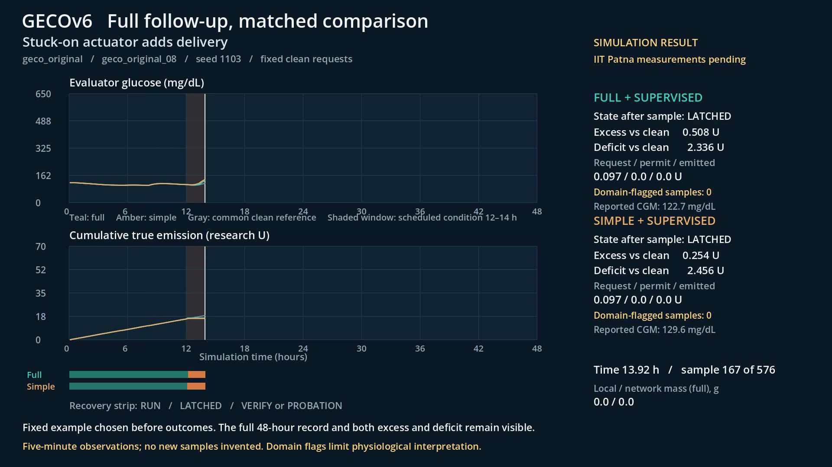
Stuck-on delivery and recovery
RESULT PLAYBACK
PLAY: TAB, THEN ENTER
Play with Tab, then Enter. Numerical playback only; all displayed quantities come from the frozen trace.
GECOv6 | Nonclinical research | SIMULATION / METHODS | 25 / 49
Notes:
S25 — Stuck-on delivery and recovery
Evidence class: SIMULATION / METHODS
Supported claim IDs: Source-derived explanation
Play the 55 second trace once. Point out the fault interval, then compare the two response states. Extra stopping is not automatically better. For Hovorka, explicitly name the domain flag counter before discussing glucose. The movie has no narration; presenter notes supply the explanation.
Source locators:
06_RIG_AND_MEDIA/Result_Player/SOURCE_RECEIPT.json
Source SHA-256:
06_RIG_AND_MEDIA/Result_Player/SOURCE_RECEIPT.json 87fd8d455579d0a068e5e68ebf01e55f934123f0019814d5fa605482cb7757df
Critical limit: numerical findings depend on explicit model assumptions; conceptual geometry is not as-built. No physical performance or clinical safety is established.

Slide 26
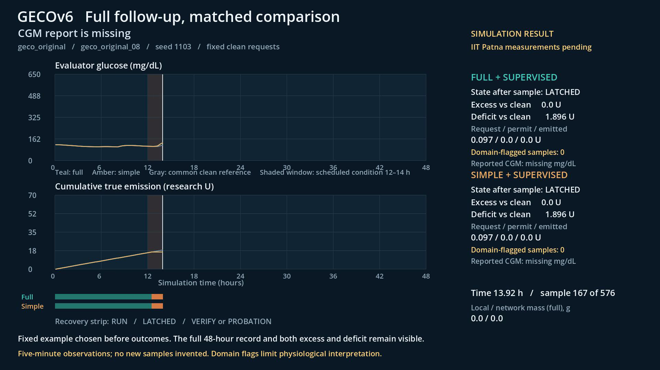
Missing observation and interruption
RESULT PLAYBACK
PLAY: TAB, THEN ENTER
Play with Tab, then Enter. Numerical playback only; all displayed quantities come from the frozen trace.
GECOv6 | Nonclinical research | SIMULATION / METHODS | 26 / 49
Notes:
S26 — Missing observation and interruption
Evidence class: SIMULATION / METHODS
Supported claim IDs: Source-derived explanation
Play the 55 second trace once. Point out the fault interval, then compare the two response states. Extra stopping is not automatically better. For Hovorka, explicitly name the domain flag counter before discussing glucose. The movie has no narration; presenter notes supply the explanation.
Source locators:
06_RIG_AND_MEDIA/Result_Player/SOURCE_RECEIPT.json
Source SHA-256:
06_RIG_AND_MEDIA/Result_Player/SOURCE_RECEIPT.json 87fd8d455579d0a068e5e68ebf01e55f934123f0019814d5fa605482cb7757df
Critical limit: numerical findings depend on explicit model assumptions; conceptual geometry is not as-built. No physical performance or clinical safety is established.

Slide 27
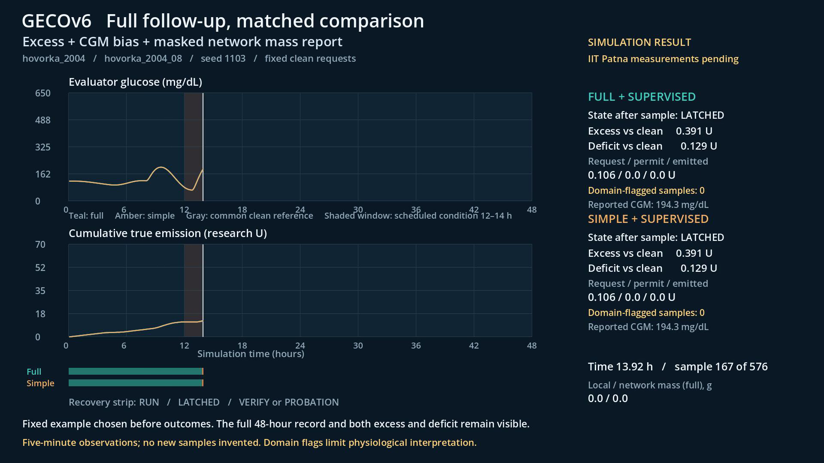
Combined fault: Hovorka domain flags
RESULT PLAYBACK
PLAY: TAB, THEN ENTER
Play with Tab, then Enter. Numerical playback only; all displayed quantities come from the frozen trace.
GECOv6 | Nonclinical research | SIMULATION / METHODS | 27 / 49
Notes:
S27 — Combined fault: Hovorka domain flags
Evidence class: SIMULATION / METHODS
Supported claim IDs: Source-derived explanation
Play the 55 second trace once. Point out the fault interval, then compare the two response states. Extra stopping is not automatically better. For Hovorka, explicitly name the domain flag counter before discussing glucose. The movie has no narration; presenter notes supply the explanation.
Source locators:
06_RIG_AND_MEDIA/Result_Player/SOURCE_RECEIPT.json
Source SHA-256:
06_RIG_AND_MEDIA/Result_Player/SOURCE_RECEIPT.json 87fd8d455579d0a068e5e68ebf01e55f934123f0019814d5fa605482cb7757df
Critical limit: numerical findings depend on explicit model assumptions; conceptual geometry is not as-built. No physical performance or clinical safety is established.

Slide 28
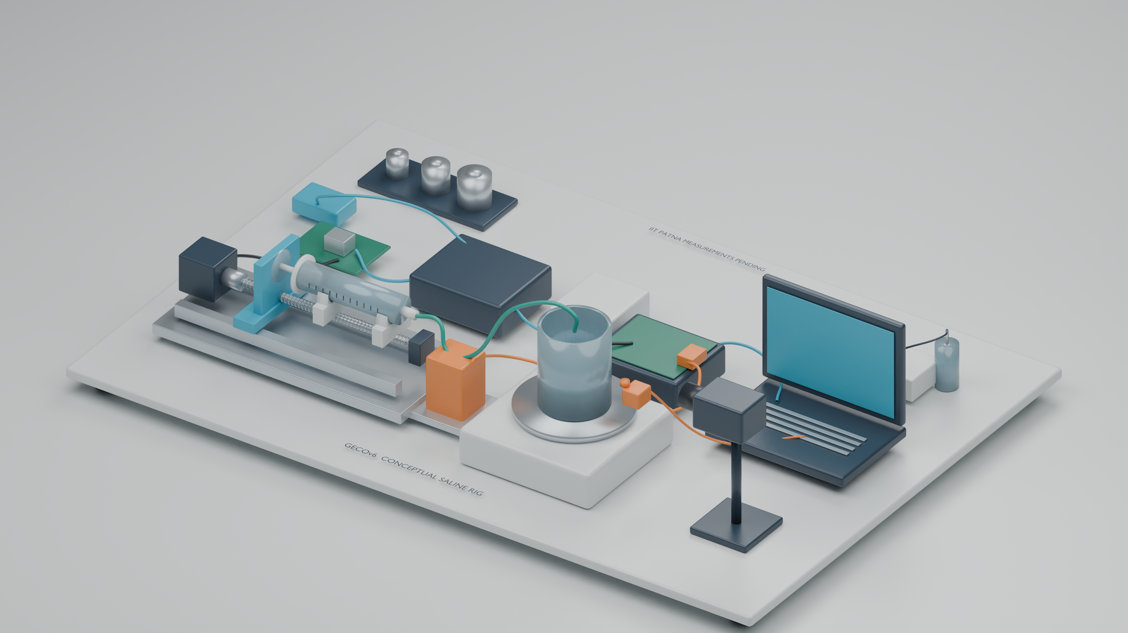
The proposed saline twin
RIG AND MEASUREMENT
Concept geometry for explanation. Every physical performance estimate is pending.
IIT Patna measurement pending
GECOv6 | Nonclinical research | CONCEPTUAL RIG | 28 / 49
Notes:
S28 — The proposed saline twin
Evidence class: CONCEPTUAL RIG
Supported claim IDs: Source-derived explanation
Walk left to right from motor and syringe to outlet receiver, balance and acquisition computer. No instrument shown has been purchased, certified or physically validated by this release. Dimensions illustrate assembly relationships and must be finalized by the team.
Source locators:
07_IIT_PATNA_HANDOFF/ACQUISITION_AND_MEASUREMENT_PROTOCOL.md
04_PAPER/IIT_PATNA_PENDING_MEASUREMENTS.md
Source SHA-256:
07_IIT_PATNA_HANDOFF/ACQUISITION_AND_MEASUREMENT_PROTOCOL.md ed0d692517f893e244caf50f81ce0665f1efdc7887c7500da6a142d7f96296bb
04_PAPER/IIT_PATNA_PENDING_MEASUREMENTS.md dab38ac32713cd02fab2aca3cfa32022292323f3a82940df2f9ec44bd2072fc9
Critical limit: numerical findings depend on explicit model assumptions; conceptual geometry is not as-built. No physical performance or clinical safety is established.

Slide 29
The complete rig explanation
RIG AND MEASUREMENT
PLAY: TAB, THEN ENTER
8-minute narrated tour: components, evidence paths, objective measurement and recovery.
IIT Patna measurement pending
GECOv6 | Nonclinical research | CONCEPTUAL RIG | 29 / 49
Notes:
S29 — The complete rig explanation
Evidence class: CONCEPTUAL RIG
Supported claim IDs: Source-derived explanation
In Slide Show, press Tab then Enter to play the embedded movie full screen. Narration is disclosed macOS synthetic speech. The model is a conceptual render; arrows indicate paths rather than measured flow rates. Use the complete tour for a general audience, or skip it and use the following chapter clips for an engineering seminar.
Source locators:
06_RIG_AND_MEDIA/narration/FINAL_TRANSCRIPT.md
07_IIT_PATNA_HANDOFF/ACQUISITION_AND_MEASUREMENT_PROTOCOL.md
Source SHA-256:
06_RIG_AND_MEDIA/narration/FINAL_TRANSCRIPT.md 52202a152b2aed2e971333942550f2da91d0cc5533fddacf00575d0e87b2dc80
07_IIT_PATNA_HANDOFF/ACQUISITION_AND_MEASUREMENT_PROTOCOL.md ed0d692517f893e244caf50f81ce0665f1efdc7887c7500da6a142d7f96296bb
Critical limit: numerical findings depend on explicit model assumptions; conceptual geometry is not as-built. No physical performance or clinical safety is established.

Slide 30
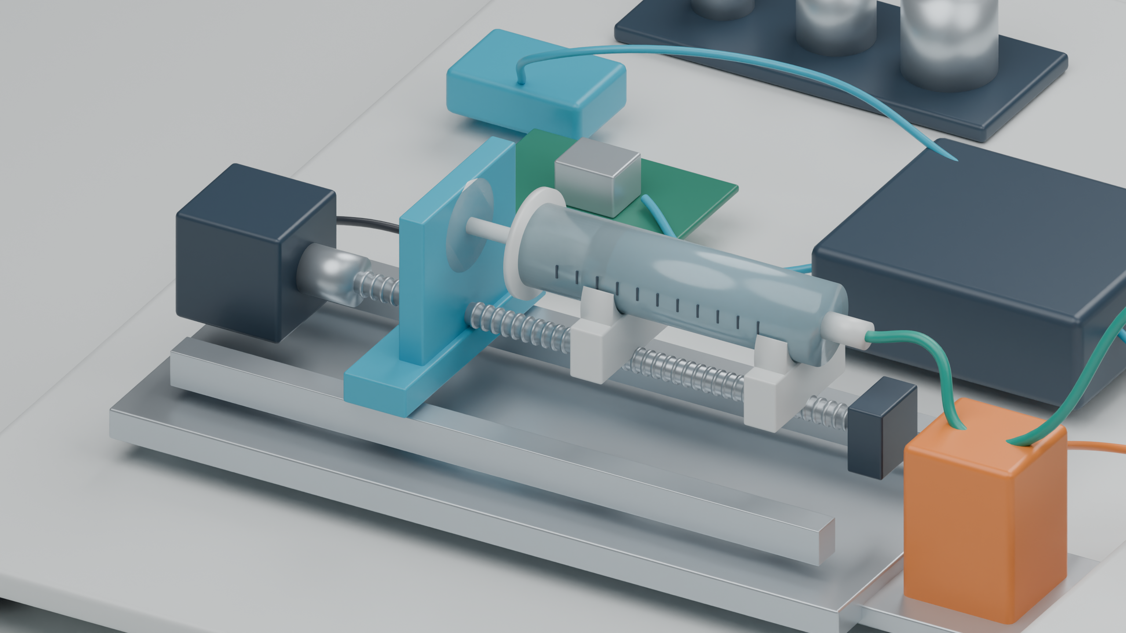
Drive mechanism
RIG AND MEASUREMENT
PLAY: TAB, THEN ENTER
Motor, coupling, lead screw, carriage and rail: verify actual travel and repeatability.
IIT Patna measurement pending
GECOv6 | Nonclinical research | CONCEPTUAL RIG | 30 / 49
Notes:
S30 — Drive mechanism
Evidence class: CONCEPTUAL RIG
Supported claim IDs: Source-derived explanation
Use the chapter clip and pause at its final component view. All performance quantities remain pending. Ask the audience to identify the reference instrument, the recorded event and the uncertainty contribution. These clips are exact excerpts from the full narrated tour.
Source locators:
07_IIT_PATNA_HANDOFF/ACQUISITION_AND_MEASUREMENT_PROTOCOL.md
04_PAPER/IIT_PATNA_PENDING_MEASUREMENTS.md
Source SHA-256:
07_IIT_PATNA_HANDOFF/ACQUISITION_AND_MEASUREMENT_PROTOCOL.md ed0d692517f893e244caf50f81ce0665f1efdc7887c7500da6a142d7f96296bb
04_PAPER/IIT_PATNA_PENDING_MEASUREMENTS.md dab38ac32713cd02fab2aca3cfa32022292323f3a82940df2f9ec44bd2072fc9
Critical limit: numerical findings depend on explicit model assumptions; conceptual geometry is not as-built. No physical performance or clinical safety is established.

Slide 31
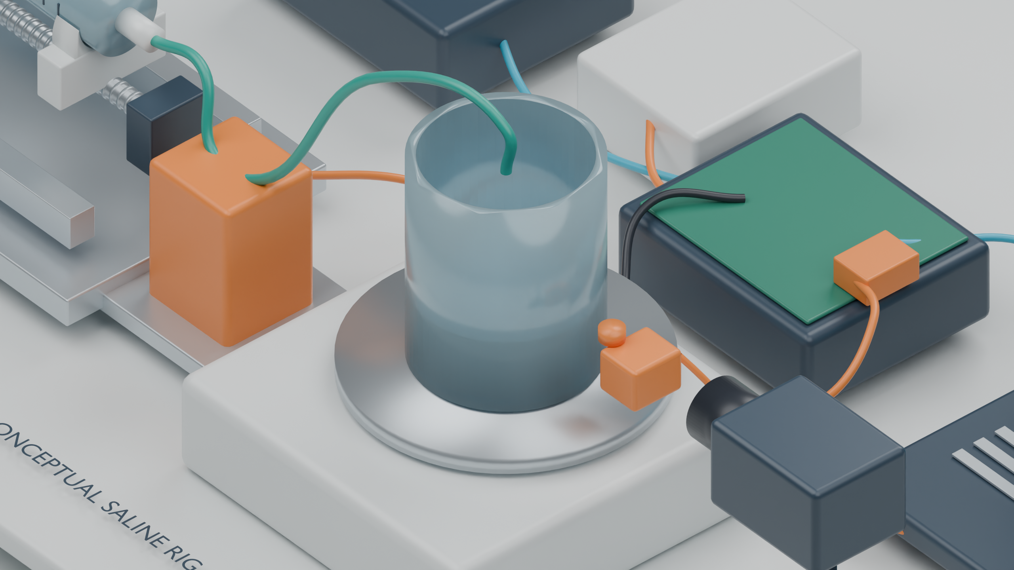
Mass measurement
RIG AND MEASUREMENT
PLAY: TAB, THEN ENTER
Receiver, load cell and independent reference: define the outlet and retain signed readings.
IIT Patna measurement pending
GECOv6 | Nonclinical research | CONCEPTUAL RIG | 31 / 49
Notes:
S31 — Mass measurement
Evidence class: CONCEPTUAL RIG
Supported claim IDs: Source-derived explanation
Use the chapter clip and pause at its final component view. All performance quantities remain pending. Ask the audience to identify the reference instrument, the recorded event and the uncertainty contribution. These clips are exact excerpts from the full narrated tour.
Source locators:
07_IIT_PATNA_HANDOFF/ACQUISITION_AND_MEASUREMENT_PROTOCOL.md
04_PAPER/IIT_PATNA_PENDING_MEASUREMENTS.md
Source SHA-256:
07_IIT_PATNA_HANDOFF/ACQUISITION_AND_MEASUREMENT_PROTOCOL.md ed0d692517f893e244caf50f81ce0665f1efdc7887c7500da6a142d7f96296bb
04_PAPER/IIT_PATNA_PENDING_MEASUREMENTS.md dab38ac32713cd02fab2aca3cfa32022292323f3a82940df2f9ec44bd2072fc9
Critical limit: numerical findings depend on explicit model assumptions; conceptual geometry is not as-built. No physical performance or clinical safety is established.

Slide 32
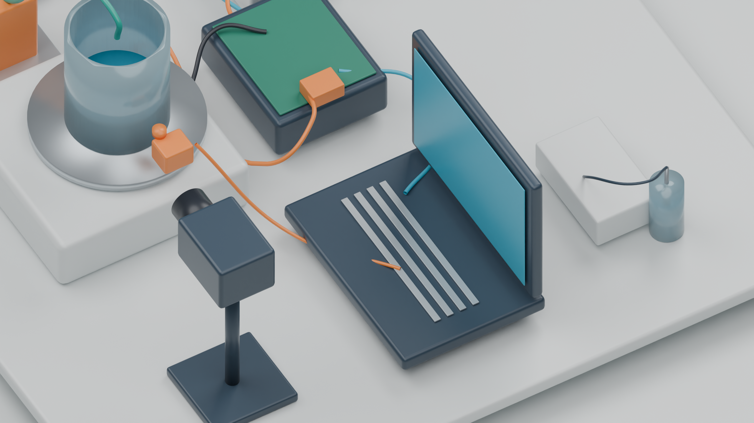
Independent recording and clocks
RIG AND MEASUREMENT
PLAY: TAB, THEN ENTER
Acquisition computer, camera and timing marker: align clocks with measured residual error.
IIT Patna measurement pending
GECOv6 | Nonclinical research | CONCEPTUAL RIG | 32 / 49
Notes:
S32 — Independent recording and clocks
Evidence class: CONCEPTUAL RIG
Supported claim IDs: Source-derived explanation
Use the chapter clip and pause at its final component view. All performance quantities remain pending. Ask the audience to identify the reference instrument, the recorded event and the uncertainty contribution. These clips are exact excerpts from the full narrated tour.
Source locators:
07_IIT_PATNA_HANDOFF/ACQUISITION_AND_MEASUREMENT_PROTOCOL.md
04_PAPER/IIT_PATNA_PENDING_MEASUREMENTS.md
Source SHA-256:
07_IIT_PATNA_HANDOFF/ACQUISITION_AND_MEASUREMENT_PROTOCOL.md ed0d692517f893e244caf50f81ce0665f1efdc7887c7500da6a142d7f96296bb
04_PAPER/IIT_PATNA_PENDING_MEASUREMENTS.md dab38ac32713cd02fab2aca3cfa32022292323f3a82940df2f9ec44bd2072fc9
Critical limit: numerical findings depend on explicit model assumptions; conceptual geometry is not as-built. No physical performance or clinical safety is established.

Slide 33
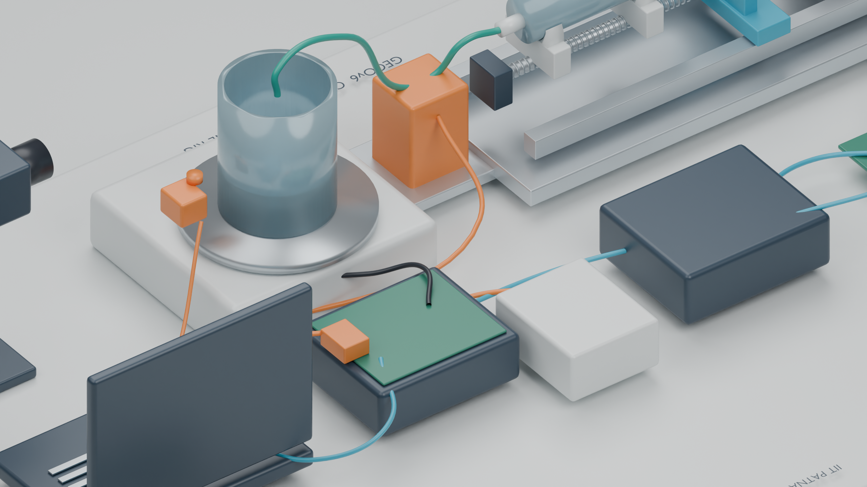
Local interruption
RIG AND MEASUREMENT
PLAY: TAB, THEN ENTER
Trip command, actuator disable and outlet cessation are separate observable events.
IIT Patna measurement pending
GECOv6 | Nonclinical research | CONCEPTUAL RIG | 33 / 49
Notes:
S33 — Local interruption
Evidence class: CONCEPTUAL RIG
Supported claim IDs: Source-derived explanation
Use the chapter clip and pause at its final component view. All performance quantities remain pending. Ask the audience to identify the reference instrument, the recorded event and the uncertainty contribution. These clips are exact excerpts from the full narrated tour.
Source locators:
07_IIT_PATNA_HANDOFF/ACQUISITION_AND_MEASUREMENT_PROTOCOL.md
04_PAPER/IIT_PATNA_PENDING_MEASUREMENTS.md
Source SHA-256:
07_IIT_PATNA_HANDOFF/ACQUISITION_AND_MEASUREMENT_PROTOCOL.md ed0d692517f893e244caf50f81ce0665f1efdc7887c7500da6a142d7f96296bb
04_PAPER/IIT_PATNA_PENDING_MEASUREMENTS.md dab38ac32713cd02fab2aca3cfa32022292323f3a82940df2f9ec44bd2072fc9
Critical limit: numerical findings depend on explicit model assumptions; conceptual geometry is not as-built. No physical performance or clinical safety is established.

Slide 34
From indication to a measurement
RIG AND MEASUREMENT
Raw balance indication
signed mass + time
Calibration evidence
reference and traceability
Corrections
drift, evaporation, buoyancy
Uncertainty statement
method + coverage
Interval volume or flow
explicit averaging window
Density and temperature
fluid-specific evidence
Never convert every negative mass change to zero. It biases low-flow estimates.
IIT Patna measurement pending
GECOv6 | Nonclinical research | PHYSICAL PROTOCOL | 34 / 49
Notes:
S34 — From indication to a measurement
Evidence class: PHYSICAL PROTOCOL
Supported claim IDs: Source-derived explanation
Mass indication is not automatically true outlet delivery. The definition must identify the outlet, transport delay and capture efficiency. The balance may settle after flow changes. Density and temperature are measured or supported by a valid model. An uncertainty budget must match the actual apparatus and interval.
Source locators:
07_IIT_PATNA_HANDOFF/ACQUISITION_AND_MEASUREMENT_PROTOCOL.md
Source SHA-256:
07_IIT_PATNA_HANDOFF/ACQUISITION_AND_MEASUREMENT_PROTOCOL.md ed0d692517f893e244caf50f81ce0665f1efdc7887c7500da6a142d7f96296bb
Critical limit: numerical findings depend on explicit model assumptions; conceptual geometry is not as-built. No physical performance or clinical safety is established.

Slide 35
Objective measurements at IIT Patna
RIG AND MEASUREMENT
Quantity | Independent evidence | Report with estimate
Cumulative delivery | Calibrated gravimetric reference | Bias, repeatability, uncertainty
Low-flow response | Long interval capture; drift/evaporation runs | Window length and detection limit
Trip-to-disable latency | Aligned command and electrical event logs | Clock offset, residual error, interval
Outlet cessation / residual fluid | Defined outlet trace + video if validated | Cessation criterion, tail mass, uncertainty
Recovery | Probe, emission and state records | Deficit, failed restart, confirmation time
IIT Patna measurement pending
GECOv6 | Nonclinical research | PHYSICAL PROTOCOL | 35 / 49
Notes:
S35 — Objective measurements at IIT Patna
Evidence class: PHYSICAL PROTOCOL
Supported claim IDs: Source-derived explanation
A camera can support an event record, but it is not automatically a calibrated flowmeter. The local load-cell signal and an independent reference must not be the same unexamined evidence. Never label the interlock “physically stopping flow” using only a software acknowledgment.
Source locators:
07_IIT_PATNA_HANDOFF/ACQUISITION_AND_MEASUREMENT_PROTOCOL.md
04_PAPER/IIT_PATNA_PENDING_MEASUREMENTS.md
Source SHA-256:
07_IIT_PATNA_HANDOFF/ACQUISITION_AND_MEASUREMENT_PROTOCOL.md ed0d692517f893e244caf50f81ce0665f1efdc7887c7500da6a142d7f96296bb
04_PAPER/IIT_PATNA_PENDING_MEASUREMENTS.md dab38ac32713cd02fab2aca3cfa32022292323f3a82940df2f9ec44bd2072fc9
Critical limit: numerical findings depend on explicit model assumptions; conceptual geometry is not as-built. No physical performance or clinical safety is established.

Slide 36
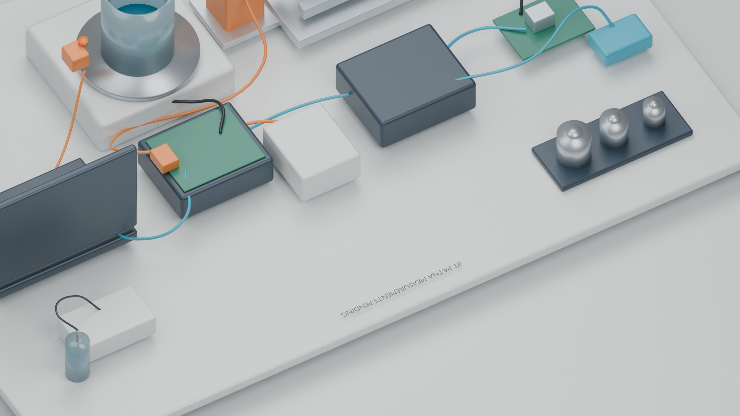
Calibration and temperature
RIG AND MEASUREMENT
Reference masses and a separate fluid-temperature sample illustrate required evidence.
IIT Patna measurement pending
GECOv6 | Nonclinical research | CONCEPTUAL RIG | 36 / 49
Notes:
S36 — Calibration and temperature
Evidence class: CONCEPTUAL RIG
Supported claim IDs: Source-derived explanation
No mass class, certificate, sensor accuracy or vendor part is asserted. The separate probe vial avoids mechanically loading the receiver. Characterize whether that sample represents fluid temperature at the measurement boundary.
Source locators:
07_IIT_PATNA_HANDOFF/ACQUISITION_AND_MEASUREMENT_PROTOCOL.md
Source SHA-256:
07_IIT_PATNA_HANDOFF/ACQUISITION_AND_MEASUREMENT_PROTOCOL.md ed0d692517f893e244caf50f81ce0665f1efdc7887c7500da6a142d7f96296bb
Critical limit: numerical findings depend on explicit model assumptions; conceptual geometry is not as-built. No physical performance or clinical safety is established.

Slide 37
An immutable acquisition record
IIT PATNA HANDOFF
Trial identity
fluid + rig revision
Instrument evidence
calibration + units
Raw samples
sequence + time + status
Independent review
accept, reject or repeat
Derived estimates
source hashes + method
Clock transformation
method + residuals
Blank templates remain blank until measured. The offline validator rejects missing evidence.
IIT Patna measurement pending
GECOv6 | Nonclinical research | PHYSICAL PROTOCOL | 37 / 49
Notes:
S37 — An immutable acquisition record
Evidence class: PHYSICAL PROTOCOL
Supported claim IDs: Source-derived explanation
The delivered validator checks data-contract consistency, not instrument accuracy. It never controls hardware. A successful validation only means the fields and rules passed. Calibration validity, physical uncertainty and experimental interpretation still require review.
Source locators:
07_IIT_PATNA_HANDOFF/ACQUISITION_AND_MEASUREMENT_PROTOCOL.md
07_IIT_PATNA_HANDOFF/tools/validate_acquisition.py
Source SHA-256:
07_IIT_PATNA_HANDOFF/ACQUISITION_AND_MEASUREMENT_PROTOCOL.md ed0d692517f893e244caf50f81ce0665f1efdc7887c7500da6a142d7f96296bb
07_IIT_PATNA_HANDOFF/tools/validate_acquisition.py 0c3f0eb692cf0a6e3d427624d81b0dff06913e2f73cbd69010919d871a95c3df
Critical limit: numerical findings depend on explicit model assumptions; conceptual geometry is not as-built. No physical performance or clinical safety is established.

Slide 38
Paper fields to fill after the build
IIT PATNA HANDOFF
Physical result section | IIT Patna must supply
Rig and instrumentation | As-built dimensions, parts, fluid, calibration evidence
Measurement performance | Mass/volume bias, repeatability, low-flow behavior
Timing and stopping | Clock alignment, disable latency, outlet cessation, residual mass
Failure and recovery | Excess, deficit, long interruption, failed and successful restart
Transfer and reproducibility | Measured-data replay, model discrepancy, raw traces and analysis
Amber text and tables in the manuscript mark these pending claims beside the relevant discussion.
IIT Patna measurement pending
GECOv6 | Nonclinical research | PHYSICAL PROTOCOL | 38 / 49
Notes:
S38 — Paper fields to fill after the build
Evidence class: PHYSICAL PROTOCOL
Supported claim IDs: Source-derived explanation
These are measurement tasks, not numbers to be estimated by the writing team. Do not remove pending markers merely because the rig is assembled; remove a marker only when its evidence, analysis and review are complete.
Source locators:
04_PAPER/IIT_PATNA_PENDING_MEASUREMENTS.md
07_IIT_PATNA_HANDOFF/ACQUISITION_AND_MEASUREMENT_PROTOCOL.md
Source SHA-256:
04_PAPER/IIT_PATNA_PENDING_MEASUREMENTS.md dab38ac32713cd02fab2aca3cfa32022292323f3a82940df2f9ec44bd2072fc9
07_IIT_PATNA_HANDOFF/ACQUISITION_AND_MEASUREMENT_PROTOCOL.md ed0d692517f893e244caf50f81ce0665f1efdc7887c7500da6a142d7f96296bb
Critical limit: numerical findings depend on explicit model assumptions; conceptual geometry is not as-built. No physical performance or clinical safety is established.

Slide 39
M01–M08: apparatus and metrology
IIT PATNA HANDOFF
ID | Evidence to complete
M01–M02 | As-built apparatus; outlet and acquisition boundary
M03–M04 | Traceable balance calibration; fluid temperature and density
M05–M06 | Evaporation/environment; mechanical force isolation
M07–M08 | Independent reference; reconstruction and zero-flow bias
IIT Patna measurement pending
GECOv6 | Nonclinical research | PHYSICAL PROTOCOL | 39 / 49
Notes:
S39 — M01–M08: apparatus and metrology
Evidence class: PHYSICAL PROTOCOL
Supported claim IDs: Source-derived explanation
Use the exact M01–M16 checklist in the manuscript companion; this slide groups work for planning. Confirm each identifier against the authoritative table before assigning tasks. The presentation does not authorize an unsupervised medical experiment.
Source locators:
04_PAPER/IIT_PATNA_PENDING_MEASUREMENTS.md
Source SHA-256:
04_PAPER/IIT_PATNA_PENDING_MEASUREMENTS.md dab38ac32713cd02fab2aca3cfa32022292323f3a82940df2f9ec44bd2072fc9
Critical limit: numerical findings depend on explicit model assumptions; conceptual geometry is not as-built. No physical performance or clinical safety is established.

Slide 40
M09–M16: interruption and transfer
IIT PATNA HANDOFF
ID | Evidence to complete
M09–M10 | Delivery accuracy and timing; acquisition synchronization
M11–M12 | Stop response; post-stop residual flow
M13–M14 | Stop-path independence; nuisance alarms and misses
M15–M16 | Restart and recovery; locked physical study and records
IIT Patna measurement pending
GECOv6 | Nonclinical research | PHYSICAL PROTOCOL | 40 / 49
Notes:
S40 — M09–M16: interruption and transfer
Evidence class: PHYSICAL PROTOCOL
Supported claim IDs: Source-derived explanation
These are grouped labels; the exact evidence requirements and manuscript insertion locations are in the M matrix. A safe-looking animation supplies none of these measurements.
Source locators:
04_PAPER/IIT_PATNA_PENDING_MEASUREMENTS.md
Source SHA-256:
04_PAPER/IIT_PATNA_PENDING_MEASUREMENTS.md dab38ac32713cd02fab2aca3cfa32022292323f3a82940df2f9ec44bd2072fc9
Critical limit: numerical findings depend on explicit model assumptions; conceptual geometry is not as-built. No physical performance or clinical safety is established.

Slide 41
What can be claimed now
CONCLUSION
A reproducible simulation and methods contribution with explicit evidence boundaries.
A corrected prediction comparison that favors simpler candidates on these records.
A documented intervention tradeoff and a physical validation protocol ready for the team.
GECOv6 | Nonclinical research | SIMULATION / METHODS | 41 / 49
Notes:
S41 — What can be claimed now
Evidence class: SIMULATION / METHODS
Supported claim IDs: Source-derived explanation
The paper is ready for team review as a simulation/methods manuscript. Publication acceptance is a reviewer decision. The scientific value includes the negative result: added monitor complexity did not earn an unconditional superiority claim.
Source locators:
04_PAPER/GECOv6_MANUSCRIPT.md
Source SHA-256:
04_PAPER/GECOv6_MANUSCRIPT.md 787d1d5372ebdf4ec8a88e0d3f7ac37c5cd61f3d8ccf2c786519027e72fb1c7c
Critical limit: numerical findings depend on explicit model assumptions; conceptual geometry is not as-built. No physical performance or clinical safety is established.

Slide 42
What remains before submission
CONCLUSION
Authors must approve the claims, contributions, references and assistance disclosure.
Choose the IEEE venue, then apply its exact scope, length and submission requirements.
Physical measurement claims remain amber until IIT Patna supplies reviewed evidence.
GECOv6 | Nonclinical research | SIMULATION / METHODS | 42 / 49
Notes:
S42 — What remains before submission
Evidence class: SIMULATION / METHODS
Supported claim IDs: Source-derived explanation
Hardware is not automatically required for every simulation paper. A submission can proceed on a carefully scoped simulation contribution if the venue accepts that scope. Hardware accuracy, physical cessation and clinical safety claims need the corresponding evidence; the manuscript does not make them.
Source locators:
04_PAPER/GECOv6_MANUSCRIPT.md
Source SHA-256:
04_PAPER/GECOv6_MANUSCRIPT.md 787d1d5372ebdf4ec8a88e0d3f7ac37c5cd61f3d8ccf2c786519027e72fb1c7c
Critical limit: numerical findings depend on explicit model assumptions; conceptual geometry is not as-built. No physical performance or clinical safety is established.

Slide 43
The research story
CONCLUSION
We asked whether a monitor can connect permission with credible delivery evidence.
We repaired the testable implementation and challenged it against simpler alternatives.
The strongest result is a transparent method, a bounded claim and a concrete next experiment.
GECOv6 | Nonclinical research | SIMULATION / METHODS | 43 / 49
Notes:
S43 — The research story
Evidence class: SIMULATION / METHODS
Supported claim IDs: Source-derived explanation
Close by returning to the opening question. The contribution is more persuasive when the audience can see what would falsify it. Explain that future saline measurements can either support or challenge the assumed sensor and actuator behavior.
Source locators:
04_PAPER/GECOv6_MANUSCRIPT.md
Source SHA-256:
04_PAPER/GECOv6_MANUSCRIPT.md 787d1d5372ebdf4ec8a88e0d3f7ac37c5cd61f3d8ccf2c786519027e72fb1c7c
Critical limit: numerical findings depend on explicit model assumptions; conceptual geometry is not as-built. No physical performance or clinical safety is established.

Slide 44
Technical: prediction and calibration
TECHNICAL APPENDIX
Item | Definition or limit
Innovation normalization | Inflation scales alarm normalization, not nominal measurement covariance
Forecast candidates | Mechanistic, persistence, bounded causal trend
Gap handling | Filter memory reset after prolonged missing observations
Coverage | Empirical symmetric ±1.96-scale coverage; participant range
Optimization | Bounded fit; near-bound solutions are not identifiability evidence
GECOv6 | Nonclinical research | SIMULATION / METHODS | 44 / 49
Notes:
S44 — Technical: prediction and calibration
Evidence class: SIMULATION / METHODS
Supported claim IDs: Source-derived explanation
Refer to the paper equations and exact frozen configuration for numerical details. The filter uses a Joseph covariance update and records reset behavior. Separate one-step innovation coverage from 30-minute forecast coverage.
Source locators:
03_EXPERIMENTS/filter_calibration/AGGREGATE_RESULTS.json
04_PAPER/GECOv6_MANUSCRIPT.md
Source SHA-256:
03_EXPERIMENTS/filter_calibration/AGGREGATE_RESULTS.json 1b6a4899b849bdc64f3341a80d66f3e09c6fc63ab78122353818544f43deb1ec
04_PAPER/GECOv6_MANUSCRIPT.md 787d1d5372ebdf4ec8a88e0d3f7ac37c5cd61f3d8ccf2c786519027e72fb1c7c
Critical limit: numerical findings depend on explicit model assumptions; conceptual geometry is not as-built. No physical performance or clinical safety is established.

Slide 45
Technical: model assumptions
TECHNICAL APPENDIX
Item | Frozen illustrative value
Sampling and horizon | 5 min; 576 intervals over 48 h
Dose-to-mass mapping | 0.1005 g per research U
Actuator | 200 steps/U; gain 1.015; positive-command dribble 0.0015 g
Balance | 0.01 g quantization; median of 5; 0.003 g sample noise
Mass residual scale | 0.0051435068 g; supplied numerical calibration
GECOv6 | Nonclinical research | SIMULATION / METHODS | 45 / 49
Notes:
S45 — Technical: model assumptions
Evidence class: SIMULATION / METHODS
Supported claim IDs: Source-derived explanation
These are simulation assumptions, not measured specifications of the proposed saline rig. The calibrated synthetic balance scale is not a traceable physical uncertainty. The actuator also adds configured positive-command noise and the study records all delivered values.
Source locators:
04_PAPER/GECOv6_MANUSCRIPT.md
Source SHA-256:
04_PAPER/GECOv6_MANUSCRIPT.md 787d1d5372ebdf4ec8a88e0d3f7ac37c5cd61f3d8ccf2c786519027e72fb1c7c
Critical limit: numerical findings depend on explicit model assumptions; conceptual geometry is not as-built. No physical performance or clinical safety is established.

Slide 46
Technical: uncertainty and pairing
TECHNICAL APPENDIX
Analysis | Unit and meaning
Forecast contrast | Participant paired difference; 10,000 bootstrap resamples
Intervention contrast | Parameter-vector mean over paired seeds; vector bootstrap
Clean comparison | Shared request tape and clean reference emission
Recovery censoring | Reported separately; failed recovery is not a finite time
Multiplicity | Descriptive contrasts; no universal superiority conclusion
GECOv6 | Nonclinical research | SIMULATION / METHODS | 46 / 49
Notes:
S46 — Technical: uncertainty and pairing
Evidence class: SIMULATION / METHODS
Supported claim IDs: Source-derived explanation
A large number of five-minute samples does not create the same number of independent subjects. HUPA0027P contributes 41,285 of 77,110 forecast pairs, which is why equal participant weighting and participant bootstrap matter.
Source locators:
03_EXPERIMENTS/filter_calibration/AGGREGATE_RESULTS.json
03_EXPERIMENTS/comparative_study/PAIRED_PARAMETER_UNIT_CI.json
04_PAPER/GECOv6_MANUSCRIPT.md
Source SHA-256:
03_EXPERIMENTS/filter_calibration/AGGREGATE_RESULTS.json 1b6a4899b849bdc64f3341a80d66f3e09c6fc63ab78122353818544f43deb1ec
03_EXPERIMENTS/comparative_study/PAIRED_PARAMETER_UNIT_CI.json a3b601d26949969c2675e0e5461db7a1bb3f4351252533ec44e124b01f269dd2
04_PAPER/GECOv6_MANUSCRIPT.md 787d1d5372ebdf4ec8a88e0d3f7ac37c5cd61f3d8ccf2c786519027e72fb1c7c
Critical limit: numerical findings depend on explicit model assumptions; conceptual geometry is not as-built. No physical performance or clinical safety is established.

Slide 47
Technical: prior work and distinction
TECHNICAL APPENDIX
Source family | What it contributes | GECOv6 boundary
GlucOS; KnowSafe | Safety monitoring and runtime decisions | No first-monitor claim
Hovorka 2004; prediction literature | Physiology and forecasting context | Not clinical model validation
Gravimetric pump metrology | Measurement and uncertainty methods | No transferred instrument accuracy
IEEE author guidance | Format and assistance disclosure | No acceptance or affiliation claim
GECOv6 | Nonclinical research | SIMULATION / METHODS | 47 / 49
Notes:
S47 — Technical: prior work and distinction
Evidence class: SIMULATION / METHODS
Supported claim IDs: Source-derived explanation
Consult the numbered manuscript references and source ledger for exact DOI, year, title and access limits. Use primary sources for factual attribution; preserve metadata-only limitations where full text was inaccessible.
Source locators:
01_RESEARCH_PROTOCOL/literature_editorial/SOURCE_LEDGER.json
04_PAPER/GECOv6_MANUSCRIPT.md
Source SHA-256:
01_RESEARCH_PROTOCOL/literature_editorial/SOURCE_LEDGER.json ac71d77af712c2b4fad3a00f04e47a7eec4a0fc2e5d0398f54120f79a01af663
04_PAPER/GECOv6_MANUSCRIPT.md 787d1d5372ebdf4ec8a88e0d3f7ac37c5cd61f3d8ccf2c786519027e72fb1c7c
Critical limit: numerical findings depend on explicit model assumptions; conceptual geometry is not as-built. No physical performance or clinical safety is established.

Slide 48
Technical: originality and provenance
TECHNICAL APPENDIX
Scientific review precedes writing and similarity diagnostics.
The bounded local overlap check is evidence about the supplied corpus only.
AI assistance and synthetic narration are disclosed; no AI-free, SynthID-free or detector certification is claimed.
GECOv6 | Nonclinical research | SIMULATION / METHODS | 48 / 49
Notes:
S48 — Technical: originality and provenance
Evidence class: SIMULATION / METHODS
Supported claim IDs: Source-derived explanation
The work includes AI-assisted code, analysis, text and visuals. Style changes must not alter numerical results or erase assistance provenance. A zero exact 12 word overlap finding is not a comprehensive plagiarism check and does not cover a proprietary publication database.
Source locators:
08_REVIEW_AND_QA/editorial/FINAL_MANUSCRIPT_LOCAL_OVERLAP.json
04_PAPER/GECOv6_MANUSCRIPT.md
Source SHA-256:
08_REVIEW_AND_QA/editorial/FINAL_MANUSCRIPT_LOCAL_OVERLAP.json b45eed552398bbf582c1aa16fd3595a9bd9773e85f34f9cdf40b468d92e0723d
04_PAPER/GECOv6_MANUSCRIPT.md 787d1d5372ebdf4ec8a88e0d3f7ac37c5cd61f3d8ccf2c786519027e72fb1c7c
Critical limit: numerical findings depend on explicit model assumptions; conceptual geometry is not as-built. No physical performance or clinical safety is established.

Slide 49
Technical: reproduce and inspect
TECHNICAL APPENDIX
Frozen inputs, configurations, raw traces and review receipts travel with this package.
The original release is preserved separately; new results are clearly versioned.
Start with the release guide, then follow the exact experiment and artifact instructions.
GECOv6 | Nonclinical research | SIMULATION / METHODS | 49 / 49
Notes:
S49 — Technical: reproduce and inspect
Evidence class: SIMULATION / METHODS
Supported claim IDs: Source-derived explanation
The all-in-one package contains the source and native media projects. External build tools and environments are documented. Never present a simulator replay as a physical measurement. Any sharing of the private prior archive requires a separate rights and privacy review.
Source locators:
04_PAPER/GECOv6_MANUSCRIPT.md
Source SHA-256:
04_PAPER/GECOv6_MANUSCRIPT.md 787d1d5372ebdf4ec8a88e0d3f7ac37c5cd61f3d8ccf2c786519027e72fb1c7c
Critical limit: numerical findings depend on explicit model assumptions; conceptual geometry is not as-built. No physical performance or clinical safety is established.

