Slide 1
ZEXTOR
(The First Person
Shooting Game)
Group Members :
Rishabh Madani
Vivek Sinha
Akshansh Gupta

Slide 2
INTRODUCTON
Basically we have worked on a game called “Zextor” that is full of fun.
In this game, you have to shoot the enemies with your weapons. There are many types of weapons. The basic aim of the player of this game is to shoot the enemy heroes with the provided weapons.
We have used UNITY to make this project working. there are other functionalities can be further implemented like different stages and different looks for hero.
Hence there are many thing we can implement to make this project look more user friendly and charming. The aim of this document is to describe the development process and the results of this project.

Slide 3
PROJECT DESCRIPTION
The primary objective of the game is for the player to eliminate all the bots present on the level.
Throughout the level, there are various items placed on different locations where player can pick up and use to aid their way on the level.
Our game is a first person shooter game. Commencing from the real life-like graphics, it consists of enemy bots, very user-friendly UI and game environment provided with tutorials at every step for a new user.
In the game, player will be playing various levels consisting of enemy bots, weapons and other assets such as ammo, powerups, health packs, etc.
Interesting features :- Characters • Enemy bots. • Player • Items • Weapons and their ammo • Weapon upgrades • Health packs

Slide 4
Cont…
Player Actions
The abilities of our character as a player are:
Walking and running in all four directions,
Crouching
Jumping
Punching
Using-Reloading-changing weapons
Collecting the pick-ups

Slide 5
Cont…
Main features
1. Health Bar
2. Mini Map
a. Terrain
b. Visible Units
3. Hostile Counter
a. Showing the number of remaining enemies
4. Ammo Counter
a. Showing the number of remaining ammos

Slide 6
REQUIREMENTS
Following are the suggested software and the hardware requirements for this project to work seamlessly.
Software=>
• Adobe flash player
• Adobe Photoshop
• Unity 3D (game engine)
Hardware =>
• Game will be playable on all the windows version with an average of 512mb RAM and 1gbmb hard disk space.

Slide 7
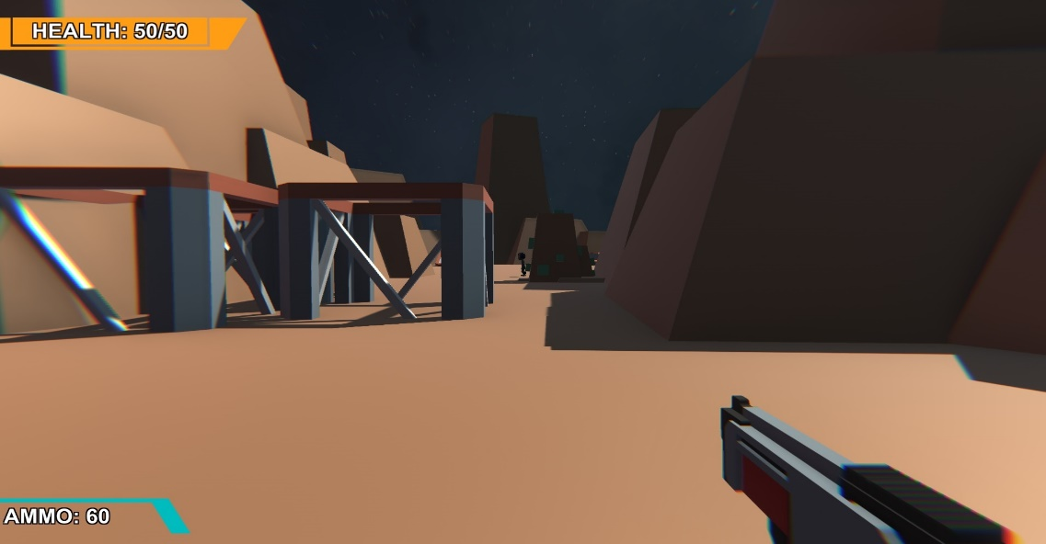
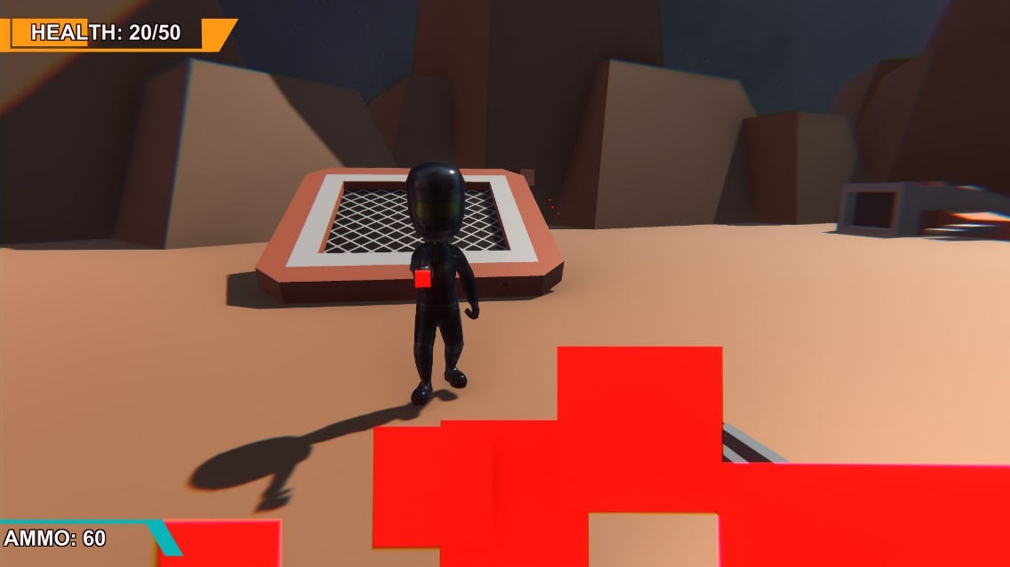
SCREENSHOTS

Slide 8
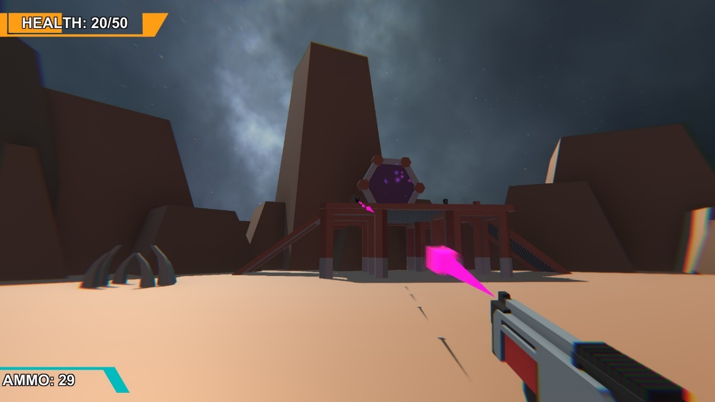
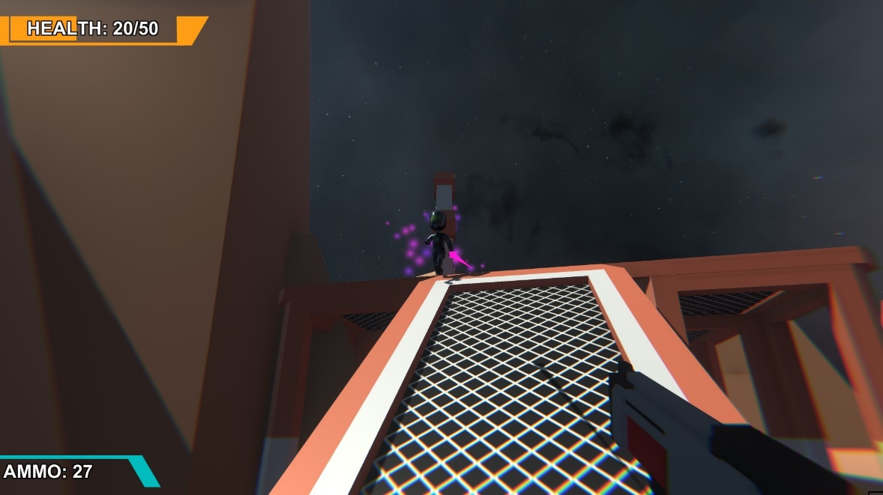

Slide 9
THANK YOU & enjoy!!

