Slide 1

INDIAN INSTITUTE OF TECHNOLOGY GANDHINAGAR
PG Diploma in AI-ML and Agentic AI Engineering · Cohort 2 · Build 1
BRIEF C · INVOICE-TO-CAPTURE RECONCILIATION · GROUP 10
Can Finance separate timing from missing matches?
At H1 2026 close, 11,586 of 162,876 invoices (₹26.828 crore billed) carried ₹1.947 crore in positive balances; after later captures, ₹1.648 crore (6.14% of H1 billings) remained open across 9,824 invoices on 15 July, while 1,541 H1 captures worth ₹0.267 crore still lacked a safe invoice match—Finance should prioritize June's open invoices and resolve both exception lists before calling balances lost.
Rishabh · Group 10
Notes:
Say the question and the claim, nothing else. Twenty seconds. The cover is read, not presented.

Slide 2
1 · THE QUESTION
1 / 6
Which H1 invoices had no captured match, which captured payments matched no invoice, and how much was timing?
Her words:
“Which invoices were never paid, which payments match no invoice, and how much of the gap is only timing?”
Our translation:
Build an H1 invoice-to-capture bridge at each source table’s grain, applying only safe reference matches and showing counts, rupees, and cutoffs.
The decision it drives:
Prioritize Finance follow-up while keeping late receipts and unresolved exceptions separate from confirmed losses.
Indian Institute of Technology Gandhinagar · PG Diploma in AI-ML and Agentic AI Engineering · Cohort 2 · Build 1
Notes:
One minute. Her words first, then the translation in one line, then the decision. If the panel does not know what decision hangs on your answer by the end of this slide, nothing after it matters.

Slide 3
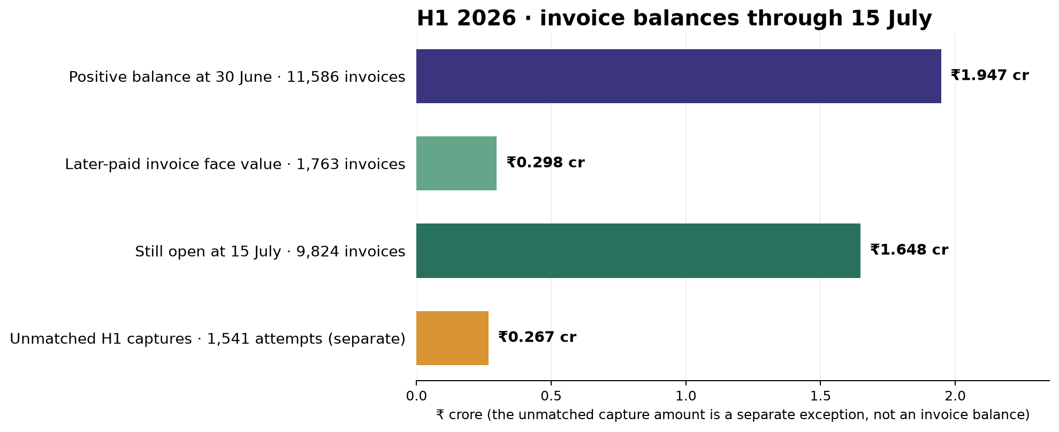
2 · THE PICTURE
2 / 6
Close balances, later receipts, remaining open amount, and unmatched captures
Indian Institute of Technology Gandhinagar · PG Diploma in AI-ML and Agentic AI Engineering · Cohort 2 · Build 1
Notes:
Ninety seconds. Point at two numbers on the picture, the two that carry the claim. Do not read the diagram aloud.

Slide 4
3 · THE CLAIM
3 / 6
A board sentence with period, denominator, cutoff, and a Finance action
At H1 2026 close, 11,586 of 162,876 invoices (₹26.828 crore billed) carried ₹1.947 crore in positive balances; after later captures, ₹1.648 crore (6.14% of H1 billings) remained open across 9,824 invoices on 15 July, while 1,541 H1 captures worth ₹0.267 crore still lacked a safe invoice match—Finance should prioritize June's open invoices and resolve both exception lists before calling balances lost.
Indian Institute of Technology Gandhinagar · PG Diploma in AI-ML and Agentic AI Engineering · Cohort 2 · Build 1
Notes:
Say the sentence. Stop. Count to two. The silence is the point; the slide has one sentence on it so the room reads it twice.

Slide 5
4 · THE EVIDENCE
4 / 6
Three measured numbers; the fourth bar is a separate exception
1 · 4.97% growth
457,539 / 435,880 active scheduled test lines, H1 2026 vs H1 2025; rounds to 5%.
2 · ₹1.947 crore
Positive balances across 11,586 invoices at 30 June.
3 · ₹1.648 crore
Still open across 9,824 invoices by 15 July: 6.14% of ₹26.828 crore H1 billing.
Indian Institute of Technology Gandhinagar · PG Diploma in AI-ML and Agentic AI Engineering · Cohort 2 · Build 1
Notes:
Two minutes. Each number with its denominator, said aloud. Point at the chart's axis label where the denominator is written. This is the slide the finance controller checks against the decisions log.

Slide 6
5 · THE CAVEAT AND THE ALTERNATIVE
5 / 6
The balance is provisional; do not net unrelated invoices or claim a loss
What could change the claim:
Finance has not confirmed source completeness, contractual due dates, refunds/reversals, or independent bank and clinic-cash coverage. The ₹1.648 crore is open at the observation cutoff, not a verified overdue or loss amount.
Alternative rejected:
Netting ₹0.117 crore of overcaptures against positive balances would reduce the headline from ₹1.947 crore to a net diagnostic of ₹1.830 crore, but could offset unrelated invoices. We report the positive balances and overcaptures separately.
Indian Institute of Technology Gandhinagar · PG Diploma in AI-ML and Agentic AI Engineering · Cohort 2 · Build 1
Notes:
Ninety seconds. One caveat, chosen, with its size. One rejected alternative from the approach log. This slide is where the panel decides whether you thought or just computed.

Slide 7
6 · THE ACTION
6 / 6
Start with the largest measured cohort; verify both exception queues
Do: Review June invoices first (45.8% of the 15 July open balance), then resolve the late-capture and unmatched-capture lists.
It costs: Finance review time; hours are not estimated from the supplied files.
If we are wrong, it costs: Misstating collections or treating a timing/reference issue as a permanent loss.
With two more days: Confirm due dates, source coverage, reversals, and bank/cash evidence, then rerun the bridge.
Indian Institute of Technology Gandhinagar · PG Diploma in AI-ML and Agentic AI Engineering · Cohort 2 · Build 1
Notes:
One minute. End on the cost of being wrong. No thanks, no summary, no inspirational closing line. Then say 'questions' and stop talking.

Slide 8
Questions
Approach, cleaning and caveats: github.com/RishabhInTech/c2-build1-brief-C-group-10
Notes:
Leave this up during questions. When asked 'why this and not that', open the approach-log row on screen rather than answering from memory.

Slide 9
APPENDIX A
7 / 8
Appendix A · The decisions that moved the headline
Rule 1 · Volume: count active nonblank booking-test lines by scheduled date; 4.97% growth reproduces the handbook’s rounded 5%.
Rule 2 · Matching: exact invoice ID, then hyphen removal only when the canonical invoice key is unique; no amount/date fuzzy matches.
Rule 3 · Balance: calculate positive balances invoice by invoice; keep ₹0.117 crore overcaptures separate.
The full cleaning and timing choices are in docs/decisions-log.md.
Indian Institute of Technology Gandhinagar · PG Diploma in AI-ML and Agentic AI Engineering · Cohort 2 · Build 1
Notes:
Backup slide: shown only if the panel asks. Do not present it.

Slide 10
APPENDIX B
8 / 8
Appendix B · The cold run
Full-pack cold run in a fresh Codespace: not yet recorded.
Focused tests: 10 passed. Notebook JSON and code-cell validation: passed.
Headline: ₹1.947 crore positive balance at 30 June; ₹1.648 crore still open by 15 July.
Branch: Rishabh · validate the full data-pack run before final presentation.
Indian Institute of Technology Gandhinagar · PG Diploma in AI-ML and Agentic AI Engineering · Cohort 2 · Build 1
Notes:
Backup slide: shown only if the panel asks. Do not present it.

