Slide 2
Accident Prediction and Notification System
PRESENTED BY:-
Raja Kumar (R164216049)
Ravikant Saini (R164216050)
Rishabh Kumar (R164216053)
Sakshi Raj (R164216057)
Under the guidance of
Ms. Gaytri Bakshi
Assistant Professor
(Dept. of Cybernatics)

Slide 3
ABSTRACT
An approach to predict the road accidents in a particular area , by
analyzing the data of number of accidents happening in that area
throughout a particular course of time . It will be a probabilistic prediction
based on certain machine learning algorithms . We will be developing a
desktop application in java to demonstrate our prediction and a notification
system to alert the nearby Ambulances and hospitals.

Slide 4
INTRODUCTION
Analyzing the dataset.
Predicting Accident Prone Areas.
Notifying.

Slide 5
PROBLEM STATEMENT
There is a need to predict the road accidents in our country , so that we can prepare ourselves for those accidents. By preparing ourselves means , we can handle those situation more efficiently and can provide the people with faster and better medical facilities.
A need to create a efficient alert/Notification system for the ambulance drivers , so that they can prepare themselves earlier before these accidents can even occur.

Slide 6
OBJECTIVES
Predicting Accident Prone Areas using old datasets and generating notifications regarding the chances of accidents to be take place in the particular area.

Slide 7
Methodology
A Desktop based application is designed in JSwing to create a Graphical user interface (GUI) for the Users to access the notification System and to get the probabilistic data. In the backend we will be implementing machine learning algorithms to manage the datasets and to get the required results out of it. We will be trying to implement regression based machine learning algorithms to get the required test results and to develop test cases according to that. The regression models will be providing us with results.

Slide 8
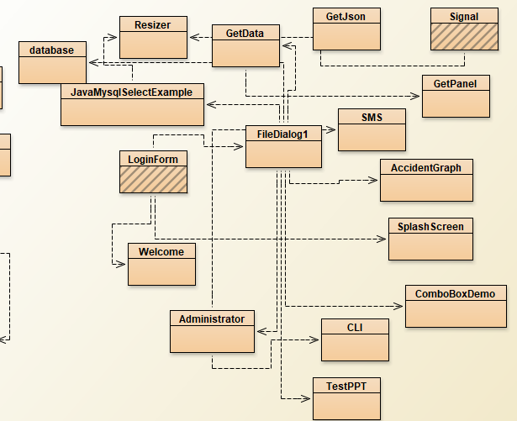
Architecture

Slide 9
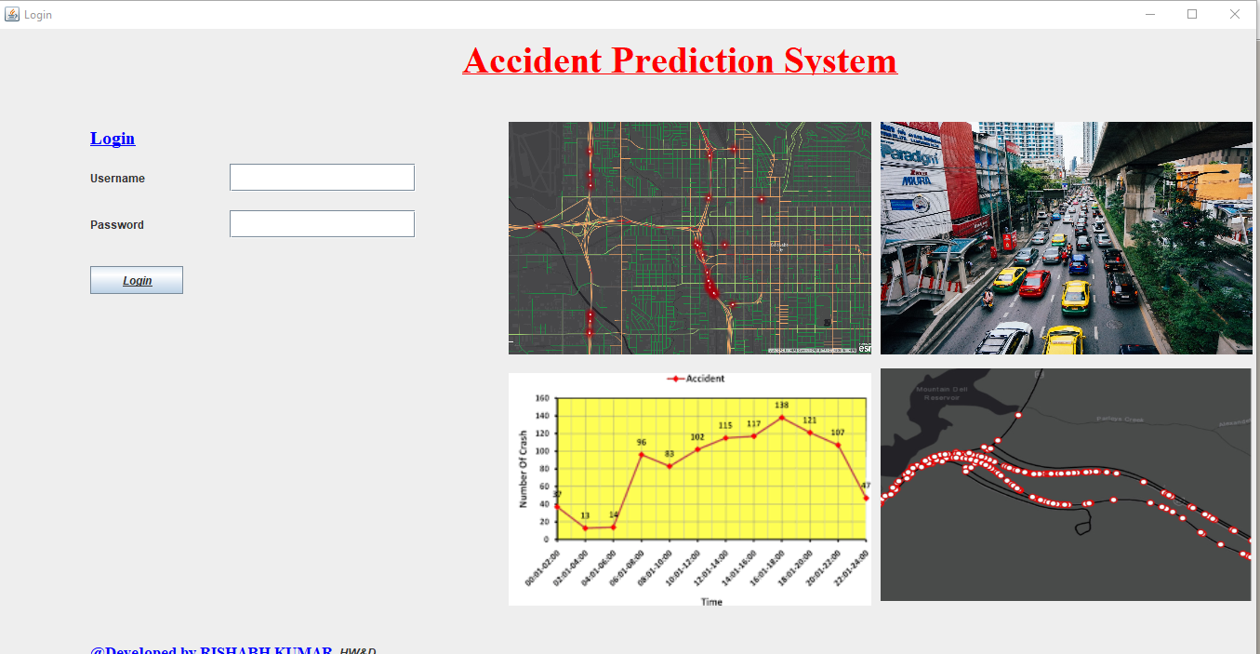
Authentication

Slide 10
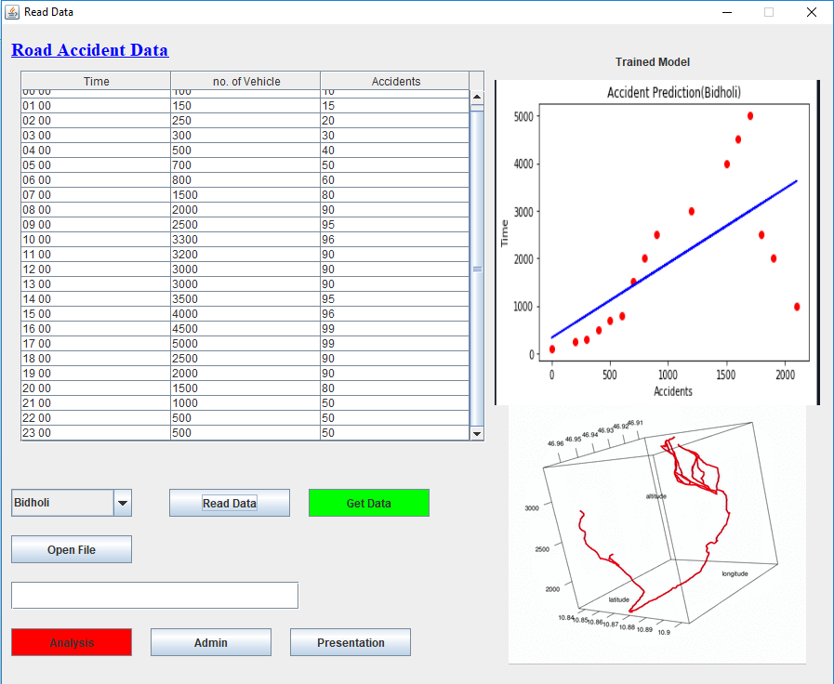
Analysis

Slide 11
REFERENCES
1. Zhuoning Yuan, Xun Zhou, Tianbao Yang, James Tamerius, and Ricardo Mantilla. 2017. Predicting Traffic Accidents Through Heterogeneous Urban Data: A Case Study. In Proceedings of 6th International Workshop on Urban Computing, Halifax, Nova Scotia, Canada, August 2017 (UrbComp-2017), 9 pages. https://doi.org/10.475/123_4
2. Predictive Analytics of Road accidents in Oman using machine learning Approach by Girija Narasimhan , Sunitha cheriyan , Ben George, Balasupramanian . N in 2017 International Conference on Intelligent Computing,Instrumentation and Control Technologies (ICICICT)

