Slide 1

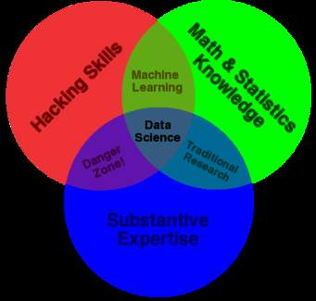
“Battle of Neighborhoods”

Slide 2
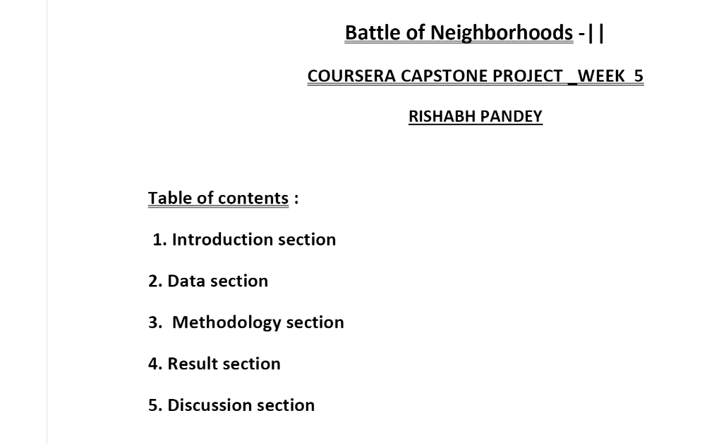
“Battle of Neighborhoods”

Slide 3
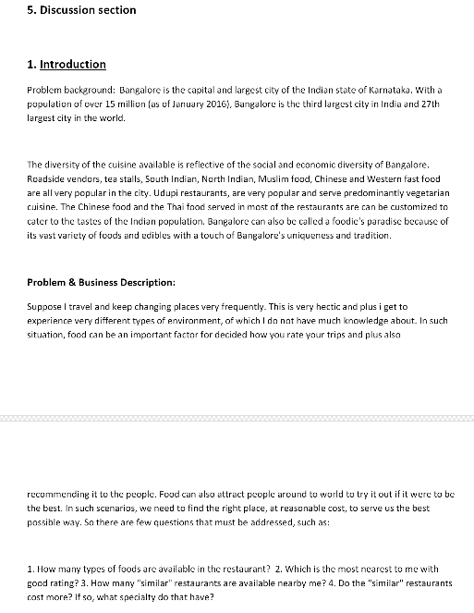
“Battle of Neighborhoods”

