Slide 1
Tired of paying the entire bill and resubmitting the bills to the insurance company for reimbursements ??

Slide 2


Hospital Management System

Slide 3
Hospital Management System
Pranoti Dhabu
Rishabh Modi
Sai Vennela Nekkanti
Jainul Abideen Abul
Janhavi Pawashe
Adwait Kulkarni

Slide 4
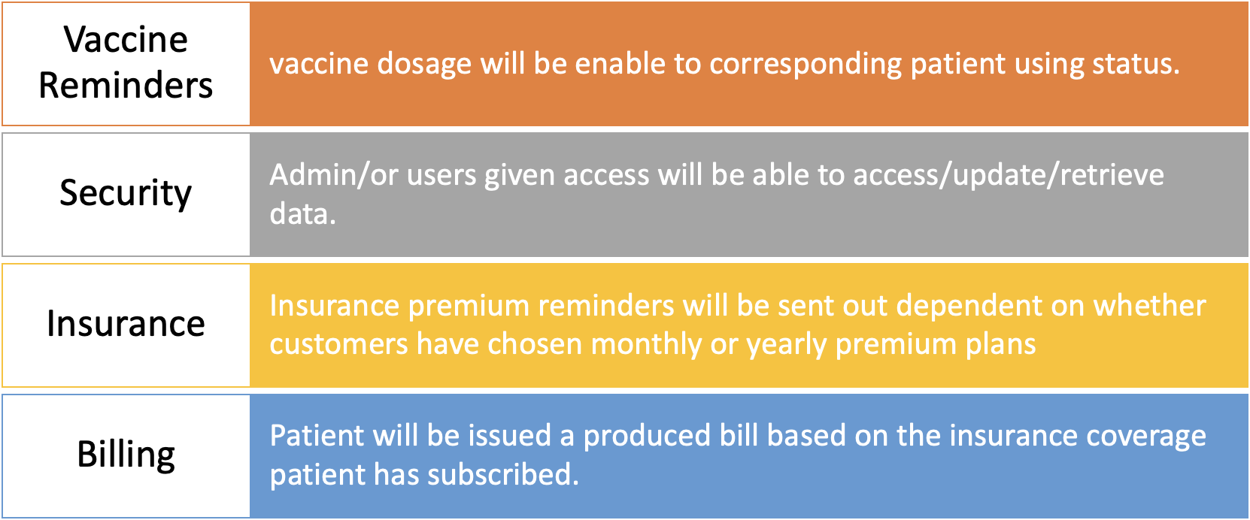
Features

Slide 5
Execution
Procedures to enable the status of vaccine
Multiple execution of initialization of DB
Created Various Views using Joins
Enable various users with limited access over data
Exception Handling done in all procedures and functions
Used triggers to update the billing, due date of Insurance premium

Slide 6
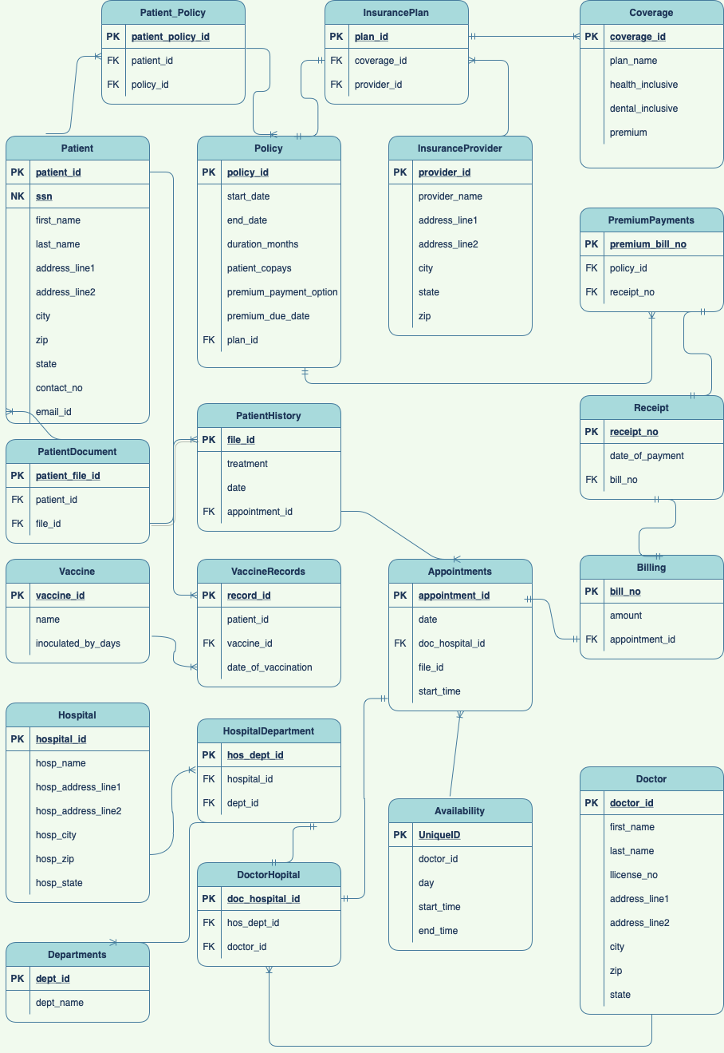
ERD

Slide 7
Rishabh Modi Architecture and ERD
Trigger Table creation
DDL & DML execution
Function
security
Pranoti Dhabu
Architecture and ERD
Table creation
DDL & DML execution
Stored Procedures
Security
Contributions
Sai Vennela Nekkanti
Architecture and ERD
DFDs
Views
Stored Procedures
Function
Jainul Abideen Abul KalamAsath
Data Dictionary
Reports
Table creation
Adwait Kulkarni
Adwait
Business Model
Data Dictionary
Reports
Janhavi Pawashe
Business Model
Data Dictionary
Reports

Slide 8
Advantages
The proposed Hospital Management System has following advantages:
We have enhanced the system to enable every user to access their data anytime and can go paperless
This systems enables seamless billing for patients and insurance claims sent directly to the insurance company, eradicating the hassles of reimbursement.
Its fast, convenient and reliable
Avoids data redundancy and inconsistency
Provides more security and integrity

Slide 9
Future Scope
Can enhance the system by including more facilities like:
Patient room management
Stock details of medicines in pharmacy.
Schedule for the facilities/testing provided by the hospital.

Slide 10
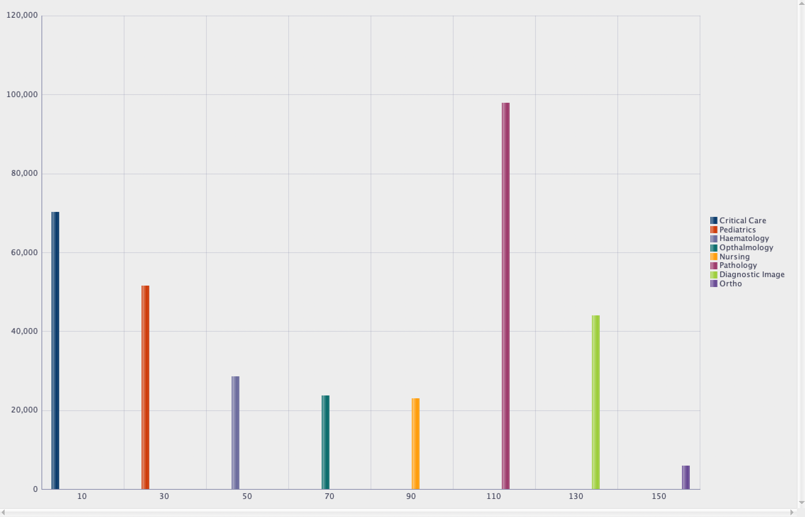
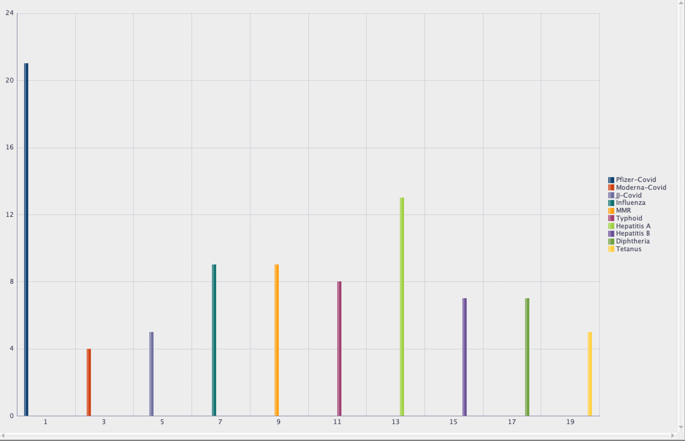
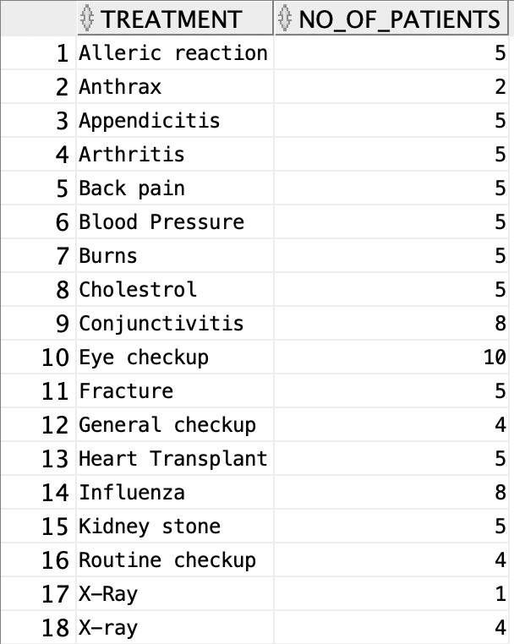
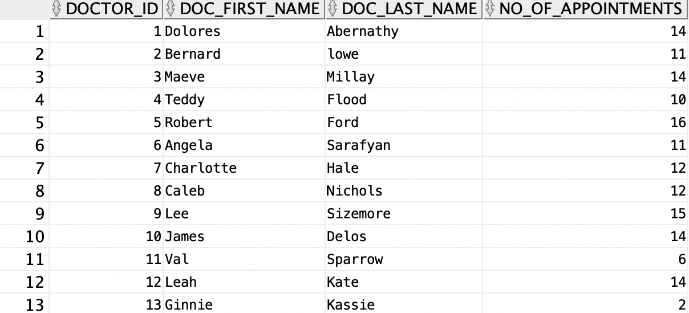
Reports

Slide 11
References
https://docs.oracle.com/en/
https://stackoverflow.com/questions/tagged/sql
https://medium.com/analytics-vidhya/roles-in-oracle-database-f14fc18c7c9c
https://www.oracletutorial.com/oracle-basics/

