Slide 1
Building Permit Category Prediction
By:
Rishabh R Jain

Slide 2
Content
About the Data
Data Pre-Processing
Feature Generation
Key Observations
Model Overview
Model Selection
Feature Importances
Evaluation Metrics
Proposed Improvements

Slide 3
About the Data
Data has various Categorical, Numerical and Text features
Imbalanced Data set
Data has null values which either need to be replaced or removed.

Slide 4
Data Preprocessing
Drop columns which are redundant, sparse or if they don’t help in predicting Target variable
Find the various Categorical, Text and Numerical columns required for processing
Replace null with NA in categorical and “” in text data.

Slide 5
Date columns are converted to DateTime type for easy usage.

Slide 6
Feature Generation
From Date columns, extract a new feature called Total period which is the number of days between Expiration and Application Date.
Find Total period grouped by Target category.
Fill null values in Total period based on Target Category.

Slide 7
For text features, we use count vectorizer.
From Address feature, we extract only the street names and neglect door numbers.
Eg:- 1924 10TH AVE E is transformed to 10THAVEE. We remove spaces so that it is encode as one word.
Description and Contractor features are directly encoded as vectors

Slide 8
For text vectors, we have two approaches.
We can either train a model only on text vectors and then use its prediction along with other numerical and categorical features. But this way there is risk of Data Leakage.
So the best way is stack all the vectors horizontally and the train using only one model.

Slide 9
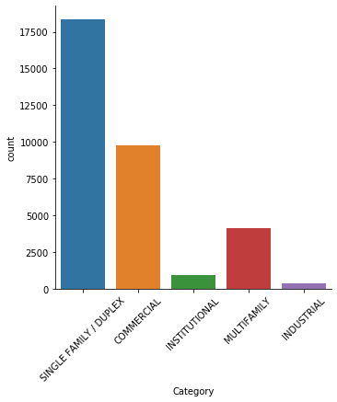
Key Observations
The dataset is imbalanced

Slide 10
The description column contains very informative data with important keywords like Single, Office, Restaurant, Multifamily, Commercial which directly correlate with target category
The Total period value is highest for Multifamily and lowest for Commercial.

Slide 11
Model overview
Text Features
Categorical /
Numerical Features
M
O
D
E
L
Final
Prediction
Count Vectorizer
Text vectors
hstack

Slide 12
Model Selection
Logistic Regression performs decently with an accuracy of 90%. But since dataset is imbalanced we need to focus on Precision and Recall.
To improve latter metrics, I use a balanced Xgboost(give more weightage to data points of less frequent classes)
Currently, I get a precision and recall of 0.94

Slide 13
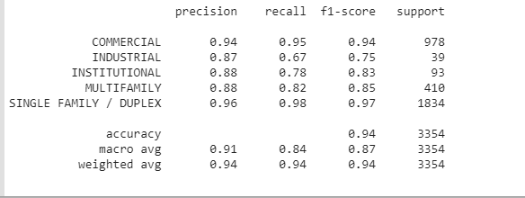
Evaluation Metrics

Slide 14
Proposed Improvements
As we see in the last slide, model performs bad on two categories namely Industrial and Institutional.
We can use SMOTE to increase number of samples of minority class to make dataset balanced.

