Slide 1
Building Permit Category Prediction
By:
Rishabh R Jain

Slide 2
Content
About the Data
Data Pre-Processing
Feature Generation
Key Observations
Model Overview
Model Selection
Feature Importances
Evaluation Metrics
Proposed Improvements

Slide 3
About the Data
Data has various Categorical, Numerical and Text features
Imbalanced Data set
Data has null values which either need to be replaced or removed.

Slide 4
Data Preprocessing
Drop columns which are redundant, sparse or if they don’t help in predicting Target variable
Eg:- Location (which can be found through other features), Issue Date and Final Date (Sparse), Applicant Name.
Find the various Categorical, Text and Numerical columns required for processing
Replace null with NA in categorical and “” in text data.

Slide 5
For location data i.e latitude and longitude, we fill null values with mean. This is done seperately for Train and Test data.
Date columns are converted to DateTime type for easy usage.

Slide 6
Feature Generation
From Date columns, extract a new feature called Total period which is the number of days between Expiration and Application Date.
Find Total period grouped by Target category.
Fill null values in Total period based on Target Category.

Slide 7
For text features, we use count vectorizer.
From Address feature, we extract only the street names and neglect door numbers.
Eg:- 1924 10TH AVE E is transformed to 10THAVEE. We remove spaces so that it is encode as one word.
Description and Contractor features are directly encoded as vectors

Slide 8
For text vectors, we have two approaches.
We can either train 3 models for each one of the vector or can combine all 3 vectors to be trained by a single model.
In general, the latter is better since it will not overfit the data.

Slide 9
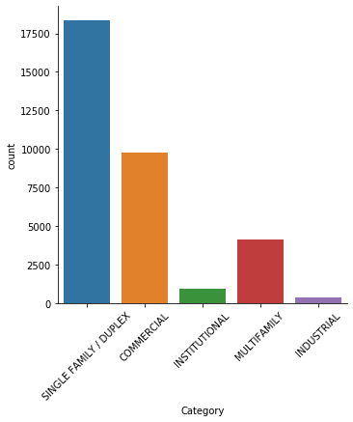
Key Observations
The dataset is imbalanced

Slide 10
The description column contains very informative data with important keywords like Single, Office, Restaurant, Multifamily, Commercial which directly correlate with target category
The Total period value is highest for Multifamily and lowest for Commercial.

Slide 11
Model overview
I create two models and stack first models output as a feature to the second model.
The first model is trained only on text vectors obtained from Address, Description and Contractor columns.
The prediction done by this model is fed into the second model along with numerical and categorical features.

Slide 12
Model overview
Text Features
Categorical /
Numerical Features
M
O
D
E
L
2
Final
Prediction
Count Vectorizer
Model 1
One hot encoding

Slide 13
Model Selection
For Model1, I tried Random Forest and Xgboost. Both models perform equally well
I choose xgboost since it generally performs well due to its adaptive mechanism.
Model 1 output is one hot encoded and fed to Model2 along with other features.
For Model 2, I choose Random Forest.

Slide 14
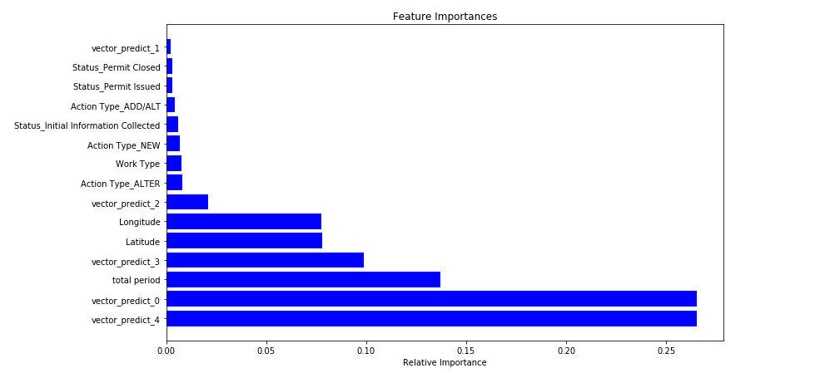
Feature Importance

Slide 15
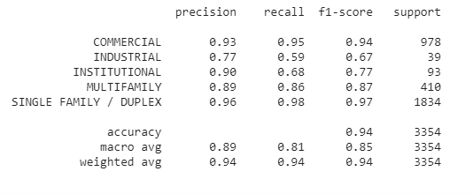
Evaluation Metrics

Slide 16
Proposed Improvements
As we see in the last slide, model performs bad on two categories namely Industrial and Institutional.
We can use SMOTE to increase number of samples of minority class to make dataset balanced.
For prediction of text vectors, Logistic Regression could have been used since it performs well on simple data.

