Slide 1
OpsPilot
Every operations request read, checked against the systems of record, and routed to the person who can decide it
Agentic AI Operations Assistant for a growing retail chain · take-home for the Forward Deployed Engineer role
Live app https://92-4-93-133.sslip.io
Code github.com/RishabhRaizada/agentic-ops-assistant
Demo login any role on the login page · password Demo@2026
Rishabh Kumar Raizada · 4 November 2026
Notes:
OpsPilot turns emailed operations requests into tracked cases. AI agents extract and check the facts and propose costed options; deterministic code enforces policy and routes approvals; people decide. Everything is audited.

Slide 2




Ops decisions today depend on inbox archaeology and follow-ups
Urgent Delivery Delay – Store Launch
Facts are scattered
Inventory, purchase orders, supplier quotes and the store calendar all live in different places; the email is often wrong or incomplete.
Our supplier has informed us that 500 display units required for the Pune store launch will be delayed by 10 days. The store is scheduled to open next week, and only 120 units are currently available in the warehouse. Please assess the impact, identify possible alternatives, and obtain approval for any additional cost by 4:00 PM today.
Deadlines are hours, not days
A 4 PM cut-off leaves no time to chase people for numbers or for the right signature.
Authority depends on amount and region
Who may approve ₹36k vs ₹1.4 lakh vs ₹3 lakh is tribal knowledge; escalation is manual.
No record of who decided what
The assignment's sample email: five facts, four systems to check, one approver to find, hours to decide.
Management summaries are rewritten by hand; there is no trail an auditor can trust.
Notes:
Users: ops analysts triage; ops managers and regional heads approve within limits; directors handle large spend; auditors verify. Their common need: the right facts, the right approver, fast, with a record.

Slide 3


Agents read and propose, code verifies and routes, people decide
AI agents
Deterministic code
People
Extract facts with an exact evidence quote for each
Detect duplicates, updates, cancellations
Assess risk and business impact
Query systems and propose costed options
Critique the plan, draft stakeholder emails and management briefs
Checks email claims against inventory, POs and store calendar
Computes shortfall, launch slip, revenue at risk
Scores confidence from evidence, not self-report
Picks the approver by amount, region and limit
Runs SLA timers, escalation, retries and the audit chain
Correct any fact; AI value is kept beside theirs
Choose, edit or replace an option
Approve, reject with a budget cap, or ask a question
Click send on every outbound message
Close with a resolution reason
Notes:
The core design decision: the LLM never decides authority, money or routing. It reads and proposes; code verifies against systems of record and enforces policy; people make every consequential decision.

Slide 4
From inbox to closure in one tracked flow
1
2
3
4
5
6
7
8
9
Receive
Screen
Extract
Correlate
Verify
Assess
Plan
Decide
Execute & close
Email, form, .eml or webhook
Injection guard on datamarked text
Facts + evidence quotes
Duplicate, update or new
Inventory, POs, calendar
Risk agent vs rules engine
Tool calls → 3 costed options → review
Policy routing, SLA, escalation
Actions, comms, brief, audit
System
AI agent
AI agent
AI agent
Code
AI agent
AI agent
Person
Person
Assignment email, live: about 25 seconds from receipt to three costed options (₹36k / ₹1.42 lakh / ₹2.89 lakh). The ₹1.42 lakh option is routed to the West regional head with the reasons: additional spend, critical risk, supplier order change. If she does not respond by the due time, it escalates to the director.
Notes:
Lifecycle states: NEW, SCREENING, ANALYZING, NEEDS_INFO, NEEDS_REVIEW, READY_FOR_APPROVAL, AWAITING_APPROVAL, APPROVED, IN_PROGRESS, RESOLVED, CLOSED, plus REPLANNING, ON_HOLD, MERGED and CANCELLED. Illegal transitions are rejected and every transition is an audit event.

Slide 5
Seven agents share one fact ledger, and never call each other
Guard
Intake
Correlation
Human approval is mandatory when
any spend, supplier order or customer-commitment change
risk is high or critical
confidence is below 0.75, injection is suspected, or AI was unavailable
any outbound stakeholder email (a person clicks send)
Orchestrator + fact ledger
Comms · Reporter
F1…Fn: value, source, status, confidence; AI and human values side by side
Confidence is earned, not self-reported
field = min(model, grounding)
overall = extraction × agent-vs-rules agreement × 0.7ⁿ conflicts × reviewer × citations
Below 0.5 the AI option cannot be submitted without a written justification.
Risk
Planner + tools
Reviewer
Typed I/O contracts · every claim cites F# or T# · validators force self-correction
Notes:
Coordination is hub-and-spoke over a blackboard. A human correction bumps the ledger version and re-runs only downstream agents; approvals bound to the old plan hash are withdrawn. Unsupported output is handled in layers: schema validation, grounding and citation validators, confidence caps, reviewer critique, rules cross-check, human override, fallback model, rules-only mode. Every run is stored with prompt version, model, input hash, tool calls, retries, tokens and latency.

Slide 6
A small, boring production footprint around the agents
React SPA
Vite + TypeScript + Tailwind; role-aware screens; live polling of agent progress
Model chain (each has its own quota pool)
1. Gemini 3.5 Flash-Lite
Caddy
Automatic HTTPS, static files, /api reverse proxy, security headers
2. Gemini 3 Flash
3. Gemini 3.5 Flash
4. Gemini 3.6 Flash
FastAPI
Auth + RBAC · state machine · policy engine · reconciler · confidence · SLA monitor · outbox · hash-chained audit
5. Groq gpt-oss-120b
6. Deterministic rules
Runs on a 1 GB free VM
PydanticAI agents
7 typed agents, read-only tools, output validators, FallbackModel
systemd service, about 140 MB RAM
Single-file database, demo reset in one click
Docker Compose for local runs; GitHub Actions CI
Trade-off: single instance; Postgres + job queue is the scale path
Data & systems
SQLite (WAL, Postgres-ready) · inventory, PO, supplier-quote and store-calendar adapters with circuit breakers and fault injection
Notes:
Why no agent framework graph: approvals wait hours, so they are database rows with due times rather than paused graph threads, and every transition is auditable. PydanticAI gives typed outputs, validator-driven retries, model fallback and offline test models.

Slide 7
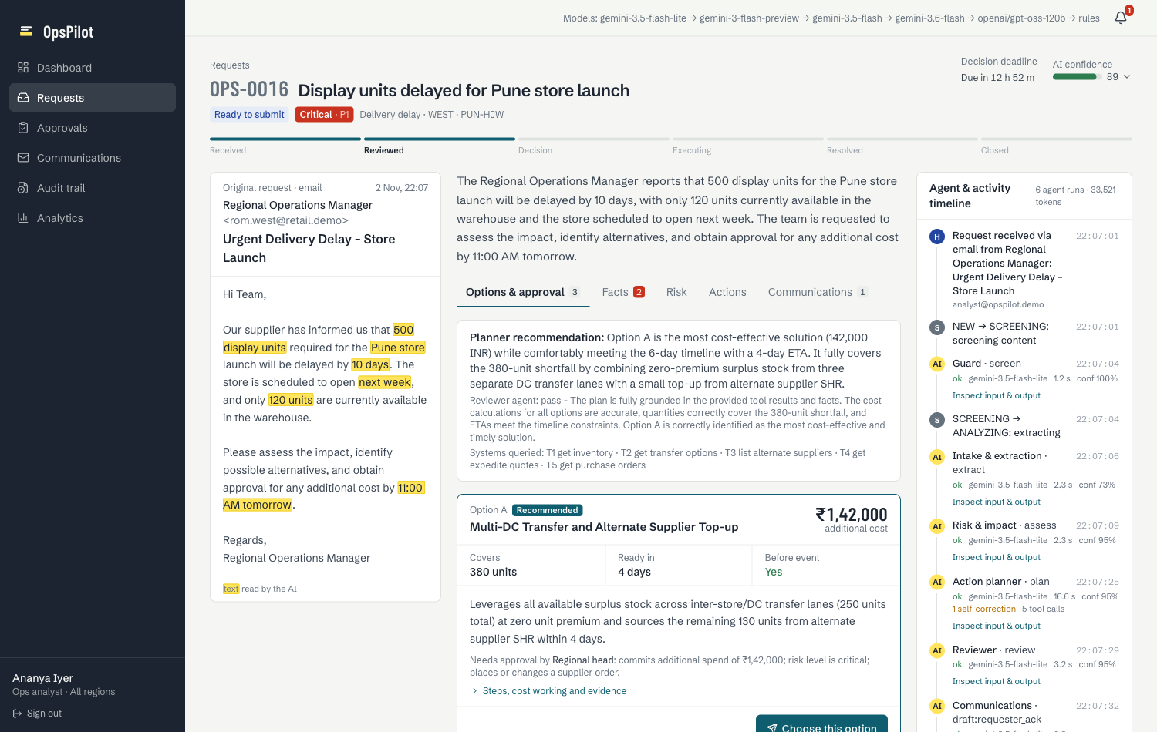
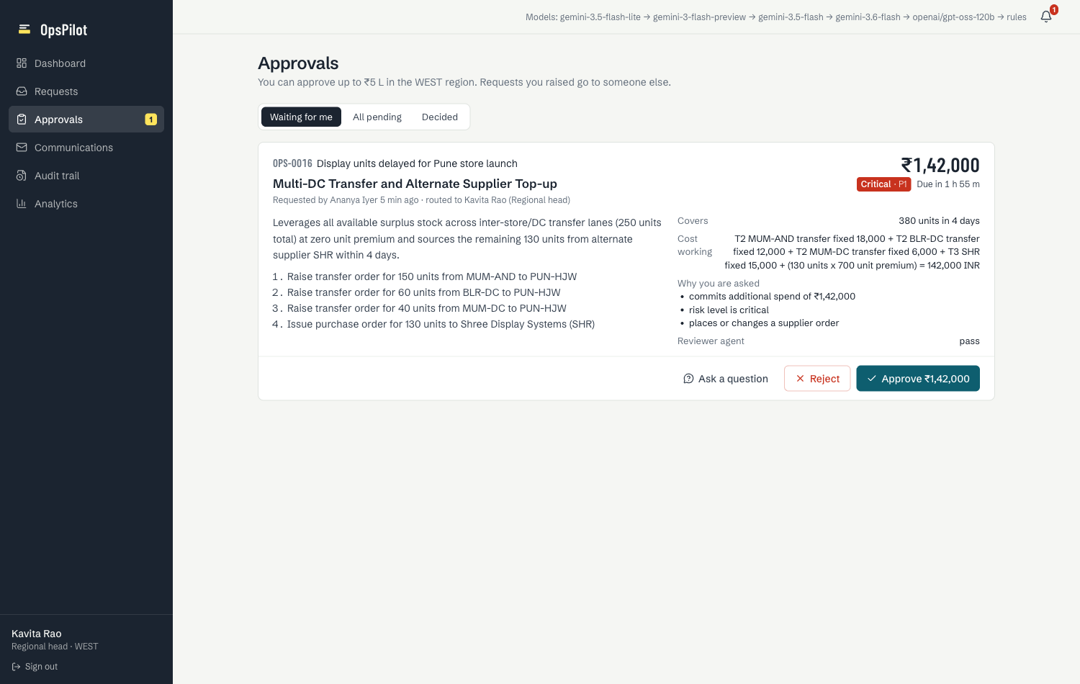
Every AI value shows where it came from and who can act on it
Approval center: what is being approved, the cost working, why this person is asked, approve / reject with budget cap / ask a question, SLA countdown.
The video walks the assignment email from receipt to closure, then demonstrates seven edge cases live.
Request detail: highlighted evidence in the source email, facts checked against systems, three costed options with the required approver, and a live agent timeline with inspectable inputs and outputs.
Notes:
Screens: dashboard, request inbox with simulated mailbox, request detail, approval center, communications outbox, audit trail with chain verification, analytics with AI-quality metrics, admin with fault injection and demo clock.

Slide 8



15 edge cases, each detected, surfaced, recovered and recorded
Data quality
Workflow
Resilience
Security
Missing info → clarification email, SLA paused
Email 150 vs inventory 100 → human picks source
Duplicate sender → merged, requester linked
Multi-issue email → split into linked cases
Wrong extraction → override, AI value kept, re-run
Low confidence → blocked without justification
Approver silent → reminder, auto-escalation
Rejection → re-plan under budget cap
Supplier revises date → approval superseded
Launch postponed → approvals withdrawn
Model or quota failure → next model, then rules
Inventory API down → breaker, unverified flag
Email bounce → retry ×3, dead-letter, in-app
Agents disagree on risk → human acknowledges
Out-of-authority approval → refused + audited
Prompt injection → flagged, quarantined, inert
Every case has an automated test (35 in total) and a simulated email or admin control for live demonstration.
Notes:
Highlight for the panel: the prompt-injection email references a real purchase order; it is flagged, its instructions highlighted, and it is deliberately not merged into or allowed to edit the real case. No agent has any tool that approves, sends or spends.

Slide 9




Built to be trusted, not just demoed
0
5
35
100%
agent tools that can approve, send or spend
model backends before rules-only mode
automated tests, one per edge case
of actions in a hash-chained audit log
Authority in code
Injection defence in layers
Role rank, region scope, approval limit and separation of duties are checked server-side; refusals explain why and are audited.
Regex signals + Guard agent on datamarked text; untrusted mail cannot merge into or edit other cases; humans gate every effect.
Tamper-evident record
Observable AI
Append-only events with SHA-256 chaining; database triggers block edits; one-click verification and CSV export.
Per-run prompt version, model, fallback, retries, tokens and latency; override, fallback and ungrounded rates on the analytics page.
Notes:
Also: httpOnly session cookie with CSRF header, HTTPS, secrets only in environment files, idempotent approval decisions, circuit breakers, outbox retries, readiness probe reporting breaker states and chain integrity.

Slide 10
How I would deploy this with the customer
Discover
Integrate
Shadow
Pilot
Hand over
Week 0
Weeks 1–2
Week 3
Weeks 4–6
Week 7+
Shadow the ops desk, collect 50–100 real requests, map the real approval matrix, baseline the metrics
Ops mailbox → webhook, ERP/WMS/PO adapters (or their stock sheets), SSO, policy loaded in Admin
AI runs on every request while people work as today; tune prompts and rules to ≥ 90% field accuracy
West region decides in OpsPilot; weekly override review with the ops lead; fixes shipped weekly
Region-by-region rollout, Teams/Slack approvals, runbook and training so their team owns it
−60%
≥ 95%
< 10%
Risks I would manage
Model quota or quality → five-backend chain, validators, rules floor
Over-trust → evidence on screen; people approve every effect
Integration delays → adapters behind one module; start from their spreadsheets
request-to-decision time for P1/P2
approvals decided within SLA
extracted fields corrected by people
Pilot exit targets, measured from per-state timestamps and the AI-quality panel
Notes:
I approached the brief as a customer engagement. The deployment plan has explicit exit criteria per phase, agreed with the ops lead. Integration points are isolated: intake webhook, one adapter module for systems of record, mail provider, model chain via environment, and policy in Admin with no code change.

