Slide 1
Predictive Autoscaling with Traffic Replay
Record real traffic. Replay it. Tune scaling before production sees the spike.
k6 • KEDA • Prometheus • Terraform • Kubernetes
Notes:
Introduce the question: can we scale before the load arrives, using what we already know about our traffic?

Slide 2
The problem: autoscaling is always a little late
• Static fleets are sized for the peak and idle most of the day (wasted money).
• Reactive autoscalers wait for load, then need scrape + poll + start-up time (users feel it).
• Scaling knobs (targets, windows, schedules) are usually tuned by guessing, in production.
• Question: can we measure the trade-off safely, before a launch or sale?
Notes:
Reactive scaling needs several steps before a new pod serves traffic: metric scrape, KEDA poll, HPA decision, pod start. For a sharp spike that is tens of seconds of pain.

Slide 3
The idea: record, replay, tune
1. Record
Turn an access log into a profile: requests per second for each time bucket.
2. Replay
k6 replays the profile at compressed time against a test cluster.
3. Tune
Compare static, reactive and scheduled scaling on cost and latency; keep the winner.
One recorded day replays in 24 minutes (1 minute = 1 hour).
Notes:
Three steps, all automated and repeatable. The same profile drives every strategy so the comparison is fair.

Slide 4
Architecture
Access log
record_traffic.py
profile.json
generate_schedule.py
k6 Job
arrival-rate replay
demo-app pods
Flask, 20 ms CPU/request
scale
KEDA ScaledObject
prometheus | cron triggers
traffic
scrape
Prometheus
Terraform: kind cluster + KEDA + kube-prometheus-stack + image load
Notes:
Top row is offline preparation. The middle row is the live loop: k6 sends load, Prometheus measures it, KEDA scales the app. Terraform builds everything underneath.

Slide 5
Who does what
Tool | Role in this project
k6 | Replays the recorded profile as an open-loop arrival rate
Prometheus | Measures request rate and p95 latency from the app's /metrics
KEDA | Scales the Deployment from a Prometheus query (reactive) or cron windows (scheduled)
Terraform | Creates the kind cluster, installs KEDA and Prometheus, loads images
Kubernetes | Runs the app, HPA, and the k6 Job
Notes:
Each tool has exactly one job. Replace any of them (Locust for k6, Datadog for Prometheus) and the idea still holds.

Slide 6
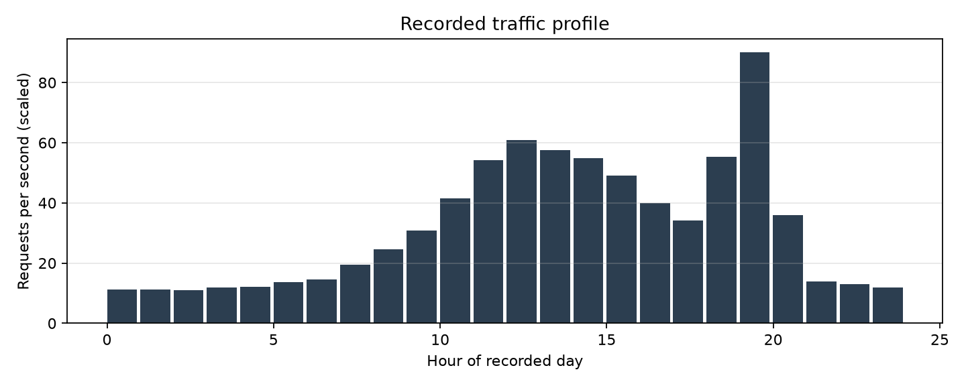
The recorded traffic
• 24 buckets, 1 bucket = 1 recorded hour = 1 minute of replay
• Evening spike is a step change
• Peak scaled to 90 rps for the lab
Notes:
Quiet night, a broad afternoon hump, then an evening flash-sale spike that jumps from about 55 to 90 rps within one bucket. That jump is the hard part.

Slide 7
Three strategies, same traffic
 | Static | Reactive | Scheduled (predictive)
How | Fixed pods sized for peak | KEDA watches Prometheus rps | KEDA cron windows from the profile
Target | 6 pods always | 15 rps per pod | 15 rps per pod, 1 bucket look-ahead
Strength | Simple, safe | No forecast needed | Pods ready before the spike
Weakness | Pays for idle capacity | Late by scrape + poll + start-up | Needs a repeatable pattern
Pod: 20 ms CPU/request, 500m CPU limit, about 25 rps capacity. Pods bounded 2 to 12.
Notes:
Scheduled is the 'predictive' one: it uses the profile to look one bucket ahead and pre-warm pods before a step up.

Slide 8
How the experiment is run
• run_experiment.py resets the cluster, then runs each mode in turn
• Scheduled mode: the cron ScaledObject is generated for that run's exact start time
• k6 waits for a shared start timestamp so cron windows line up with traffic
• Metrics pulled from Prometheus every 15 s: rps, p95, pods
• SLO: p95 under 500 ms. Cost: pods x minutes x $0.04/pod-hour
Notes:
Fairness: identical profile, identical pod size, identical SLO. Cost is a proxy: pod-minutes times an illustrative price.

Slide 9
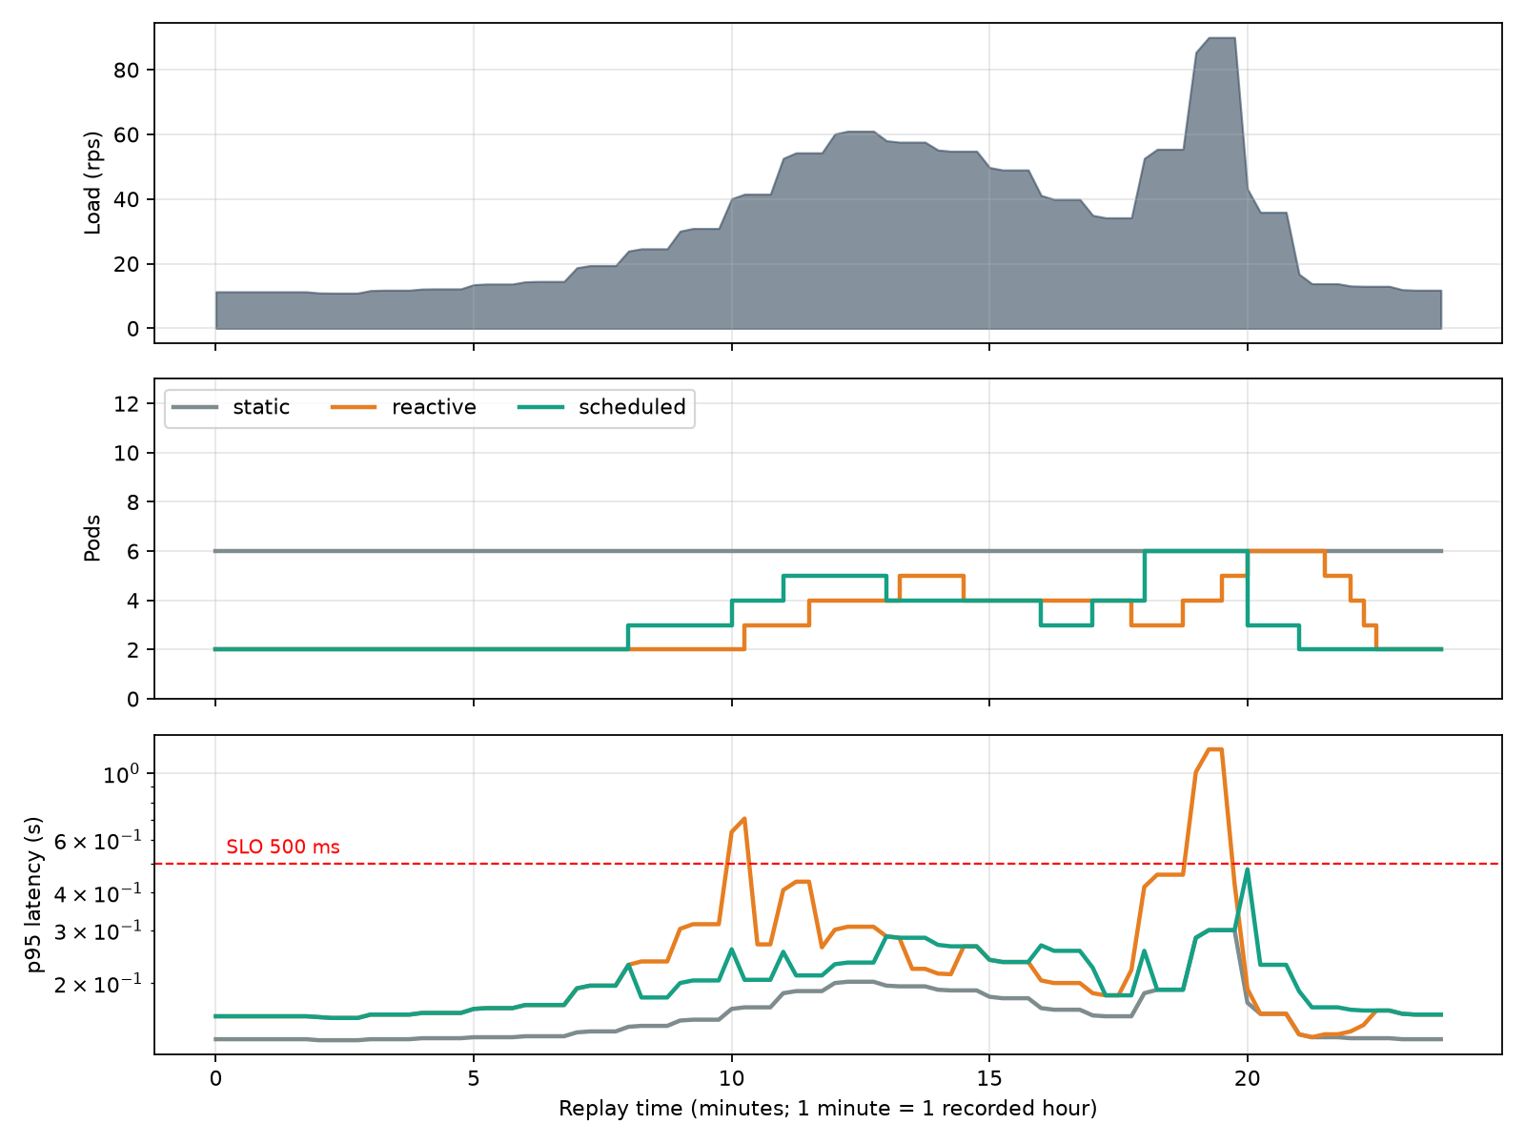
Results: timeline (simulation)
Notes:
Read top to bottom: load, pods, latency. Reactive pods trail the load, and the latency peaks sit exactly at the steps. Scheduled pods step up one bucket early.

Slide 10
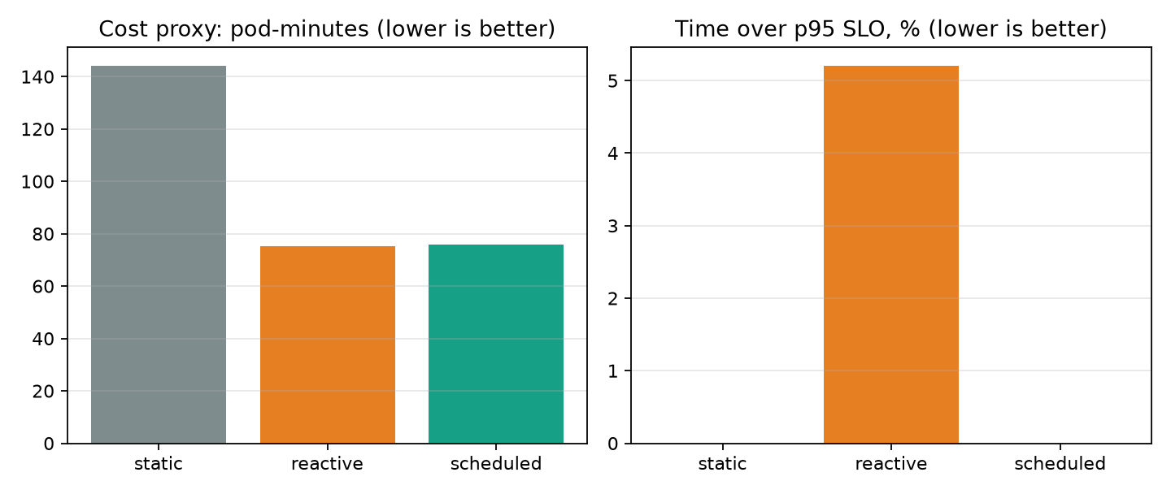
Results: cost vs latency (simulation)
Strategy | Pod-min | Over SLO | Worst p95
static | 144.0 | 0.0% | 0.3 s
reactive | 75.25 | 5.2% | 1.2 s
scheduled | 76.0 | 0.0% | 0.478 s
Reactive spent 5.2% of the run over the 500 ms p95 SLO (worst p95 1.2 s): it only reacts after load has arrived.
Scheduled spent 0.0% over the SLO (worst p95 0.478 s) at similar cost, because pods were ready before the load step.
Notes:
Static is the safe-but-expensive baseline. The interesting comparison is reactive versus scheduled: nearly identical cost, very different SLO behaviour.

Slide 11
Key findings
• Both elastic strategies cut pod-minutes by about 48% (reactive) and 47% (scheduled) versus a peak-sized static fleet.
• Reactive spent 5.2% of the run over the 500 ms p95 SLO (worst p95 1.2 s): it only reacts after load has arrived.
• Scheduled spent 0.0% over the SLO (worst p95 0.478 s) at similar cost, because pods were ready before the load step.
• Static met the SLO (0.0% over) but paid for 6 pods around the clock.
Notes:
Numbers are derived from the results files, so they update when you re-run on a real cluster.

Slide 12
Run it yourself
# no cluster needed
python scripts/simulate.py
python scripts/report.py --source simulation
# full lab on kind
cd terraform; terraform init; terraform apply
kind export kubeconfig --name autoscale-lab
python scripts/run_experiment.py
python scripts/report.py --source cluster
python scripts/build_deck.py --source cluster
Notes:
Simulation needs only Python. The cluster path needs Docker, kind, Terraform and kubectl.

Slide 13
Limits and next steps
• Scheduled scaling only helps if traffic repeats; add a fallback reactive trigger for surprises
• Lab app is CPU-bound by design; real services also depend on databases and caches
• Cron granularity is one minute, so replay buckets are at least 60 s
• Next: forecast the schedule from history, add Grafana dashboards, run in CI before big launches
Notes:
Be upfront: the simulator and the lab prove the method, not your production numbers. Use real logs and your own SLO.

Slide 14
Questions?
Measure scaling before production does it for you.

