Slide 1

SOLAR IMS
Solar Intelligent Monitoring System
Soiling Intelligence & Cleaning Recommendation System
An intelligent decision-support system for solar asset operations
Internship Project Demonstration
Notes:
Open by naming the product, not the assignment: 'Solar IMS is a decision-support system that tells a solar plant's maintenance team exactly when a panel needs cleaning.' Do not over-explain yet — this is a 10-second cold open, not the pitch. Transition: 'To understand why this matters, let's look at the context every solar operator is dealing with today.'

Slide 2



BUSINESS CONTEXT
Solar is scaling faster than the ability to monitor it
Utility-scale solar is growing fast, but our operations teams are still stuck using manual checks and fixed schedules.
Industry context
Every percentage point of lost generation directly reduces plant revenue and delays ROI.
Operating teams need intelligent, data-driven monitoring, not periodic manual checks.
3x
1000s
24/7
PV asset growth vs. 5 years ago
of panels per plant to monitor daily
generation windows, minimal margin for downtime
Solar Intelligent Monitoring System | Soiling Intelligence & Cleaning Recommendation
02
Notes:
Set the stage: solar is one of the fastest-growing generation asset classes, and plants are becoming too large to monitor manually panel by panel. Don't dive into any technology yet — this slide is about the industry backdrop, not the product. Transition: 'Within that growth, one operational problem keeps recurring — dust.'

Slide 3






CURRENT CHALLENGE
A silent efficiency drain, managed by guesswork
Dust Accumulation
Reduced Efficiency
Energy Loss
Reactive Maintenance
Fixed Schedules
Dust and dirt build up quietly on the panels.
Power output silently drops below what it should be.
Once the day is over, that lost energy is gone for good.
We only react after the problem is obvious.
We clean based on a calendar, not when the panels actually need it.
The main issue is that we just cant see the actual condition of the panels.
Solar Intelligent Monitoring System | Soiling Intelligence & Cleaning Recommendation
03
Notes:
Walk left to right as a chain: dust builds up silently, output drops, energy is lost forever that day, teams only react once it's visible, and schedules are fixed rather than condition-based. Keep this to the pattern, not plant-specific numbers — the financial size of the problem comes next. Transition: 'So what does this actually cost the business? Let's put numbers to it.'

Slide 4



BUSINESS IMPACT
Soiling erodes value across the plant
Revenue Loss
Lower Generation
Higher Maintenance Cost
Poor Resource Allocation
Operational Uncertainty
Every lost kWh means lost revenue, and it adds up fast.
Dirty panels quietly underperform compared to their true potential.
Cleaning too often wastes labor, water, and time.
We send crews out based on a schedule, instead of where they are needed most.
Without good data, its hard to know which plant needs help first.
Without smart monitoring, we are almost never cleaning at the right time.
Solar Intelligent Monitoring System | Soiling Intelligence & Cleaning Recommendation
04
Notes:
This is the financial translation of the previous slide — each card is a cost line a stakeholder already tracks (revenue, generation, opex, crew utilization, planning risk). Don't attach specific currency figures unless the plant's actuals are available — speak in terms of the categories of loss. Transition: 'This is the exact gap Solar IMS was built to close — let's introduce the solution.'

Slide 5





OUR SOLUTION
Introducing Solar IMS
A smart tool to help us run our solar plants better.
WHAT IT IS
Solar IMS checks how the plant is doing right now against what it should be doing. Then, it gives our maintenance team a clear, prioritized action plan.
A decision-support layer
on top of plant operations
Detects performance gaps early
It doesnt replace our operations teams.
Prioritizes where action matters most
It isnt just another dashboard with raw numbers.
Recommends the right action, at the right time
A system that turns data into a clear next action
Solar Intelligent Monitoring System | Soiling Intelligence & Cleaning Recommendation
05
Notes:
Position Solar IMS as a decision-support system, not a piece of software or a model — the value is the recommendation it produces, not the technology underneath. Explicitly avoid the words 'machine learning' or 'algorithm' here — save all technical framing for the workflow slide, and even there keep it at a conceptual level. Transition: 'Here is the simple operational workflow behind that recommendation.'

Slide 6




PROTOTYPE WORKFLOW
How cleaning decisions are made step-by-step
1: Input — Sensor Data
2: Process — AI Prediction
3: Validation — Condition Gates
4: Branch — Healthy or Degraded
5: Diagnosis — Classify Severity
6: Correction — Recommendation
7: Output — Dashboard Alerts
Every reading is validated, branched into healthy or degraded, then diagnosed against severity thresholds before a recommendation is issued.
A performance ratio at or above 0.95 is Healthy; below that, readings are classified as Monitor, Schedule Cleaning, or Clean Immediately.
Solar Intelligent Monitoring System | Soiling Intelligence & Cleaning Recommendation
06
Notes:
Narrate this once, left to right, at the conceptual level only: data comes in, gets processed, current performance is analyzed against what's expected, any loss is quantified, and a recommendation reaches the dashboard. Do not name specific model types or metrics here — if pressed, say the modeling approach is documented in the notebook. Transition: 'That workflow powers a specific set of capabilities — here's what the system actually delivers.'

Slide 7

KEY CAPABILITIES
What Solar IMS is expected to deliver
Performance Monitoring
Expected Power Estimation
Operational Health Assessment
Constant visibility into how the plant is actually doing.
A solid baseline for how much power we should be making.
A clear view of the plants condition, rather than just raw numbers.
Cleaning Recommendation Engine
Business Impact Estimation
Interactive Dashboard
Tells us exactly what to do: Healthy, Monitor, Schedule, or Clean Immediately.
Shows exactly how much energy and money we are losing.
One simple view for both operators and executives to make decisions.
Solar Intelligent Monitoring System | Soiling Intelligence & Cleaning Recommendation
07
Notes:
Treat this as a product feature summary, similar to a solution one-pager — six capabilities, each in one breath. Do not explain how any capability is computed; if a manager asks, refer them to the notebook and dashboard for the underlying detail. Transition: 'Let's now walk through how an operator actually uses these capabilities day to day.'

Slide 8


OPERATIONAL WORKFLOW
A day in the life of a maintenance operator
01
02
03
04
05
Monitor
Identify
Prioritize
Act
Review
Check the plants health right when the shift starts.
Find any areas that are underperforming.
Focus on the issues that actually impact our bottom line.
Send crews out only where they can actually help.
Confirm the issue is fixed and move on.
Solar Intelligent Monitoring System | Soiling Intelligence & Cleaning Recommendation
08
Notes:
Walk through this as the operator's actual daily loop, not as system architecture — this is the human workflow the product supports. Deliberately avoid the words 'machine learning' or 'model' anywhere in this slide; describe outputs only as 'flags' and 'recommendations.' Transition: 'Repeated every day, this loop is where the real business value comes from — let's quantify it.'

Slide 9


BUSINESS VALUE
What is ultimately achieved
Reduced Unnecessary Cleaning
Improved Maintenance Planning
Potential Energy Recovery
Crews only go out when the panels actually need it, saving us money.
We move away from fixed calendars and only clean when necessary.
Catching issues early saves energy we would have otherwise lost.
Net effect
Moving from fixed schedules to smart, targeted maintenance.
Better Resource Utilization
Data-Driven Decision Making
We focus our maintenance efforts where they matter most.
Every action is backed by data, not guesswork.
Solar Intelligent Monitoring System | Soiling Intelligence & Cleaning Recommendation
09
Notes:
This slide converts the operator workflow into the value story stakeholders care about — cost avoidance, better planning, recovered revenue, and utilization. Keep every point qualitative unless the team has agreed, plant-specific figures to quote — don't improvise numbers live. Transition: 'This value is delivered through a single interface — let's look at the dashboard.'

Slide 10
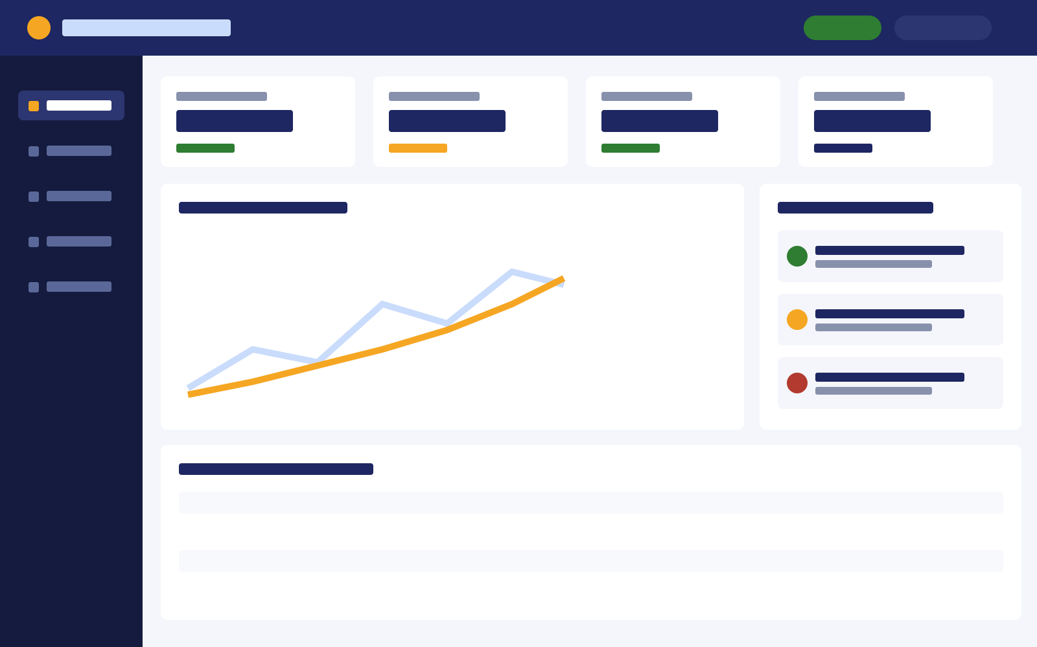

DASHBOARD PREVIEW
Everything we need in one place.
Executive Summary
Quickly see how the whole portfolio is doing.
Plant Health
See the live condition of the plant.
Maintenance Recommendations
Clear, prioritized steps to take right now.
Business Impact
See exactly how much money and energy were losing.
Analytics
Dive deeper into the data if you need to.
Illustrative preview — see live Streamlit dashboard for full detail
Solar Intelligent Monitoring System | Soiling Intelligence & Cleaning Recommendation
10
Notes:
Frame this as a preview, not a live walkthrough — name the five panels and what each is for, then move on. Do not attempt to explain individual charts or click through logic here; hand off to the live Streamlit dashboard for that. Transition: 'This is where the product stands today — here's where it's headed next.'

Slide 11
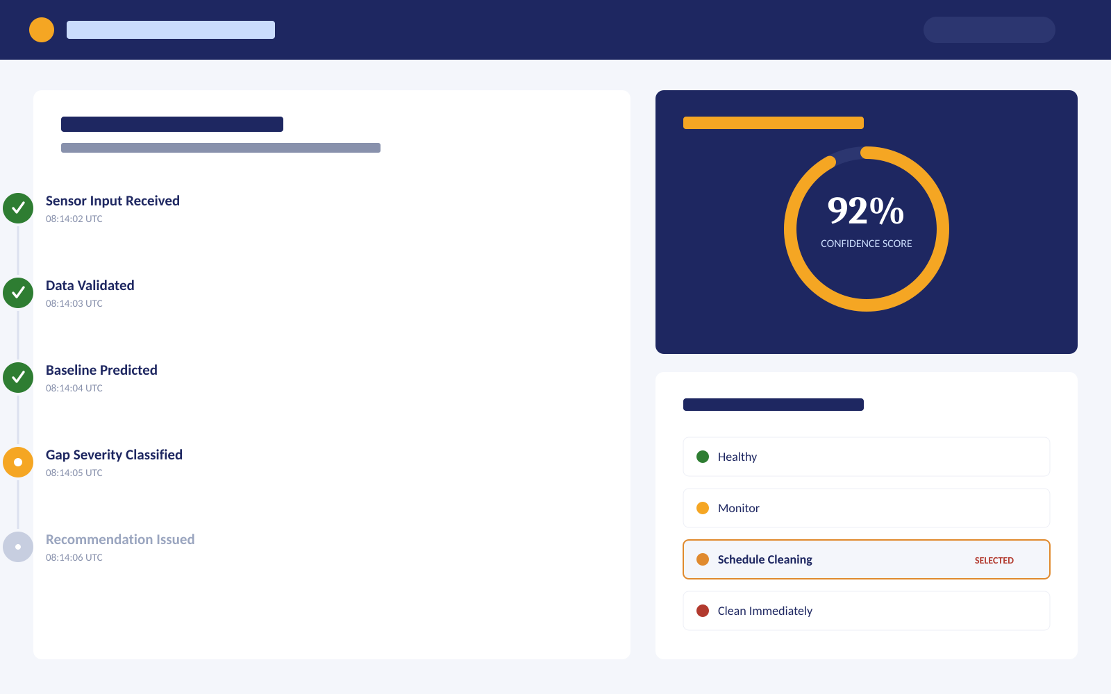
EXPLAINABLE AI & DECISION TRACE
Building trust with a transparent 9-stage audit trail.
Complete Audit Trail
Every decision is tracked from sensor input to final recommendation.
Data Validation Gates
Irradiance and power metrics are validated before any prediction runs.
Transparent ML Model
The model estimates baseline generation and shows the performance gap.
Rule-Based Severity
The gap is classified into clear severity bands, never a black box.
Weighted Confidence
A 0–100% confidence score reflects the quality of the input data.
Illustrative preview — see live Streamlit dashboard for full detail
Solar Intelligent Monitoring System | Soiling Intelligence & Cleaning Recommendation
11
Notes:
Frame this as a preview, not a live walkthrough — name the five panels and what each is for, then move on. Do not attempt to explain individual charts or click through logic here; hand off to the live Streamlit dashboard for that. Transition: 'This is where the product stands today — here's where it's headed next.'

Slide 12





FUTURE ENHANCEMENTS
A roadmap for plant-wide monitoring
Real-Time IoT Integration
SCADA Integration
Thermal Camera Analysis
Move from periodic data to continuous, live monitoring.
Connect directly into existing plant control systems.
Detect hotspots and cell-level faults, not just soiling.
Drone Inspection
Predictive Maintenance
Fleet-Wide Monitoring
Automated aerial surveys for large-footprint plants.
Anticipate issues before performance is affected.
A single view across every plant in the portfolio.
Solar Intelligent Monitoring System | Soiling Intelligence & Cleaning Recommendation
12
Notes:
Present this as a deliberate roadmap sequence — near-term integrations first (IoT, SCADA), then advanced sensing (thermal, drone), then portfolio-scale capability (predictive, fleet-wide). Keep each item to one line of business rationale; save any technical feasibility discussion for offline follow-up if asked. Transition: 'Bringing all of this together — here's the story in summary.'

Slide 13
CONCLUSION
Moving from reactive maintenance to
smart, data-driven decisions.
Problem
Solution
Value
Scalability
Dirt and dust silently eat into our power and revenue.
Solar IMS turns data into clear steps for our team.
Lower costs, more energy, and smarter maintenance.
Built to scale easily from one plant to our whole fleet.
Thank you!
Solar Intelligent Monitoring System | Soiling Intelligence & Cleaning Recommendation
13
Notes:
Close by restating the arc in one breath — problem, solution, value, scalability — then land on the closing line as the single sentence you want the room to remember. Do not reopen technical discussion here; this is the summary and close, not a Q&A slide — invite questions verbally instead. This is the final slide — end with the closing statement and open the floor for questions.

