Slide 1


CDACLinkup
Streamlining student registration and teacher management through role-based access at CDAC Noida.
Presenter
Sanjana Kumbhar, Rishabh Singh, Akarsh Pratap Singh

Slide 2
Introduction and Ob jective
Developing an Efficient Web Application for Educational Management
Web AR.Rl ication Objectives
•
•
•
•
User-Friendly Design
The application will prioritize an intuitive layout, ensuring students and teachers can navigate it effortlessly.
Student Registration
Facilitate a streamlined registration process for students, enabling quick access to their courses and resources.
Teacher Management
Provide features for teachers to manage their classes, and communication with students effectively.
₋:₋
Role-Based Access
Implement security measures that grant different access levels for students and teachers and admin.

Slide 3

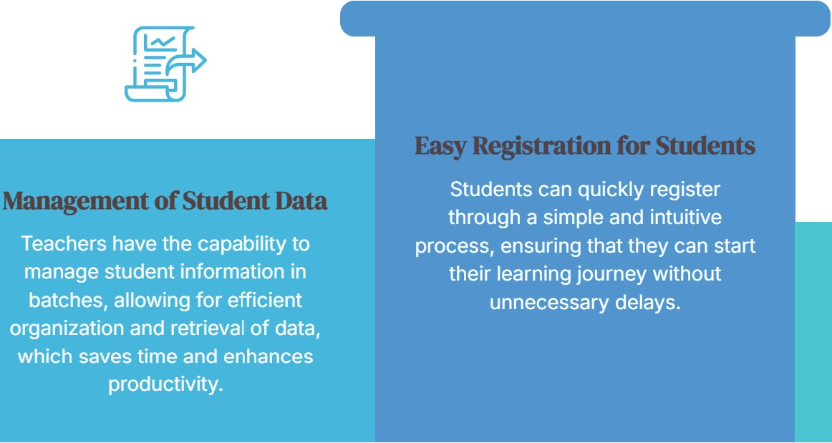


Key Features
Features Overview
Overview of Essential Functionalities for an Effective Learning Environment
Secure Logln -

Slide 4



Frontend and Backend Technologies
Key Technologies in Web Development
•
•
0
Frontend Technologies
The frontend is crucial for user experience, utilizing technologies like HTML for structure, CSS for styling, and ReactJS for dynamic interfaces.
llT\1L
css

Slide 5

Frontend and Backend Technologies
Key Technologies in Web Development
•
•
•
0
Frontend
HTML
HTML (Hypertext Markup Language) forms the backbone of web pages, providing the essential structure needed for
css
ReactJS

Slide 6

Frontend and Backend Technologies
Key Technologies in Web Development
• •
•
•
llT\1L
css
CSS (Cascading Style Sheets} enhances the visual appeal of web pages, allowing developers to apply styles and layouts
ReactJS
Backen

Slide 7
Frontend and Backend Technologies
Key Technologies in Web Development
• •
•
•Jaya
css
ReactJS
ReactJS is a powerful JavaScript library for building user interfaces, enabling the creation of reusable components for dynamic web
Backend

Slide 8
Frontend and Backend Technologies
Key Technologies in Web Development
• •
•Jaya
•
ReactJS
Backend Technologies
The backend handles data processing and server logic, primarily using Java, a robust and widely-used programming
Fraine\

Slide 9

Frontend and Backend Technologies
Key Technologies in Web Development
• •
•
•
Backend
Java
Java is a versatile and platform­ independent language, commonly used for building enterprise-level applications and server-side development.
Dataha
-

Slide 10
Frontend and Backend Technologies
Key Technologies in Web Development
• •
0
Database
Jaya
Framework
Spring Boot is an essential
framework that simplifies Java development, providing tools for building production-ready
.
...

Slide 11
Frontend and Backend Technologies
Key Technologies in Web Development
• •
Fra111e\vork
Database
MySQL is a popular relational database management system used for storing and managing application data efficiently.
.

Slide 12
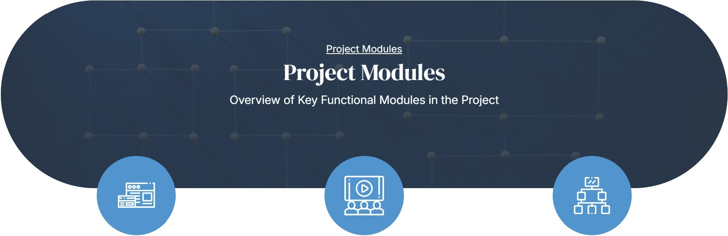
Student Module
Teacher Module
Admin Module
Enables students to register, log in, and retrieve their personal details, ensuring a seamless user experience.
Allows teachers to log in and access student data organized by batches, facilitating effective class management.
Planned enhancements include functionalities for administrators to manage teachers and student system configurations.

Slide 13


Role-Based Access
Understanding Access Rights for Different Roles
Access Control
Teachers' Access
Teachers' Access
Students' Access
Students have access to their personal information, including grades and attendance, enabling them to monitor their academic performance.
Admins' Access
Admin have access to View Users, Filter/Search Users, Edit User Information, Delete Users. Admins manage role assignments for users (students, teachers, and other admins} to ensure appropriate access levels.

Slide 14
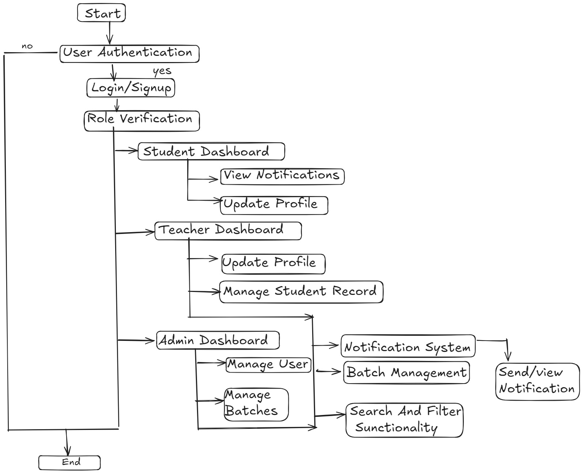
Flow Chart

Slide 15
Key Functionalities
Comprehensive Overview of System Features
KeY. Features
Login/Sign Up Secure login process with | Dashboard Centralized interface | Student Info Profile Detailed profiles for each | Teacher Table Interactive table allowing
OTP verification ensures | displaying essential | student, providing | filtering of students by
user identity and data | student information and | essential academic and | batch and year,
protection. | teacher data for efficient | personal information. | enhancing accessibility to
 | management. |  | student details.
Redirect to Student | Search and Filter API | Mail Notifications | Real-time
Info Page Upon selecting a student, | Robust API integration for searching and filtering | Automated email notifications to keep | Notifications Instant notifications via
users are redirected to a dedicated info page with view-level access.
data, streamlining user experience.
users updated on important events and changes.
API integration to ensure users receive

Slide 16


The CDACLinkup project has been a comprehensive learning experience and a significant step in our professional development. Through this project, we aimed to design and implement a robust and user-friendly website for managing institutional data at CDAC Naida, addressing the needs of students, teachers, and administrators effectively.
Conclusion

