Slide 1
LEARNING TO PROTECT COMMUNICATION WITH ADVERSARIAL NEURAL CRYPTOGRAPHY
Team Artificial Learners :
Akash C R (2020111004)
Ruchitha J (2020101093)
Rishabh Srivastava (2020101047)

Slide 2
Problem Statement
The aim of the paper was to experiment whether neural networks can learn to use cryptography to protect information from other neural networks. Specifically, focusing on ensuring confidentiality properties in a multiagent system, and the properties are specified in terms of an adversary. Thus, in this case a system consists of neural networks named Alice and Bob, and are aiming to limit what a third neural network named Eve learns from eavesdropping on the communication between Alice and Bob. No specific cryptographic algorithms are imposed on these neural networks; instead, train end-to-end, adversarially.

Slide 3
Solution proposed in paper
Paper tried to demonstrate how neural networks can learn to protect the confidentiality of their data from other neural networks by discovering forms of encryption and decryption, without being taught specific algorithms for these purposes.
It considered a classic scenario in security involving three parties such as Alice, Bob, and Eve.Typically, Alice and Bob wish to communicate securely, and Eve wishes to eavesdrop on their communications.Thus, the desired security property is secrecy, and the adversary is a ‘passive attacker’ that can intercept communications but cannot initiate sessions, inject messages, or modify messages in transit.
And for the encryption and decryption purposes Symmetric encryption is being used that is same key will be used for both encryption and decryption.

Slide 4
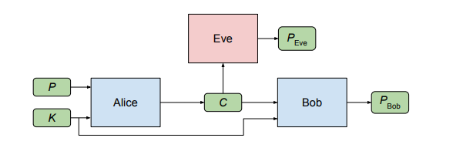
Symmetric cryptosystem
Here, Alice wishes to send a single confidential message P to Bob. The message P is an input to Alice. When Alice processes this input, it produces an output C.Both Bob and Eve receive C, process it, and attempt to recover P. Alice and Bob have an advantage over Eve as they share a secret key K which makes the decryption easier for Bob.For us Alice, Bob, and Eve are all neural networks.

Slide 5
How data points are represented.?
All data points are 1 dimensional binary data points with length N. (Paper has experimented with N = 16)
Binary representation is done using 1 and -1 to represent bit values.
While passing input for Alice and Bob, we need two such data points.
1 is used as plaintext to be encrypted and other is key for encryption.
Plaintext and Key are concatenated and passed to Alice which will generate N bit ciphertext.
Bob receives concatenation of N bit ciphertext and Key K as input and return P_{bob} as output.
Eve is eavesdropper and does not have access to key K and hence takes only Ciphertext as input and generates N bit plaintext P_{eve} as output.

Slide 6
Structure of Alice , Bob and Eve
All are Neural Networks and uses mixture of FC perceptron layers and Convolutional layers.
In case of Alice and Bob, Input vector is processed through 2N x 2N FC layer.
Then the data is sent through 4 successive convolutional layers.
Each layer can be represented with kernel size, in channel, out channel, stride.
Layers are [4, 1, 2, 1] , [2, 2, 4, 2], [1, 4, 4, 1] and [1, 4, 1, 1]
Use sigmoid non-linear unit after each layer except the final one.
Use tanh layer after the final layer to get the values in the range of [-1, 1]
Eve has exact same structure except for the initial FC layer which is N x 2N FC layer.

Slide 7
Loss functions
We write A(θ_{A}, P, K) for Alice’s output on input P, K, write B(θ_{B}, C, K) for Bob’s output on input C, K, and write E(θ_{E}, C) for Eve’s output on input C.
L1 distance d(P, P’ ) = Σ^{N}_{i=1} |Pi − P i’ | where N is the length of plaintexts. ’d’ is the distance function on plaintexts.
Eve’s loss function is direct L1 distance between E(θ_{E}, C) and P
Alice - Bob error depends on two components :
How well the Bob is reconstructing the ciphertext back to plaintext which denotes the successful communication
How well they are able to hide it from Eve which denotes secrecy.
The first component is simply the L1 distance between B(θ_{B}, C, K) and P.
The second component is given by (N/2 - Eve L1 error)²/(N/2)²

Slide 8
Training the Network
While training the network, mini-batches of size 256 to 4096 are used.
Adam optimiser is used with learning rate of 0.0008 for SGD.
Training alternates between Alice-Bob pair and Eve similar to GANs.
In each iteration Alice and Bob are trained for one mini-batch
Eve is trained for two mini-batches.
Ratio of 1:2 is selected and it has been mentioned that empirically this value has worked well.
Training has been continued for 25000 iterations even though equilibrium is achieved at around 15000.
Training is considered successful if even after 25000 iterations Eve’s reconstruction error is around 0.5 (That is equal to random guessing) and Bob’s reconstruction error is less than certain threshold.

Slide 9
What else is there in paper.?
The paper also contains experiment about Selective encryption that is given several inputs and security requirement the network should learn to encrypt only specific part of it.
For this purpose four correlated data points A, B, C and D are taken.
Exact same information structure of Alice, Bob and Eve is used.
Alice takes input as A, B, C and calculated D but outputs D-public (which is an encrypted version of D).
Now the aim of Bob is to get the true D value from D public using the key.
Eve will try to guess what C might be using the knowledge of cipher text of D.
This experiment was done to understand if the selective encryption can be done by neural networks or not.
But scope of our project is to only implement the Secure communication part and not Selective encryption part.

Slide 10
Experiments conducted
We have done several experiments with the encryption decryption idea by modifying network structure, modifying hyper parameters, etc which can be listed as follows :
We changed the batch_size and observed how the reconstruction error of bob and reconstruction error of eve are changing with iterations. Batch sizes being : 128, 256, 512, 1024.
We increased the learning rate from 0.0008 to 0.008, 0.08 and 0.01 and observed how it is affecting the training.
We tried sizes 16 and 32 for input sizes.
We changed the model structure to keep only perceptron layers without any convolutions
We changed the model structure to keep only Convolution layers without any perceptron layer
We also experimented with keeping different convolution layers than as prescribed by the literature.
We also tried to verify the results through implementing RNN, LSTM and GRU.

Slide 11
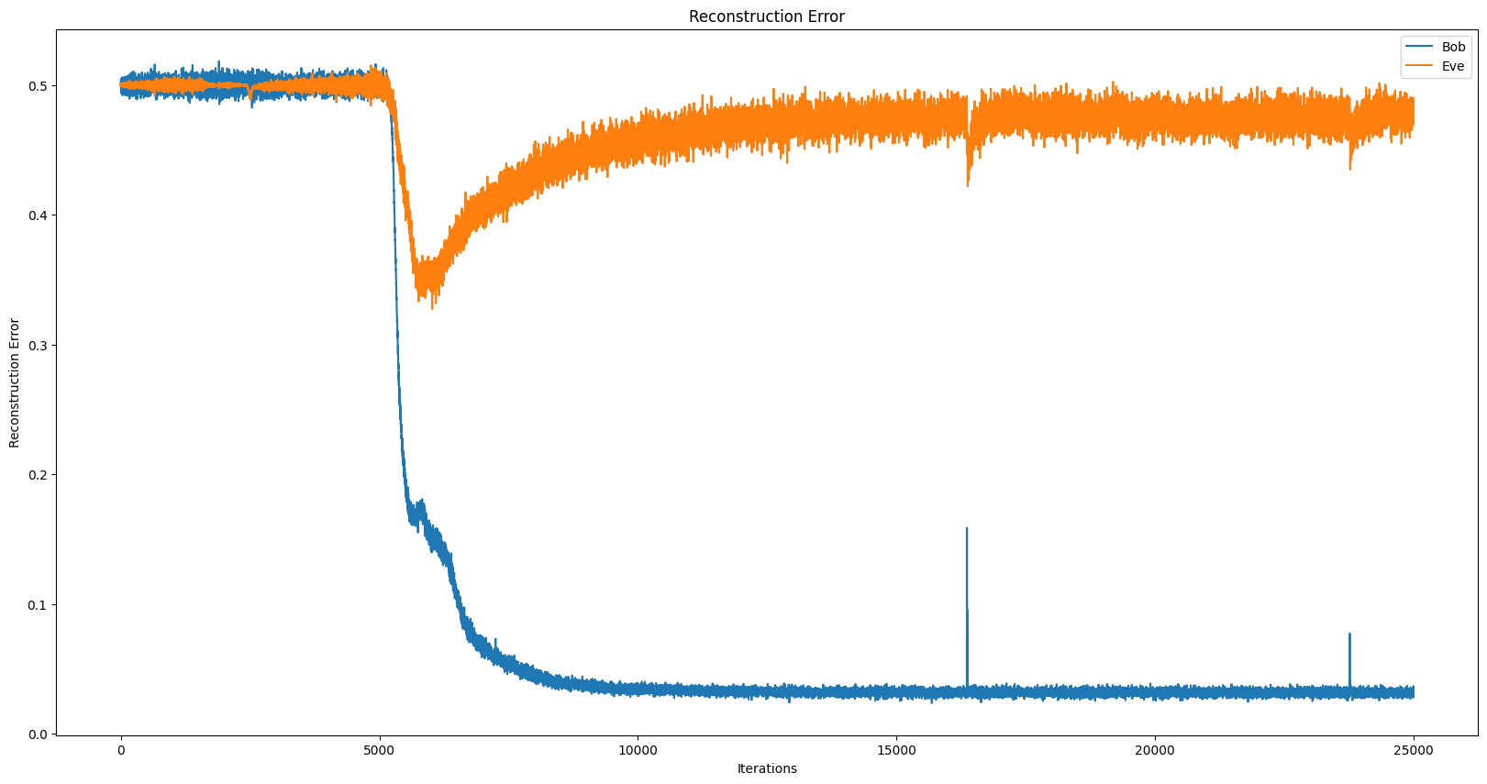
Results of implementation of paper

Slide 12
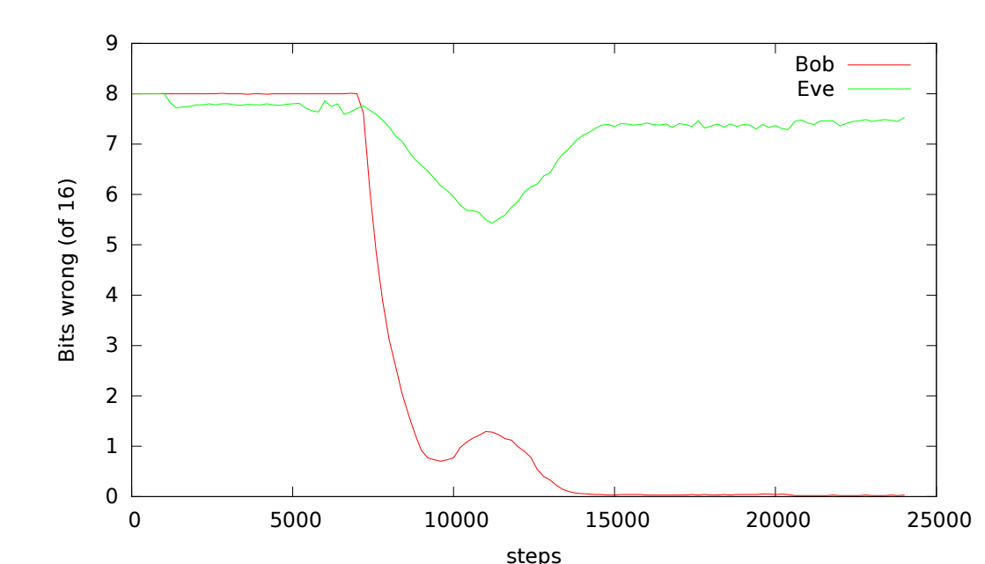
Results as per the paper.

Slide 13
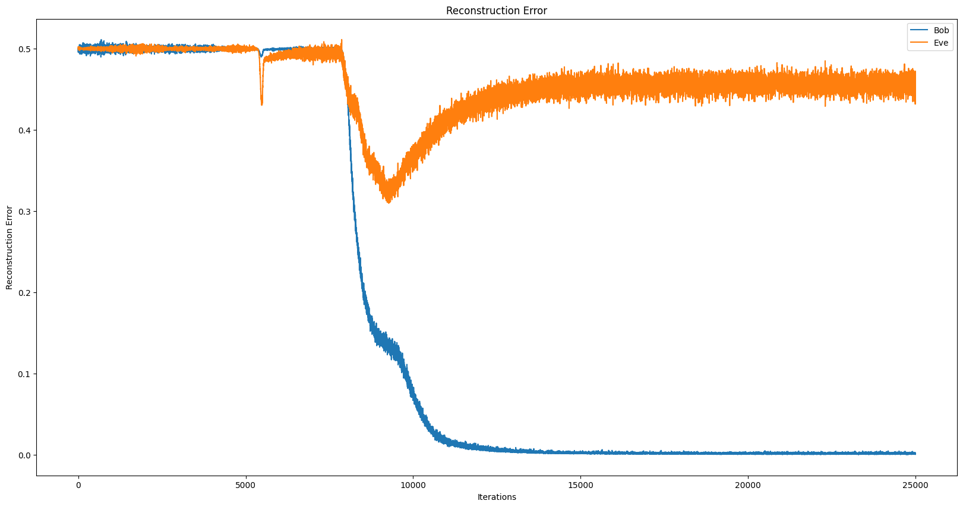
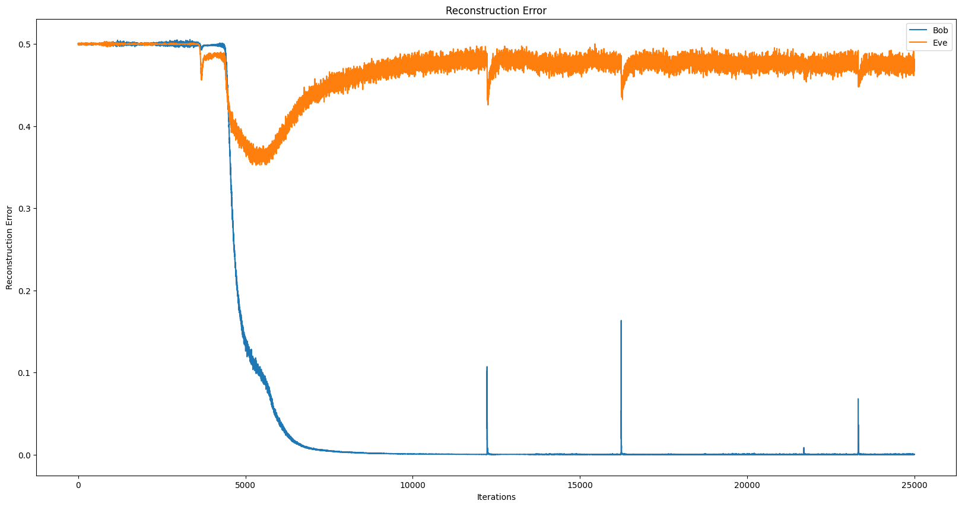
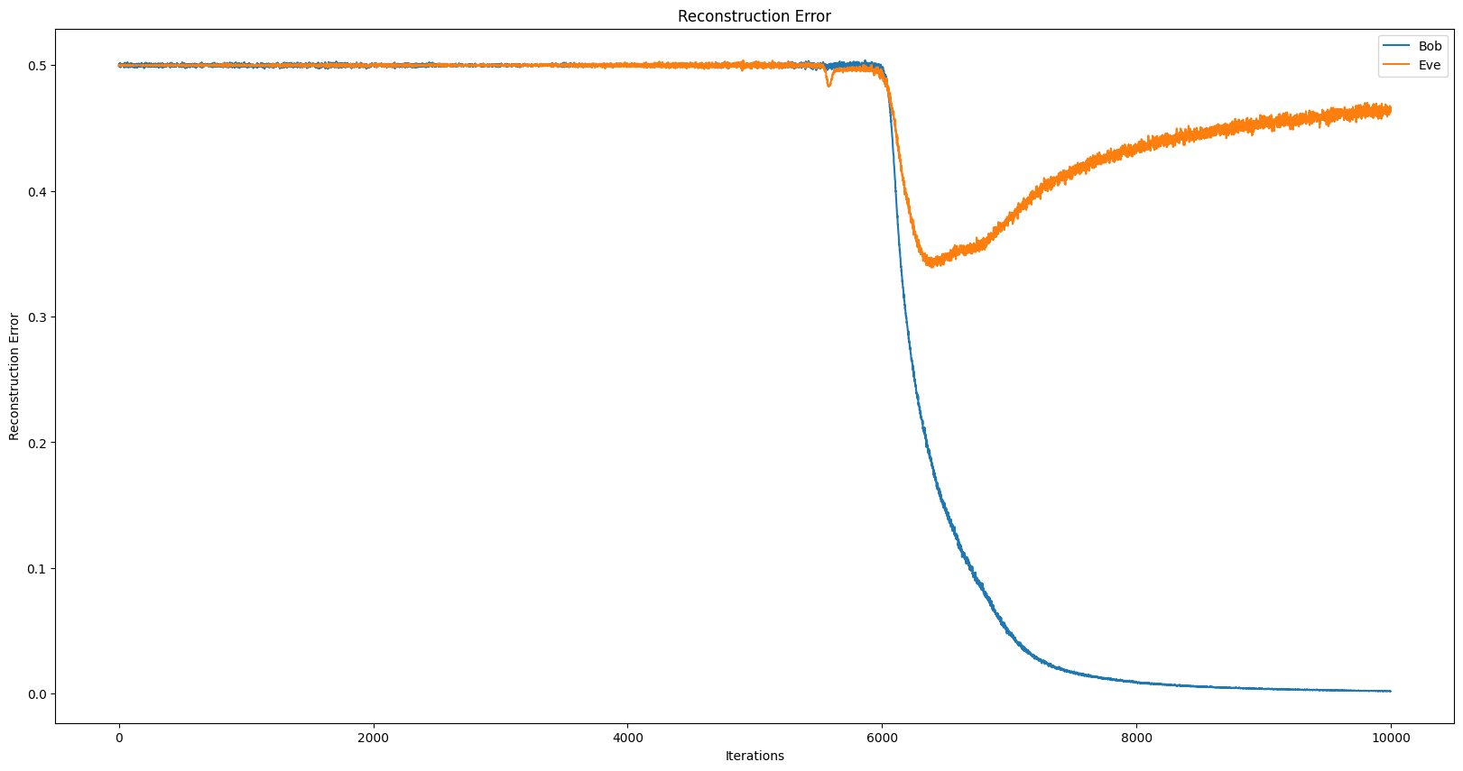
Changing batch-sizes

Slide 14
Observation
The graphs plotted in previous slides are for batch sizes are :
128 (Top-Left)
256 (Top-right)
512 (Bottom-left)
1024 (Bottom-right)
All are for 25000 iterations except , batch size = 1024 which is for 10000 iterations due to computation limitations
As the batch-size is increasing the graph is getting smoother and smoother with very less jitter but the trend for the equilibrium state remains the same.
With higher batch-size, number of tries required for successful training is reducing.

Slide 15
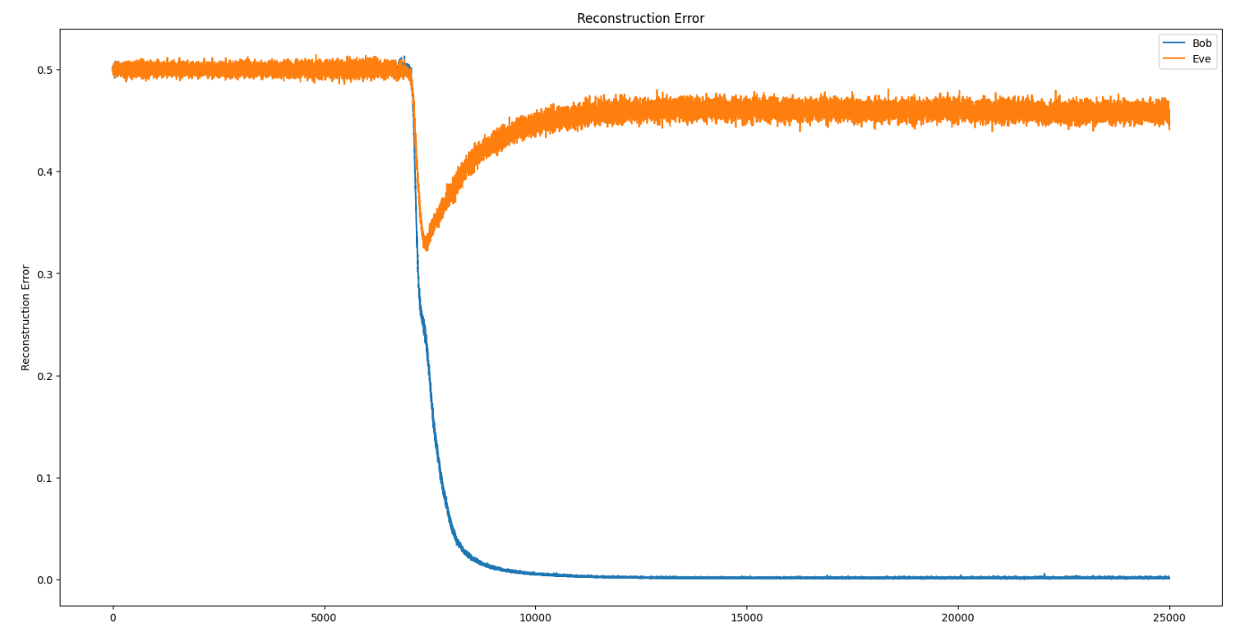
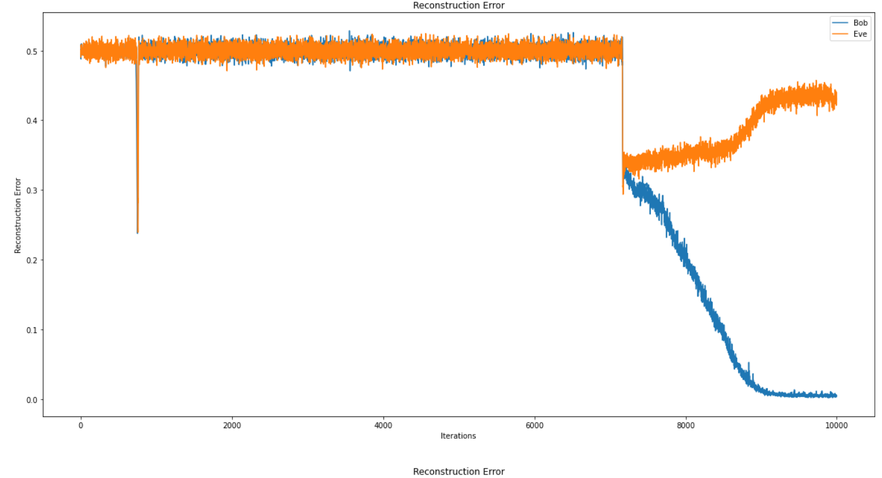
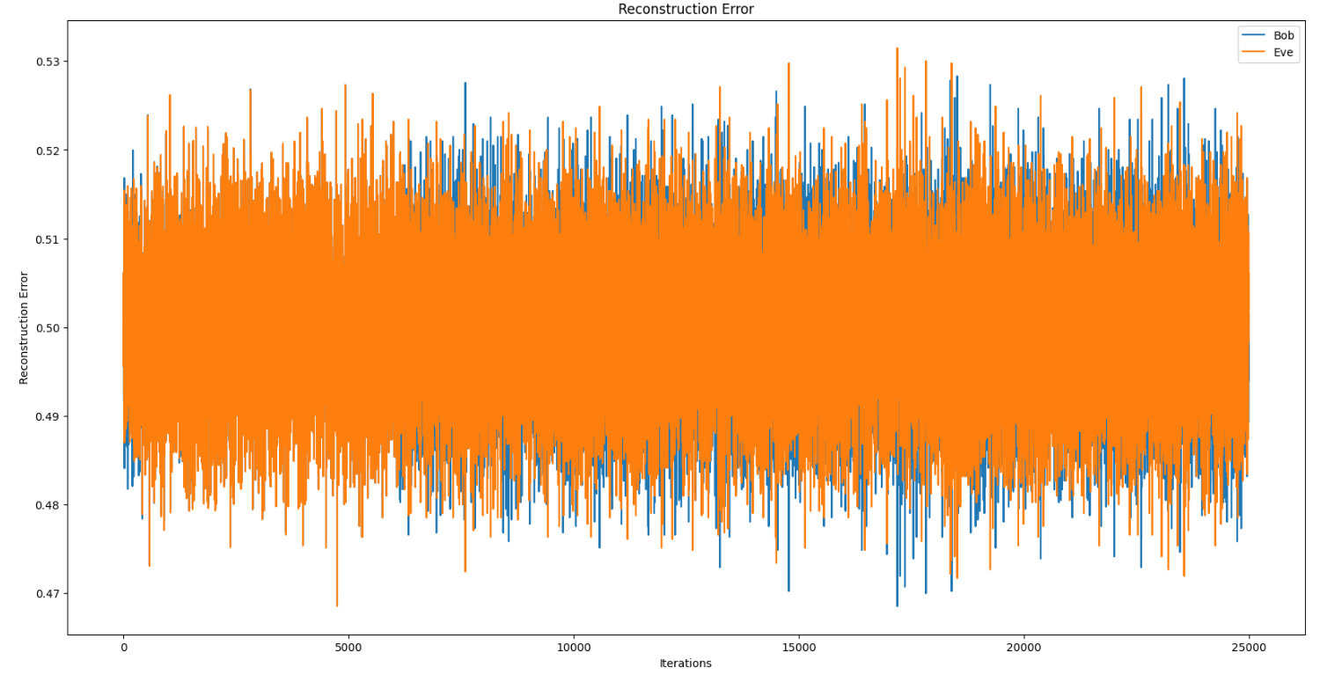
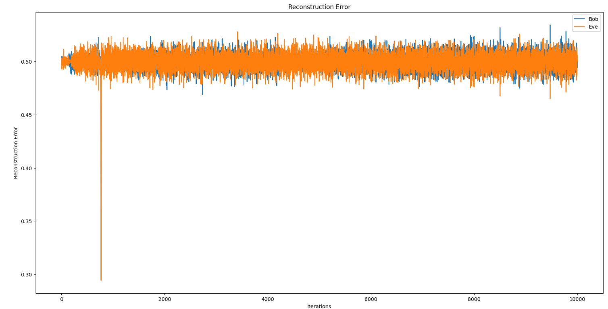
Increased Learning rates

Slide 16
Observations
All other parameters except learning rate is kept constant for the graphs in previous slides. Length is 16, batch size is 256, iterations = 250000
Learning rates used are as follows :
0.0008 (Top left)
0.008 (Top right)
0.08 (Bottom Left)
0.01 (Bottom Right)
As can be understood from the original small learning rate , i.e. 0.0008, we need to take really small steps in order to find the minima.
Since the learning rate is almost increased by 10 to 100 times in the other three experiments, it might be the case that, it is jumping over the minima and is unable to find the global minima due to very large steps being taken.

Slide 17
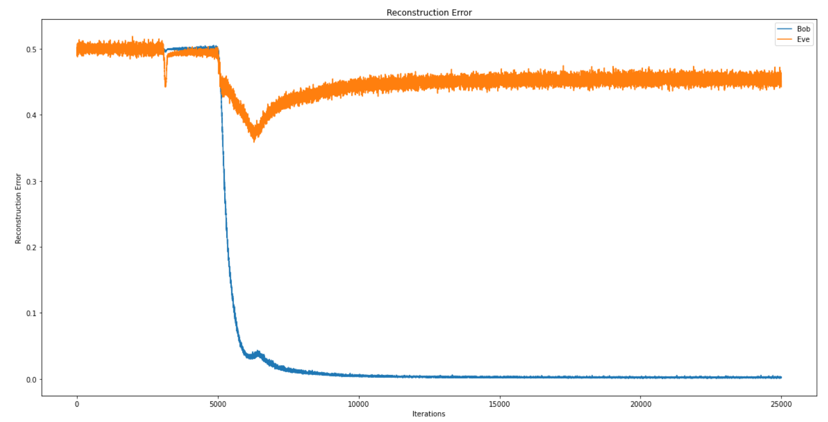
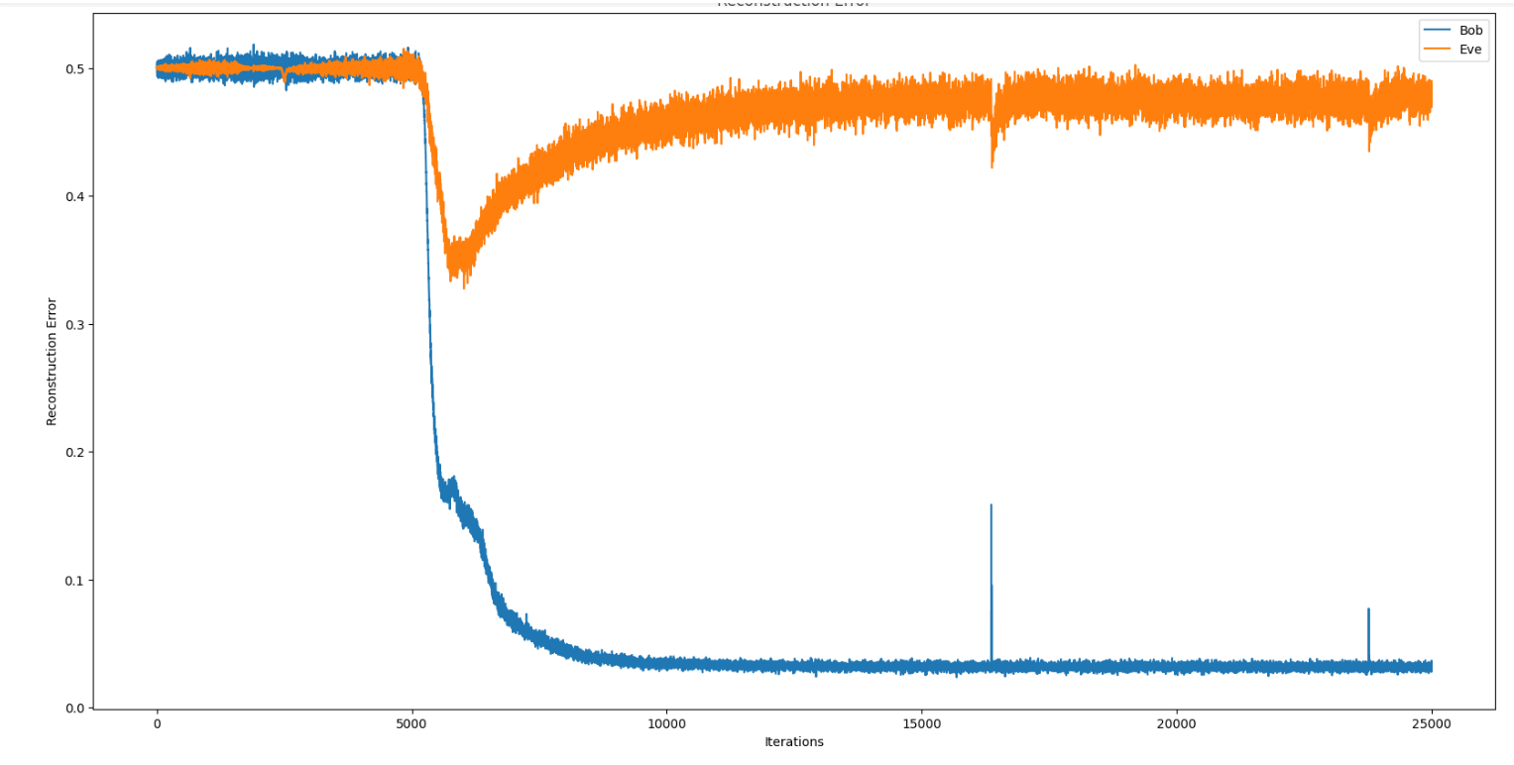
Changing length of input plain text
PLAIN TEXT SIZE : 16 BITS
PLAIN TEXT SIZE : 32 BITS

Slide 18
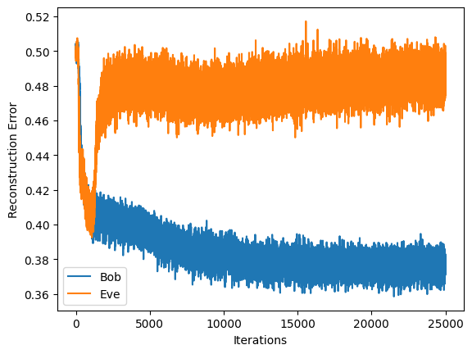
Model with only perceptron layers
RESULT IS SAME EVEN IF WE USE ALL PERCEPTRON LAYERS IN PLACE OF CONVOLUTION LAYERS.

Slide 19
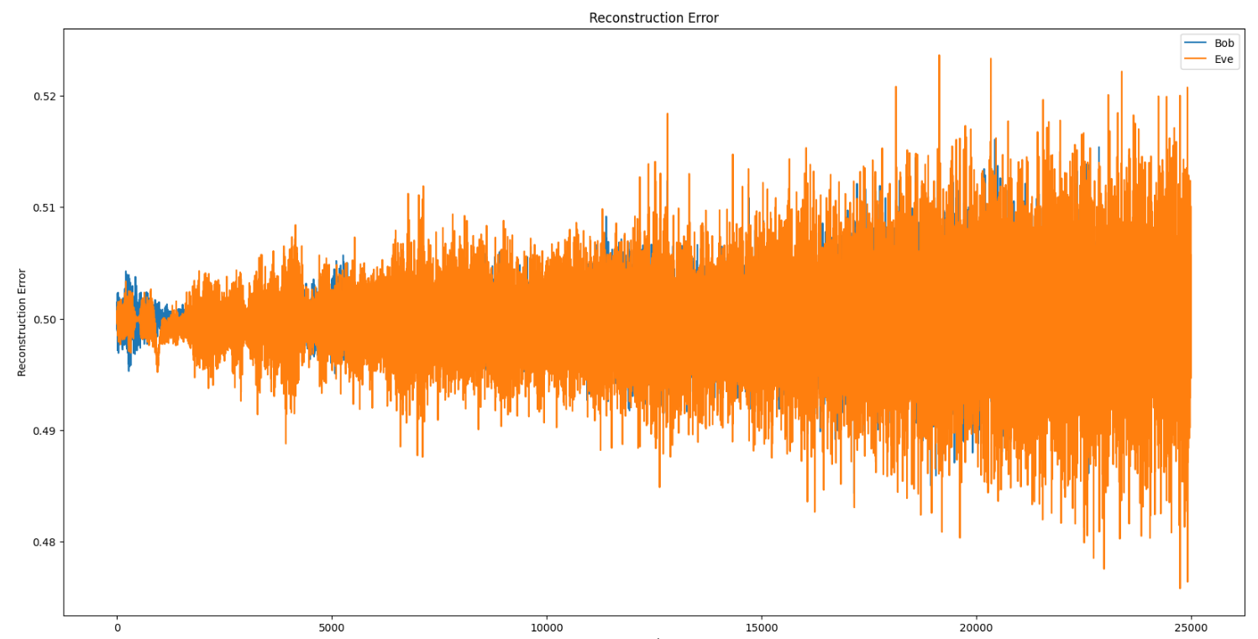
Model with only Convolution layers
IT IS NOT ABLE TO SUCCESSFULLY LEARN THE ENCRYPTION 😣😥😥

Slide 20
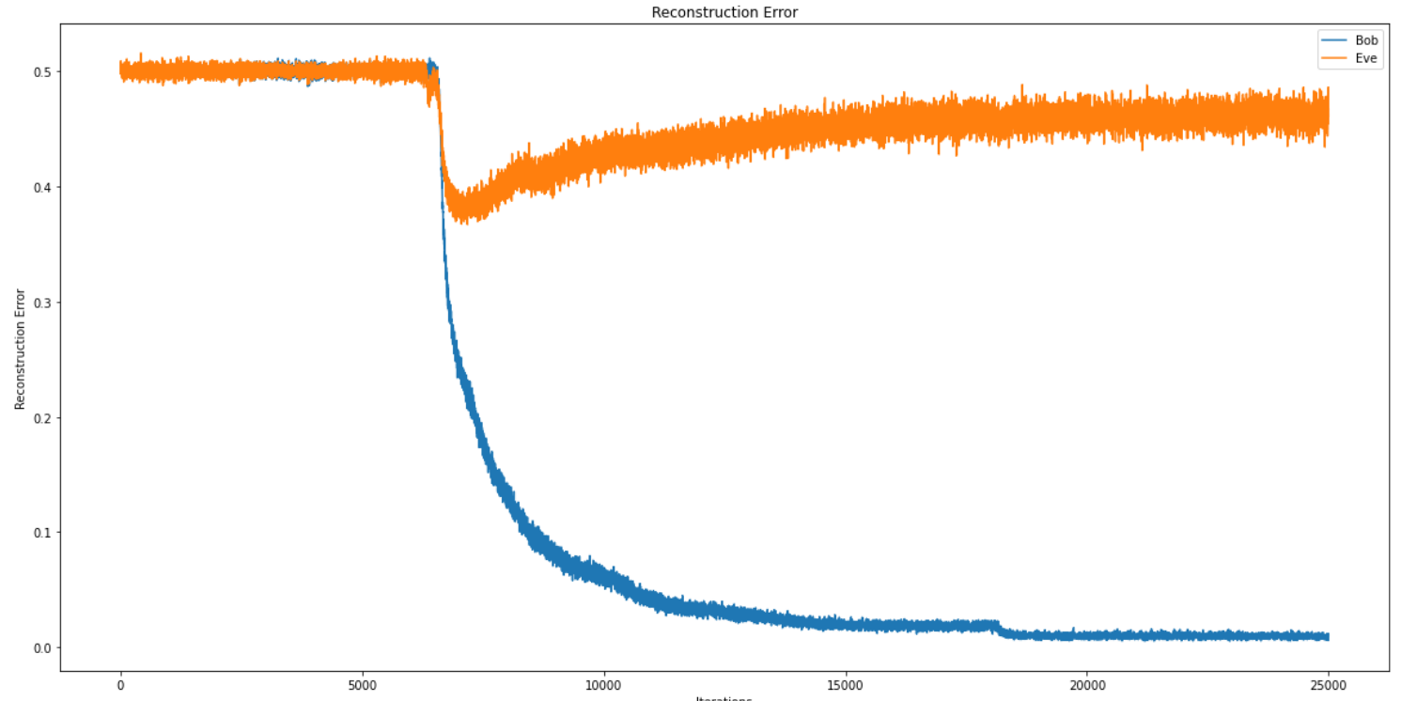
Model with original structure but modified CNN
RESULTS ARE SIMILAR TO THE ORIGINAL MODEL STRUCTURE

Slide 21
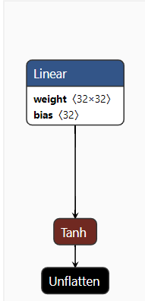
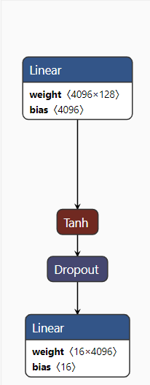
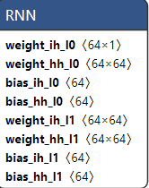
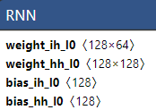
TRYING WITH RNN
The detailed description of model can be founded here: https://wandb.ai/rishabhsri14/SMAI_Project/runs/c7c6ny03/files/model/LSTM/alice.pt

Slide 22
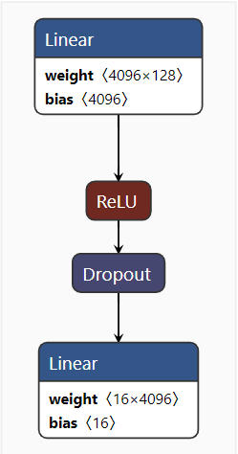
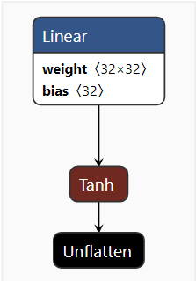

TRYING WITH LSTM
The detailed description of model can be founded here: https://wandb.ai/rishabhsri14/SMAI_Project/runs/c7c6ny03/files/model/LSTM/alice.pt

Slide 23
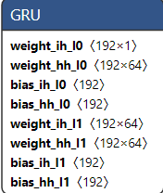
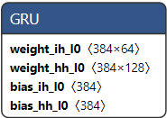
TRYING WITH GRU
The detailed description of model can be founded here: https://wandb.ai/rishabhsri14/SMAI_Project/runs/1f7tvnkf/files/model/GRU/alice.pt

Slide 24
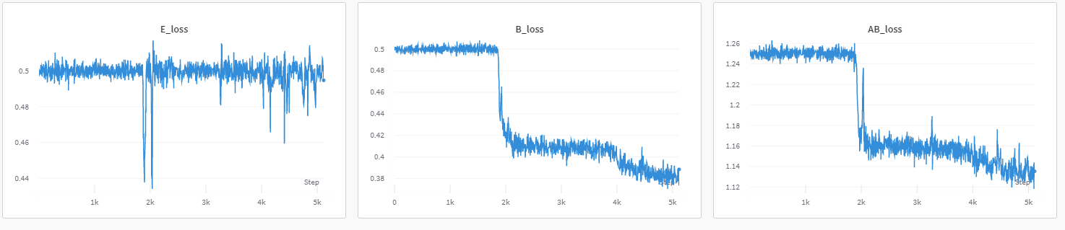
Best Performance
Model:LSTM; Optimizer: RMSProp; Lr:0.0001; Batch Size: 512; Epochs: 50

Slide 25
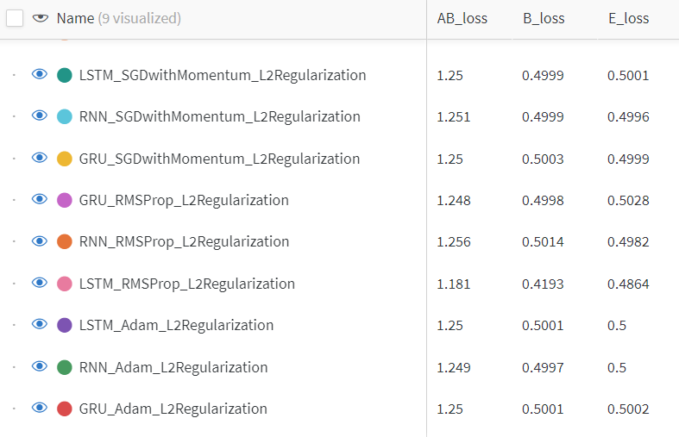
Comparative Study(Optimizers)
Best Optimizer:
RMSProp

Slide 26
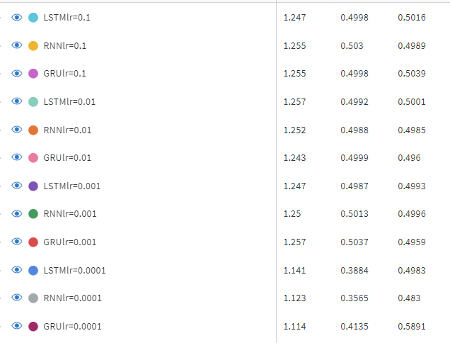
Comparative Study(LR)
Best LR: 0.0001

Slide 27
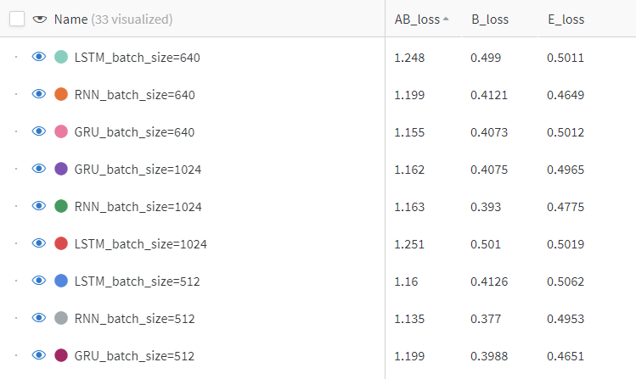
Comparative Study(LR)
Best batch_size: 512

Slide 28
Individual contribution within the team
AKASH C R :
Wrote code for basic model structure and error functions and saving the model
Implemented the paper
Some experiments with modified CNN and modified hyperparameters
RUCHITHA J :
Experimented with all perceptron layer network structure
Experimented with fully convolution layer network structure
Some experiments with modified hyperparameters.
RISHABH SRIVASTAVA :
Experimented with RNN
Experimented with LSTM
Experimented with GRU

Slide 29
THANK YOU

