Slide 1


PORTFOLIO PROJECT · POWER BI · CODEBASICS CHALLENGE #2
AtliQ Mart
Supply Chain Service-Level Dashboard
End-to-end supply-chain analytics: 6 CSV tables → Power Query star schema → 19 DAX measures → 5-page Power BI dashboard — with verified numbers and root-cause insights.
31,729
57,096
OTIF 29.0%
0 / 35
orders
order lines
vs 65.9% target
customers on target
Rishab Arya — Data Analyst · M.Tech Data Science candidate
Notes:
- Introduce the project: my second portfolio project, built for Codebasics Resume Challenge #2 (AtliQ Mart).
- One-line pipeline framing: 6 CSV tables → Power Query star schema → 19 DAX measures → 5-page Power BI dashboard.
- Point at the OTIF headline stat as the story hook: 29.0% actual vs 65.9% target.
- Zero of 35 customers on target — that gap is the tension the whole deck resolves.
- Quick self-intro: Rishab Arya, data analyst, M.Tech Data Science candidate.

Slide 2

THE PROBLEM
Key customers are walking away over late, incomplete deliveries
AtliQ Mart is an FMCG manufacturer in Gujarat, India, supplying retail chains across Surat, Ahmedabad and Vadodara — and about to expand into new metros and Tier-1 cities.
Several key customers have declined to renew their annual supply contracts, citing late and incomplete deliveries. Leadership needed a daily service-level tracking dashboard before the expansion replicates the problem in new cities.
“
Where is order fulfillment failing — for whom, how badly, and why — so the supply chain can be fixed before the expansion replicates the problem in new cities?
WHAT THE DASHBOARD TRACKS
OT%
IF%
OTIF%
LIFR
VOFR
On-Time
In-Full
On-Time In-Full
Line Fill Rate
Volume Fill Rate
All measured per customer against negotiated targets.
Notes:
- Set the business scene: FMCG manufacturer in Gujarat — Surat, Ahmedabad, Vadodara — with an expansion into new metros and Tier-1 cities pending.
- Trigger: key customers declined to renew annual supply contracts, citing late and incomplete deliveries.
- Read the guiding question aloud — it defines the dashboard's job: where, for whom, how badly, why.
- Name the five KPIs: OT%, IF%, OTIF%, LIFR, VOFR — each measured per customer against negotiated targets.

Slide 3
THE DATA
Six CSV tables, six months of order flow
01 Mar – 31 Aug 2022
3
35
18
DATA WINDOW
CITIES
CUSTOMERS
PRODUCTS
Surat · Ahmedabad · Vadodara
in 3 categories
TABLE
ROWS
ROLE
fact_order_lines
57,096
FACT — one row per order line
fact_orders_aggregate
31,729
FACT — one row per order (OT / IF / OTIF flags)
35
DIMENSION — retail customers (chain + city)
dim_customers
18
DIMENSION — products and categories
dim_products
183
DIMENSION — daily calendar, Mar–Aug 2022
dim_date
dim_targets_orders
35
DIMENSION — per-customer OT / IF / OTIF targets
✓
Every figure was recomputed from the raw CSVs during the build — chart exports checked by hand. Headline LIFR 65.96% and VOFR 96.59% reproduce the values widely cited for this dataset, validating the metric definitions.
Notes:
- Two fact grains: order-level (fact_orders_aggregate, 31,729 rows) and line-level (fact_order_lines, 57,096 rows).
- Four dimensions: customers (35), products (18), date (183 days), per-customer targets (35).
- Window: 01 Mar – 31 Aug 2022, three cities — Surat, Ahmedabad, Vadodara.
- Verification discipline as a portfolio differentiator: every figure recomputed from raw CSVs; LIFR 65.96% and VOFR 96.59% match cited values.

Slide 4
BUILD · PHASE 1 — POWER QUERY
Five quiet data traps, each fixed at the source
PROBLEM
FIX
01
Invisible BOM characters hiding in dim_date.date and order_id headers
→
Headers renamed character-by-character — the invisible bytes would silently break relationships later
02
Two different date formats: "Tuesday, March 1, 2022" vs "01-Mar-22"
→
Both parsed to a true Date type, so time-intelligence and the calendar connection work
03
Category casing broken: "beverages" vs "Dairy" / "Food"
→
Transform → Format → Capitalize Each Word — after Replace Values failed silently by acting on the wrong column
04
% signs polluting target column names (ontime_target%)
→
Renamed — values already numeric (87 = 87%), the % was decoration that made DAX formulas ugly
05
Spaces in "In Full" / "On Time" / "On Time In Full" columns
→
Renamed to in_full / on_time / on_time_in_full
Notes:
- All cleaning happened in Power Query (M), not DAX — problems fixed at the source.
- The BOM-character trap is the classic silent killer: invisible bytes in headers would break relationships downstream.
- Two date formats parsed to a true Date type so time intelligence and the calendar connection work.
- Replace Values lesson: it failed silently on the wrong column — Capitalize Each Word fixed the casing properly.
- Renamed %-signed and spaced column names so DAX formulas stay clean.

Slide 5
BUILD · PHASE 2 — DATA MODEL
A clean star schema — six one-way streets, no fact-to-fact joins
✿
MODEL MAP
✓
KEY DECISIONS
Deleted the auto-created fact-to-fact order_id relationship
dim_customers
dim_date
⌘
Facts must never filter each other; two competing filter paths produce ambiguous numbers
35 rows
183 rows
Rebuilt dim_customers ↔ dim_targets_orders as one-to-many, single direction
→
The arrow must point customers → targets, or every matrix row shows the same grand-average target
fact_orders_aggregate
fact_order_lines
order grain · 31,729 rows · OT/IF/OTIF flags
line grain · 57,096 rows · delivery qty
mmm_yy sorted alphabetically (Apr before Feb)
⇅
Added a month_sort column in Power Query and set it as the sort-by column
dim_products
dim_targets_orders
18 rows
35 rows
▦
Disabled Auto date/time
The model uses its own dim_date — no hidden calendar tables
6 relationships
all single-direction
filters flow dimension → fact only
Notes:
- Why fact-to-fact joins are forbidden: two competing filter paths produce ambiguous numbers — the auto order_id join was deleted.
- Single-direction matters for the target filter: customers → targets, otherwise every matrix row shows the same grand-average target.
- mmm_yy sorted alphabetically (Apr before Feb) — fixed with a month_sort column set as the sort-by column.
- Auto date/time disabled — the model relies on its own dim_date, no hidden calendar tables.

Slide 6

BUILD · PHASE 3 — DAX
19 explicit measures — zero implicit aggregations
THE CORE KPI
✦
Measure inventory
19 total
OTIF % =
2
DIVIDE (
base totals
SUM ( fact_orders_aggregate[otif] ),
5
service-level KPIs
[Total Orders]
)
3
targets
GAP IN POINTS
3
gaps (pts)
OTIF Gap =
3
conditional colors
( [OTIF %] - [OTIF Target %] ) * 100
TRAFFIC-LIGHT COLOR, WIRED INTO MATRIX CELLS
2
switcher routers + dynamic chart title
OTIF Gap Color =
✦
VAR GapPoints = [OTIF Gap]
DAX HABITS
RETURN SWITCH ( TRUE (),
✓
DIVIDE over / — safe divide-by-zero
GapPoints >= 0, "#63BE7B",
SUM on 0/1 flags as counters
GapPoints >= -10, "#FFEB84",
✓
GapPoints >= -25, "#FDAE61",
✓
SWITCH ( TRUE() ) ladders
"#F8696B"
)
✓
VAR … RETURN
✓
SELECTEDVALUE + disconnected table
◆
A disconnected Metrics table + SELECTEDVALUE router powers the metric switcher on the trend charts.
✓
VERIFIED VALUES
OT 59.0%
IF 52.8%
OTIF 29.0%
LIFR 66.0%
VOFR 96.6%
Notes:
- All 19 measures are explicit — zero implicit aggregations anywhere in the model.
- DIVIDE instead of "/" protects every ratio against divide-by-zero blanks.
- The SWITCH(TRUE()) ladder maps the OTIF gap to the four traffic-light hex colors wired into the matrix cells.
- A disconnected Metrics table + SELECTEDVALUE router switches the five KPIs on one trend chart.
- Close on the verified strip: OT 59.0 · IF 52.8 · OTIF 29.0 · LIFR 66.0 · VOFR 96.6.

Slide 7
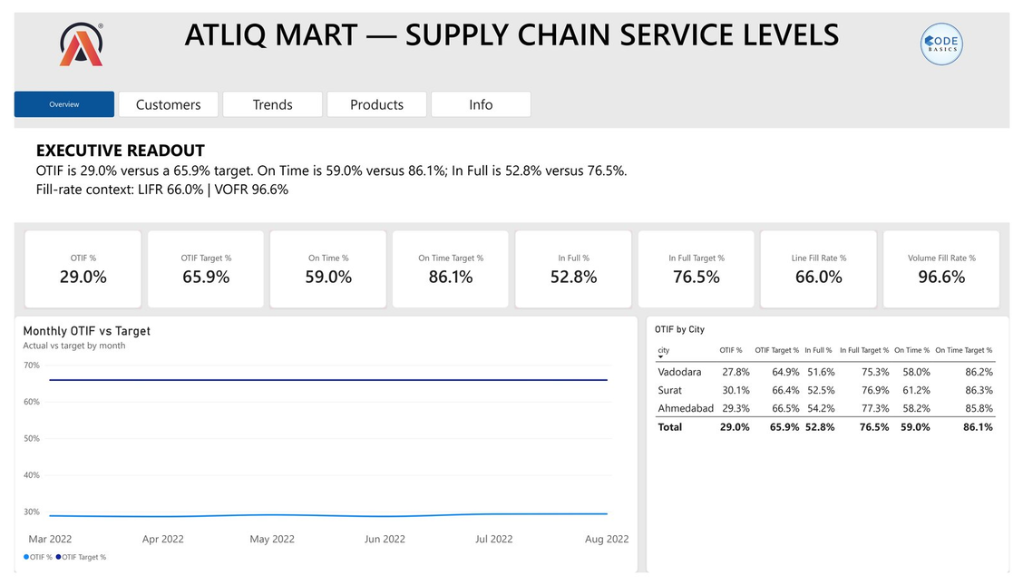
THE DASHBOARD · PAGE 1 OF 5
Five pages, one story — starting with the one-screen answer
01
Overview
executive readout: five KPIs vs targets, city split, monthly OTIF trend
VIEWING
02
Customer Performance
account matrix + watchlist
03
Trends
metric switcher + month→day drill
04
Product Insights
fill rates + sparklines
KPI cards (actual vs target), the city matrix, and the monthly OTIF trend answer the one-screen question: how are we doing?
05
Definitions & Data Model
59.0%
52.8%
29.0%
definitions, schema, insights
OT
IF
OTIF
↘
gaps −27.1 / −23.7 / −36.9 pts
vs 86.1% target
vs 76.5%
vs 65.9%
Notes:
- Five pages: Overview, Customer Performance, Trends, Product Insights, Definitions & Data Model.
- Overview is the executive entry point — five KPIs vs target, city split, monthly OTIF trend on one screen.
- The gap cards were moved up here during the restructure, so the one-screen answer already includes the deltas.
- Point at the gap chip: OTIF −36.9 pts is the headline the next four pages explain.

Slide 8
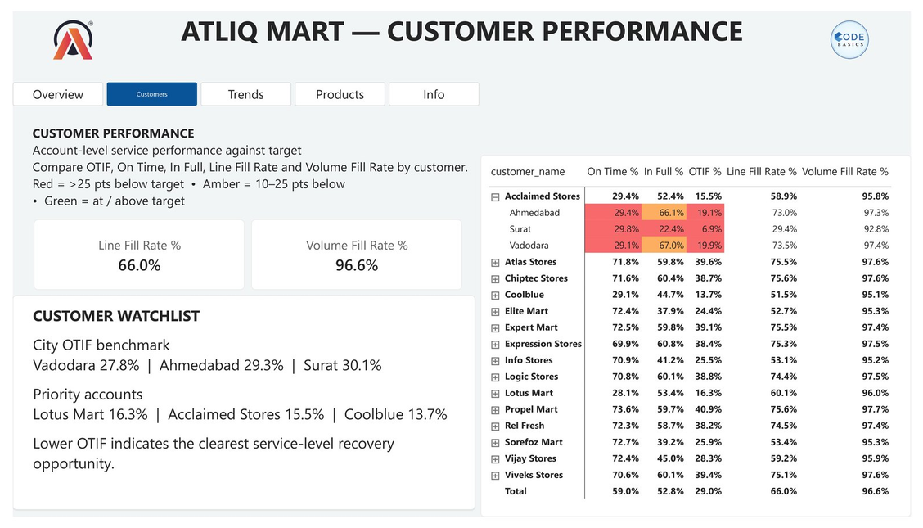
THE DASHBOARD · PAGE 2 OF 5
Every account, every metric, color-coded by gap to target
▦
Account-level matrix
OT / IF / OTIF / LIFR / VOFR for each of the 35 customers, against that customer's negotiated target
✦
Traffic-light cells
Conditional formatting driven by field-value measures
#63BE7B
at/above target
#FFEB84
within 10 pts
#FDAE61
within 25 pts
#F8696B
beyond 25 pts
⚑
Customer Watchlist
City OTIF benchmark plus the lowest-OTIF priority accounts — the renewal-risk shortlist
⚖
The verdict: 0 of 35 customers meet their OTIF target.
Notes:
- Matrix grain is one row per customer — all 35 accounts scored against their own negotiated targets.
- Colors encode gap to target, not raw values — read the legend before the cells.
- The Watchlist (city OTIF benchmark + lowest-OTIF accounts) feeds the renewal conversation.
- Verdict to land hard: 0 of 35 customers meet their OTIF target.

Slide 9
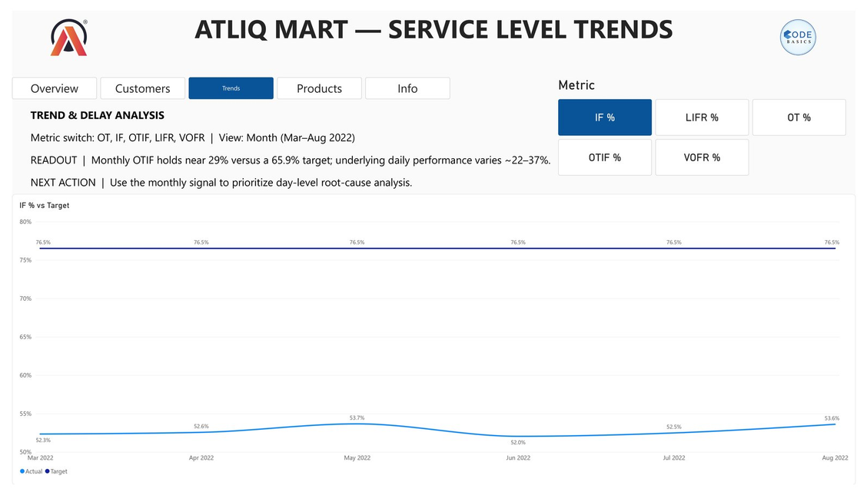
THE DASHBOARD · PAGE 3 OF 5
One signal, five metrics, drilled from months to days
⚙
Metric switcher
A disconnected Metrics table + SELECTEDVALUE router drives OT / IF / OTIF / LIFR / VOFR on the same trend chart
☰
Drill path
▦
Months
↓
▦
Weeks
↓
▦
Days
exposing how unstable daily performance really is — daily OTIF swings 22–37%
✦
Dynamic chart title
A DAX title measure shows the selected metric and current drill level, using ISFILTERED
Notes:
- One trend chart, five metrics — a disconnected Metrics table + SELECTEDVALUE router does the switching.
- Disconnected means the slicer table cannot accidentally filter the fact tables.
- Drill months → weeks → days exposes the volatility hidden inside monthly averages.
- Daily OTIF swings 22–37%; the dynamic title (ISFILTERED) always names metric + drill level.

Slide 10
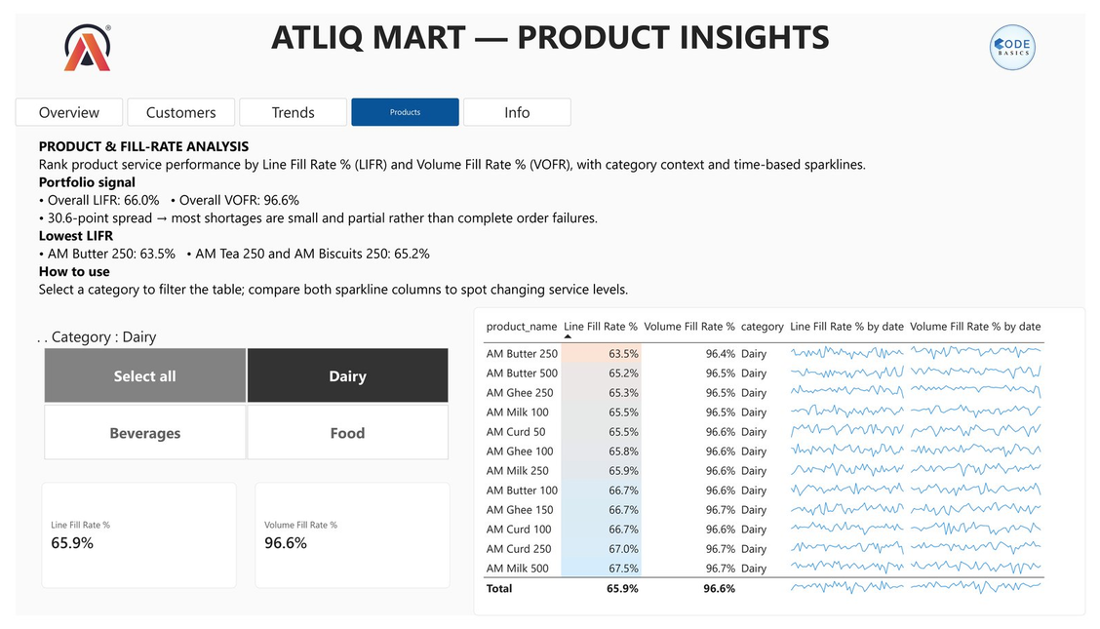
THE DASHBOARD · PAGE 4 OF 5
Fill rates by product, with time embedded in every row
▦
LIFR & VOFR by product
All 18 products with both fill-rate metrics side by side — which SKUs starve the orders
⌇
Sparklines in-table
Each row carries its own time sparkline, so trend quality is visible without leaving the table
☰
Category slicer
Dairy
Food
Beverages
Filter the table to one category for focused reviews
▤
Page 5 — Definitions & Data Model — documents metric definitions, the star-schema layout, and the key insights, keeping the report self-explanatory for any stakeholder who opens it cold.
Notes:
- The product lens complements the customer lens — who fails vs what fails.
- LIFR next to VOFR flags the SKUs that starve the orders.
- In-table sparklines flag deteriorating SKUs without adding another visual.
- Category slicer — Dairy / Food / Beverages — for focused category reviews.
- Page 5 makes the whole report self-documenting for a cold reader.

Slide 11
0/35
FINDINGS · 1 OF 2
Under half the promised reliability — everywhere
↘
Both pillars are short
OT 59.0% vs 86.1% target (−27.1 pts) · IF 52.8% vs 76.5% target (−23.7 pts) — on-time and in-full fail together, so OTIF compounds the damage
29.0%
65.9%
TARGET
◎
Systemic, not regional
↘
−36.9 pts below target
City OTIF sits in a narrow 27.8–30.1% band — every city fails the same way, so no local hero story explains it
ACTUAL OTIF
⌇
Flat but erratic
0 of 35 customers meet their OTIF target
Monthly OTIF barely moves (28.7–29.4%) while daily swings reach 22–37% — the average hides the volatility
⊗
Notes:
- OTIF is the compound metric — an order only counts if it is on-time AND in-full, so 29.0% vs the 65.9% target is the one headline number.
- The kicker stat: 0 of 35 customers meet their OTIF target — nobody is winning; that is the renewal-risk story.
- Both pillars fail together: OT 59.0% vs 86.1% (−27.1 pts) and IF 52.8% vs 76.5% (−23.7 pts).
- The 27.8–30.1% city band is systemic — no local hero story; the flat 28.7–29.4% monthly average hides 22–37% daily swings.

Slide 12
FINDINGS · 2 OF 2
Two independent failure modes — not one problem
MODE A
⊟
MODE B
▣
the big-3 chains collapse on on-time
mid-tier accounts ship on time but under-fill
Coolblue
13.7%
Info Stores
Elite Mart
Sorefoz
Vijay
15.5%
on-time
~72%
Acclaimed
in-full
only ~40%
Lotus
16.3%
~30% of all orders · on-time only ~29%
~23% of orders
The largest accounts are late on most orders — everything downstream of dispatch fails for them
These accounts arrive when promised — the boxes are just light
Shortages are small and partial
Lateness is frequent but shallow
▣
LIFR 66.0% yet VOFR 96.6% — orders are almost complete, not failed; fixing pick accuracy and SKU-level stock recovers most of the gap
◔
28.9% of lines ship late — average 1.7 days, never more than 3: a scheduling problem, not a transport failure
Notes:
- Two independent failure modes — they need two different fixes, not one blanket program.
- Mode A is dispatch: the big-3 chains — Coolblue 13.7%, Acclaimed 15.5%, Lotus 16.3% OTIF — on ~30% of all orders.
- Mode B is planning: mid-tier accounts (Info Stores, Elite Mart, Sorefoz, Vijay) arrive on time (~72%) but in-fill only ~40%.
- LIFR 66.0% vs VOFR 96.6% — shortages are small and partial, so pick accuracy and SKU-level stock recover most of the gap.
- Lateness averages 1.7 days and never exceeds 3 — a scheduling buffer, not a transport redesign.

Slide 13
RECOMMENDATIONS
Two parallel workstreams, sequenced by account value
⊟
Workstream 1 — Dispatch & scheduling
▣
Workstream 2 — Supply planning
attacks Mode A: the on-time collapse of the big-3 chains
attacks Mode B: the partial fills of the mid-tier accounts
01
Open renewal conversations with the big-3 accounts first
◌
they are ~30% of order volume; retention starts where the risk concentrates
02
Add a 1–2 day scheduling buffer rather than redesigning transport
▦
lateness is shallow (avg 1.7 days, never more than 3) — a calendar fix, not a fleet fix
03
Hold SKU-level safety stock and review pick accuracy
⌂
the shortfalls are small and partial (VOFR 96.6%), so warehouse discipline recovers most of the in-full gap
➤
Pilot the fixes in Vadodara — the weakest and highest-volume city — before scaling to the expansion metros.
Notes:
- Map each workstream to its mode: Workstream 1 (dispatch & scheduling) attacks Mode A; Workstream 2 (supply planning) attacks Mode B.
- Big-3 conversations first — they are ~30% of order volume, so retention starts where the risk concentrates.
- A 1–2 day scheduling buffer beats a fleet redesign — lateness is shallow (avg 1.7 days, never more than 3).
- VOFR 96.6% means shortfalls are small and partial — SKU-level safety stock and pick accuracy recover most of the in-full gap.
- Pilot in Vadodara — the weakest, highest-volume city — before scaling to the expansion metros.

Slide 14
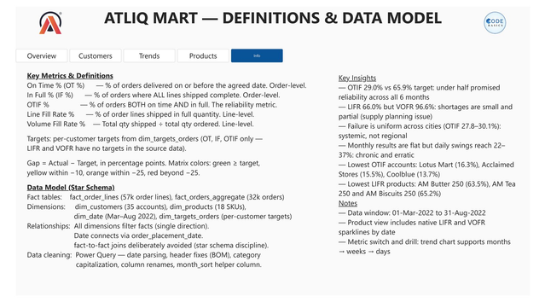
WHAT SHIPS WITH THE PROJECT
Verified numbers, open artifacts
✓
VERIFIED NUMBERS
59.0%
52.8%
29.0%
66.0%
96.6%
OT
IF
OTIF
LIFR
VOFR
31,729
57,096
35
18
6
ORDERS
LINES
CUSTOMERS
PRODUCTS
TABLES
▤ Page 5 documents the model so anyone can audit it
❄
Power Query (M)
▦
Power BI Desktop
cleaning & shaping
star schema + DAX
Rishab Arya — Data Analyst
M.Tech Data Science candidate
✦
Python / pandas
▤
Markdown docs
↗
github.com/Rishabharya810/FMCG-Supply-Chain-Dashboard
verification
measures reference + project journal
↗
linkedin.com/in/rishab-arya-4a84481b1
Scenario & data: Codebasics Resume Project Challenge #2 — AtliQ Mart (codebasics.io). Dashboard design, analysis, and insights are the author's own work.
▣
The repo ships the .pbix dashboard, the 6 source CSVs, a full PDF report, an executive deck, and the docs/ journal.
Notes:
- Close on reproducibility — every headline number was recomputed from the raw CSVs: OT 59.0%, IF 52.8%, OTIF 29.0%, LIFR 66.0%, VOFR 96.6%.
- Invite the reviewer to open the .pbix — page 5 (shown here) documents the definitions and the star-schema model for auditing.
- Point to the open artifacts: the 6 source CSVs, the full PDF report, the executive deck, and the docs/ journal.
- Credit the source: Codebasics Resume Project Challenge #2 — AtliQ Mart scenario and data; the analysis and design are the author's own.

