Slide 1

Project Title: Salary Prediction Name: Rishabh Kosta
Objective: To predict the salaries of data professionals based on various features.
Tools and Libraries: Python, Pandas, NumPy, Matplotlib, Seaborn, Scikit-learn

Slide 2
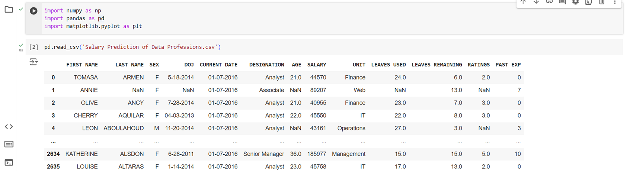
Dataset Overview:
Storing dataset in a variable named ‘data’

Slide 3
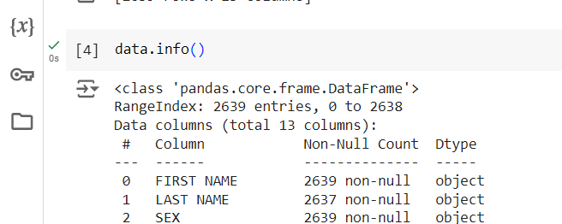
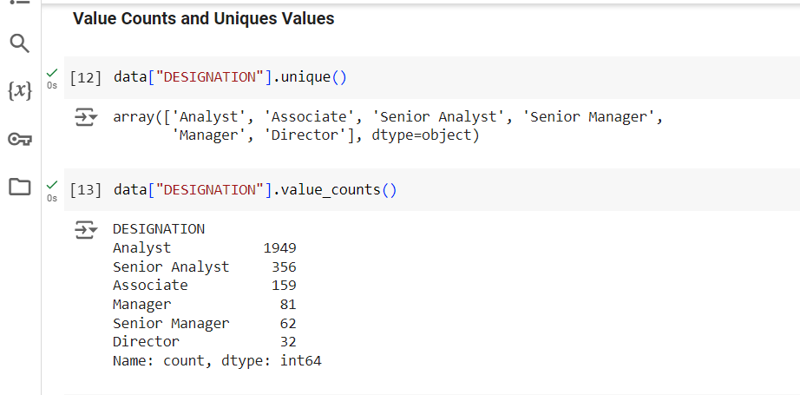
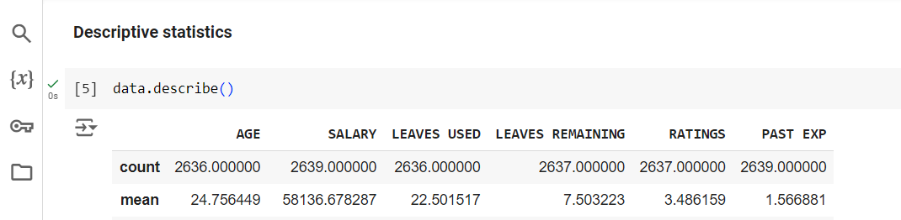
Getting info of dataset : Details about features in the dataset
Initial Data Exploration: Rows: 2639, Column : 13
Descriptive Statistics: Summary statistics of the dataset.
Unique Values and Value Counts: Found unique values and value count for designation and unit

Slide 4
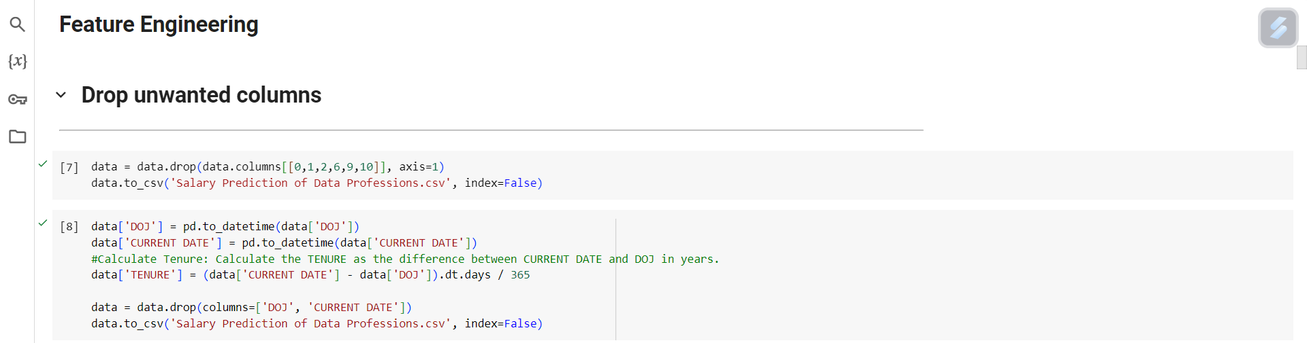
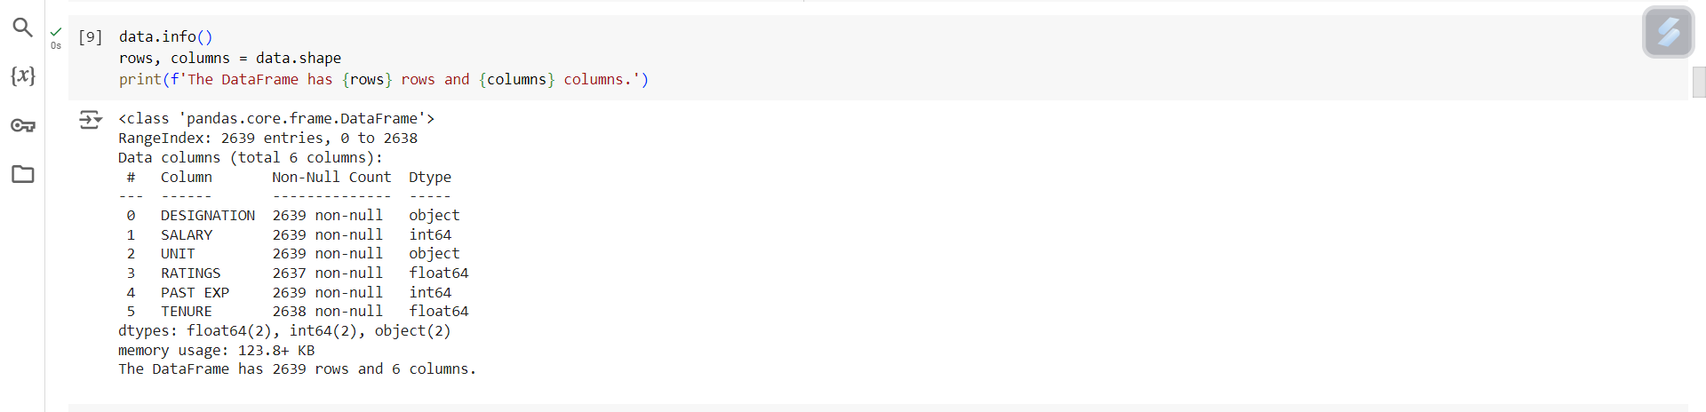
Feature Engineering:
Dropped unwanted columns.
Calculated tenure as the difference between CURRENT DATE and DOJ.

Slide 5
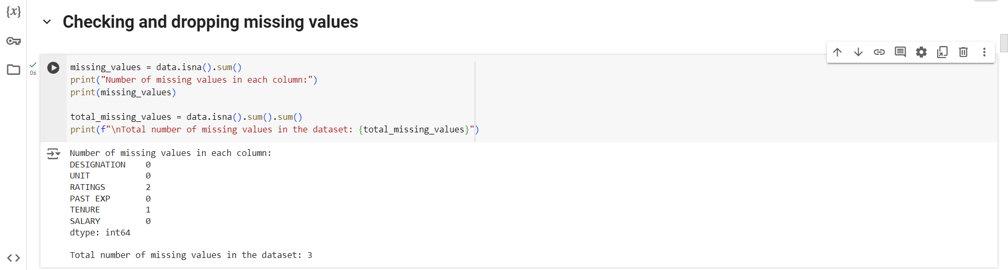
Checking number of missing values in each column and total number of missing values in the dataset
Dropping missing values

Slide 6
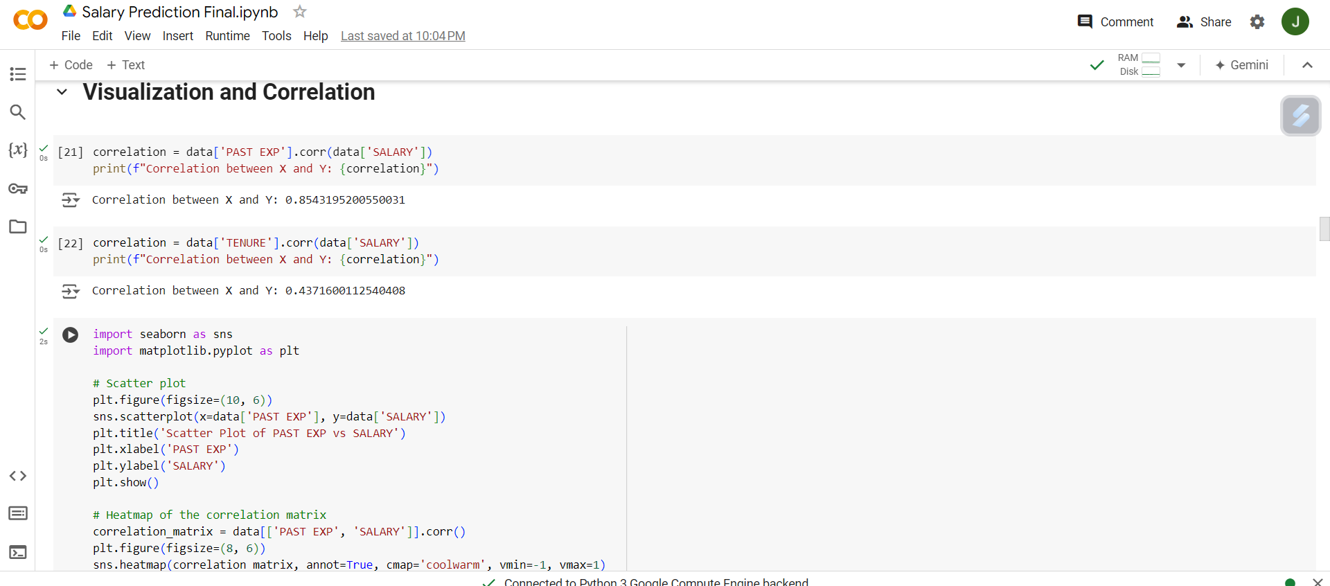
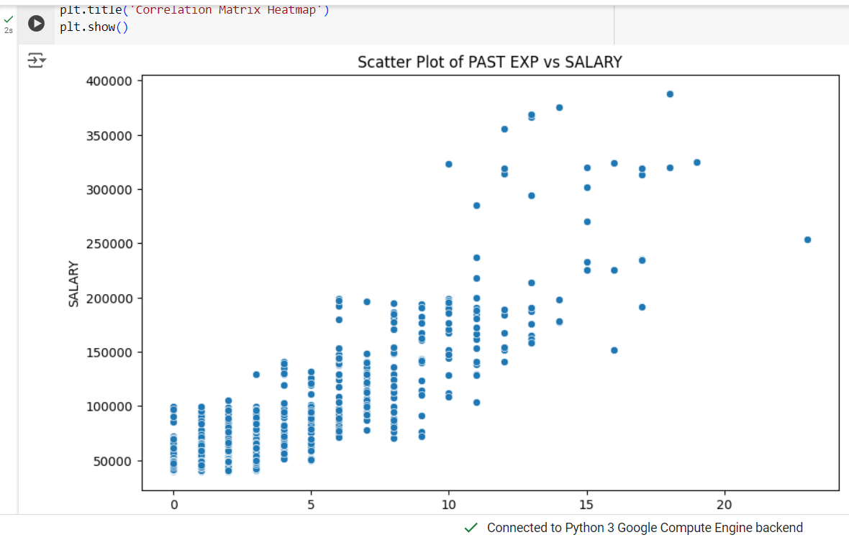
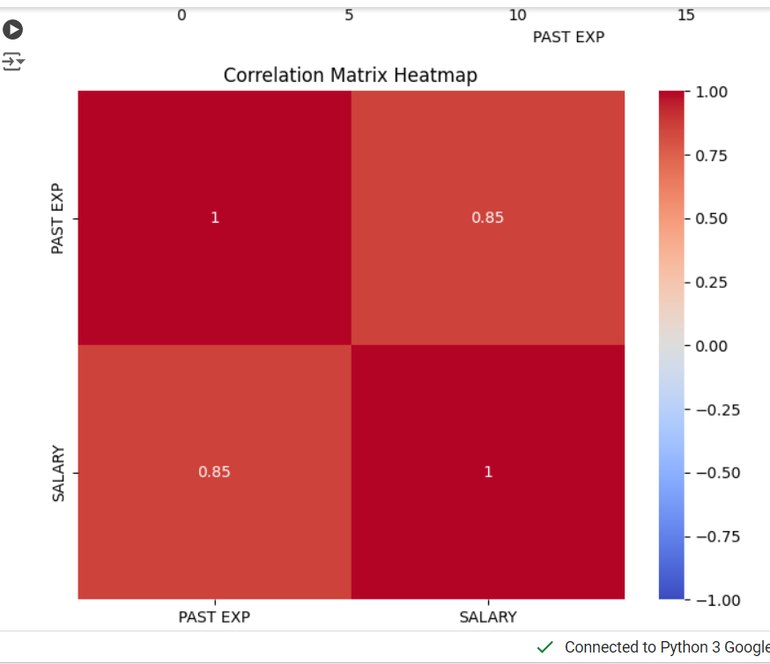
Visualization and Correlation
Correlation Analysis: PAST EXP vs SALARY: Correlation value: 0.8543, TENURE vs SALARY: Correlation value: 0.4371
Scatter Plots: PAST EXP vs SALARY, TENURE vs SALARY
Heatmaps: Correlation matrix heatmap for PAST EXP and SALARY, Correlation matrix heatmap for TENURE and SALARY.

Slide 7
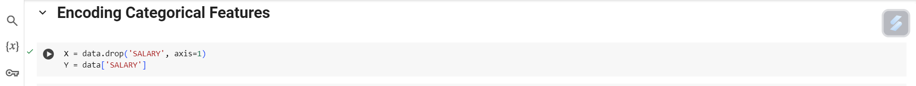
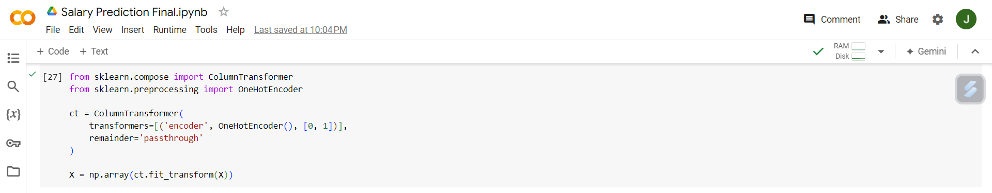
Data Encoding
Encoding Categorical Features: OneHotEncoder() for categorical variables.

Slide 8
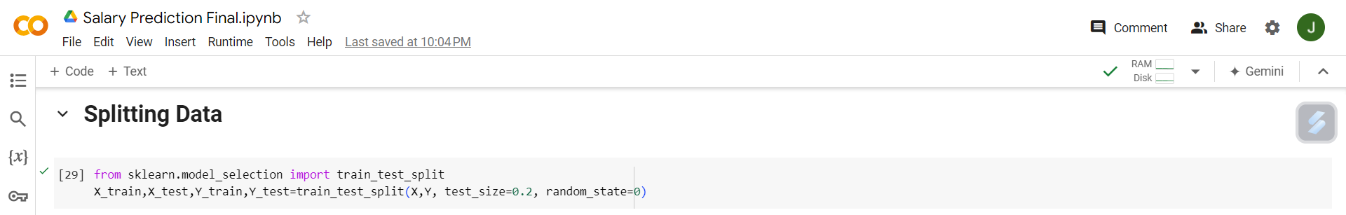
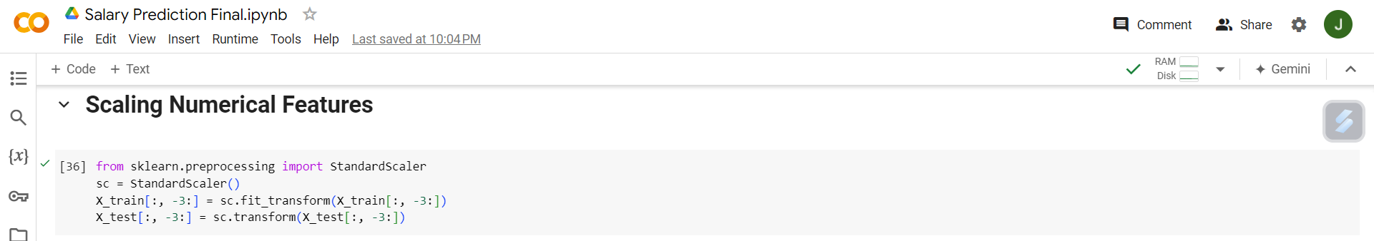
Data Splitting: Train-Test Split: 80% training, 20% testing.
Scaling Numerical Features: StandardScaler applied to numerical features in the dataset.

Slide 9
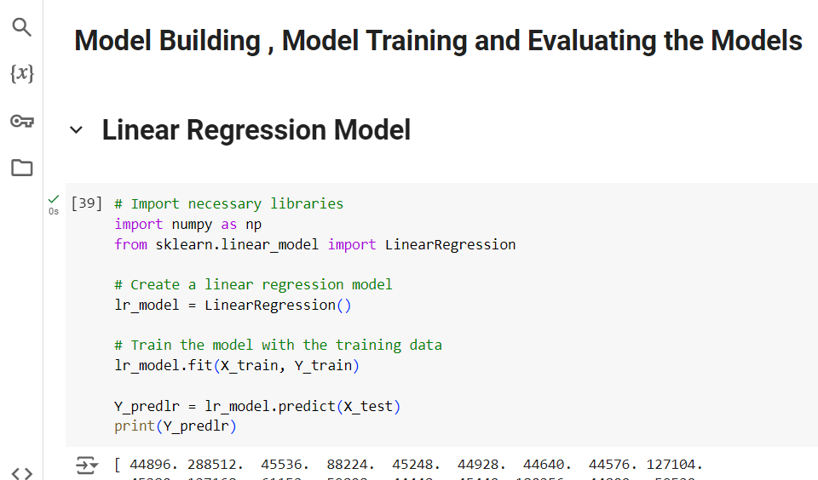
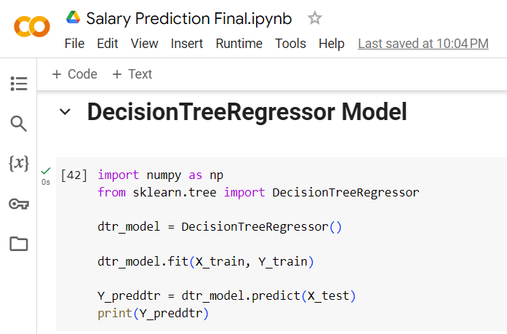
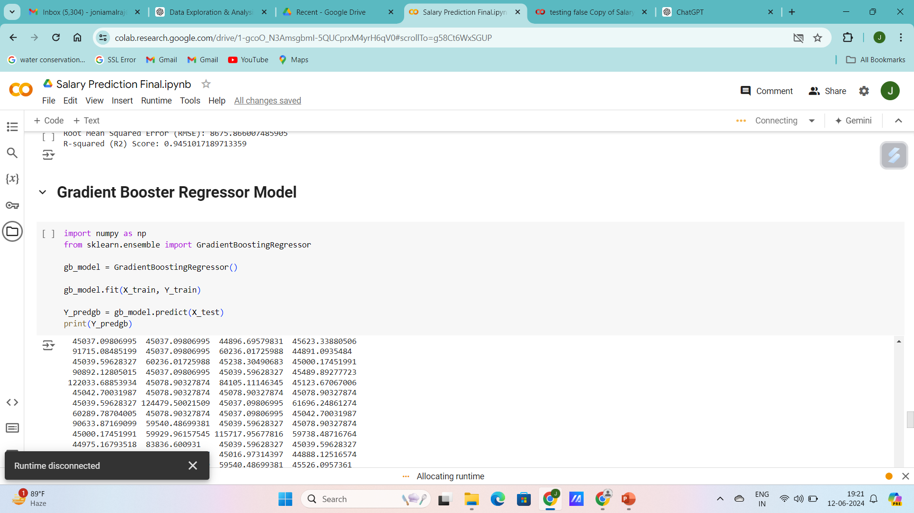
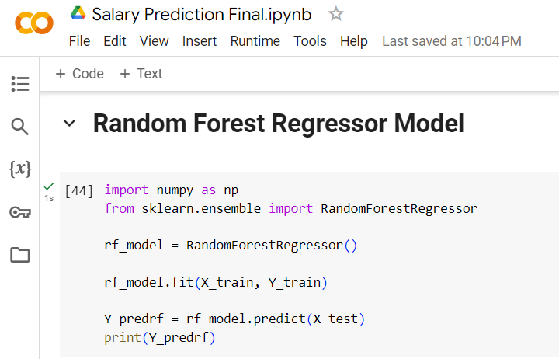
Building and Training Model : Built and Trained Linear Regression, Decision Tree Regressor, Gradient Booster Regressor , Random Forest Regressor Models

Slide 10
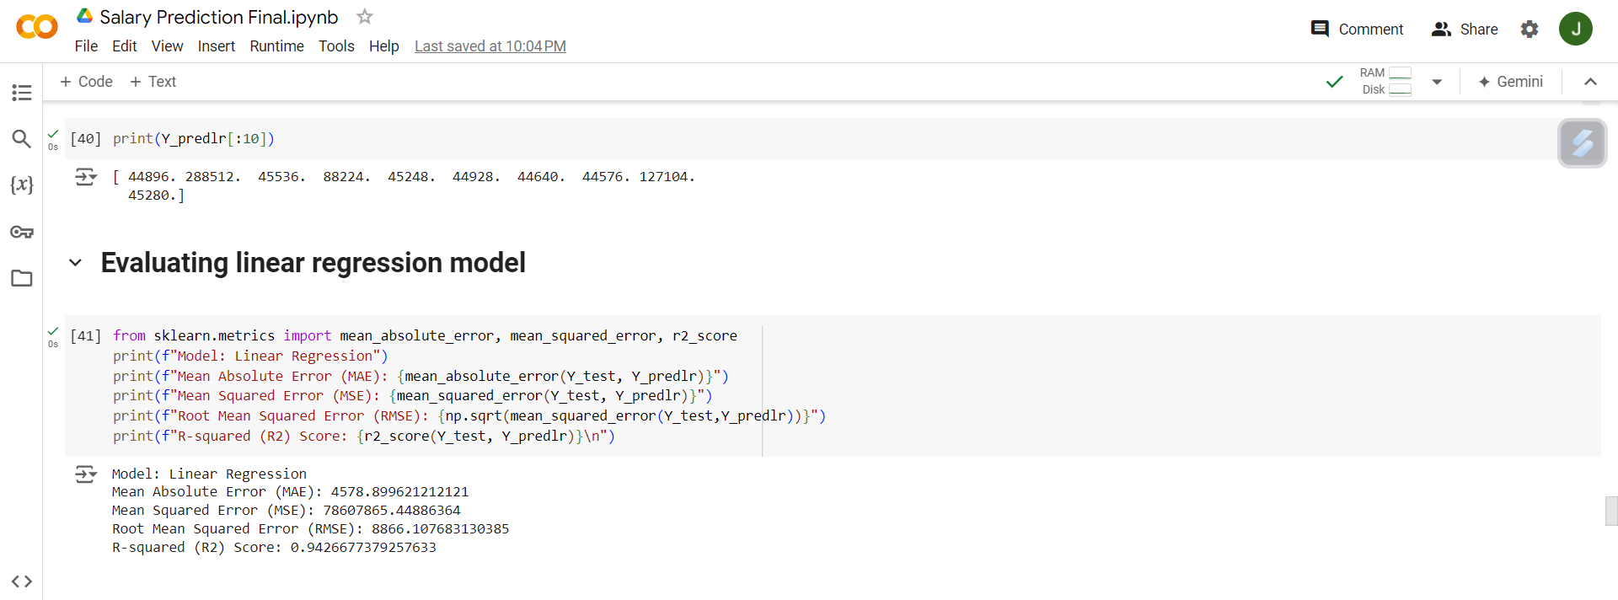
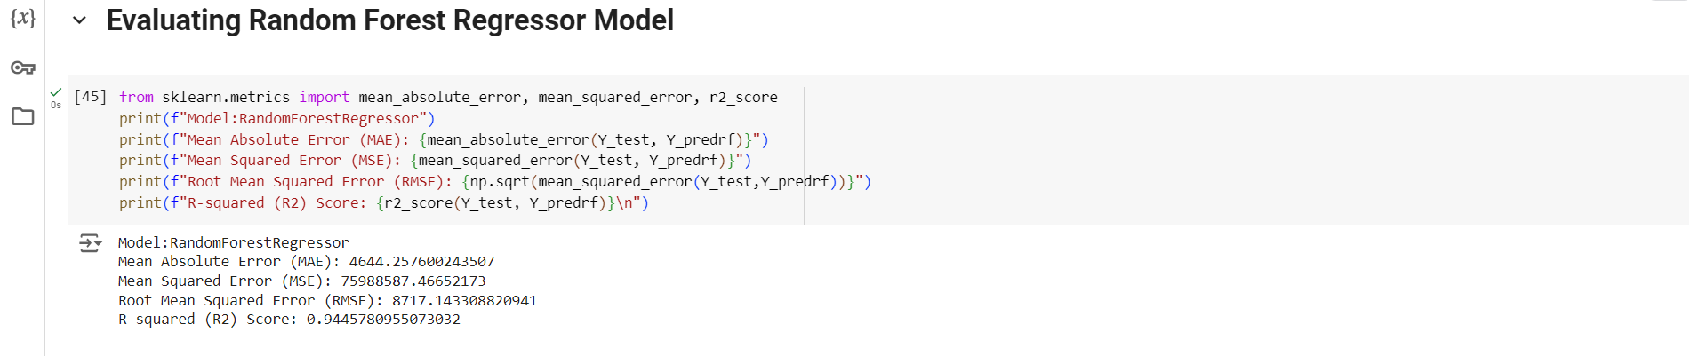
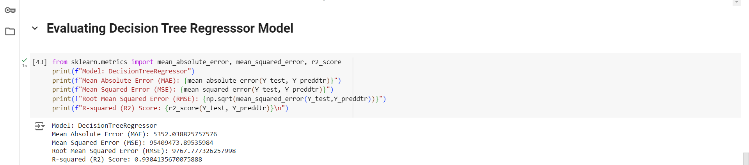
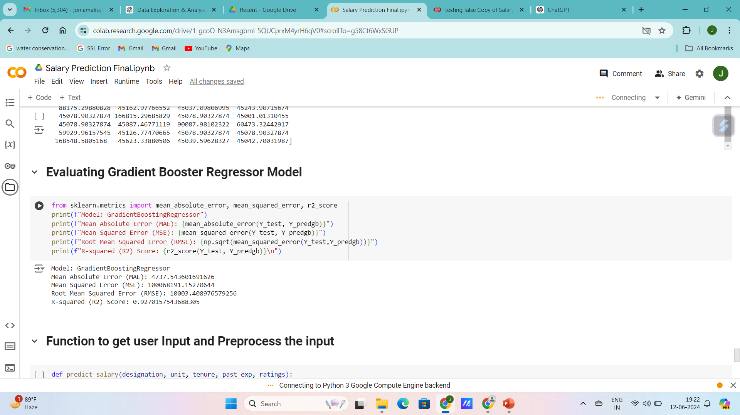
Evaluating the Models :

Slide 11
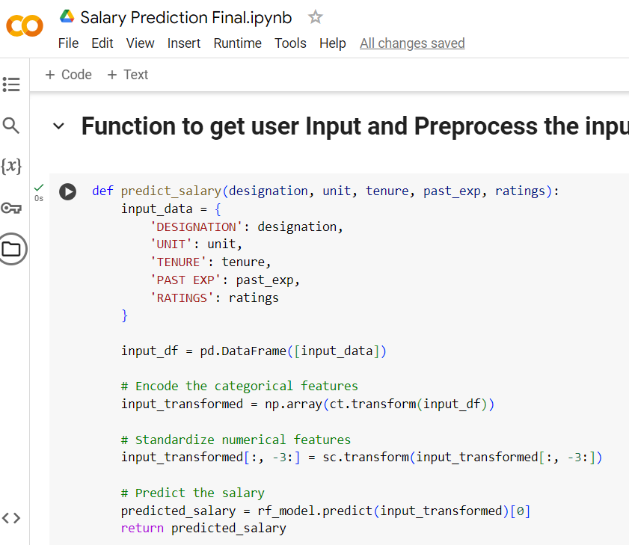
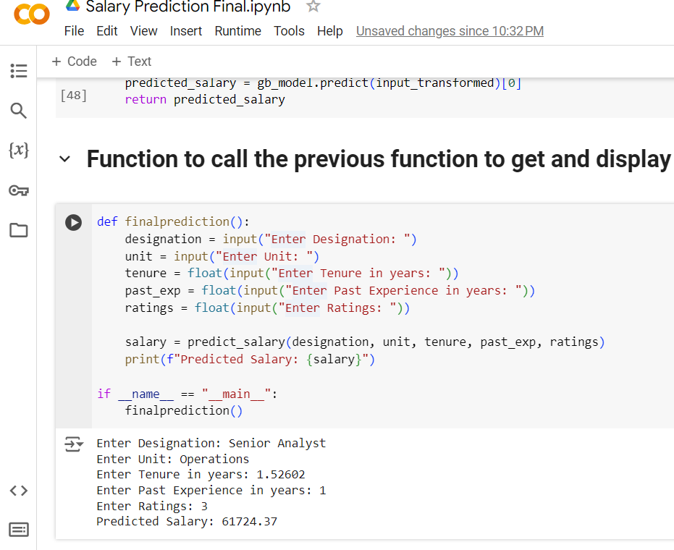
User Input and Prediction
Predict Salary Function: Gathers user input (designation, unit, tenure, past experience, ratings). Preprocesses input data. Predicts salary using the Random Forest Regressor Model.
Final prediction function: Function to gather input and display predicted salary.

Slide 12
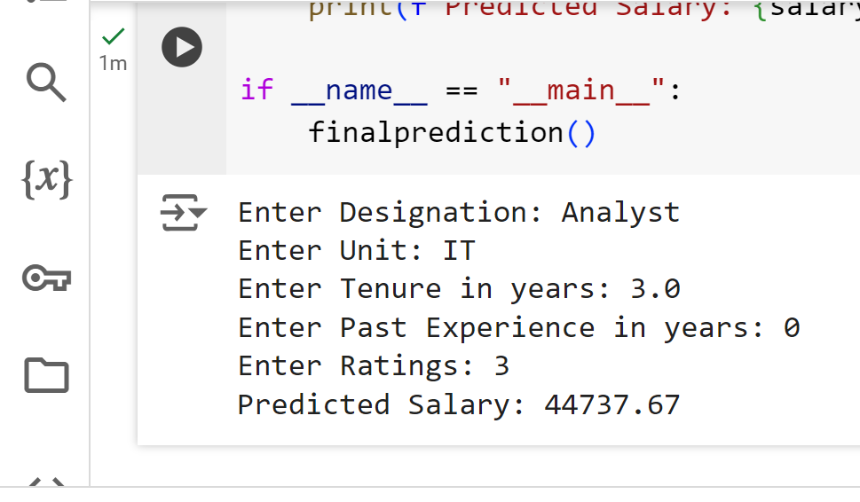
Conclusion:
The Random Forest Regressor has the best overall performance, as it has the lowest MSE, the lowest RMSE, and the highest R² score, indicating it explains the most variance in the data and has the best predictive accuracy among the models compared. The Linear Regression model has a slightly lower MAE, but its other metrics are not as strong as those of the RandomForestRegressor. Therefore, Random Forest Regressor is the best model among the four provided. So the final prediction is made using the Random Forest Regressor Model

