Slide 1
NATURAL LANGUAGE PROCESSING
CS491
TOPIC SEGMENTATION WITH A STRUCTURED TOPIC MODEL

Slide 2
TEAM DETAILS – G5
1. Kumari Renuka
2. Soumi Pal
3. Rishabh Kumar Kandoi
U101115FCS111
U101216FCS158
U101115FCS283

Slide 3
PAPER TITLE AND AUTHORS
PAPER TITLE
Topic segmentation with a structured topic model.
AUTHORS
Lan Du, Macquarie University
Wray Buntine, National ICT Australia
Mark Johnson, Macquarie University

Slide 4
PROBLEM DESCRIPTION
TOPIC MODELLING
The discourse Topic Modelling provides a convenient way to analyse big unclassified text. A topic contains a cluster of words that frequently occurs together. A topic modelling can connect words with similar meanings and distinguish between uses of words with multiple meanings.
OBJECTIVE
Implementation of topic segmentation using topic modelling in python
Main aim is the topic assignments and creating topic detection boundary for the slack dataset.

Slide 5
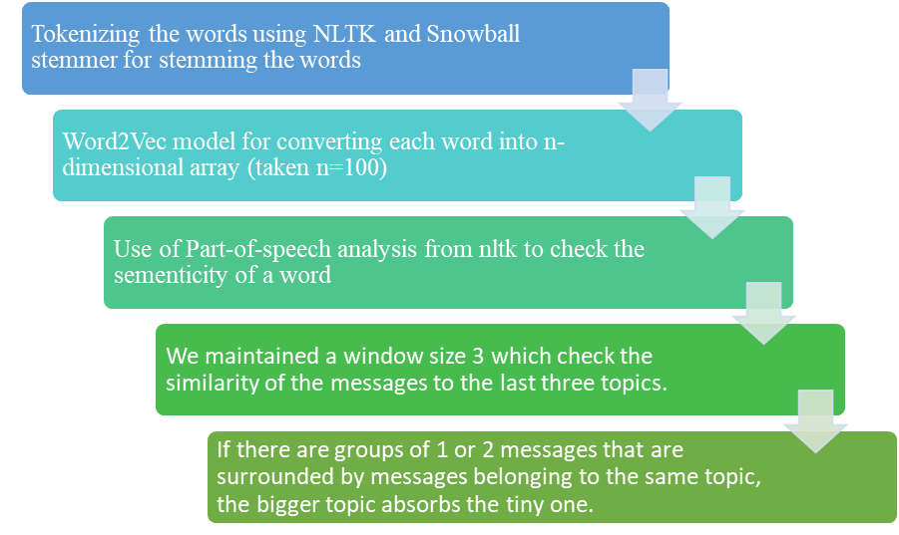
WORKFLOW OF TOPIC SEGMENTER

Slide 6
IMPLEMENTATION: FLOW
To segment chat text (SLACK Dataset) on the basis of following criteria:
i. Analysing if the message is a reply object.
ii. Calculating Similarity Distance for comparing messages.
iii. Messages belonging to same author.
iv. Timestamp of messages.
Assigning the topic names to the segmented chats.
Providing detailed output on terminal.

Slide 7
REFERENCE PAPER
TextTiling: Segmenting text into multi-paragraph subtopic passages. Computational linguistics
Text segmentation based on semantic word embeddings
Statistical models for text segmentation. Machine learning
Topic segmentation algorithms for text summarization and passage retrieval: An exhaustive evaluation
Text Segmentation with Topic Modelling and Entity Coherence

Slide 8
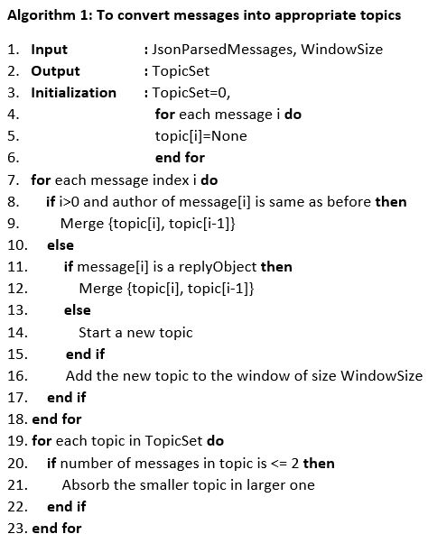
IMPLEMENTATION: ALGORITHM 1 TO CONVERT MESSAGES INTO APPROPRIATE TOPICS

Slide 9
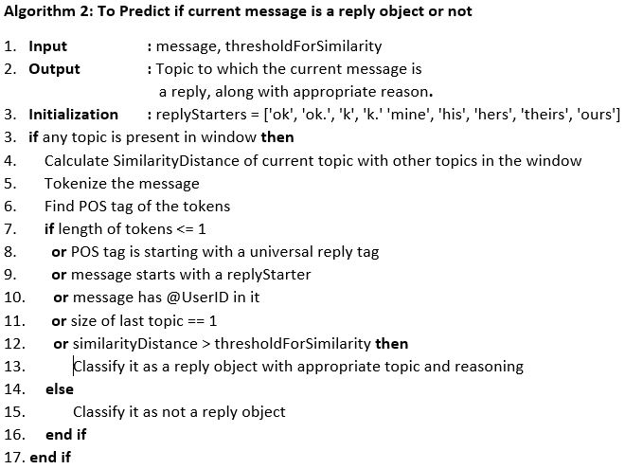
IMPLEMENTATION: ALGORITHM 2 TO PREDICT IF CURRENT MESSAGE IS A REPLY OBJECT OR NOT

Slide 10
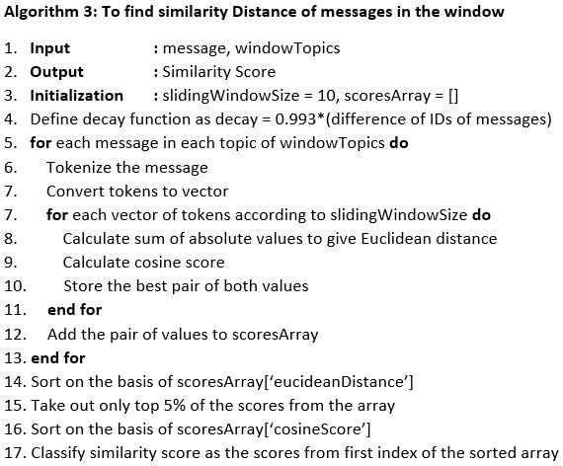
IMPLEMENTATION: ALGORITHM 3 TO FIND SIMILARITY DISTANCE OF MESSAGES IN THE WINDOW

Slide 11
DATASET DESCRIPTION
SLACK DATASET
We have used the same dataset that is being provided to us along with the reference paper. It is basically a slack dataset. The format of the dataset is as follows:
Each text file contains around 25 chat conversations.
Each conversation consists of the text being written by the user along with the User ID and timestamp.
Each conversation comes in a single line.
URL - https://aclanthology.coli.uni-saarland.de/papers/I17-1020/i17-1020

Slide 12
DATASET DESCRIPTION
This dataset is then converted to JSON format for further processing. The JSON format thus formed is as follows:
There are 4 objects named as “anon_text”, “user”, “ts” and “type”.
Extract all chat text from each conversation and store it to “anon_text”.
Extract all User IDs from each conversation and store it to “user”.
Extract all timestamp information from each conversation and store it to “ts”.
Since currently each conversation if by default of type “message”, so for each conversation, store the string “message” to the object “type”.

Slide 13
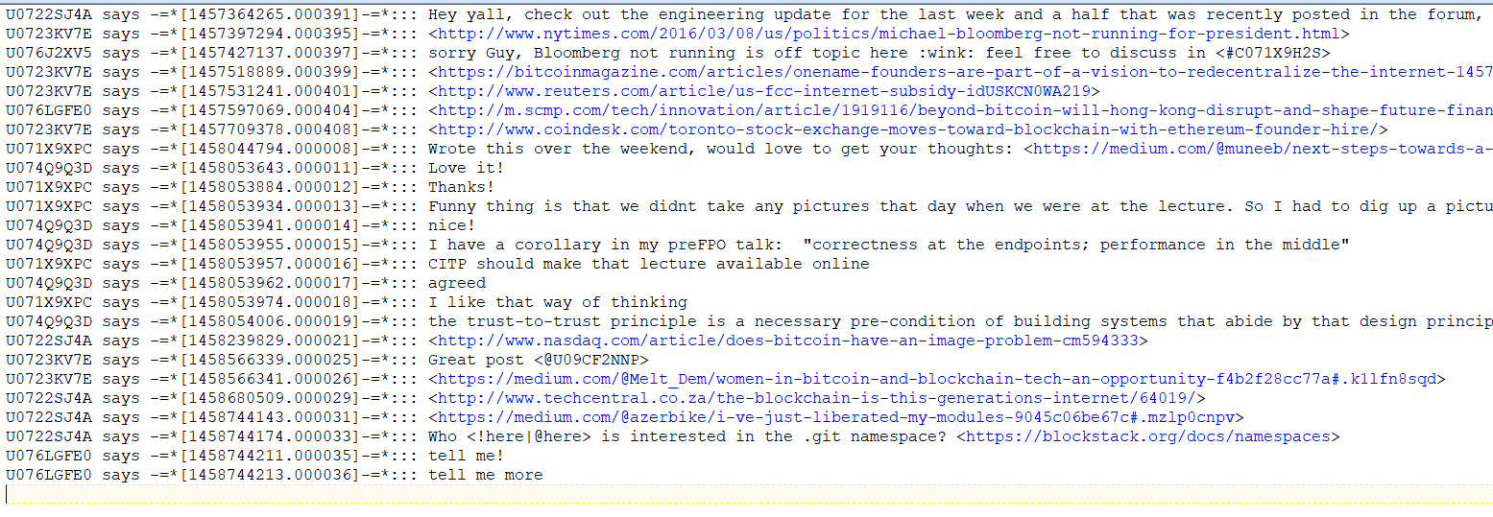
DATA SET : SCREENSHOT

Slide 14
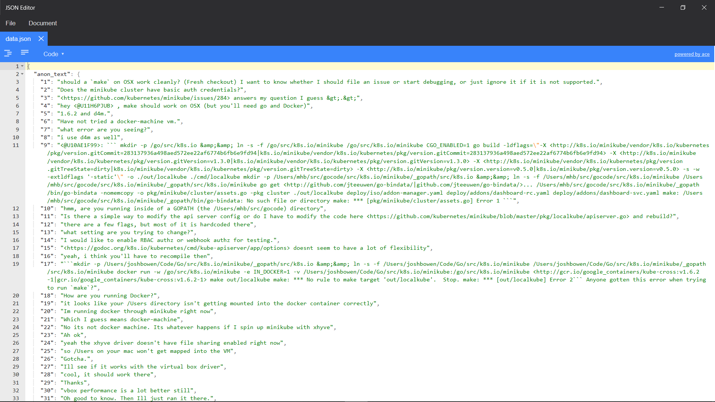
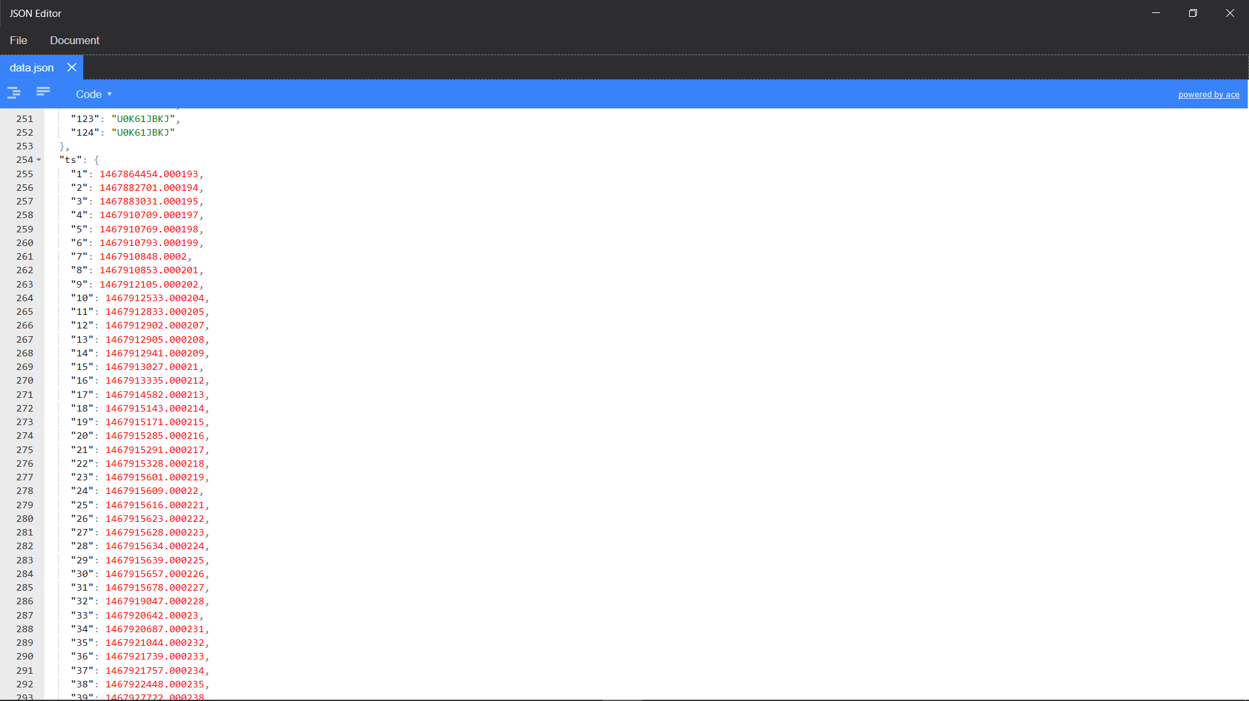
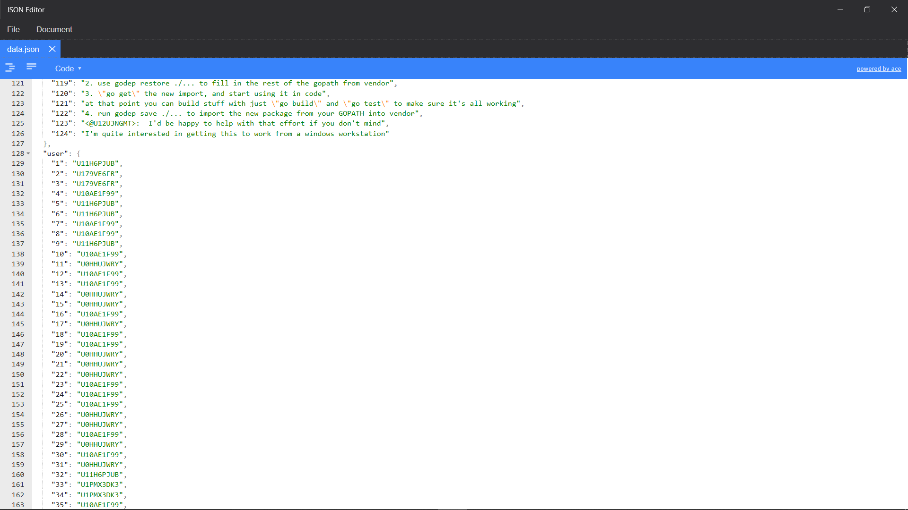
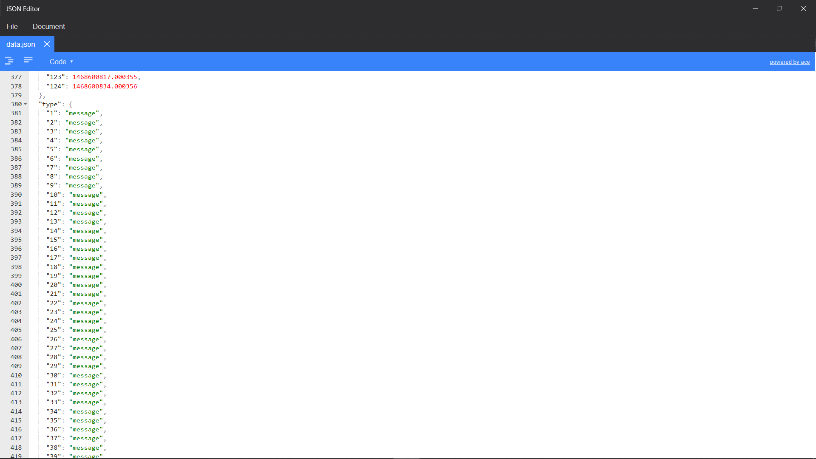
DATA SET : SCREENSHOT

Slide 15
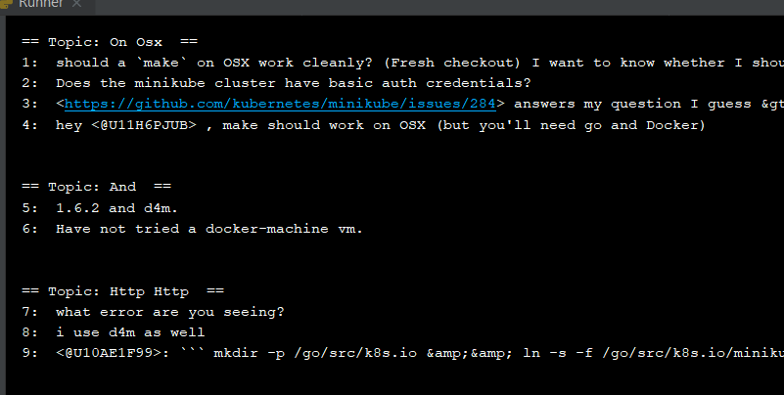
IMPLEMENTATION: OUTPUT1

Slide 16
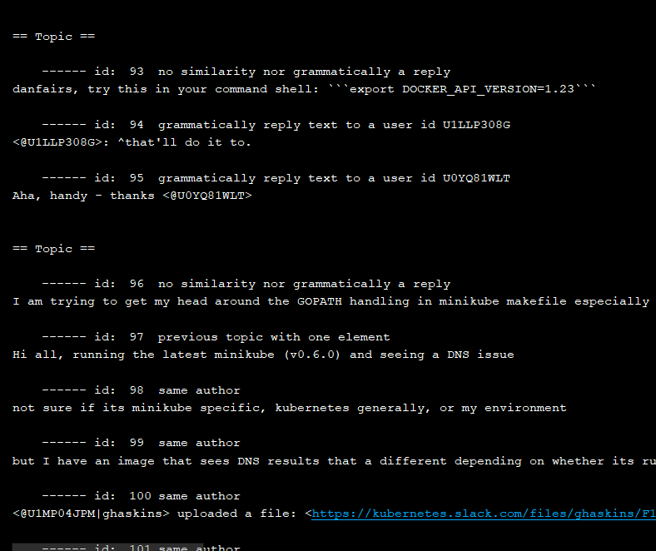
IMPLEMENTATION: OUTPUT2

Slide 17
INDIVIDUAL CONTRIBUTION: RISHABH
Dataset conversion
Conversion of raw dataset into JSON file with User Id, timestamp and chat text as objects for quick processing.
Tokenization
It refers to dividing a string into appropriate tokens. By appropriate, we mean removing stop words and punctuations.
Identify Reply Objects
It is very important to identify if a message is a reply or not, in order to merge it to the earlier topic. So, in order to consider a message as a reply, we considered various situations like if we have a singleton message, whether the message starts with words like ok, fine, etc., whether the message contains a user id or not, etc.

Slide 18
INDIVIDUAL CONTRIBUTION: RENUKA
Stemming
The use of snowball stemmer as a library in python lead us to achieve stemming. It chops off the ending letters to reduce inflectional forms and sometimes derivationally related forms of a word or token to a common base form.
Vectorizing
Converting each token to vector give the ample opportunity to perform mathematical computations like calculating Similarity Distance.
Find Similarity distance
Similarity Distance calculation involves quantifying the similarity between two objects, which are vectors of tokens in our case. This also involves calculating Euclidean Distance of a message to provide a central score of that message.

Slide 19
INDIVIDUAL CONTRIBUTION: SOUMI
Integrating all to convert raw data to topics :
Dividing the complete objective into modules and classes in order to debug the code precisely lead to simplifying the process of integration.
Naming the topics :
It involves tokenizing the stemming the messages in a topic and using probabilistic model to get the most likely word(s) as a name of the topic.
Incorporate window size functionality :
We kept the size of window to be 3, which means the last three topics need to be remembered so that the comparison can be made for analysing whether a message is a reply object or not. Since large window size would lead to keeping messages that have huge difference in timestamp, so deciding a reasonable size is important.

Slide 20
CONCLUSION AND FUTURE WORK
Train the model for more accurate segmentation.
Name the topics manually and train the model to give more appropriate Topic Names.
Give suggestion for an issue by searching the related topic.
Keeping window size (currently 3) dynamic based on the importance (or weights) of topics.

Slide 21
REFERENCES
Du, L., Buntine, W. and Johnson, M., 2013. Topic segmentation with a structured topic model. In Proceedings of the 2013 Conference of the North American Chapter of the Association for Computational Linguistics: Human Language Technologies (pp. 190-200).
Hearst, M.A., 1997. TextTiling: Segmenting text into multi-paragraph subtopic passages. Computational linguistics, 23(1), pp.33-64.
Alemi, A.A. and Ginsparg, P., 2015. Text segmentation based on semantic word embeddings. arXiv preprint arXiv:1503.05543.
Beeferman, D., Berger, A. and Lafferty, J., 1999. Statistical models for text segmentation. Machine learning, 34(1-3), pp.177-210.
https://en.wikipedia.org/wiki/Topic_model

Slide 22
THANK YOU

