Slide 1
NATURAL LANGUAGE PROCESSING
CS491
GROUP CHAT TEXT SEGMENTATION USING TOPIC MODELING

Slide 2
TEAM DETAILS – G5
1. Kumari Renuka
2. Soumi Pal
3. Rishabh Kumar Kandoi
U101115FCS111
U101216FCS158
U101115FCS283

Slide 3
PAPER DETAILS
AUTHOR: Du, L., Buntine, W. and Johnson, M.
TITLE: Topic segmentation with a structured topic model.
WAS SUBMITTED AT: In Proceedings of the 2013 Conference of the North American Chapter of the Association for Computational Linguistics: Human Language Technologies (pp. 190-200).

Slide 4
PROBLEM DESCRIPTION
The Paper presents a new hierarchical Bayesian unsupervised topic segmentation model, integrating a point-wise boundary sampling algorithm with a structured topic model.
This model provides high quality segmentation performance.
Project managers can utilize these platforms for various tasks such as decision auditing and dynamic responsibility allocation.

Slide 5
WORK DONE TILL NOW

Slide 6
SUMMARY
To segment chat text (SLACK Dataset) on the basis of following criteria:
i. Analysing if the message is a reply object.
ii. Calculating Similarity Distance for comparing messages.
iii. Messages belonging to same author.
iv. Timestamp of messages.
Naming the topics thus segmented.
Providing detailed output on terminal.

Slide 7
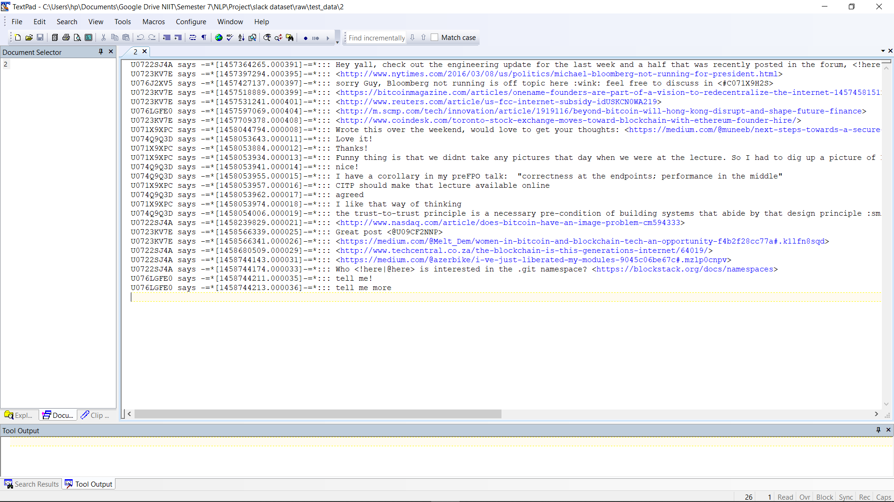
DATA SET DESCRIPTION
1. Chat Dataset – SLACK
2. Multiple files for performing segmentation.
3. Each file is of same format as shown here.

Slide 8
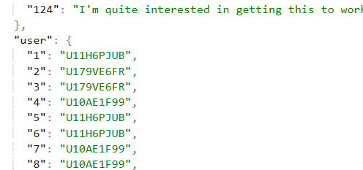
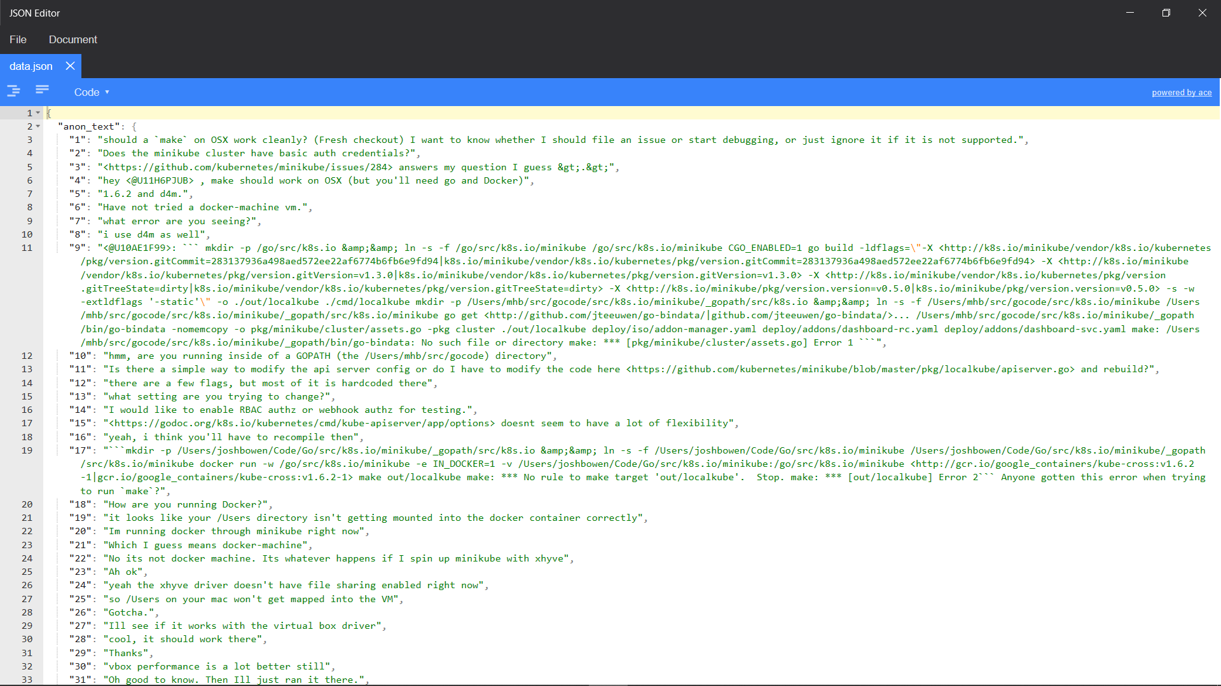
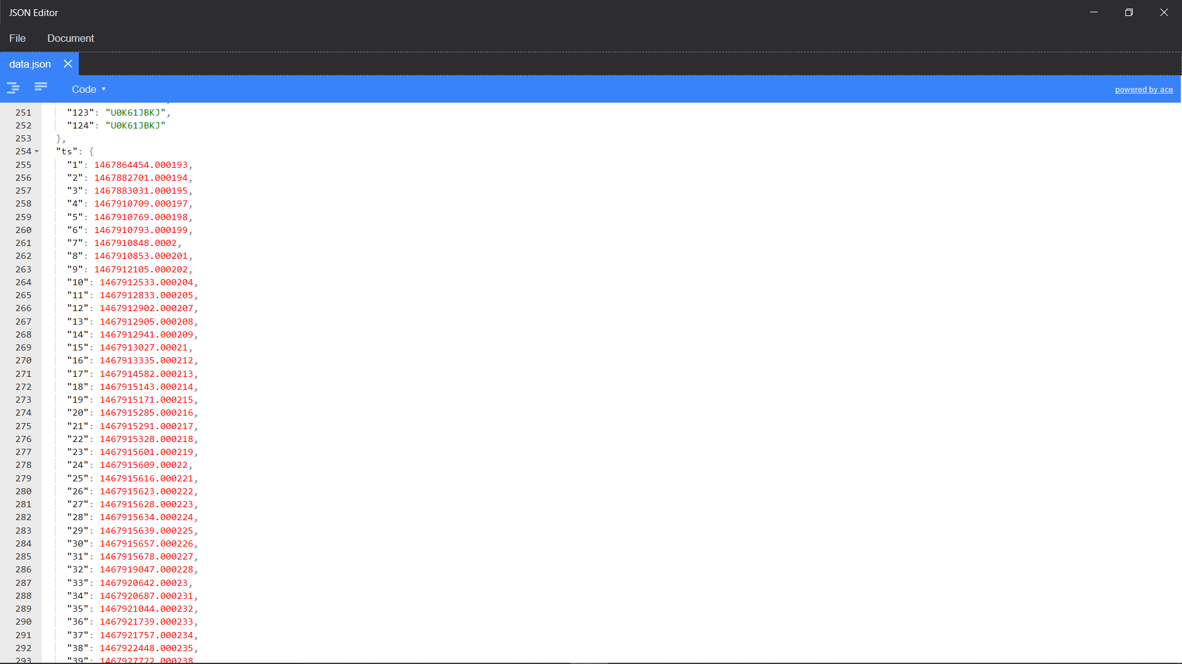
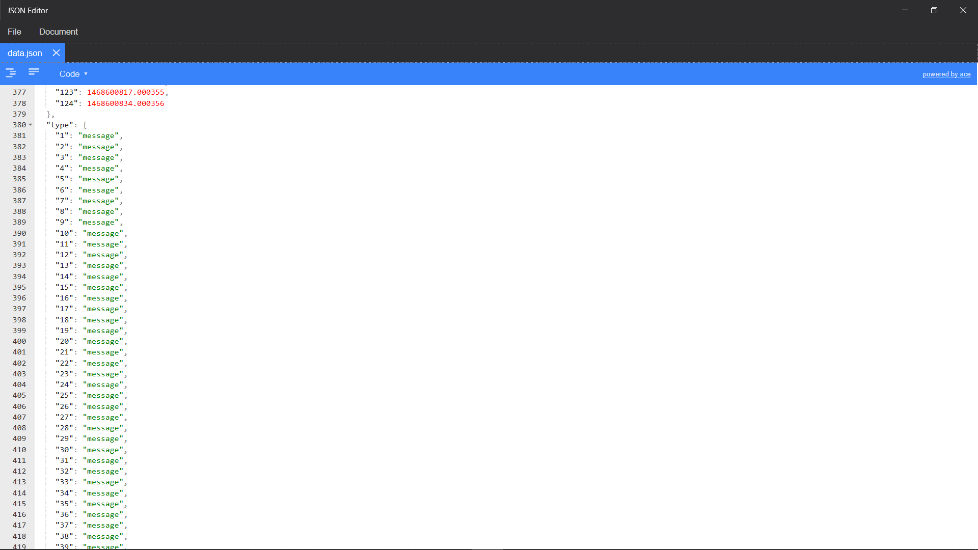
DATA SET DESCRIPTION
4. Parse the dataset into JSON file as shown.
5. Now we can easily store JSON objects in python and process it.

Slide 9
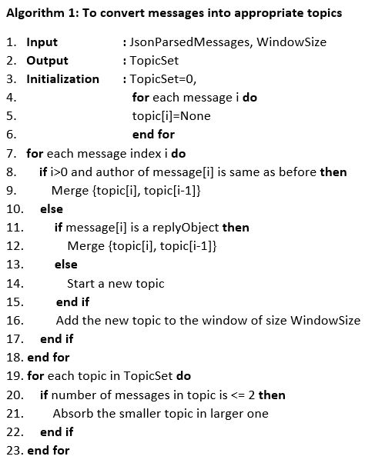
ALGORITHM 1 : TO CONVERT MESSAGES INTO APPROPRIATE TOPICS

Slide 10
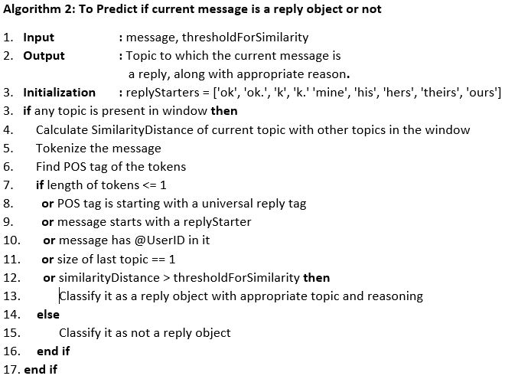
ALGORITHM 2 : TO PREDICT IF CURRENT MESSAGE IS A REPLY OBJECT OR NOT

Slide 11
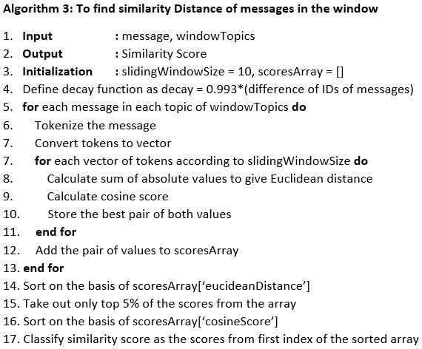
ALGORITHM 3 : TO FIND SIMILARITY DISTANCE OF MESSAGES IN THE WINDOW

Slide 12
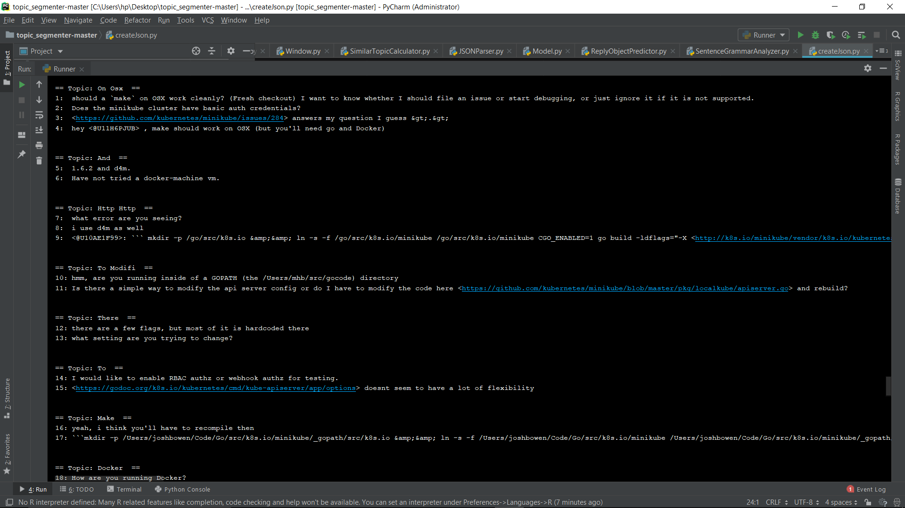
OUTPUT 1

Slide 13
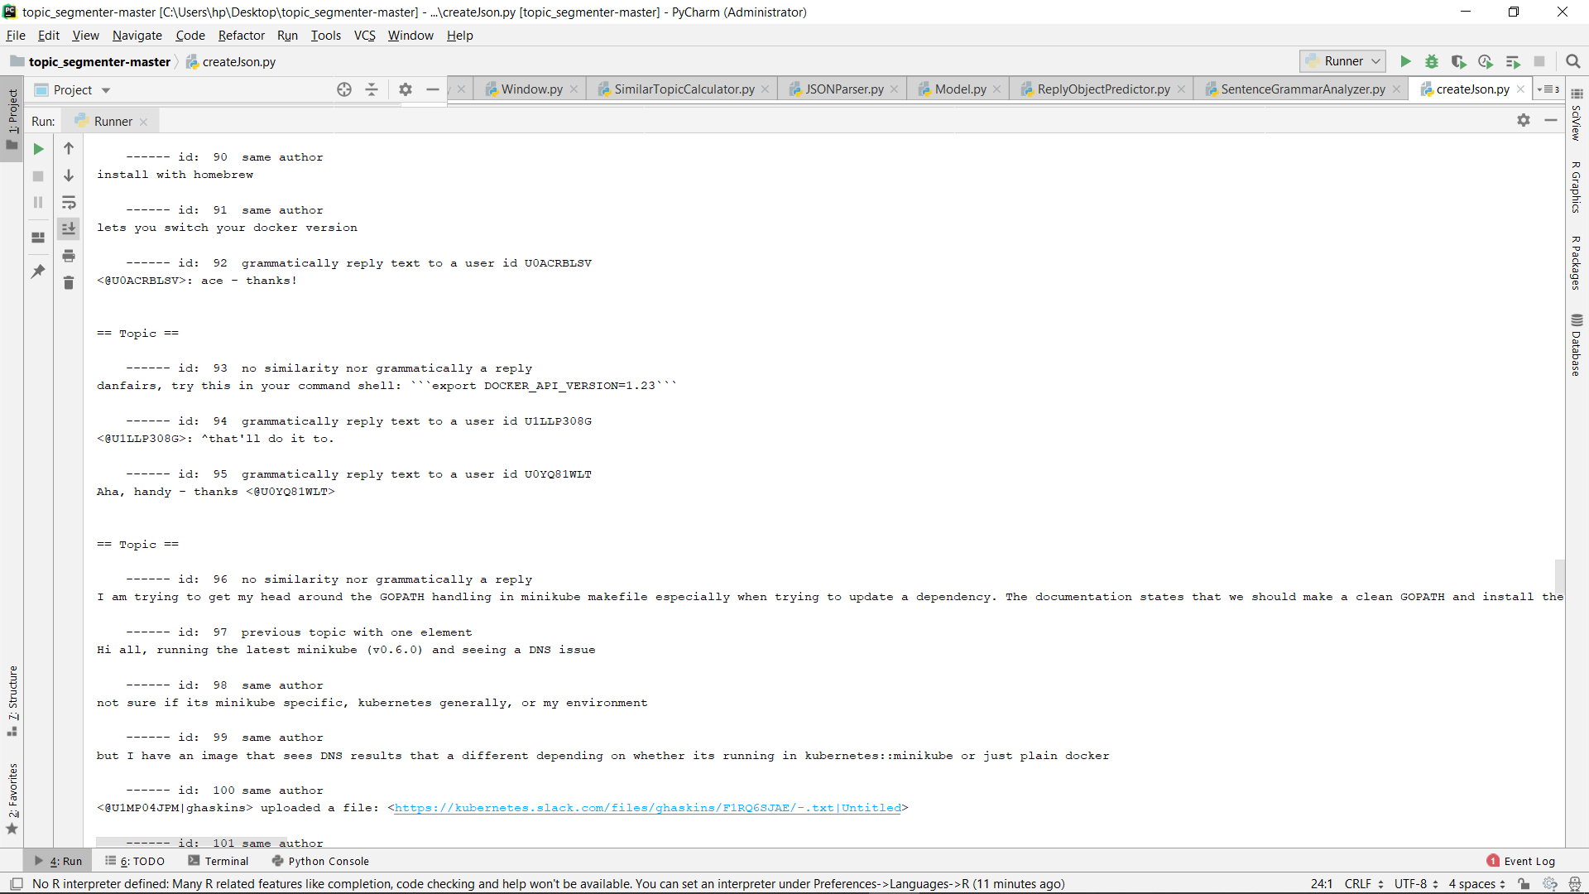
OUTPUT 2

Slide 14
INDIVIDUAL CONTRIBUTIONS

Slide 15
RISHABH
Dataset Conversion (JSON Parsing).
Tokenization.
Analysing Reply Objects.

Slide 16
RENUKA
Stemming.
Vectorizing.
Calculate Similarity Distance.

Slide 17
SOUMI
Researched and came out with the idea.
Project Integration.
Topic Naming.
Terminal Report Generation.

Slide 18
CONCLUSION

Slide 19
FUTURE SCOPE
Train the model for more accurate segmentation.
Name the topics manually and train the model to give more appropriate Topic Names.
Give suggestion for an issue by searching the related topic.
Keeping window size (currently 3) dynamic based on the importance (or weights) of topics.

