Slide 1

ENTREPRENEURSHIP MGT401 BUSINESS PLAN PADHOMITRON
Group no: 2301 Section: S2-S3

Slide 2
TEAM MEMBERS
Kumari Renuka U101115FCS111
Yash Vaidya U101115FCS182
Tushar Sharma U101115FCS168
Shailesh Mohta U101115FCS305
Rishabh Kumar Kandoi U101115FCS283
Abhimanyu Kishor Sangitrao U101115FCS038

Slide 3
INTRODUCTION: ABOUT PADHOMITRON
Our company, PadhoMitron provides a platform with complete guidance of what all paths can be followed when a person, of any age, is going to start his/her career in any field.
Provide a customized inventory of resources (MOOCs, books, websites, blogs, projects, etc.) recommended on the basis of the user’s choice of a subject.
One-to-One mentorship
Location – Neemrana, Rajasthan

Slide 4
INTRODUCTION: ABOUT PADHOMITRON
LEGAL STRUCTURE
PadhoMitron is structured as C-Type Corporation
BRIEF HISTORY
Conceptualized in mid February, 2018.
Survey conducted to test the demand of the product in the targeted market space.
Concept Statement prepared.
Feasibility Report prepared to study the overall feasibility of out venture.
Case Study : “Coursera Inc.”

Slide 5
INTRODUCTION: TEAM AND ADVISORS
MANAGEMENT TEAM
Led by its 6 Co-Founders who are a group of aspiring Computer Science Engineers at NIIT University.
Kumari Renuka : ‘The Dreamer’
Yash Vaidya : ‘The Doer’
Tushar Sharma : ‘The Architect’
Shailesh Mohta : ‘The Visionary’
Rishabh Kumar Kandoi : ‘The Baniya’
Abhimanyu Kishor Sangitrao : ‘The Hustler’
ADVISORS: Prof. RAJ K. KOVID of NIIT University

Slide 6
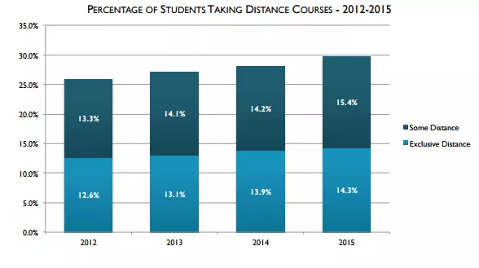
OPPORTUNITIES: PROBLEMS
SOURCE-DIGITAL LEARNING COMPASS: Distance education enrolment report 2017

Slide 7
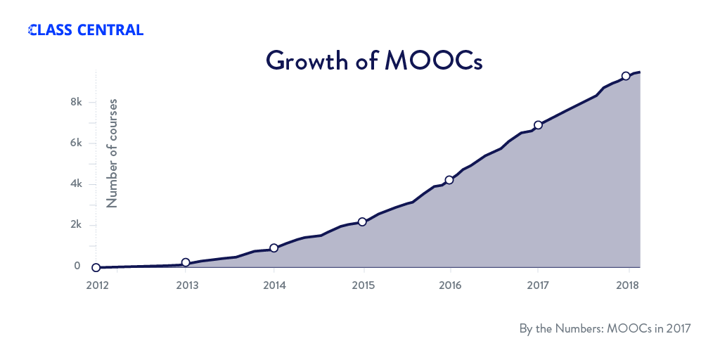
OPPORTUNITIES: PROBLEM
Rapid growth in the MOOCs industry.
A huge number of MOOCs appearing
Quality is not up to the mark.
Students are confused.

Slide 8
OPPORTUNITIES: OUR SOLUTION APPROACH
Our Product provides a bridge between online courses available(MOOC’s) and the Learner. To guide the learner through different courses and pick the best one for the aim they want to achieve.
A Platform centered around the students rather than MOOCs.
Personalized Recommendations.
Learning Paths for various careers.
One-to-one Mentor-ship from professionals.

Slide 9
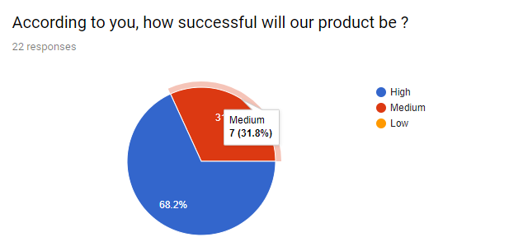
OPPORTUNITIES: FEASIBLITY SURVEY
PRODUCT/SERVICE FEASIBILITY:
Feasible
According to our finding, 68.2% of the total number of people think our venture is highly feasible.
31.8% of the total number of people think our venture is feasible.

Slide 10
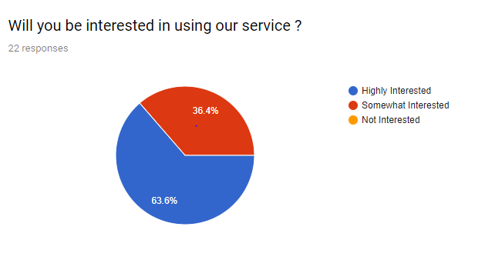
OPPORTUNITIES: BUYING INTENTION SURVEY
BUYING INTENTION SURVEY:
Feasible
According to our finding, 63.6% of the total number of people would be interested in our product.
36.4% of the total number of people would be somewhat interested.

Slide 11
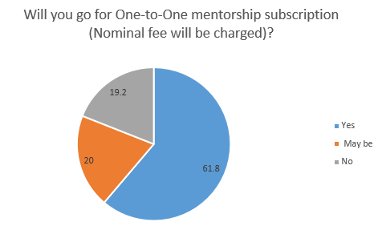
OPPORTUNITIES: BUYING INTENTION SURVEY
SUBSCRIPTION SURVEY:
61.8% of the total number of people will pay for one-to-one mentorship subscription of our service.
20% of the total number of people may pay for one-to-one mentorship subscription of our service.

Slide 12
OPPORTUNITIES: TARGET MARKET
We will focus on the following target markets with regards to the flow of money.
MOOCs partners.
Paying individual learners.
Non-paying individual learners.
Institutional customers.
Mentors from the various universities.

Slide 13
OPPORTUNITIES: COMPETITION
CURRENT COMPETITORS
The major players in global market includes-
1. EdX 2. Coursera 3. Udacity 4. Udemy 5. Duolingo 6. Englishtown
7. Google Primer 8. Lynda.com 9. CodeAcademy 10. FutureLearn 11. Esri 12. IER

Slide 14
OPPORTUNTIES: PROFITABILITY AND COMPETITIVE POSTION
COMPETITIVE ADVANTAGES
LOW COST LEADERSHIP
One-to-one mentorship which is of lost cost as compared to other MOOCs providers
Providing right learning path to each and every individual.
DIFFERENTIATION
Our Product provides a bridge between online courses available(MOOC’s) and the Learner. To guide the learner through different courses and pick the best one for the aim they want to achieve.

Slide 15
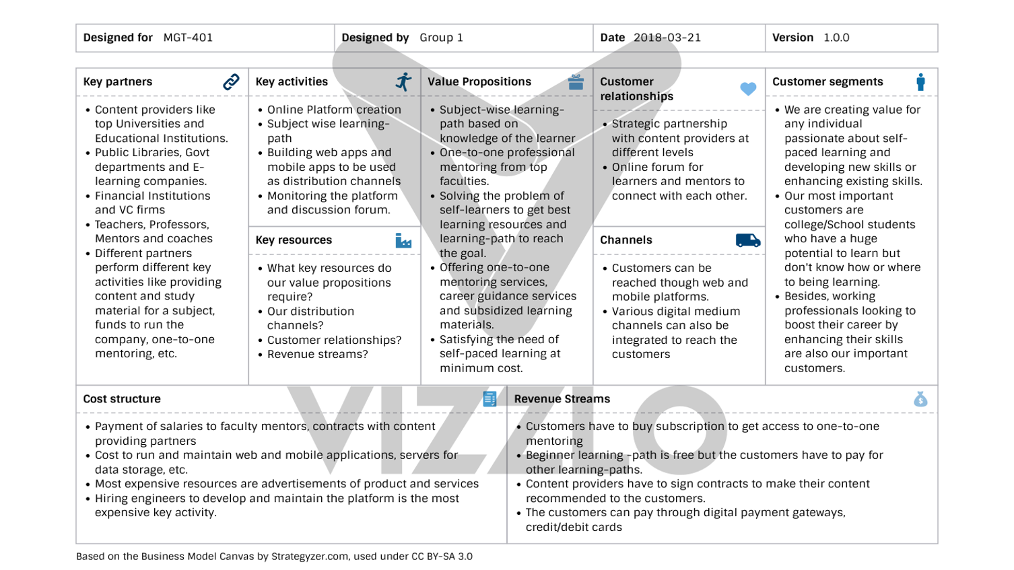
BUSINESS MODEL

Slide 16
EXECUTION: MARKETING AND SALES
OUR MISSION
To connect the learners to the best available resources available for the subject they wish to learn and to make the process of self-learning easy, convenient and goal oriented.
FINANCIAL OBJECTIVES
A double-digit growth rate for each future year.
Reduce the variable costs through efficiency gains.
Reach profitability within the first year.

Slide 17
MARKETING AND SALES: MARKETING OBJECTIVE
Develop brand awareness through a steady, month to month increase of new customers.
Develop an increase in sales while achieving a status quo state or decrease in marketing expenses.
Reach the target market through different communication channels like digital media and print media to promote the brand.
To retain the existing customers and increase their frequency of usage of our services.

Slide 18
MARKETING AND SALES: MARKETING STRATEGY
Social Media marketing
Advertising through Posters, flyers and print media
Email Marketing
Promoting the brand though celebrity Brand Ambassador
Sponsoring in tech and education events to promote our relevant products and services

Slide 19
EXECUTION: OPERATIONS
LOCATIONS & FACILITIES
PadhoMitron would be Neemrana-based Start-up company which would be located in Japanese Zone in Neemrana, Rajasthan.
TECHNOLOGY
Software such as cloud solution, database, payment gateway and google services would be required for the development of the product and hardware such as the servers, computers would be mandatory.
EQUIPMENT & TOOLS
Tools and equipment such as the IDE to develop the product and router for faster internet connection would be required.

Slide 20
EXECUTION: MILESTONES AND METRICS
TIMELINE | KEY MILESTONES
March 2018 –April 2018 | Prepare full Business Plan at the ideation stage of the product
April 2018 | Office Setup with various hardware tools and hiring people to start the development process
April 2018 - September 2018 | Start product development and complete the prototype for beta testing
October - December 2018 | Customer validation/feedback
January – March 2019 | Beta users feedback and product development
April – June 2019 | Prepare schedule for funding/investment
July – August 2019 | Pitch for funding/investment from VC or angel investors
September – December 2019 | Begin operations and product marketing

Slide 21
EXECUTION: KEY METRICS
The important thing to be considered is to keep the platform up and running all the time which can be achieved by upgrading to better quality of servers and storage providers.
Updating the platform from time to time depending on the new resources available in the market.
Analysis of the users in order to increase the traffic is important
Maintaining good customers relationship through discussion forum.
Understanding the growth in the number of key partners (content providers) and growth in the number of subjects according to the user preference.

Slide 22
FINANCIAL PLAN: FORECAST

Slide 23
FINANCIAL PLAN: NET PROFIT/LOSS
By forecasting the future revenue and expenses, the value for net profit is achieved for 3 subsequent years.
Formula: Total Revenue – Total Cost
Key Assumptions: Around a lakh customers per year, with cost of one-to-one mentorship being $60 per year, and appointing 500 mentors per year.

Slide 24
FINANCIAL PLAN:STATEMENTS
PARAMETERS | FY2018 | FY2019 | FY2020
Revenue | $3.6 million | $3.8 million | $4.2 million
Direct Costs | $1.88 million | $2.1 million | $2.2 million
Gross Margin % | 47.7 | 44.7 | 47.6
Total Operating Expenses | $27380 | $19615 | $20415
Total Expenses | $1.9 million | $2.11 million | $2.2 million
Net Profit | $1.7 million | $1.69 million | $1.98 million
Net Profit / Sales | 0.47 | 0.44 | 0.47

Slide 25
FINANCIAL PLAN:STATEMENTS
PARAMETERS | FY2018 | FY2019 | FY2020
Total Current Assets | $3.6 million | $3.8 million | $4.2 million
Long-Term Assets | $7700 | $7700 | $7700
Accumulated Depreciation | $3800 | $3800 | $3800
Total Long-Term Assets | $3900 | $3900 | $3900

Slide 26
FUTURE WORK
Collaboration with Universities to provide personalized courses according to their course structure.
Collaboration with cooperations to provide personalized training to employees.
Monetizing detailed path analysis for customers.
Package deal for purchase of one-to-one mentorship along with paid courses of different MOOCs providers.

Slide 27
THANK YOU
ANY QUESTIONS?

