Slide 1
IOT Project
AUTOMOBILE BALANCER

Slide 2
TEAM DETAILS
1. Shivarama Devarasetty
2. Priadarshan Nair
3. Rishabh Kumar Kandoi
U101115FCS298
U101216FEC228
U101115FCS283

Slide 3
PROJECT OBJECTIVES
Problem-
During the high speed of the moving vehicles, the vehicles tends to topple due to sudden changes in the direction. Hence in order to prevent vehicles from toppling we have provided a model which reverses the direction of the motors.
Objective
Our main objective is to avoid the toppling of the vehicle by remotely sensing the different movements of the vehicle by using a motor to actuate the steer of the vehicle.

Slide 4
TECHNOLOGY STACK
Software:
Programming Language: Python, MATLAB
Platform: Python IDE, ThingSpeak Server
Hardware:
RaspberryPi 3
MPU-6050
DC Motor

Slide 5
WHY RASPBERRYPI ?
Key Benefits –
Low cost
Faster Processing
Wireless Access Point
Security Monitoring
Abundant GPIO’s
SPI, I2C

Slide 6
MPU-6050
It’s a Integrated system of Gyroscope and Accelerometer.
It communicates using I2C protocol.
Gyroscope is used to sense the elevation of the automobile.
Accelerometer for detecting the motion of the vehicle.
DC Motor: It depicts the behavior of the steering wheel during the imbalancing situation.

Slide 7
ABOUT THINGSPEAK SERVER
ThingSpeak™ is an IoT analytics platform service that allows you to aggregate, visualize and analyze live data streams in the cloud.
It provides instant visualizations of data posted by devices to ThingSpeak.
With the ability to execute MATLAB® code in ThingSpeak you can perform online analysis and processing of the data as it comes in.

Slide 8
IMPLEMENTATION USING THINGSPEAK
Setup account
Set channel settings and insert fields you require to retrieve from device
Set visualization to show output in appropriate manner
Note MQTT API Key, writeAPI Key and channel Id as it will be used to establish connection and enable data transfer via device.

Slide 9

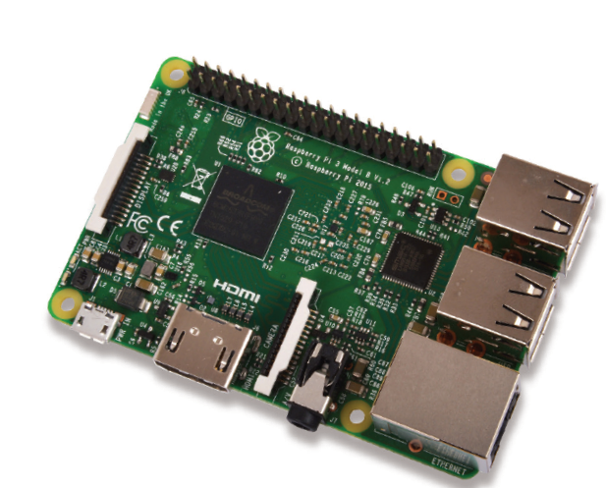

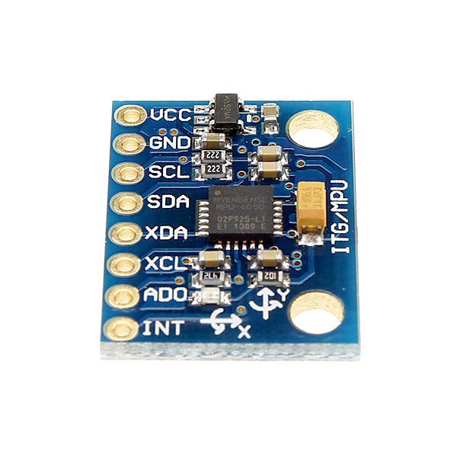
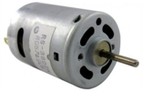
BLOCK DIAGRAM
THINGSPEAK
MQTT
THINGSPEAK
MQTT
RaspberryPi
I2C
MPU-6050
DC Motor

Slide 10
WORKING
MPU-6050 senses the elevation of the vehicle.
DC motor actuates the steer automatically in case of unbalance situation
The Data regarding the elevation of the vehicle, state of the Steer and the acceleration can be monitored in server remotely.
Above data is transferred to the server using MQTT protocol.

Slide 11
DEMONSTRATION

Slide 12
APPLICATIONS
Avoidance of accidents due to imbalance of vehicles.
Security of the vehicle.
Sensing the speed of the vehicle.

Slide 13
THANK YOU ANY QUESTIONS ?

