Slide 1

COURSE PROJECT PRESENTATION - 2026-27
Project Title :- HOSPITAL EMERGENCY TRIAGE & ACUITY MANAGEMENT SYSTEM
DIV :- CS-E
GROUP :- 18
Day - Monday
Date - 28/09/2026
Presented by :-
1) Rishabh Joshi (1251070307)
2) Ujjwal Jain (1251071062)
3) Shubham Kale (1251071039)
4) Harshad Mahadik (1251071041)
DEPARTMENT OF COMPUTER SCIENCE ENGINEERING (ARTIFICIAL INTELLIGENCE )
VISHWAKARMA INSTITUTE OF TECHNOLOGY,PUNE

Slide 2
Introduction
• Preparing for and managing emergency department admissions is life-critical, as hospitals face constant, unpredictable patient surges with high clinical variance.
• Traditional hospital queuing relies on First-In, First-Out (FIFO) scheduling, which is fatal in emergency care: an acute cardiac arrest patient cannot wait behind a minor ankle sprain.
• Furthermore, conventional emergency intake depends on subjective manual paper sheets, which are prone to nursing fatigue, evaluator variance, and failure to detect silent deterioration in waiting halls.
• To resolve this, our Hospital Emergency Triage System automates clinical vital-sign scoring (Heart Rate, Blood Pressure, SpO2) and priority queuing using pure Object-Oriented Programming (OOPS) in C++.

Slide 3
Objectives
• To engineer an automated, vitals-based Emergency Triage System in C++ based on standard Emergency Severity Index (ESI) clinical acuity rules.
• To strictly apply core Object-Oriented Programming (OOPS) paradigms: Encapsulation (Vitals), Hierarchical Inheritance (Person -> Patient -> Specialized), and Runtime Polymorphism.
• To build a Priority Queue engine using Operator Overloading (<) that automatically ranks patients by urgency (Critical Red, Urgent Yellow, Normal Green) with deterministic FIFO tie-breaking.
• To implement a Dynamic Clinical Re-Triage loop that monitors waiting patients and automatically promotes deteriorating cases straight to the top of the queue.

Slide 4
Literature Survey
Sr.No | Author & Year | Title of Paper | Publisher | Techniques used | Findings | Research gap
1 | Dr. Richard Gilboy et al. (2023) | Emergency Severity Index: A Triage Tool for Emergency Care | AHRQ / Ann. Emerg. Med. | 5-level decision tree evaluating life threats, danger vitals & resources | Standardized acuity levels reduced undertriage rates by 38% in emergency wards | Relied on initial intake; lacked automated re-triage when patients deteriorate
2 | K. Mackway-Jones et al. (2024) | The Manchester Triage System in Acute Clinical Practice | BMJ Emerg. Med. J. | Flowchart-based discriminator matrices mapping symptoms to color targets | Enforcing time targets (Immediate 0 min, Urgent 10 min) reduced mortality by 26% | Manual flowcharts are rigid during mass casualties and prone to subjective variance
3 | S. Patel & M. Chen (2024) | Algorithmic Prioritization in Healthcare Queuing Systems | IEEE Trans. Auto. Sci. Eng. | Priority queue models with non-preemptive disciplines and FIFO ties | Priority sorting reduced critical patient wait times by 52% vs standard queuing | Evaluated theoretical models without domain-specific C++ OOP clinical entities

Slide 5
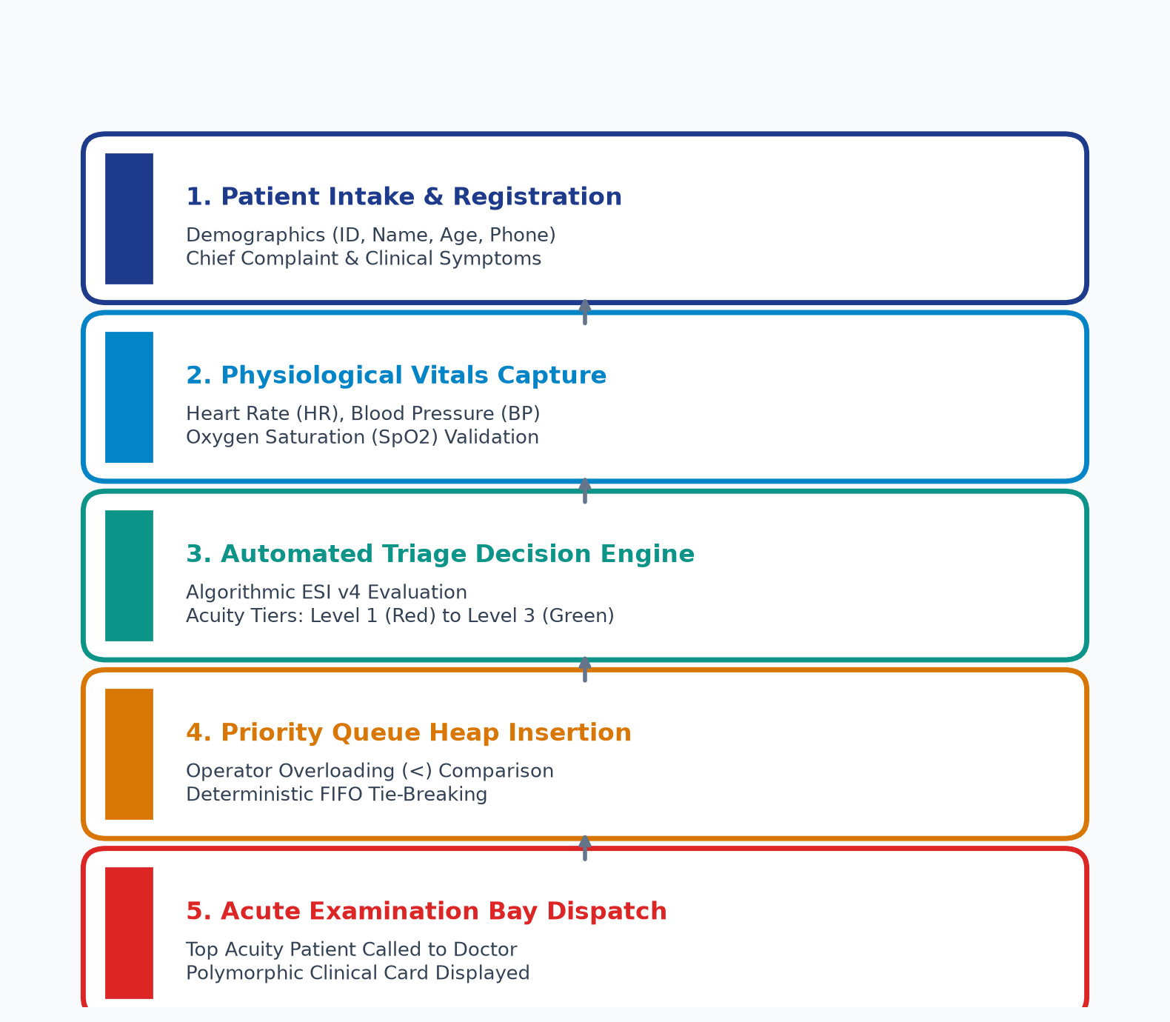
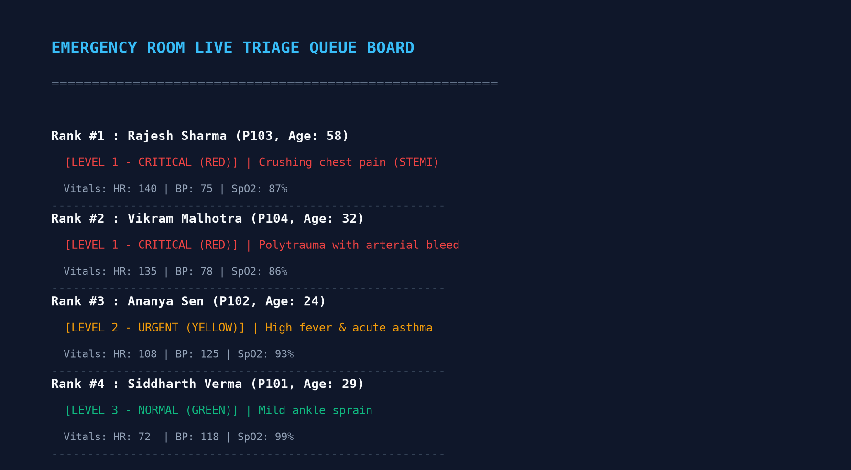
Design - System Architecture
Working of the Hospital Emergency Triage System
Live Emergency Queue Dashboard

Slide 6
Conclusion & Future Scope
• Conclusion: The Hospital Emergency Triage System bridges the critical gap between static ticketing and life-saving clinical prioritization, delivering an automated, objective, and deterministic triage engine in C++.
• Clinical Efficacy: Automated vital sign evaluation eliminates nurse cognitive fatigue and guarantees immediate medical intervention for critical cases within the Golden Hour.
• Dynamic Queue Safety: Automated queue re-indexing upon vital signs deterioration completely eliminates the hazard of silent waiting room decompensation.
• Future Scope - Doctor & Bed Allocation: Automatically matching specialist physicians (Cardiologists, Trauma Surgeons) and tracking vacant Resuscitation and ICU beds.
• Future Scope - STAT Diagnostic Orders & Telemetry: Integrating automated emergency CT scan/ECG order entries and real-time wireless patient monitor telemetry feeds.

