Slide 1
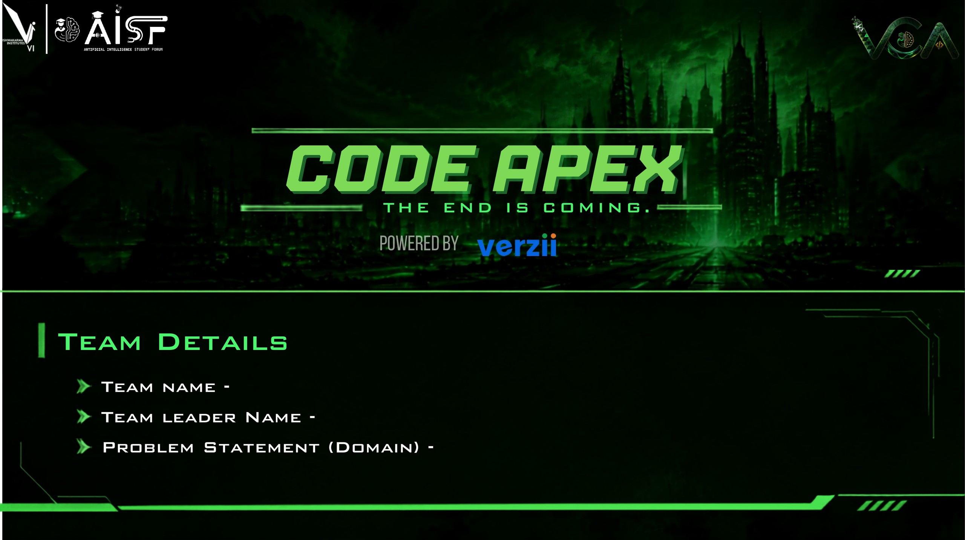
Team Kartos
Soham Jadhav
Autonomous AI QA Engineer | iMocha Track 2
Notes:
Team Kartos, led by Soham Jadhav. Track 2 (iMocha), Problem 02: Autonomous AI QA Engineer - an AI agent that explores a web app, generates and runs tests, and reports bugs with evidence.

Slide 2
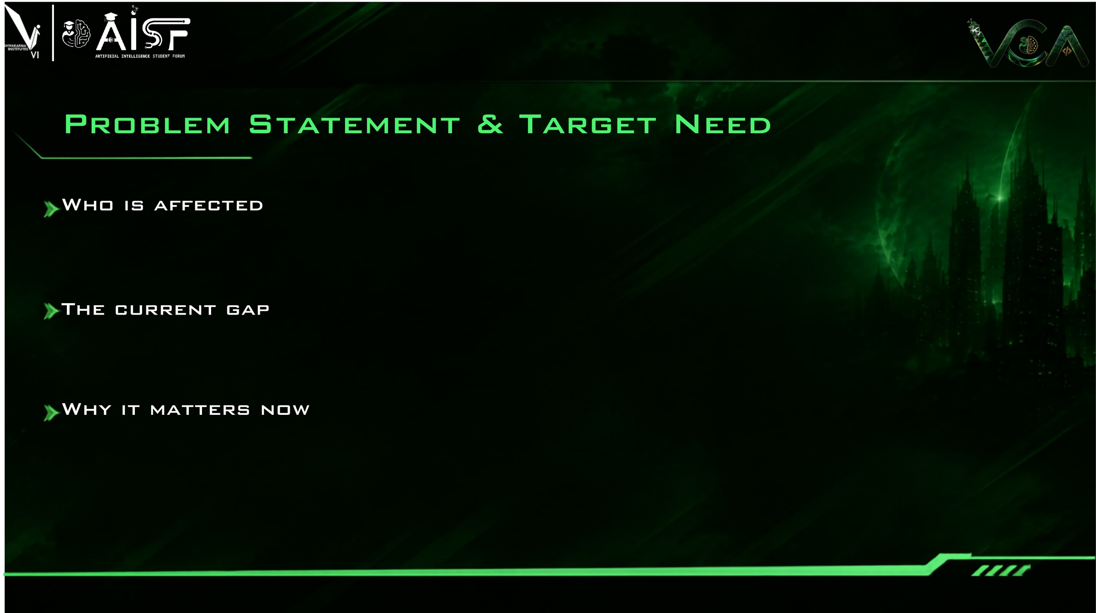
Dev teams and startups shipping web apps fast with little or no QA capacity
QA engineers stuck in repetitive regression testing and script upkeep
End users and product owners who run into bugs in production
Manual testing is slow; scripted automation is brittle and breaks on UI changes
Tools generate tests but don't explore on their own or give reproducible evidence
Bug reports lack steps and proof, causing dev-QA back-and-forth
AI-assisted coding is raising code output faster than humans can test
Shorter release cycles make testing the new bottleneck
LLM agents with vision and browser control can now explore apps on their own
Illustrative trend, not measured data
Notes:
Who is affected, the gap, and why now. The chart is illustrative - it shows the shape of the problem (output growing faster than manual QA capacity), not measured data.

Slide 3

Fully autonomous exploration: paste a URL, no pre-written test scripts needed
Evidence-first bug reports: steps, expected vs actual, screenshot, console / network logs and trace
Verification loop re-runs every suspected bug to cut false positives, plus automatic severity triage
1 EXPLORE
Crawls the app, maps pages & flows
2 PLAN
LLM proposes test scenarios
3 GENERATE
Builds executable Playwright tests
4 EXECUTE
Runs headless, captures evidence
5 VERIFY
Re-runs failures to filter flaky bugs
6 REPORT
Files bug with steps, proof & severity
Playwright and LLM APIs are mature, ready-to-use building blocks
MVP scope: one web-app URL and core flows (navigation, forms, login, CRUD)
Live demo on a sample web app with seeded bugs, so results are visible and verifiable
Notes:
What makes it different: autonomous exploration, evidence-first reports, verification loop. Core mechanism is a six-step pipeline. Feasible because Playwright and LLM APIs are mature and the MVP scope is one URL plus core flows.

Slide 4

User Dashboard
React UI · enter app URL
API Server
FastAPI · REST + WebSocket
Job Queue
Redis · Celery workers
React + Tailwind CSS dashboard
Python FastAPI · Celery + Redis job queue
AUTONOMOUS QA AGENT
Playwright Executor
Headless browser actions
Test Generator
Scenarios → Playwright code
LLM Planner
Claude API · test scenarios
PostgreSQL · object storage for evidence
Target Web App
Site under test (any URL)
Evidence Capture
Screens · DOM · logs · video
Verifier
Re-run + flaky filter
Claude API (LLM) · Playwright automation
Results Dashboard
Bug reports · run history
Database + Storage
PostgreSQL · object store
Bug Reporter
Steps · proof · severity
Docker · GitHub Actions · cloud deploy
Every run is stored, so tests, evidence and bug reports stay reproducible and shareable.
Notes:
Walk the diagram: dashboard to API to job queue; the agent plans with the LLM, generates Playwright tests and executes them against the target app; evidence is captured, verified, turned into bug reports, stored, and shown back on the dashboard.

Slide 5

KARTOS QA AGENT | Live Run
One-click run
Paste a URL and start testing; no scripts or setup needed
Live agent view
Watch actions and screenshots stream in real time
https://demo-shop.example.com
RUN AGENT
[explore] 14 pages mapped
[plan] 23 scenarios
[exec] 19 / 23 passed
[verify] 4 failures re-run
[report] 3 bugs confirmed
14
Pages
23
Tests
3
Bugs
Auto-generated tests
Review, edit and re-run the generated Playwright suite
Evidence-rich bug cards
Steps, expected vs actual, screenshot, logs, severity
Coverage 82%
UI mockup, sample data
Severity dashboard
Run history and trends at a glance
Regression & integrations
Re-run on every build; GitHub / Jira export planned
BUG B-014
HIGH
Checkout fails when coupon field is empty
Steps: 1 Add item to cart, 2 Open checkout, 3 Click Pay
Expected: order confirmed | Actual: HTTP 500 error
UI/UX: dark neon console that is easy to scan, with evidence one click away from every bug.
screenshot evidence
console.log
network.har
video.webm
Sample data from a demo run
Notes:
Six key features on the left. On the right: a mock of the live-run dashboard, a bug report card with evidence, and a severity chart. All numbers on this slide are sample data from a demo, not measured results.

Slide 6

BUILT TODAY (demo scope)
IN PROGRESS
PLANNED BEYOND THE HACKATHON
URL input and run dashboard
Playwright-based explorer and test executor
Bug report with screenshot evidence
Seeded-bug sample app for the live demo
LLM test planner and test generator
Verification loop to filter false positives
Severity triage and run history
Live agent action stream
CI/CD integration (GitHub Actions)
GitHub / Jira issue export
Authenticated flows, API and mobile testing
Parallel browser workers for large apps
PHASE 1 | CORE MVP
PHASE 2 | INTELLIGENCE & INTEGRATIONS
PHASE 3 | SCALE & EXPAND
Notes:
Three columns: built today, in progress, planned beyond the hackathon, mapped to three phases. Update the status columns to match the team's real progress before presenting.

Slide 7

Who benefits
Startups and dev teams with little or no QA capacity
QA engineers freed from repetitive regression work
Product owners and users who get fewer production bugs
How big the opportunity is
Every team that ships a web app needs testing
AI-assisted coding is widening the testing bottleneck
Natural path from hackathon tool to SaaS for teams
How it grows beyond a demo
Multi-tenant SaaS with one-line CI/CD integration
Parallel browser workers for large applications
Mobile and API testing; learns from past runs
22 h -> ~2.5 h per cycle
Illustrative target estimates, to be validated with prototype benchmarks
Notes:
Impact and scalability. The hours-per-cycle chart is an illustrative target, not a measured result - validate with prototype benchmarks before claiming it.

Slide 8

Team Kartos
Team leader: Soham Jadhav
Autonomous AI QA Engineer | iMocha Track

