Slide 1
Team 16 - NLP Mini Project Classifying and understanding the Topic of Toxic Comments
Compiled by -
Joe Rishon Manoj | F section | PES2201800340
Ketan Malempati | A section | PES2201800088
Rishab Kashyap | F section | PES2201800065

Slide 2
INTRODUCTION
Toxic comments and hate speech prove to be a common issue in social media sites such as youtube, instagram and so on.
In the following project, we aim to apply the concepts of Natural Language Processing and Deep Learning to create a system that can classify these toxic comments based on the context of the text analyzed.
Through this project we aim to eliminate the frequent use of hate speech in public social media arenas

Slide 3
LITERATURE SURVEY
In the following slides, we present a few papers that played an important role in shaping the project.

Slide 4
Paper1 - NLP and Machine Learning Techniques for Detecting Insulting Comments on Social Networking Platforms
Link to the paper here
Data of Publication : 2018
Authors : Hitesh Kumar Sharma, K Kshitiz, Shailendra
Publication: IEEE
Conference: 2018 International Conference on Advances in Computing and Communication Engineering
The paper involves determining ways to identify bullying in text by analyzing and experimenting with different methods to find a feasible way of classifying rude and toxic comments.
They propose an effective algorithm for the same, combining the techniques of Natural Language Processing as well as Machine Learning in the process.
Their main aim and result of detecting such toxic comments is to eradicate the effect of cyberbullying through various social networks.

Slide 5
NLP and Machine Learning Techniques for Detecting Insulting Comments on Social Networking Platforms
PROPERTIES:
Uses Twitter Dataset for classification purposes
Stemming and lemmatization, TF-IDF to increase accuracy
TF-IDF features with n-gram sequencing of upto 5 levels is used
Decision trees like Naive Bayes and Ensemble, or Artificial Neural Networks
AUC Curve for evaluation and metrics analysis
ADVANTAGES:
Converted the classification to binary classification by naming all neutral comments 0 and the toxic ones 1
Four types of classifiers used - Logistic Regression, SVM, Random Forest, Gradient Boost
Simple streaming mechanism to enable real time learning using JSON format
Disadvantages:
Fails to generalize the test dataset to give better accuracy due to size of the dataset, poor cleaning, variety in the dataset, other languages, and so on.
Multiple classifiers require different types of inputs, eg: Sparse matrix for logistic and dense matrix for gradient Boost algorithm.
Multiple features such as LDA, LSA, and so on need to be constantly used to improve quality of data and classification which can be costly.

Slide 6
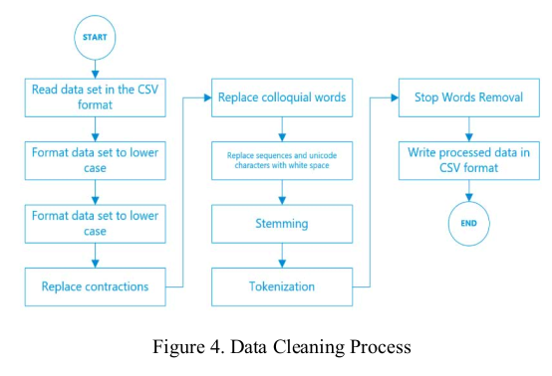
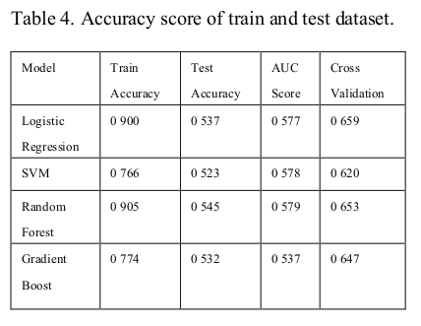
NLP and Machine Learning Techniques for Detecting Insulting Comments on Social Networking Platforms

Slide 7
LITERATURE SURVEY
PAPER 2: Detecting Online Hate Speech Using Context Aware Models
Data of Publication : 2017
Authors : Lei Gao Texas,Ruihong Huang
Conference : International Conference Recent Advances in Natural Language Processing (RANLP)-2017
The paper provides an annotated corpus of hate speech with context information well kept as well as proposes two types of hate speech detection models that incorporate context information, a logistic regression model with context features and a neural network model with learning components for context.

Slide 8
LITERATURE SURVEY
PAPER 2: Detecting Online Hate Speech Using Context Aware Models
Context accompanying a hate speech text is always useful for detecting hate speech.
Dataset - 1528 Fox News user comments, which were taken from 10 complete discussion threads for 10 widely read Fox News articles.
Logistic Regression Models -
Extract four types of features - word level, character level, n-gram features and two types of lexicon derived features.(LIWC feature and NRC Emotion Lexicon Feature)
Neural Network Models -
Consists of three parallel LSTM layers which are concatenated later-
The target comment - bi directional LSTM with attention mechanism
News title , Username - bi directional LSTM
Pre trained word embedding in word2vec. - for the target comments and news title.
One hot encoding - for the Username

Slide 9
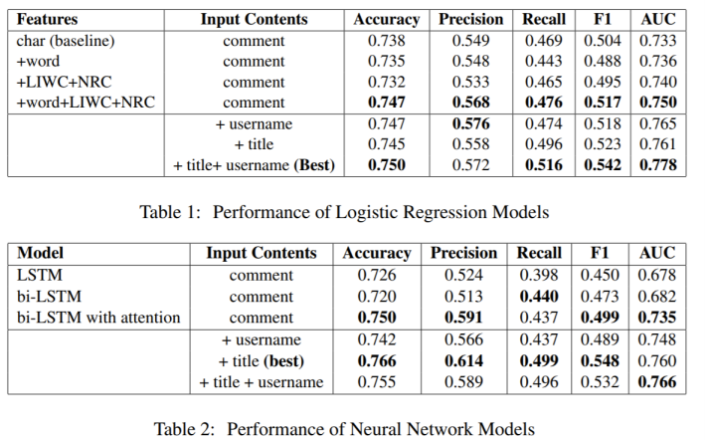
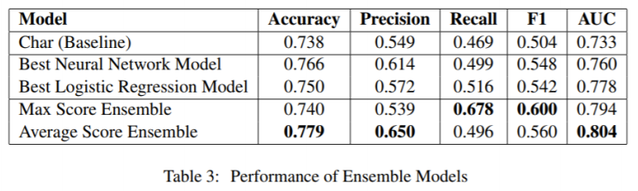
LITERATURE SURVEY
PAPER 2: Detecting Online Hate Speech Using Context Aware Models

Slide 10
LITERATURE SURVEY
PAPER 2: Detecting Online Hate Speech Using Context Aware Models
Conclusions -
Proved the importance of utilizing context information for online hate speech detection.
Ensemble models leveraging strengths of both logistic regression models and neural network models achieve the good performance for automatic online hate speech detection
Disadvantages -
User annotated comments dataset posted by 678 different users in 10 complete news discussion threads , thus no benchmark dataset has been used to experiment results.

Slide 11
LITERATURE SURVEY
PAPER 3: Detecting Hate Speech on Twitter Using a Convolution-GRU Based Deep Neural Network
Data of Publication : 2018
Authors : Ziqi Zhang David Robinson Jonathan Tepper
Publication: Springer (European semantic web conference)
This paper introduces a new method based on a deep neural network combining convolutional and gated recurrent networks and conduct an extensive evaluation of the method against several models on collection of publicly available Twitter datasets and compare the previous results reported on those datasets

Slide 12
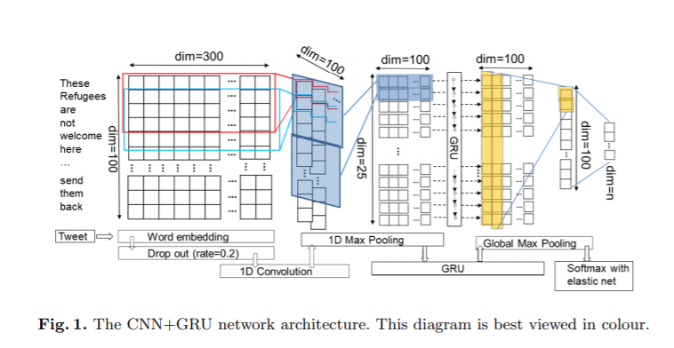
LITERATURE SURVEY
The first layer is a word embedding layer, which maps tweet into a real vector domain
Then it goes to the dropout layer with a rate of 0.2, the purpose of which is to regularise learning to avoid overfitting
1D convolutional layer with 100 filters with a window size of 4, padding the input such that the output has the same length as the original input. The rectified linear unit function is used for activation.
1D max pooling layer it gives the extracted features
Then it is fed into GRU
Global max pooling layer takes the highest value in each set i.e the best feature in a tweet
Finally softmax function to predict probability distribution over all possible classes

Slide 13
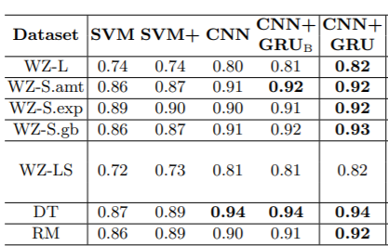
LITERATURE SURVEY
RESULTS
There are many datasets used in this paper and used by many models
SVM is multiclass classification
SVM+ adding enhanced features leads to incremental improvement over SVM
CNN + GRU
CNN+GRUB is formed by we remove the drop-out and the global max pooling layer
CNN we further remove the GRU layer

Slide 14
LITERATURE SURVEY
ADVANTAGES:
deep neural network model combining CNN and GRU that are found to empirically improve classification accuracy.
conducted comparative evaluation on the largest collection of public datasets and compared with different models
Disadvantages :
classifiers make relatively more errors on predicting any categories of hate tweets than non-hate

Slide 15
LITERATURE SURVEY
PAPER 4: Deep Learning Based Fusion Approach for Hate Speech Detection
Data of Publication : 2020
Authors : Yanling Zhou; Yanyan Yang; Han Liu; Xiufeng Liu; Nick Savage
Publication: IEEE
The paper proposes a general way to improve the overall results of classification by fusing the various classifiers.It focusses on several famous machine learning methods for text classification such as Embeddings from Language Models (ELMo), Bidirectional Encoder Representation from Transformers (BERT) ,Convolutional Neural Network (CNN) and adopt some fusion strategies to combine the classifiers to improve the overall classification performance.

Slide 16
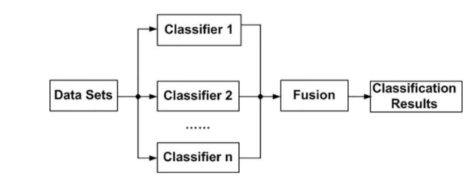
LITERATURE SURVEY
PAPER 4: Deep Learning Based Fusion Approach for Hate Speech Detection
ELMo and BERT focus on word embedding, while CNN focuses on neural networks processing.
It is no easy task to decide which method is the best. The specific performance also depends on the specific data set.
The idea of ensemble learning in machine learning can advance the overall classification performance and improve the overall accuracy in prediction.
The paper uses the below framework and uses vote and other algebraic rules of combination like mean, max and product.

Slide 17
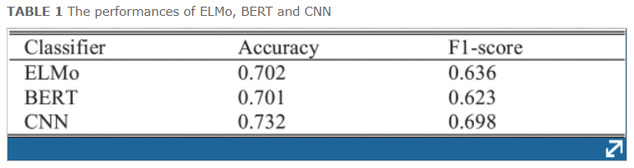
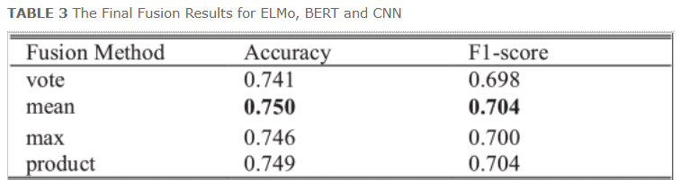
LITERATURE SURVEY
PAPER 4: Deep Learning Based Fusion Approach for Hate Speech Detection
Experimental Results -
ElMo - pre-trained model by Google
Bert - BERT(base) uncased model was chosen for fine tuning to avoid the memory overflow of the GPU
CNN - They first use a character embedding of 128, then 256
According to the below results, the paper concludes that the fusion approach can help improve the classification accuracy and F1-score.

Slide 18
LITERATURE SURVEY
PAPER 4: Deep Learning Based Fusion Approach for Hate Speech Detection
Conclusion -
The results showed that fusion processing is a viable way to improve the performance of hate speech detection and with little additional cost.
Disadvantages -
The degree of integration of the separate classification models is not deep enough.
Each of the separate classifiers must have good performance and the results must be highly diverse.

Slide 19
Paper 5 - Automatic hate speech detection using killer natural language processing optimizing ensemble deep learning
Link to the paper here
Data of Publication : 2019
Authors : Zafer Al‐Makhadmeh, Amr Tolba
Publication: Springer-Verlag GmbH Austria, part of Springer Nature 2019
The following paper discusses the ill effects of hate speech and the need to overcome it in social media applications inclusive of youtube, facebook, twitter, etc.
Hate speech is defined as statements that discriminate against individuals or groups of people based on characteristics such as gender, race, ethnicity, skin color, nationality, political activity, sexual orientation or region characteristics.
Makes use of KNLPEDNN - Killer Natural Language Processing optimization Ensemble Deep Neural Network approach.

Slide 20
Automatic hate speech detection using killer natural language processing optimizing ensemble deep learning
PROPERTIES:
Selected dataset: Stormfront - neo-Nazi website, Crowdflower
Stemming & Lemmatization after removal of symbols such as @,#, etc.
Tokenization to break sentences into smaller bits for classification
Binary classification: -1 for negative tokens and +1 for neutral
Neural Network with three hidden layers and sigmoid activation
Advantages:
Extremely efficient model in comparison to most other techniques
High accuracy, precision, recall and so on with best performance
Minimal loss function values from Neural Network
Disadvantages and further work:
Accuracy is too high, might result in overfitting
Aim to add in audio and video formats for hate speech detection process

Slide 21
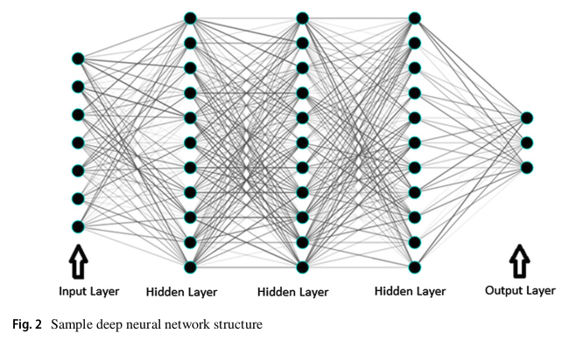
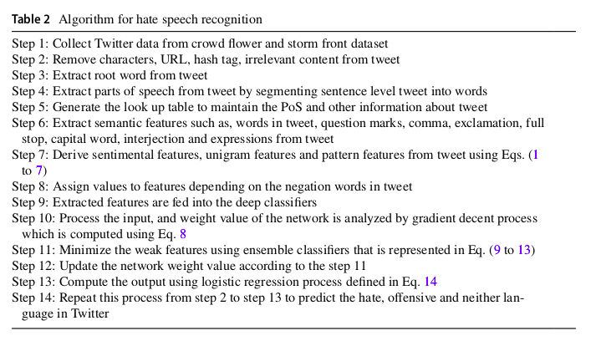
Automatic hate speech detection using killer natural language processing optimizing ensemble deep learning

Slide 22
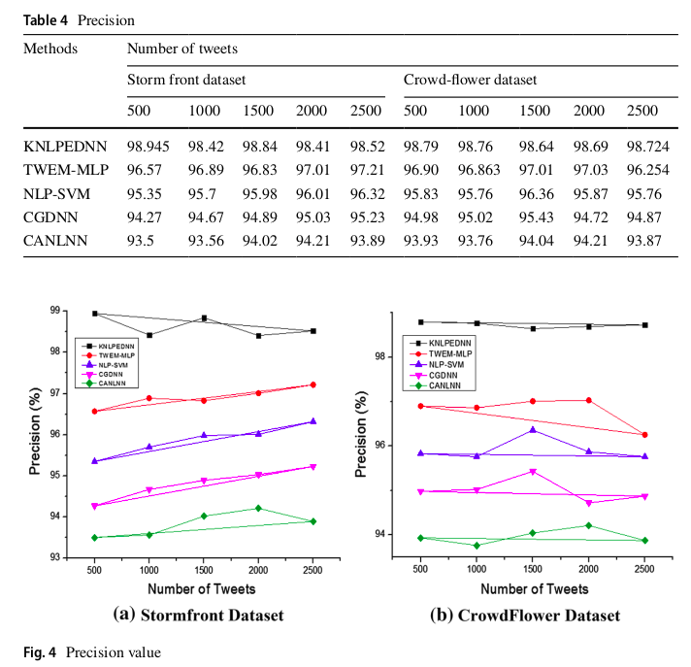
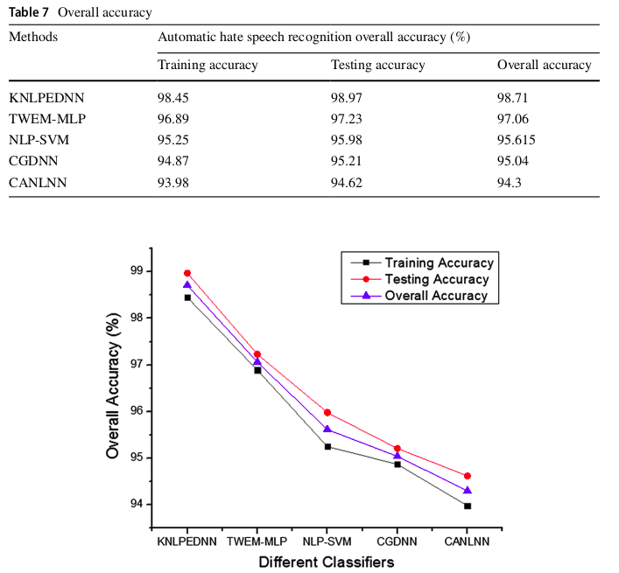
Automatic hate speech detection using killer natural language processing optimizing ensemble deep learning

Slide 23
Takeaways from Literature Survey
Multiple classifier models seem to give good results for this task.
Ensemble learning tries to improve the overall performance of the system efficiently by combining the outputs from various candidate systems
Deep neural networks have shown promise with reasonable accuracy for hate speech detection and allied applications. However, the classifiers are heavily dependent on the size and quality of the training data. Such a high-quality large data set is not easy to obtain. Moreover, the existing data sets that have emerged in recent times are not created following the same annotation guidelines and are often concerned with different types and subtypes related to hate.

Slide 24
Proposed Idea -
Finding the best model which suits our project idea and gives the best result.
Fine tuning the pre trained BERT Model by leveraging syntactical and contextual information of all BERT’s transformers as very recent papers/kaggle notebooks suggest they outperforms previous works.

Slide 25
Current Implementation Status (Review 1)-
We have gone ahead and implemented some of the various approaches we saw in the above papers.
Since there is no particular benchmark dataset, we have gone ahead and different ready made available datasets in the internet. (we hope to combine these before training the final model)

Slide 26
Current Implementation Status (Review 2)-
Understand how BERT works
Preprocess text data for BERT and build PyTorch Dataset (tokenization, attention masks, and padding)
Build Hate Speech Classifier by Fine tuning the pretrained BERT Model on our dataset.
Evaluate the model on test data
Predict on any raw text

Slide 27

Implementation -
The way our we preprocess text data for BERT and build PyTorch Dataset using tokenization, with the addition of attention masks and padding to make the data compatible to the work of the BERT model.

Slide 28
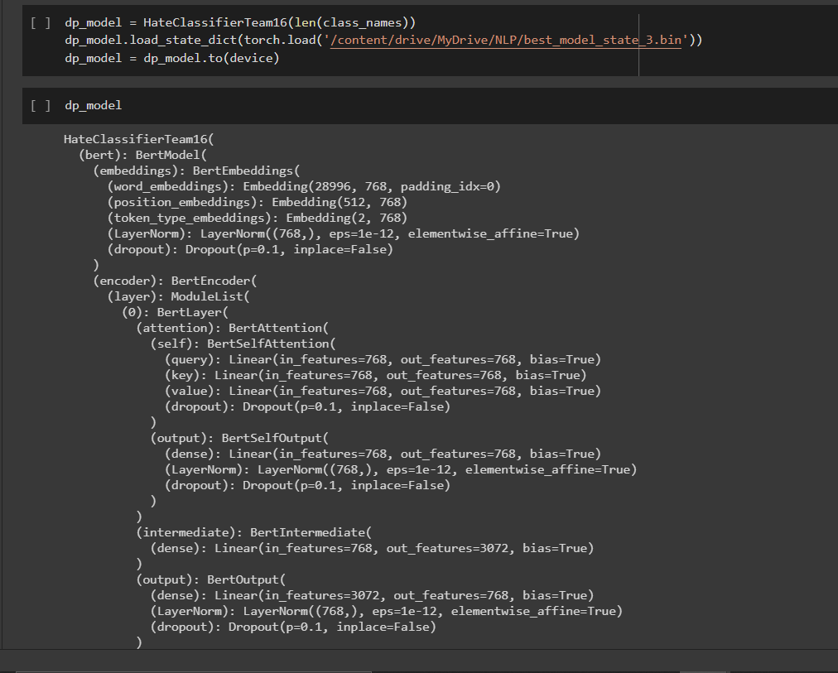
Implementation -
The structure of the Hate Classifier model which has been fine tuned on the Bert Model.

Slide 29
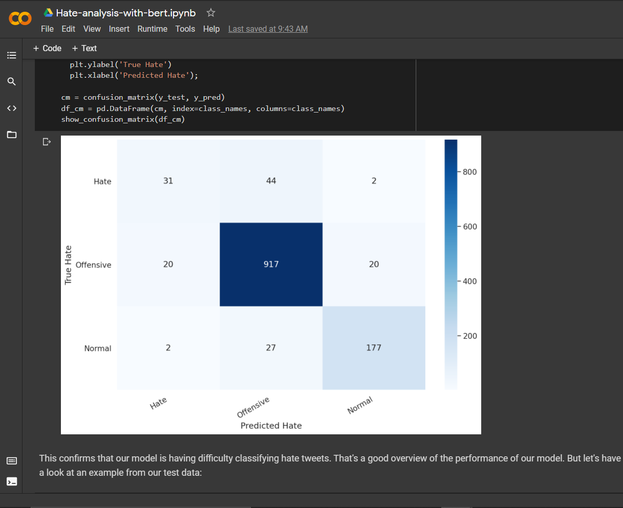
Implementation -
This confusion matrix shows our model performs well at classifying “offensive” tweets from the normal tweet.
The model achieved about 91% accuracy on the test data.It was even able to classify the right type on raw text.

Slide 30
Conclusion and Future Scope of Work
The BERT model which is first initialised with the pre-trained parameters has been fine tuned by us to meet a specific downstream task i.e. Hate Classification in this project.
We saw how with small amounts of data and a some fine tuning , the model does give decent results compared to current state of the art models.
As Future work , We also hope to leverage the concept of homogeneous multi-task learning where we utilized the multiple classification task data sets to be trained jointly to solve the task.

