Slide 1
EXCEL ASSESSMENT
- RISHAB SENTHILKUMAR

Slide 2
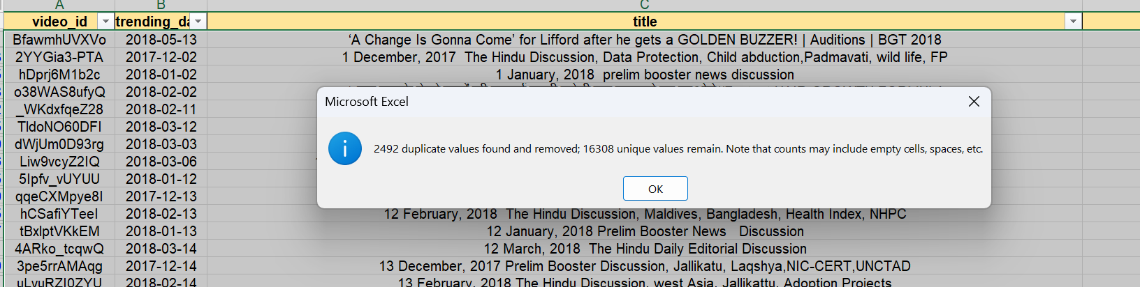
QUESTION 1
Steps and Formula:
Removed the duplicate values from the dataset.
Selected the data and From data tab, selected remove duplicates.

Slide 3
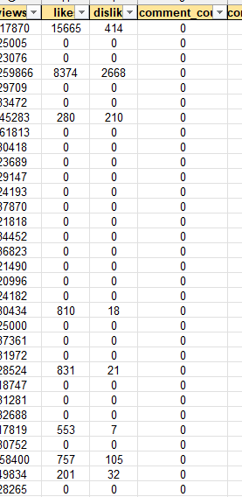
Question 1
-> The entire comment count column is zero , so I have removed it in cleaning the data.

Slide 4
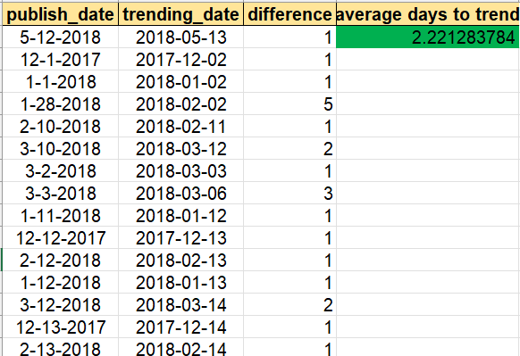
QUESTION 2
Formula:
=B2-A2 (difference) and filled it for every cell.
=AVERAGE(C2:C593) [average] and filled it every cell.
Steps:
->Calculate the difference between publish date and trend date. Find the average.
Inference:
-> Average days for videos to trend is 2.2 days.

Slide 5
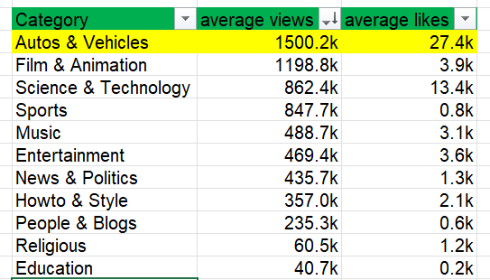
QUESTION 3
Steps:
->Initially filled the category column in main sheet using vlookup.
->Created a pivot table with category in rows and views , likes in values.
->Found average.
Formula:
->=VLOOKUP('YouTube data'!$E7,Category!$A$1:$B$33,2,0) [vlookup for category]
->pivot table and average.
Inference:
Auto & Vehicles category has highest average views and engagement rate.

Slide 6
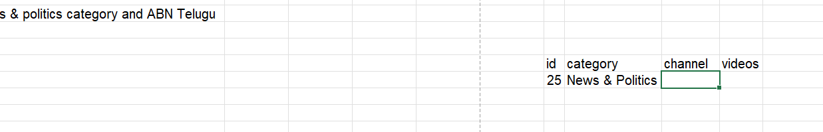
QUESTION 4

Slide 7
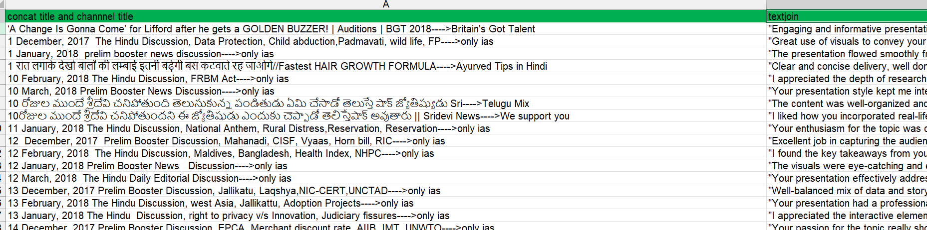
QUESTION 5
Formula:
=CONCAT('YouTube data'!C7,"---->",'YouTube data'!D7) [concat title and channel title]
=TEXTJOIN("-",0,FILTER('YouTube data'!O7:O16203,'YouTube data'!Q7:Q16203=Sheet8!A2)) [filtering and textjoining]
Steps:
->Concat and create a new column.
->filter for the concat column and do textjoin.

Slide 8
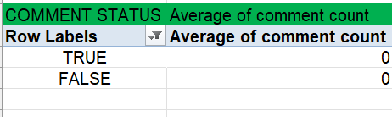
QUESTION 6
Formula and Steps:
->Grouped the videos based on comment status[True or false], using pivot table.
->Then found the average for them.
As count of comment is 0 for all it is zero.

Slide 9
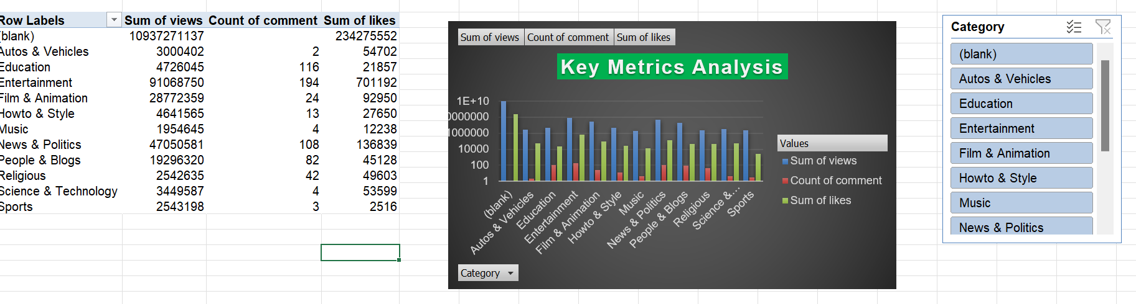
QUESTION 7
Formula & Steps:
Created a pivot table with Category as reference and views,comment,likes as key parameters.
Then created a dashboard with interative slicer.
Inference:
-> On Analysing key factors , Autos & Vehicles Category had a extraordinary reach compared to other!

Slide 10
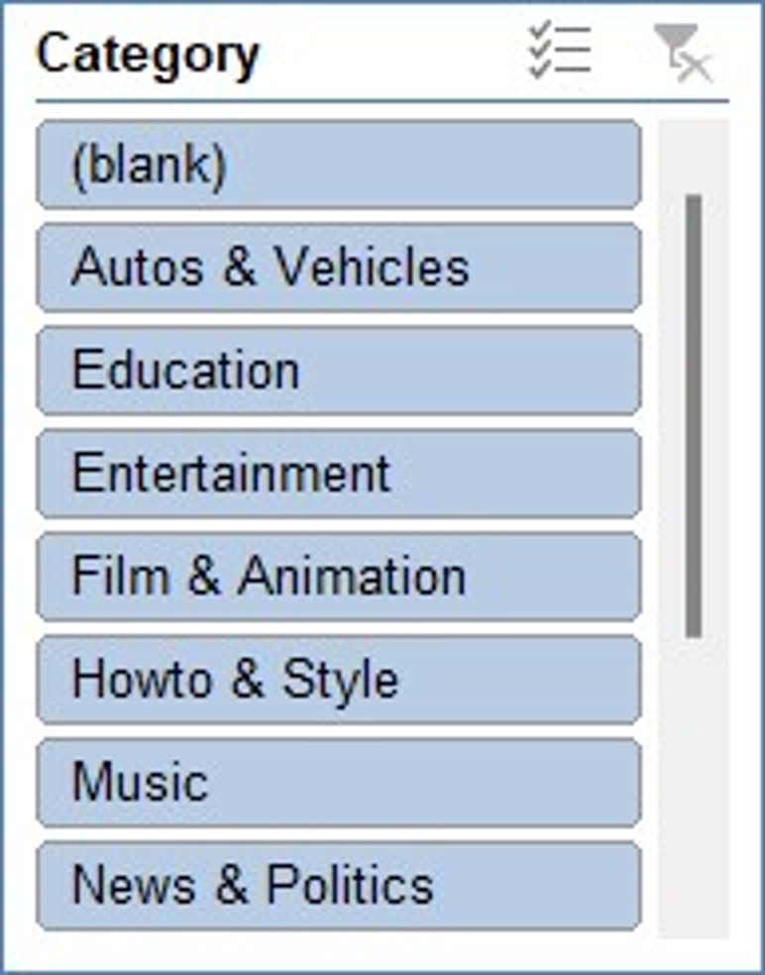
Question 7 contd

Slide 11
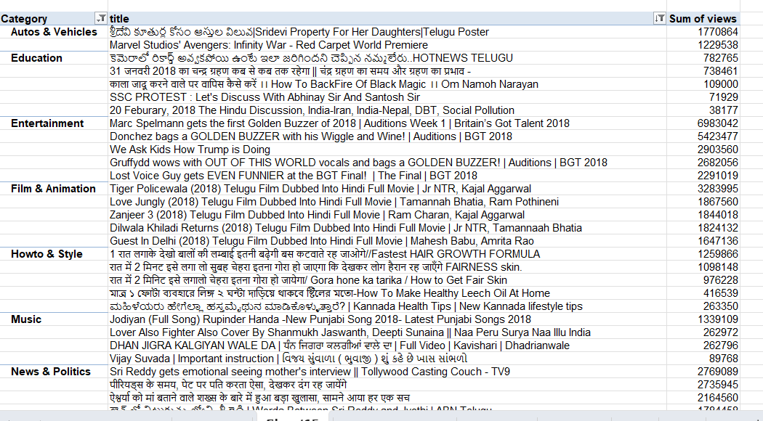
QUESTION 8
Formula & steps:
->created a pivot table with category and video title in rows.
Sorted descending based on views and engagement.
Filtered top 5 videos in each category.
Inference:
->found the top 5 videos on categories.

Slide 12
QUESTION 9

Slide 13
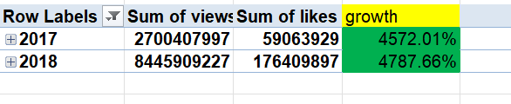
QUESTION 10
Formula & steps:
->Using pivot grouped views and likes for years.
-> =(b2/b3)*100 for percentage.

Slide 14
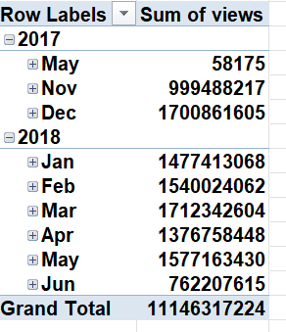
QUESTION 11
Formula & steps:
-> Used pivot table and grouped the engagement based on published time.
Inference:
->Retention rates have been mentioned for each published time.

Slide 15
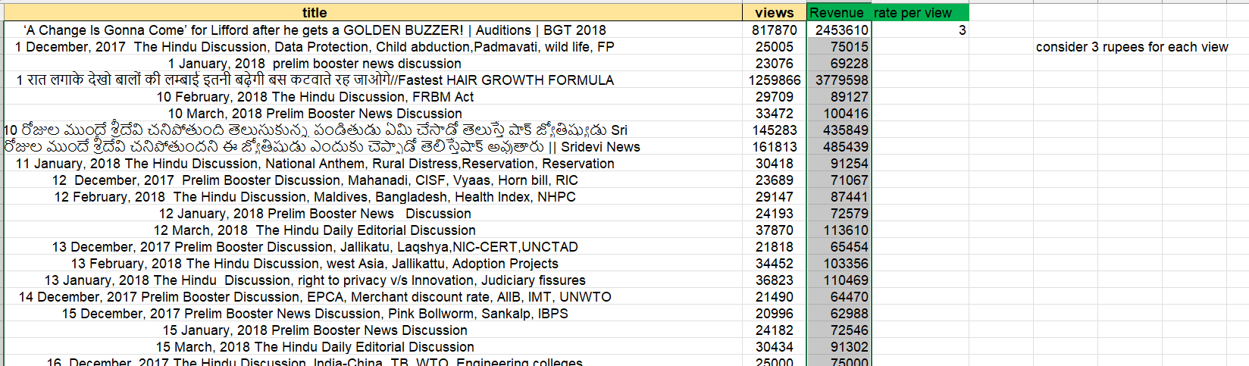
QUESTION 12
Formulas and Steps:’
Considering 3 rupees for each view
=(B2*$D$2) [Revenue calculation]

Slide 16
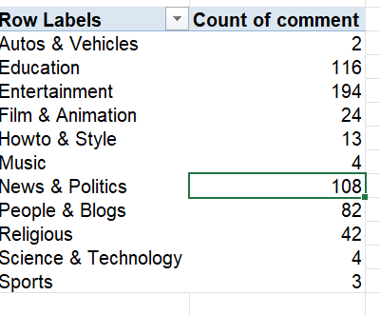
QUESTION 13
Formulas & steps:
-> Created pivot table and found count of comment for each category
Inference:
-> Found the comment count

Slide 17
QUESTION 14 will be contd in next

Slide 18
Question 14 contd
Created a visualization for key performance indicator of all category

Slide 19
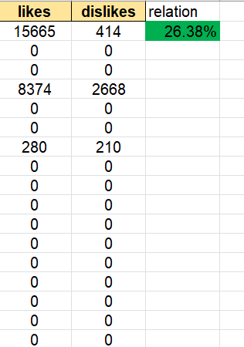
QUESTION 15
Formula & steps:
->=CORREL(A2:A593,B2:B593) [correlation ]

Slide 20
VISUALIZATION 1

Slide 21
V1
Formula & Steps:
Created a pivot table with Category as reference and views,comment,likes as key parameters.
Then created a dashboard with interative slicer.

Slide 22
V2

Slide 23
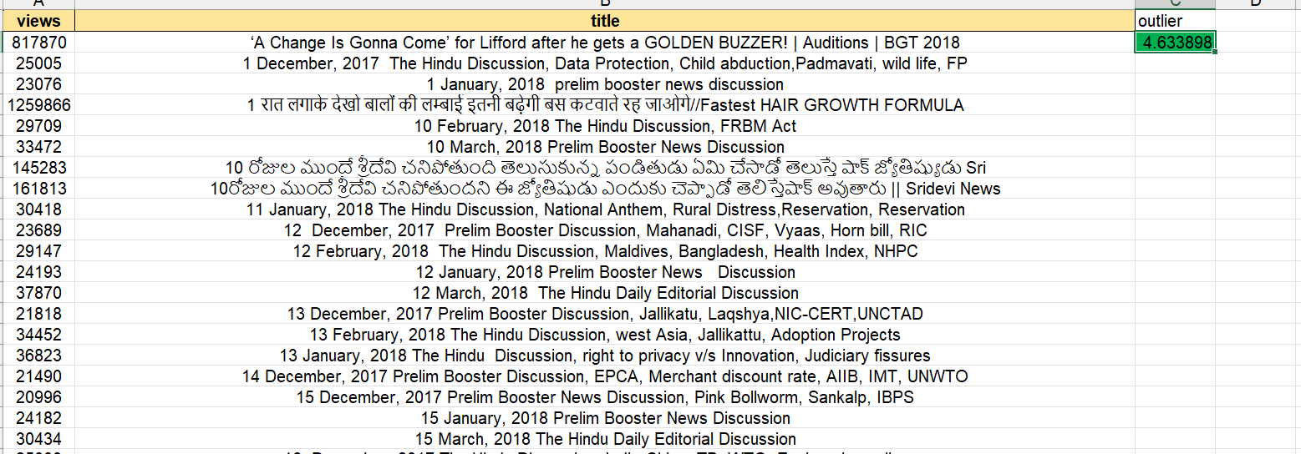
V3
Formula:
=SKEW(A2:A593)

Slide 24
V4 contd next

Slide 25
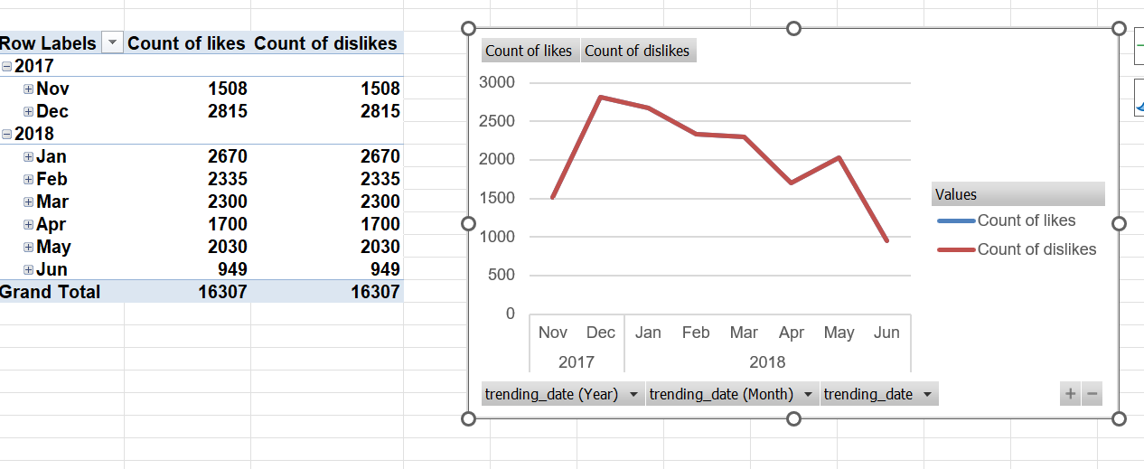
V4 contd

Slide 26
V5 contd next

Slide 27
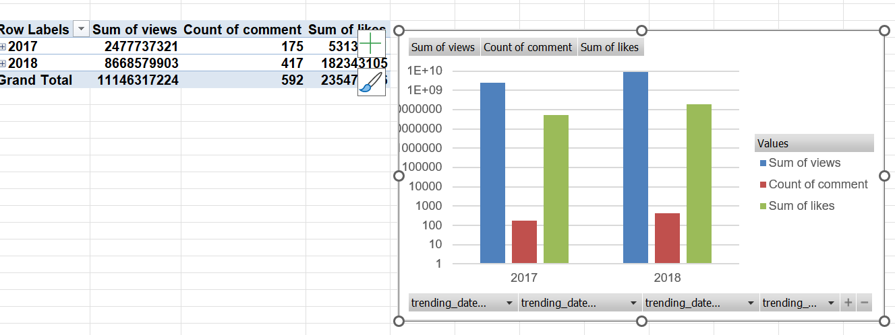
V5 contd

Slide 28
cohert

