Slide 1


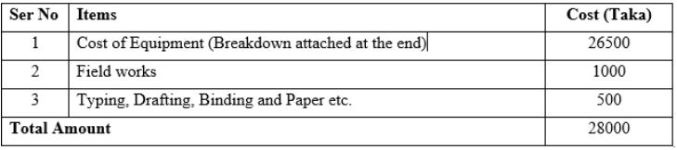
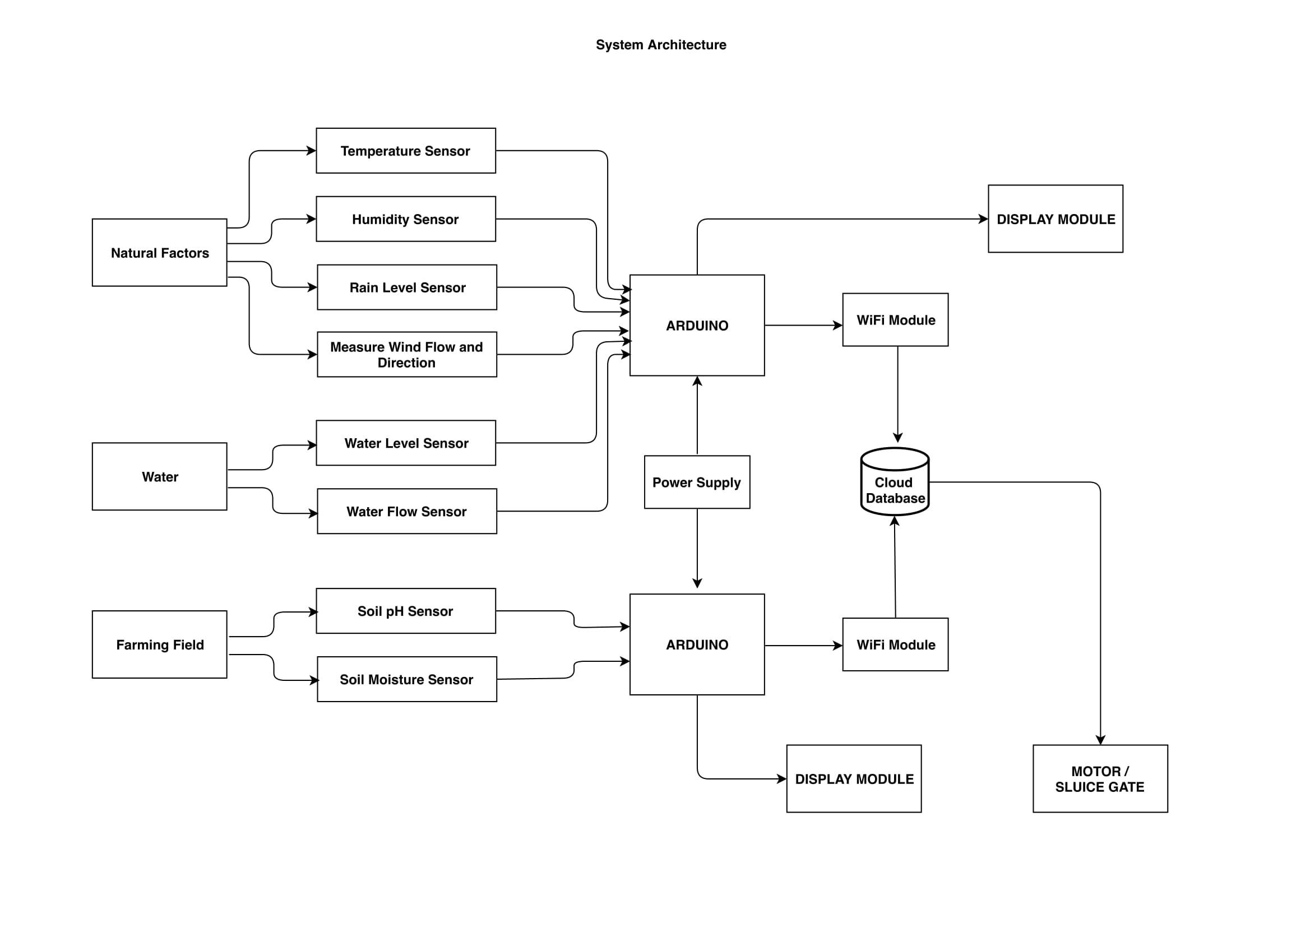
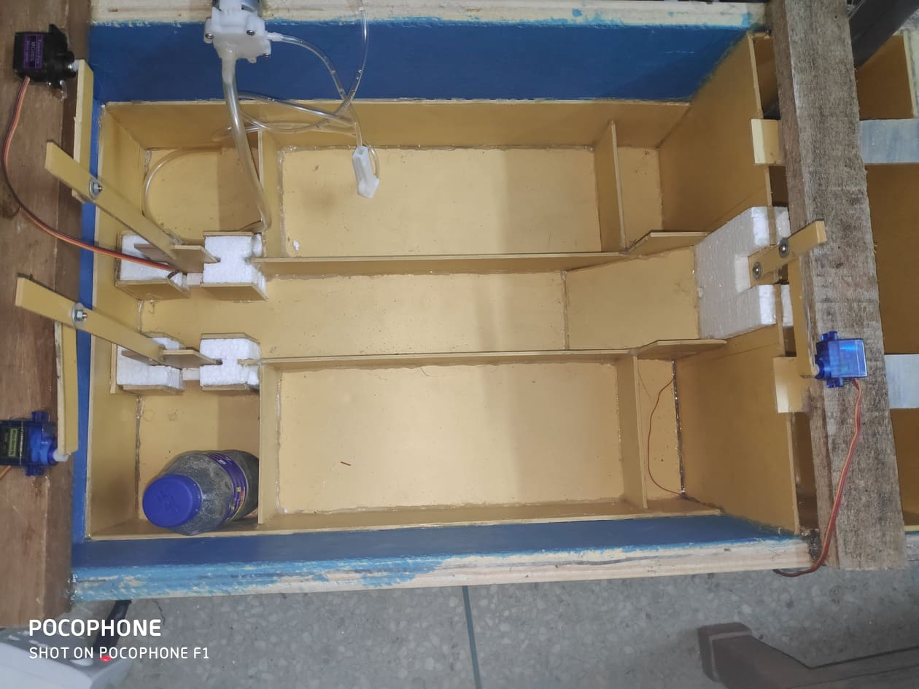
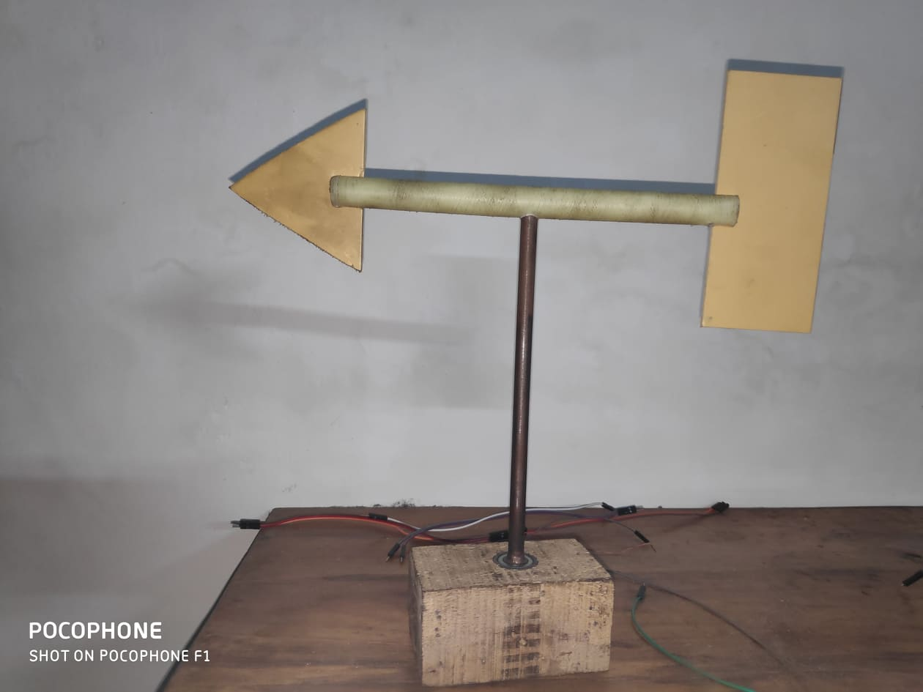
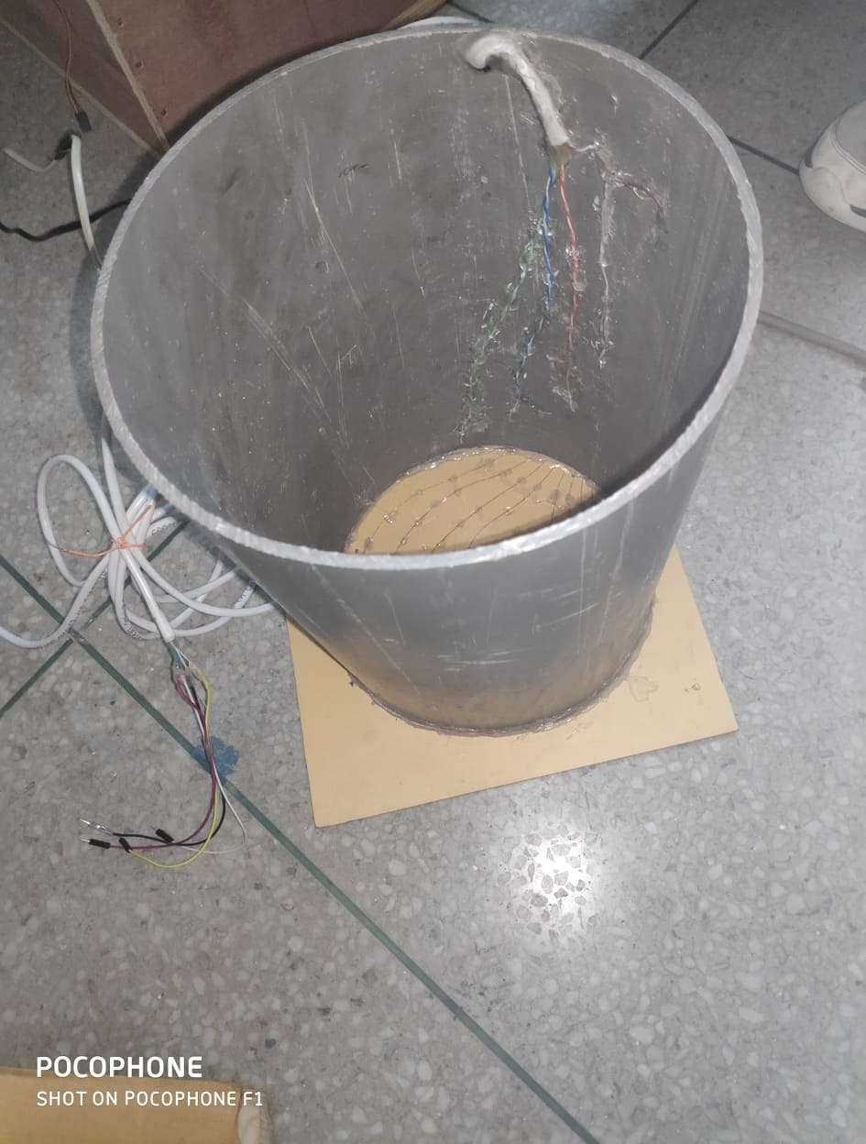
AN AGRICULTURAL GUIDE USING CLOUD
COMPUTING AND BIG DATA ANALYSIS
Abstract
Objective
Cost Analysis
Future Expansions
Rivers are contributing to the most of the agriculture of the country. But the same rivers bring disaster during monsoon. Due to the lack of efficient early warning system for natural disasters like flood every year Bangladesh suffers huge losses which includes crop damage, loss of livestock and destruction of social, physical and institutional infrastructures. So our aim is to develop an information system based on the existing systems with the utilization of some sensors and IoT and utilize the existing dams as the main source of irrigation.
In the project of Agricultural Guide, apart from hardware resources, software resources will be equally demanding. To fulfill the process the following software or applications will be required:
We will a build an android based application for the specific users and there will be an web based
application for the system developers.
The android applications will provide the aforementioned services.
The ultimate objective is to provide a cultivator with a full package of information.
We will add pesticide control as a feature of the project where the user can automatically control and prevent the side effects of pesticide in the field.
We will also add a feature which will give the farmers update about their crops even if the farmers are not in the field.
Our project can help in lot of ways to the farmers to control their agriculture digitally and efficiently.
Introduction
System Architecture and Prototype
Flooding resulting from extreme hydro and meteorological events and taking place in unexpected magnitudes and frequencies can cause loss of lives, livelihoods and infrastructure. Internet of Things (IoT) can be defined as a network of devices which are interconnected. It comprises a set of sensors, communication network as well as software enabled electronic devices that enables end users to acquire accurate data from time to time through the communication channel and allows for data interchange between users and the connected devices. This system can be used to automatize the control of dams without human interference.
Features
Early flood detection using various sensors and cloud data analysis to provide early warning and awareness through application software.
Using the dam/reservoir water for irrigation of agricultural field in a certain area in an efficient way for maximum usage of resources.
Using Big Data analysis and sensor data predictions will be given for a particular land for maximum utilization of resources available.
Forecasting weather using available data from the sensor and alerting user about upcoming weather situation.
Prototype Design
Discussions
Digitization of the Agricultural sector of Bangladesh is a must to improve the production level of our country. For that we need to come up with new ideas and experiments to help the production of crops as much as possible. Again we need to keep in mind that the experience of the farmers are lot in this aspect. So we need to create a perfect balance where the farmers can exert their experiences and also use the help of technology as smoothly as possible. Our project is keeping this aspect in mind and trying to help in the betterment of the agricultural sector of Bangladesh.
Main Prototype
Wind Direction Sensor
Rain Sensor
References
[1] M. N. Napiah, M. Y. I. Idris, I. Ahmedy, and M. A. Ngadi, “Flood alerts system with android application,” in 2017 6th ICT International Student Project Conference (ICT-ISPC). IEEE, 2017, pp. 1–4.
[2] Udathu, R. and Hency, V. (2015). Implementation of an automated irrigation system: Smart irrigation system. In: 2nd International Conference on Innovations in Information, Embedded and Communication systems (ICIIECS). [online] International Journal of Applied Engineering Research, pp.16261-16265. Available at: https://www.researchgate.net/publication [Accessed 10 Mar. 2019].
[3] J. B. Mallisetty and Chandrasekhar, “Internet of things based real time flood monitoring and alert management system,” International Journal of Pure and Applied Mathematics, vol. 118, no. 17, pp. 859–868, 2018. [Online]. Available: www.ijpam.eu/index.html

