Slide 1

Software Engineering Review 1
Virtual Classroom
Wilson Vidyut
Rishank Pratik

Slide 2
What is Virtual Classroom?
A virtual classroom is a digital replica of a traditional classroom or training room. The instructors teach, interact, communicate, view and discuss presentations, and the participants learn in real-time, face-to-face but via internet-enabled technology devices
Everything remains the way it is. The only difference is: an online classroom uses technology to support instruction and learning. What are the advantages of virtual classroom? It offers more flexibility over a traditional classroom. You can deliver the instruction to a geographically dispersed audience at one time.

Slide 3
Abstract
Currently, many E-Learning platforms of different qualities are available. Most of them lack in the direct interactivity between teacher and students and among students. In this paper, a framework of virtual classroom model on the Internet is proposed. It connects the advantages of existing offline approaches, like a white board, with the advantages of live streaming systems with many participants.
The architecture of virtual classroom on the Internet is composed of three processes: functions and protocol classification process, client/server sequential process and collaborative functions for lecturer and student process.
The virtual classroom is interesting place for lecturers and students to join and become the most important feature of E-Learning web sites that makes more attractive and complete E-Learning system.

Slide 4
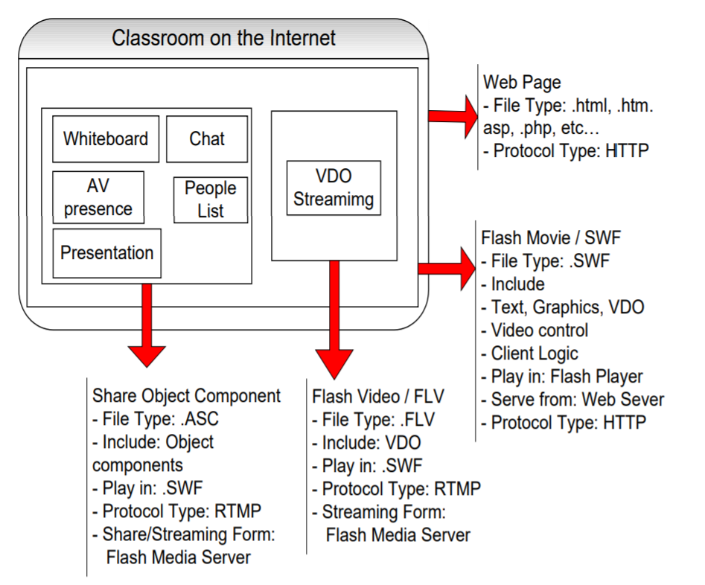
Architecture
There are many objects such as white board, presentation, chat, AV presence and people list in classroom on the Internet.
They are allowed to be shared with other learners. Remote shared objects are managed by a streaming server. Client can access shared objects and get update whenever a change is made to that shared object. VDO streaming part is also provided on the streaming server.

Slide 5
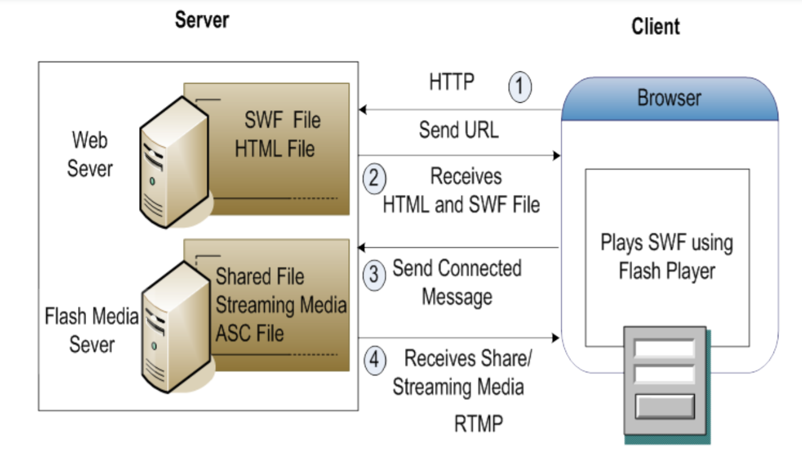
Procedure for connecting, displaying, share and streaming media

Slide 6
Objective
After experiencing ambiguities in current virtual classroom platforms and thoroughly going through recent articles and research papers we have chosen this work
Through this model, we aim to provide a simple, cost friendly and an efficient system to facilitate a classroom learning environment by improving makespan, cost and using limited yet proper resources.

Slide 7
Literature Work
Following slides contain 7 literature works we have gone through
We depicted their concept and discussed their advantages and disadvantages
For this purpose we took help from :
Research Gate https://www.researchgate.net/
Google Scholar https://scholar.google.com/

Slide 8
Author Journal Year | Title | Concepts | Advantage & Disadvantage
AlAwadhi, S., et al Virtual reality application for interactive and informative learning 2017 | Virtual environment which represents an educational society that will be seen through a Virtual Reality headset, and it will be controlled through a leap motion controller. | Wishes to deploy Virtual reality headset to students to enable perform experiments, attend online live 360D lectures, watch pre-recorded lectures, have a campus tour, and visit informative labs virtually | It’s a very efficient system and VR is the closest technology by using one can get environment like a regular classroom Very expensive, not all students can afford or access that technology.

Slide 9
Author Journal Year | Title | Concepts | Advantage & Disadvantage
Jennifer Hofmann Solutions to the top 10 challenges of blended learning 2020 | Addressing the strategies and solutions for anticipating and minimizing the most common challenges when designing and implementing a blended learning solution, including technical, organizational, and instructional challenges. | Using the best delivery methodology(ies) available for a specific objective, including online, classroom-based instruction, electronic performance support, paper-based, and formalized or informal on-the-job solutions. | Explained the mutual understanding and coordination needed in new environment of education There is no mention of how to asses student, to check if the methods are really working.

Slide 10
Author Journal Year | Title | Concepts | Advantage & Disadvantage
Mohssen Hakami Utilization of Virtual Classroom System in Traditional Teaching: Benefits and Challenges 2017 | The role of faculty members needs to be changed from providing knowledge to providing resources for learning and encouraging learners to take up cognitive processes to obtain new knowledge | Talks about improving the way of teaching by faculties and also highlights the difference in opinion of male and female students in E-Learning | Spoke about taking into account the student’s preference in E-Learning. Seems to focus more on gender and network issues more than actual problems.

Slide 11
Author Journal Year | Title | Concepts | Advantage & Disadvantage
Rajesh Sunasee Challenges of Teaching Organic Chemistry during COVID-19 Pandemic at a Primarily Undergraduate Institution 2020 | With a sudden move to remote and online teaching due to COVID-19 pandemic, Organic Chemistry became more challenging for both students and educators with the emergence of new technological challenges and instructional strategies. | Suggests a combination of asynchronous and synchronous teaching methods | Really encouraged E-Learning but it wasn’t much effective in the field of Chemistry and Medicine Didn’t provide solution

Slide 12
Author Journal Year | Title | Concepts | Advantage & Disadvantage
H.Y. Jang, H.J. Kim A Meta-Analysis of the Cognitive, Affective, and Interpersonal Outcomes of Flipped Classrooms in Higher Education 2020 | This paper aims to quantify the effects of flipped classrooms in higher education by reviewing 43 empirical studies of students’ cognitive, affective, and interpersonal outcomes. | Highlights the observations that flipped classrooms benefitted students studying chemistry, engineering, mathematics, and physics less than they did students studying other subjects. | Explained how flipped classroom fosters a sustainable, interactive, and student-centered learning environment as opposed to the traditional lecture style, in which there is little room for interaction Didn’t provide any solution

Slide 13
Author Journal Year | Title | Concepts | Advantage & Disadvantage
Anita L. Cloete Technology and education: Challenges and opportunities 2017 | Highlights the social embeddedness of technology by stressing how it is intertwined with other social developments like economy. | Discussed the following challenges: the commodification of knowledge and education and how technology is the main driving force. | Discussed problems like impact of E-education with social developments and nearly covered all other aspects Did not provide any solution

Slide 14
Author Journal Year | Title | Concepts | Advantage & Disadvantage
Kate Reynolds and Linda Flynn-Wilson Student perception of the quality of discussion in a synchronous virtual classroom environment 2018 | Observation feedback on interaction within a synchronous virtual classroom | The instructor’s teaching style and visual presence were instrumental in engaging students with the content. | Analyzed why the format of the virtual classroom didn't encouraged robust discussion Didn’t provide solution

Slide 15
Author Journal Year | Title | Concepts | Advantage & Disadvantage
Rekha Asmara Teaching English in a Virtual Classroom using WhatsApp during COVID19 Pandemic 2020 | Observation feedback on interaction within a synchronous virtual classroom | Described the usage of WhatsApp as a virtual classroom despite being a social media platform made specifically for chatting. | Clearly depicted the major flaws in using WhatsApp as a virtual classroom medium: late response due to typing, taking attendance. Didn’t provide any solution

Slide 16
Research Direction
Make virtual classroom an overall complete system which has all features like in a regular classroom
Despise use of social media platforms for teaching
Make software cheap and easy to understand
Have an application, simulation or drawing board inside the software to make practical classes possible

Slide 17
Summary of Survey
Most of them only discussed the problems
Didn’t provide solutions
Did not speak about how assessments should be conducted and evaluated
Most institutions still use social media platform to teach
Some subjects cannot be taught online with current systems

Slide 18
References
AlAwadhi, S., et al. "Virtual reality application for interactive and informative learning." 2017 2nd International Conference on Bio-engineering for Smart Technologies (BioSMART). IEEE, 2017.
Hakami, Mohssen. "Utilization of Virtual Classroom System in Traditional Teaching: Benefits and Challenges." International Journal of Education, Learning and Development 5.3 (2017): 21-29.
Sunasee, Rajesh. "Challenges of Teaching Organic Chemistry during COVID-19 Pandemic at a Primarily Undergraduate Institution." Journal of Chemical Education (2020).
Jang, H.Y.; Kim, H.J. A Meta-Analysis of the Cognitive, Affective, and Interpersonal Outcomes of Flipped Classrooms in Higher Education. Educ. Sci. 2020

Slide 19
Cloete, Anita L. "Technology and education: Challenges and opportunities." HTS Theological Studies 73.4 (2017): 1-7.
Reynolds, Kate, and Linda Flynn-Wilson. "Student perception of the quality of discussion in a synchronous virtual classroom environment." EdMedia+ Innovate Learning. Association for the Advancement of Computing in Education (AACE), 2018.
Rekha Asmara. (2020). TEACHING ENGLISH IN A VIRTUAL CLASSROOM USING WHATSAPP DURING COVID-19 PANDEMIC. Language and Education Journal, 5(1), 16-27.
Hofmann, Jennifer. "Solutions to the top 10 challenges of blended learning." United states: InSync Training, LLC (June 2020).

Slide 20
Thank You !

