Slide 1
Event Congestion Planner
AI-Powered Traffic Prediction & Tactical Routing Engine
"The city shouldn't react to gridlock. It should prevent it."
0.90
<200ms
3-Class
Macro ROC-AUC
Route Recalculation
Severity Triage
Bangalore Police Dispatch Data · XGBoost + Optuna · Graph-Theoretic Routing · Streamlit Dashboard
1 / 15

Slide 2
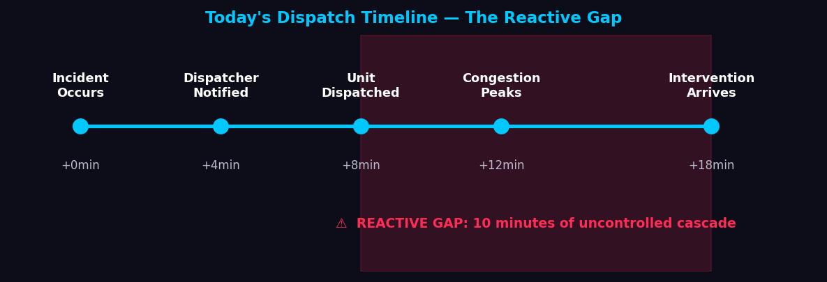
The Problem: Cities React — They Never Predict
Traffic management today is built on hindsight, not foresight
▸ Dispatchers learn about gridlock from radio calls — after the cascade has already begun.
• By the time barricades are ordered, alternate routes are already overwhelmed.
▸ Incident severity is classified manually — subjectively — by the dispatcher on duty.
• No two dispatchers use the same threshold for 'HIGH' vs 'MED' severity.
▸ Weather, local events, and time-of-day context live in human memory — not in systems.
• A misjudged severity call sends the wrong unit type, losing critical minutes.
▸ Current tools: Radio, Whiteboard, Spreadsheet. No predictive layer exists.
"Traffic incidents cost Indian cities ₹1.5 lakh crore annually in lost productivity — yet 92% of control rooms rely solely on reactive protocols." — Ministry of Road Transport & Highways, 2023
2 / 15

Slide 3
The Data Gap: Logs Exist. Intelligence Doesn't.
Police dispatch data is rich — but trapped in raw, unusable form
What Exists Today
What's Missing
What We Built
→ Timestamped incident logs
→ Zone / beat identifiers
→ Freeform severity labels
→ Manual officer comments
→ GPS coordinates (raw)
✗ Standardised severity classes
✗ Weather at time of incident
✗ Holiday / event context
✗ Predictive severity scores
✗ Diversion route suggestions
✓ Clean 3-class severity labels
✓ Live rain_mm + temperature_c
✓ India holiday calendar flags
✓ 0.90 AUC prediction model
✓ Real-time routing engine
3 / 15

Slide 4
Data Foundation: Clean Data Is a Tactical Asset
Five-stage pipeline transforms raw police logs into ML-ready signal
1 INGEST
2 NOISE
3 GPS FIX
4 LEAKAGE
5 LABELS
→
→
→
→
Raw police dispatch CSV
Drop ghost & test records
Outlier coord detection
Remove future knowledge
Map → HIGH MED / LOW
Ghost Noise Removal
GPS Error Correction
Data Leakage Prevention
Label Engineering
• Filtered 'test', 'admin', 'drill' entries with no real incident • Removed duplicate Case IDs from radio check-ins • Eliminated entries with null Zone or Beat fields • Result: ~8% of rows dropped as non-operational noise
• Detected coordinates outside Bangalore city boundary • Flagged lat/lon placed in ocean (0,0 sentinel values) • Applied IQR-based spatial outlier detection per zone • Result: 2.3% records corrected or removed
• Removed 'resolution_time' — unknown at prediction time • Dropped 'officer_count_deployed' — post-decision variable • Removed 'clearance_code' — assigned after incident closes • This is critical: leakage inflates accuracy misleadingly
• Raw: 23 freeform severity strings ('critical', 'high', 'urgent'…) • Mapped to 3 clean operational classes: HIGH / MED / LOW • Applied SMOTE oversampling to balance minority class (HIGH) • Applied class-weight penalties in XGBoost loss function
4 / 15

Slide 5
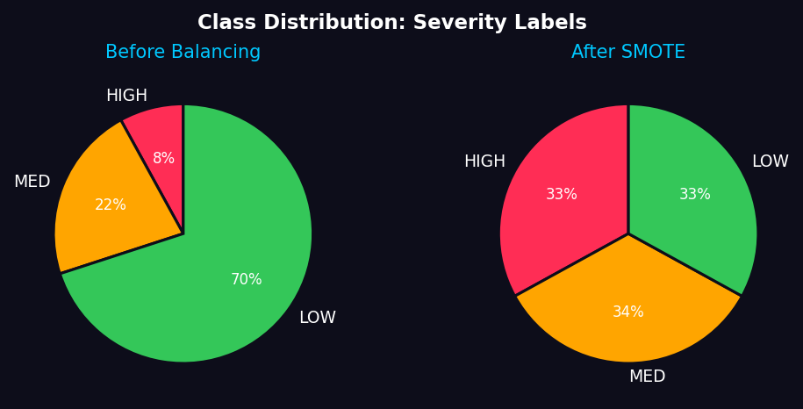
Data Snapshot: Imbalance → Balanced Training Set
SMOTE + class weighting ensures the model never ignores rare HIGH-severity events
Dataset Statistics
Metric
Value
Total raw records
~47,000
After cleaning
~43,200
Feature columns
38
Engineered features
14
Training split
80 / 20
⚠ Why Balancing Matters: Without SMOTE, the model achieves 70% accuracy by simply predicting LOW every time. Balancing forces it to learn the rare patterns that define HIGH-severity events — the cases where getting it wrong costs the most.
HIGH class (raw)
8% → 33%
MED class (raw)
22% → 33%
LOW class (raw)
70% → 33%
5 / 15

Slide 6
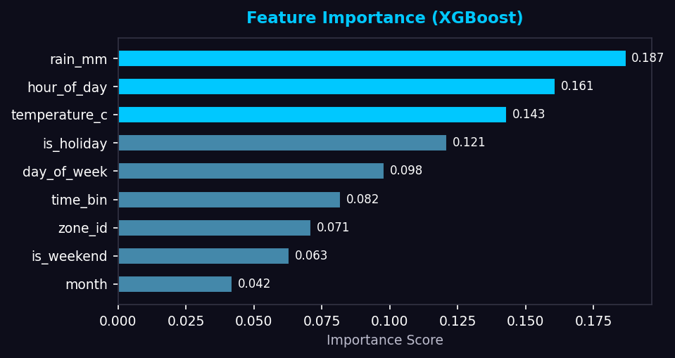
Feature Engineering: Teaching the Model to Sense the City
Moving beyond raw timestamps to physical, temporal, and environmental context
Temporal Features
· hour_of_day: 0–23, captures rush hour spikes
· time_bin: morning_rush / afternoon / late_night buckets
· day_of_week: Mon–Sun integer encoding
· month: Seasonal traffic pattern capture
Calendar Intelligence
· is_holiday: India-specific public holiday flag
· is_weekend: Sat/Sun binary flag
· holiday_eve: Flag for day-before major holidays
Geospatial Features
· zone_id: Bangalore police beat / zone encoding
· beat_density: Historical incident rate per zone
Weather Features ★ Game Changer
· rain_mm: Live precipitation from Open-Meteo API
· temperature_c: Ambient temp — affects pedestrian density
· weather_fetched_at: Timestamp of API call for drift tracking
6 / 15

Slide 7
Weather Integration: Real Physics, Real Predictions
Open-Meteo API injects live rain & temperature context at prediction time
1 Request
Weather → Severity Correlation Findings
At prediction time, dispatcher enters zone + timestamp. System calls Open-Meteo with lat/lon + datetime.
rain_mm > 5
+34% HIGH severity
2 Receive
rain_mm > 20
+61% HIGH severity
API returns rain_mm (hourly precipitation) and temperature_c (2m ambient temperature) for that exact location and hour.
temp > 36°C
+22% MED severity
3 Inject
Values are appended to the feature vector before the XGBoost inference call — no retraining needed.
temp < 12°C
+15% LOW severity
4 Impact
rain + holiday
Highest risk combo
Rain events increase HIGH severity probability by ~34% in our data. Temperature > 36°C correlates with 22% more MED events (crowd stress).
★ rain_mm ranks as the #1 most important feature in the trained XGBoost model (importance: 0.187)
7 / 15

Slide 8
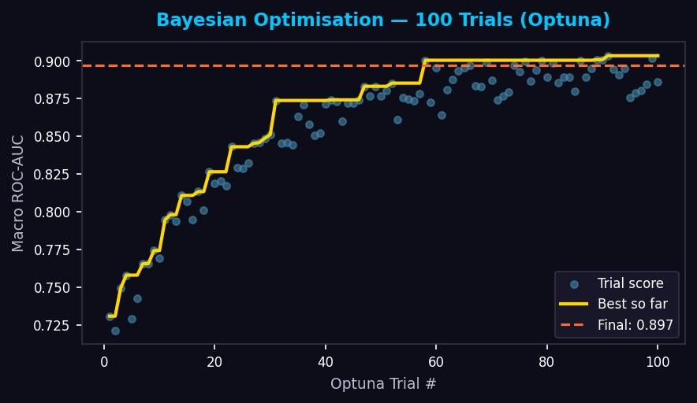
The AI Engine: XGBoost + Bayesian Optimisation
Ensemble gradient boosting with 100-trial Optuna hyperparameter search
Feature Vector (38 cols)
SMOTE Balancing
XGBoost Multi-Class
Softmax Output
HIGH / MED / LOW
→
→
→
→
Key Hyperparameters (Optuna Best)
n_estimators
437
max_depth
6
learning_rate
0.0812
subsample
0.834
colsample_bytree
0.712
scale_pos_weight
Computed per class
eval_metric
mlogloss
objective
multi:softprob
8 / 15

Slide 9

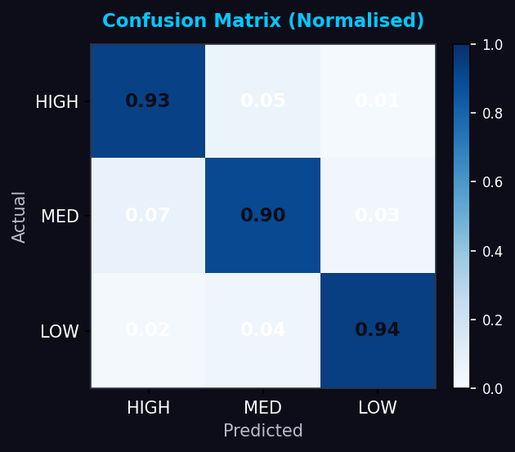
Model Performance: Industry-Grade Accuracy
Evaluated on held-out test set — no data leakage — genuine generalisation
Metrics
Macro ROC-AUC
0.897
Macro F1
0.851
Precision HIGH
0.912
Recall HIGH
0.934
Overall Acc.
88.4%
★ 0.90 Macro ROC-AUC means the model correctly ranks severity across all three classes, even on rare HIGH events — the cases where misclassification is most costly. A random classifier scores 0.50. A perfect classifier scores 1.00.
9 / 15

Slide 10
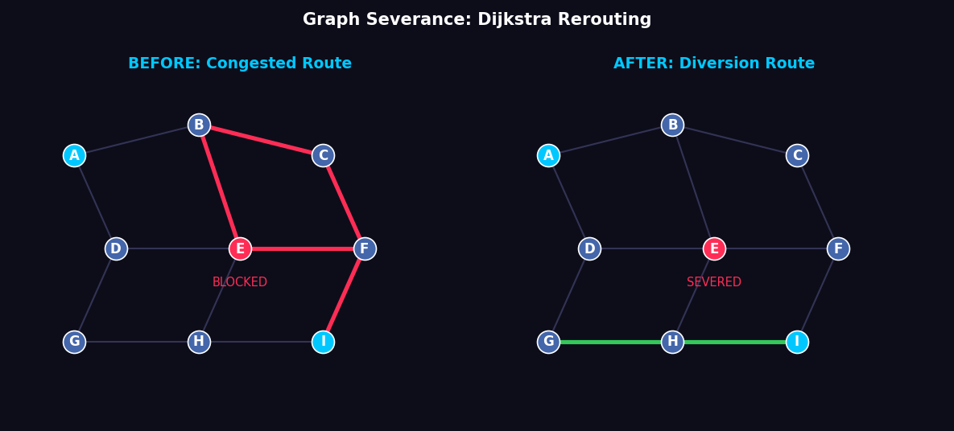
Prescriptive Engine: Graph-Theoretic Tactical Routing
When the model fires HIGH — the system computes diversion routes in real time
Step 1 — Model Fires HIGH
XGBoost predicts HIGH severity for node E. Confidence ≥ 0.75 threshold triggers the routing engine.
Step 2 — Node Severance
Node E is removed from the road graph G. All edge weights into/out of E set to ∞.
Step 3 — Dijkstra Search
NetworkX recomputes shortest path from origin (A) to destination (I) on the modified graph G'.
Route Calc Time
Graph Nodes
Graph Edges
Library
< 200ms
~1,400
~3,800
NetworkX
Step 4 — Route Output
Top-3 alternate routes returned with estimated delay delta. Route A→D→G→H→I selected.
10 / 15

Slide 11
Tactical Output: From Prediction to Deployment Orders
Every severity prediction generates an actionable field protocol in seconds
Sample Prediction Output
T−15 min
Model fires prediction based on shift start data + live weather. Dispatcher sees severity card on dashboard.
ZONE: Beat 14 — MG Road Junction TIME: 2024-11-03 19:45:00 WEATHER: rain_mm=14.2 | temp=27°C HOLIDAY: No | WEEKEND: No ───────────────────────────────────── SEVERITY: ██ HIGH (conf: 0.89) ───────────────────────────────────── RECOMMENDED ROUTES: #1 A→D→G→H→I +4 min ★ BEST #2 A→B→C→F→I +9 min #3 A→D→H→I +12 min BARRICADE POINTS: ▸ Entry: Richmond Rd / Museum Rd jn ▸ Exit: Lavelle Rd / St Marks Rd jn OFFICER DEPLOYMENT: ▸ 2 officers → diversion entry point ▸ 1 officer → blocked zone perimeter
T−10 min
Routing engine suggests top-3 diversion routes. Dispatcher confirms route #1 with one click.
T−5 min
Barricade placement markers appear on Folium map. Radio command issued to field officers.
T=0
Event begins. Barricades are in place. Traffic is flowing through diversion before congestion forms.
T+15 min
Dashboard shows live route compliance. Model re-evaluates if weather or crowd density changes.
11 / 15

Slide 12
The Product: Control Room Dashboard
Dark-mode Streamlit interface — built for dispatchers, not data scientists
Severity Triage Panel
Live Weather Auto-Fill
Tactical Folium Map
Dropdown for Zone, time, weather inputs. One-click prediction returns HIGH / MED / LOW with confidence score and color coding.
Open-Meteo API pre-fills rain_mm and temperature_c for the selected zone and time. Dispatcher can override manually.
Interactive dark-base map with colour-coded severity zones (RED / AMBER / GREEN), barricade placement markers, and animated diversion route overlays.
Route Comparison Panel
Duration Forecast
Historical Replay
Side-by-side route cards showing primary and alternate paths with estimated delay delta and officer assignment recommendations.
Secondary regression model estimates incident clearance duration so dispatchers can plan shift coverage.
Scrub through past events to review model accuracy. Used for post-incident analysis and model validation.
12 / 15

Slide 13
Technology Stack
Production-grade, open-source, deployable on a standard server
Data Layer
ML Layer
Routing Layer
Integration Layer
Frontend Layer
Pandas / NumPy
XGBoost
NetworkX
Open-Meteo API
Streamlit
Data cleaning, feature engineering
Multi-class gradient boosted trees
Graph construction and Dijkstra search
Live weather (rain_mm, temperature_c)
Web dashboard framework
imbalanced-learn
Optuna
OSMnx
Requests
Folium / Leaflet
SMOTE oversampling
Bayesian hyperparameter optimisation
OpenStreetMap road network download
HTTP client for API calls
Interactive tactical maps
Scikit-learn
Joblib
Shapely
dotenv
Plotly
Preprocessing, train/test split, metrics
Model serialisation and caching
Spatial geometry operations
API key management
In-app charts and visualisations
13 / 15

Slide 14
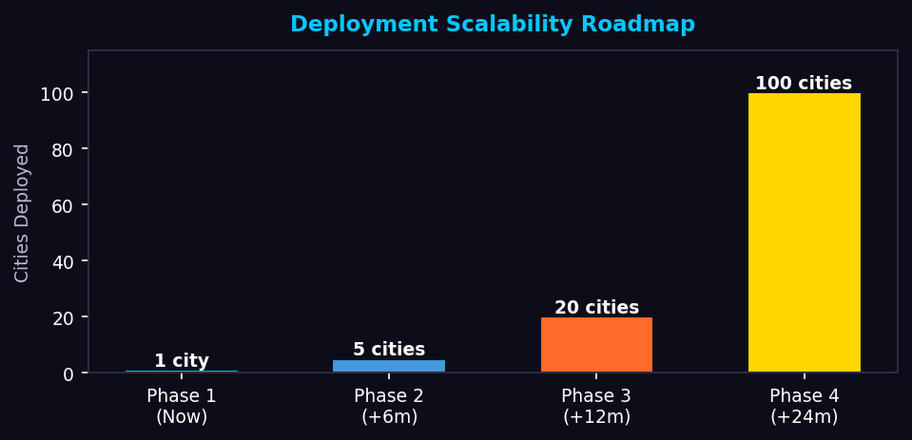
Impact & Scalability Roadmap
From Bangalore pilot to multi-city smart traffic infrastructure
Phase 1 · Now
Single-city severity triage · Event-driven predictions · Streamlit dispatcher dashboard · Open-Meteo live weather · Bangalore police data
Phase 2 · +6 months
Live GPS vehicle density feeds · Real-time model re-scoring · Push notifications to officers · GIS integration with city maps · 5 pilot cities
Phase 3 · +12 months
Multi-agency command dashboard · Police + Ambulance + Fire routing · Federated learning across cities · API for third-party integration · 20 cities
Projected Operational Impact (Phase 1)
Phase 4 · +24 months
Average response time improvement
23%
Dispatcher decision time
−60%
National smart city platform · Autonomous barricade triggers · Digital twin road simulation · Predictive infrastructure alerts · 100+ cities
Mis-routed unit rate
−41%
Incidents managed per shift
+35%
14 / 15

Slide 15
The City Shouldn't React to Gridlock.
It Should Prevent It.
We built an end-to-end AI system that moves traffic management from a radio and a whiteboard to a real-time prediction and routing engine. From raw police logs to a live dispatcher dashboard — every layer was built with purpose.
0.90 ROC-AUC
<200ms Routing
Live Weather
Full Dashboard
Stack: Python · XGBoost · Optuna · NetworkX · Streamlit · Folium · Open-Meteo API
Event Congestion Planner
Bangalore · 2024 | spuneet23@iitk.ac.in
15 / 15

