Slide 1

CAPSTONE PROJECT - 1
EDA ON HOTEL BOOKING ANALYSISS
BY -
RISHANSHU YADAV

Slide 2
WORK FLOW :
Data collection
And
Understanding
Data cleaning
And
Manipulation
Exploratory
Data
Analysis (EDA)
EDA will divided into following three analysis –
1. Univariate analysis : Univariate analysis is the simplest of the three analysis
where the data you are analyzing is only one variable.
2. Bivariate analysis : Bivariate analysis is where you are comparing two variables
to study their relationships.
3. Multivarite analysis : Multivariate analysis is similar to biavariate analysis but you
are comparing more than two variables.

Slide 3
Problem Statement :
For this project we will be analyzing Hotel Booking data . This data set contains booking information for a city hotel and a resort hotel , and includes information such as when a booking was made, length of stay , the number of adults , children , and/or babies and the number of available parking spaces .
Hotel industry is a very volatile industry and the bookings depends on above factors and many more .
The main objective behind this project is to explore and analyze data to discover important factors that concern the bookings and give insights to hotel management , which can perform various campaigns to boost the business and performance.

Slide 4
DATA COLLECTION AND UNDERSTANDINGS :
-We got here the data. This data contain 119390 rows and 32 columns .
So its becomes important to understand the columns.
Data Description:
Hotel : Type of hotel ( City hotel or Resort hotel )
is_canceled : Value indicating if the booking was canceled (1) or not (0)
lead_time : Number of days that elapsed between the entering date of the
booking and the arrival date
arrival_date_year : Year of arrival date
arrival_date_month : Month of arrival date
arrival_date_week_number : Week number of year for arrival date
arrival_date_day_of_month : Day of arrival date
stays_in_weekend_nights : Number of weekend nights( Saturday or sunday
spent at the hotel by guests.
stays_in_week_nights : Number of week nights( Monday to Friday )
adults : Number of adults among guests
children : Number of children among guests

Slide 5
babies : Number of babies
meal : Type of meal booked.
country : Country of origin.
market_segment : Market segment designation. (TA/TO)
distribution_channel: Booking distribution channel.(T/A/TO)
is_repeated_guest : is a repeated guest (1) or not (0)
previous_cancellations : Number of previous bookings that were cancelled by
the customer prior to the current booking
previous_bookings_not_canceled : Number of previous bookings not cancelled
by the customer prior to the current booking
reserved_room_type : Code of room type reserved.
assigned_room_type : Code for the type of room assigned to the booking.
booking_changes : Number of changes made to the booking from the moment
the booking was entered on the PMS until the moment of
check-in or cancellation
deposit_type : No Deposit, Non Refund , Refundable.
agent : ID of the travel agency that made the booking

Slide 6
company : ID of the company/entity that made the booking .
days_in_waiting_list : Number of days the booking was in the waiting list before
it was confirmed to the customer
customer_type : type of customer. Contract,Group,transient,Transient party.
adr : Average Daily Rate as defined by dividing the sum of all lodging
transactions by the total number of staying nights
required_car_parking_spaces : Number of car parking spaces required by the
customer
total_of_special_requests : Number of special requests made by the customer
( e.g. twin bed or high floor)
reservation_status : Reservation status (Canceled , check-out or not show )
reservation_status_date : Date at which the last reservation status was uploded.

Slide 7
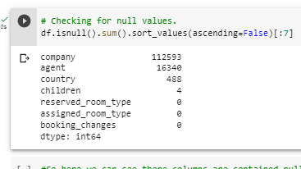
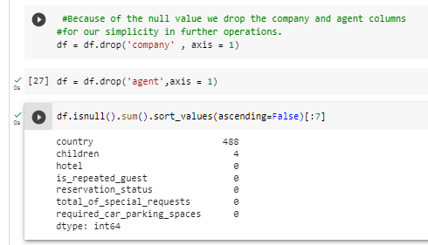
Data Cleaning and Manipulation
After importing required library and modules we move for data cleaning ,
manipulation and visualization.
From the given data set first we will see , any missing values (null values) and
duplicate value and we need to remove them.
There were 4 columns company , agent , country , and children with missing values

Slide 8
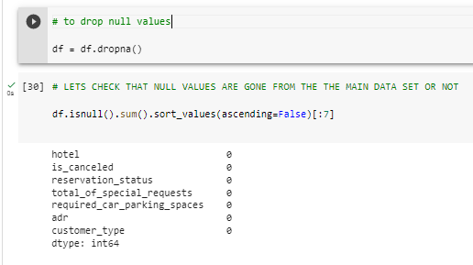
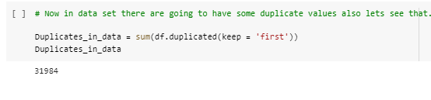

You must be wondering why I not remove the country and children column also but that
column has less null values comparing to other columns .So , for those remaining null
values I choose to remove the null rows not the whole column for the future operations .
Handling Duplicates : data had 31984 duplicates values.

Slide 9
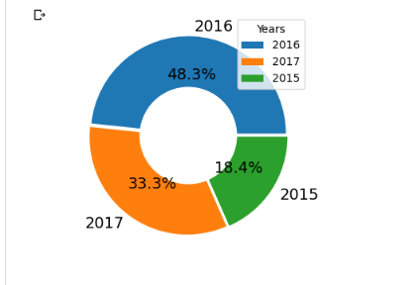
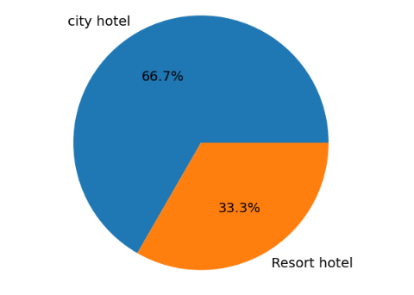
EXPLORATORY DATA ANALYSIS ( EDA ) :
Exploring the data set
From the first pie chart we can see we the data set
contain three years data. The maximum data is from
year 2016.
(i)
From the second pie chart we can see we have main
two types of hotel i.e. City hotel and Resort Hotel.
The maximum data is form City hotel i.e. 66.7% and
minimum from Resort hotel i.e. 33.3%.
(ii)

Slide 10
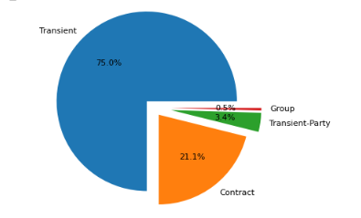
Checking the how many different types of customer are
these hotels are having
CONCLUSION :
From above chart we can see that 75.0% , 21.1 %, 3.4 %, 0.5 % business are
coming form transient, contract, transient-party and group respectively.
And here we only considered the conform bookings.

Slide 11
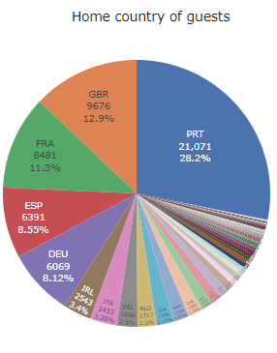
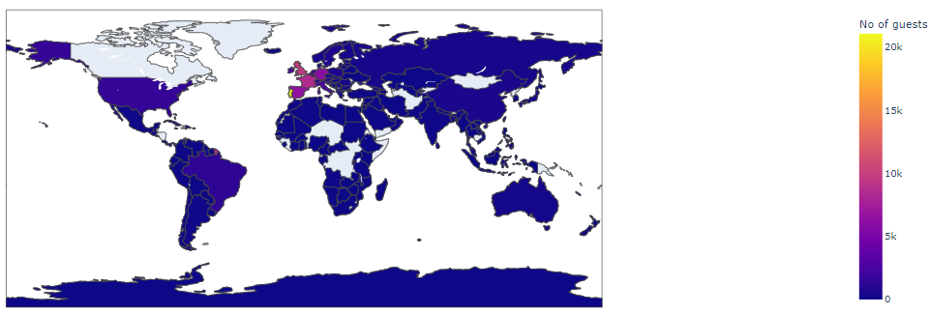
To analyze home country of guests :
CONCLUSOION :
As we see in the side pie chart the maximum number of
guests are form Portugal with 21071 guests, Great Britain
with 9676 guest and France with 8481 and so on.
Most tourists come from Europe since the top 5 countries
are in Europe.
And in the next map we expressing the geological data in
much more efficient way.

Slide 12
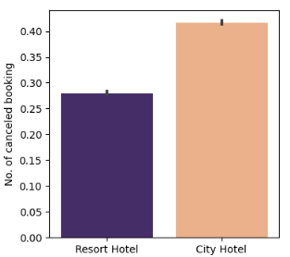
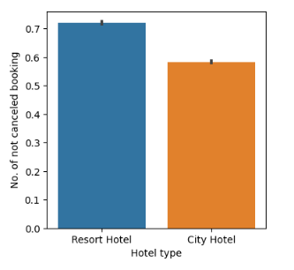
To analyze which hotel gets cancelled the most by the customer :
OBSERVATIONS :
(i)
From the first bar plot we can see the maximum
number of bookings are cancelled are from the
City hotel that indicates people love to spend their
time in peaceful Resort hotel.
From the Second bar plot we can see the
maximum number of booking not cancelled are
from Resort hotel which proves our upper
statement.
(ii)

Slide 13
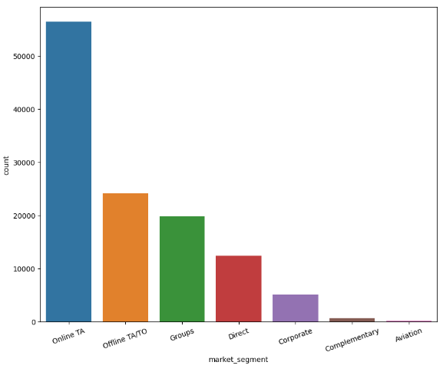
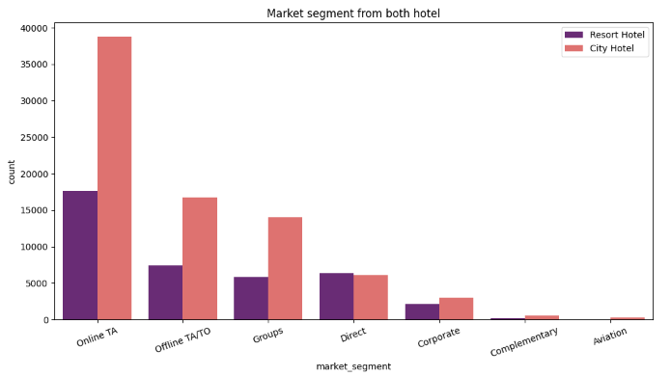
Booking by market segment
OBSERVATIONS :
From above two chart we can see that the most
of the booking are done by online travel
agencies and the second most segment is
offline travel agencies.
And the minimum bookings are coming for
aviation segment.

Slide 14
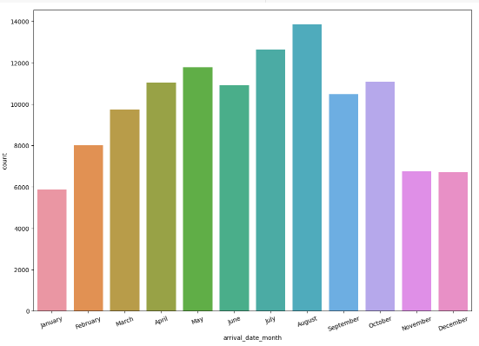
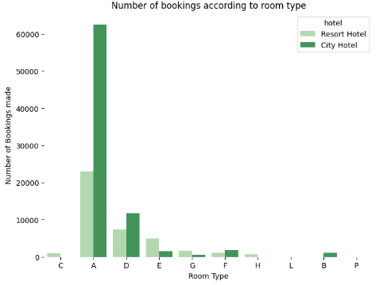
To know the count the visitor in each month and preferred type of hotel rooms
OBSERVATIONS :
From the above we can see, in the month of August the more number guest are
coming and less number guest comes in January over the year.
From the second graph we see most of the guest preferred type A rooms for staying
in both Resort and City hotel. So hotel should more focusing on how to maximize
the number of that type.

Slide 15
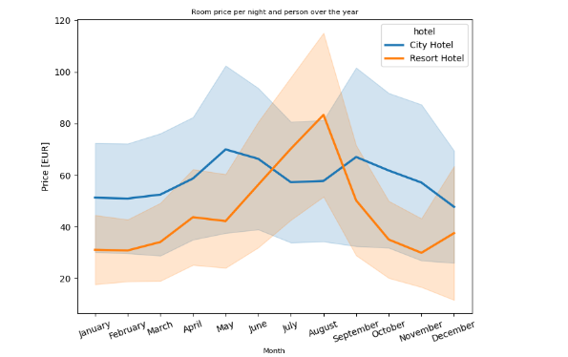
How does the price per night vary over the year ?
OBSERVATION :
There is a peak on the prices for the Resort hotel is on August.
There is a peak on the prices for the City hotel is on May and September

Slide 16
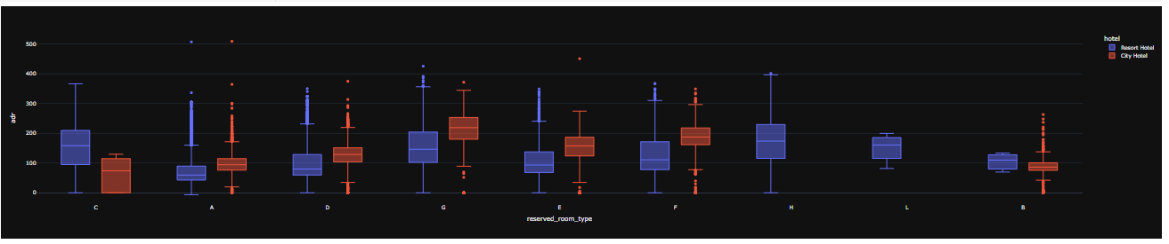
Both hotels have different room types and different meal arrangements. Seasonal
Factors are also important, So the prices varies a lot. so we are going to create
boxplot for better understanding of this.
CONCLUSION :
The figure shows that the average price per room depends on its type and the standard
deviation , And here we can see some outlier of our data.

Slide 17
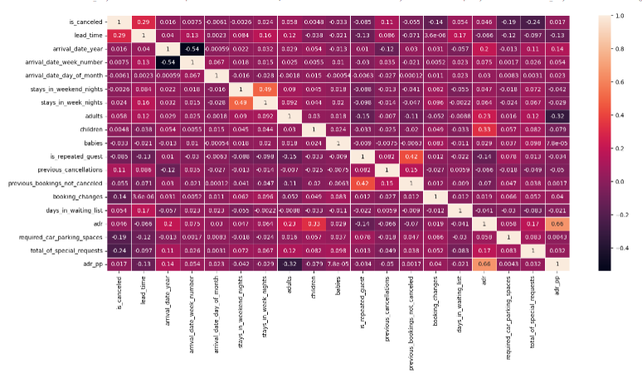
To know the relation between different variables :
CONCLUSION :
The canceled and same_room_allotted_or_not are negatively correlated. Not getting the same
room as per reversed room is not the reason for booking cancellations.
Lead_time and total stay is positively correlated means more is the stay of customer more will be the
lead time.
ADR and total people are highly correlated. That means more the people more will be adr. High
adr means high revenue.
The is_repeated_guest and previous_bookings_Not_canceled has strong
correlation. May be repeated guest are more likely to cancel their
bookings.

Slide 18
CONCLUSION :
City hotels are the most preferred hotel type by the guests. We can say City
hotel is the busiest hotel.
27.5 % bookings were got cancelled out of all the bookings.
79.1 % bookings were made through TA/TO (travel agents/Tour operators).
BB( Bed & Breakfast) is the most preferred type of meal by the guests.
Maximum number of guests were from Portugal, i.e. more than 21000 guests.
Most of the bookings for City hotels and Resort hotel were happened in 2016.
Average ADR for city hotel is high as compared to resort hotels. These City
hotels are generating more revenue than the resort hotels.
Booking cancellation rate is high for City hotels which almost 30 %.
Average lead time for resort hotel is high.
Resort hotels have the most repeated guests.
Optimal stay in both the type hotel is less than 7 days. Usually people stay for
a week.
Almost 19 % people did not cancel their bookings even after not getting the
same room which they reserved while booking hotel. Only 2.5 % people
cancelled the booking.

Slide 19


