Slide 1
POWER-BI SALES DASHBOARD
DATA ANALYST INTERNSHIP
TASK-8 ELEVATE LABS
GIT-HUB
LINKEDIN
Rishant kumar ruman

Slide 2
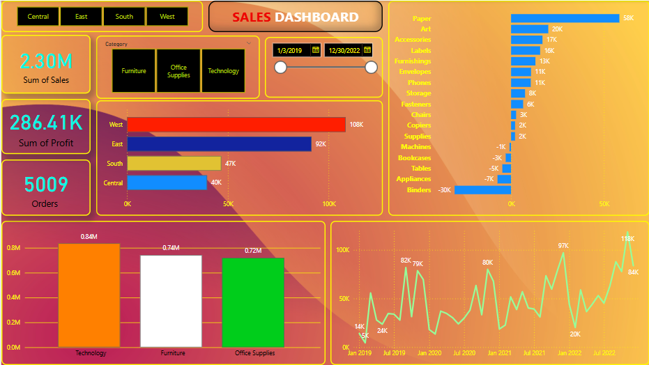
This dashboard shows sales by category, region, and time trends.

Slide 3
Key Insights from the dashboard
Technology emerged as the top-performing category in terms of total sales and profit, contributing significantly to overall revenue.
The Furniture category, despite having moderate sales, showed a low or even negative profit margin in some sub-categories like Tables and Bookcases.
Western Region led in sales volume, while the Central Region showed relatively better profit margins overall.
The Home Office segment had lower order volume but comparatively better profitability than the Corporate segment.
December and November recorded the highest sales activity, indicating a seasonal trend likely driven by year-end purchases.
Some orders had high discounts, which resulted in negative profits, highlighting the need for discount optimization.

Slide 4
Conclusion :-
In this task, I created a simple and effective sales dashboard using Power BI. It visualizes key metrics like sales trends over time, regional performance, and category-wise contributions. This helped in identifying high-performing regions and understanding overall sales patterns. The project enhanced my practical skills in data visualization and dashboard design

Slide 5
Thank You
Thank you for reviewing my work. This task helped me apply data analytics tools in a real-world context, and I look forward to learning more and growing in this field.
GIT-HUB
LINKEDIN

