Slide 1

Flask: The Python Microframework
Flask is a lightweight microframework for Python web development. It's designed to be simple and extensible. Flask gives developers the flexibility to choose components. This allows them to build exactly what they need.

Slide 2
Key Features of Flask
Lightweight
Built-in Server
Jinja2 Templating
Flask provides the essentials without overhead. Add only what you need for your project.
Test and debug easily with the development server included in Flask.
Generate dynamic web pages with Jinja2, a powerful templating engine.

Slide 3
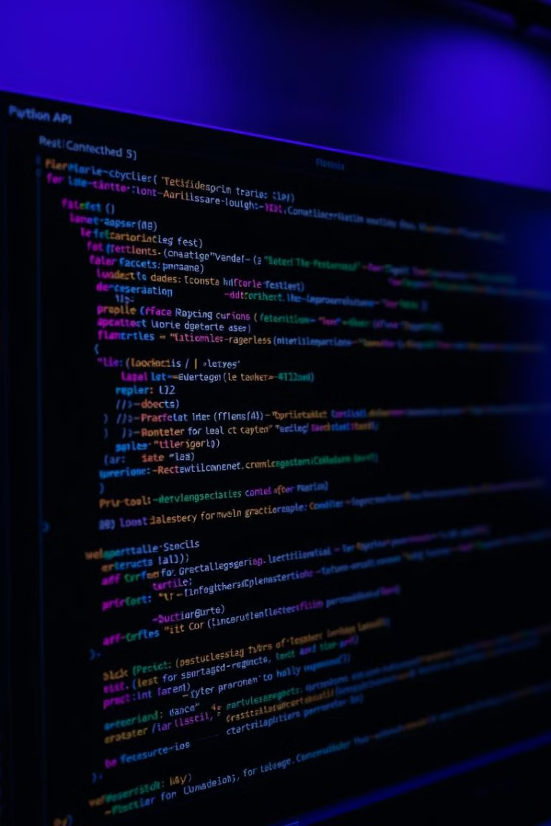



RESTful API Support
REST APIs
Extensible
Python
Ideal for building backend services that serve data to frontends.
Integrate with SQLAlchemy, Flask-Login, My SQL and other extensions.
Build efficient applications with Python's simplicity and readability.

Slide 4
Flask vs. Django & FastAPI
Flask
Django
FastAPI
Simpler and more flexible. It gives developers more control.
A full-fledged framework with many built-in features.
Optimized for building APIs with high performance.

Slide 5

Importance & Applications
Rapid Prototyping
RESTful API Dev
Microservices
Quickly build and test web apps with minimal setup.
Create APIs for serving data to frontend applications.
Build independent services that communicate with each other.

Slide 6



Real-World Flask Applications
Netflix
Reddit
Uber
Uses Flask for microservices that handle video streaming data.
Some internal APIs are powered by Flask.
Uses Flask in backend services for ride and driver management.

Slide 7

Final Thoughts
Easy to Learn
Flexible
Flask has a gentle learning curve, suitable for beginners.
Provides the necessary tools without unnecessary complexity.
Powerful
Flask allows developers to build scalable and efficient web applications.

