Slide 1

Basic Details of the Team and Problem Statement
Organization Name: Government of Jammu and Kashmir
PS Code: 1352
Problem Statement Title: Farming in the Digital Age: Leveraging Technology for Agricultural Success
Team Name: Code Catalysts Team Leader Name: Rishap Parmar
Institute Code (AISHE): U-0136 Institute Name: School of Emerging Sciences and Technology, Gujarat University.
Theme Name: Agriculture

Slide 2
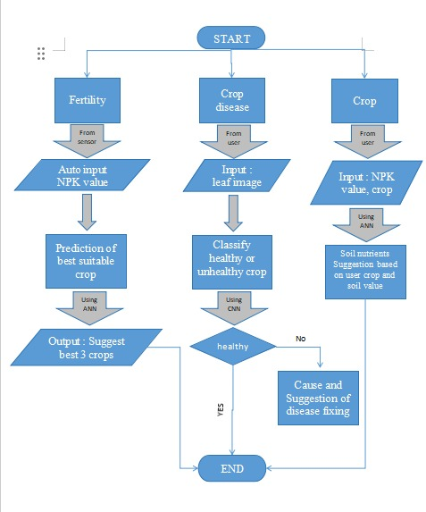
Idea/Approach Details
Flow chart
Solution:
Live monitoring system:
Crop recommendation and respective soil nutrient proportion management.
Plant health and disease classification, cause and remedies.
Soil fertility
Live comparison
Technology stack:
HTML
CSS
Python
Machine Learning
Deep Learning:
YOLO model, TensorFlow, PyTorch
PowerBI
JS

Slide 3
Idea/Approach Details
Use Cases
Showstopper
Users get better crop advice by analyzing their soil carefully.
Special soil plans make sure the soil is just right for the crops they want to grow, helping them grow well.
Smart technology looks at pictures of leaves and helps fix plant problems right away to keep crops healthy.
It's easy to use, even if you're not great with technology, and helps you make good farming choices.
This system helps farms produce more and be better for the environment, which is important for food for everyone in the world.
Harnessing cutting-edge machine learning for precision agriculture.
Real-time monitoring for improved field management.
In-depth insights into crop yield influencers.
Addressing inefficiencies in traditional farming practices.
Empowering farmers with data-driven profitability.

Slide 4
Team Member Details
Team Leader Name: Rishap Parmar
Branch: Int. MSc Stream: AI & ML Year: V
Team Member 1 Name: Kinjal Satuniya
Branch: Int. MSc Stream: DS Year: V
Team Member 2 Name: Dhrupesh Kalal
Branch: Int. MSc Stream: AI & ML Year: IV
Team Member 3 Name: Shreyanshi Shah
Branch: Int. MSc Stream: AI & ML Year: IV
Team Member 4 Name: Utkarsh Vataliya
Branch: Int. MSc Stream: AI & ML Year: IV
Team Member 5 Name: Khushi Saidava
Branch: Int MSc Stream: AI & ML Year: I
Team Mentor 1 Name: Dr. Ravi Gor
Category (Academic/Industry): Expertise (AI/ML/Blockchain etc): Domain Experience (in years):
Team Mentor 2 Rasmi Rekha Kumari
Category (Academic/Industry): Expertise (AI/ML/Blockchain etc): Domain Experience (in years):

