Slide 1
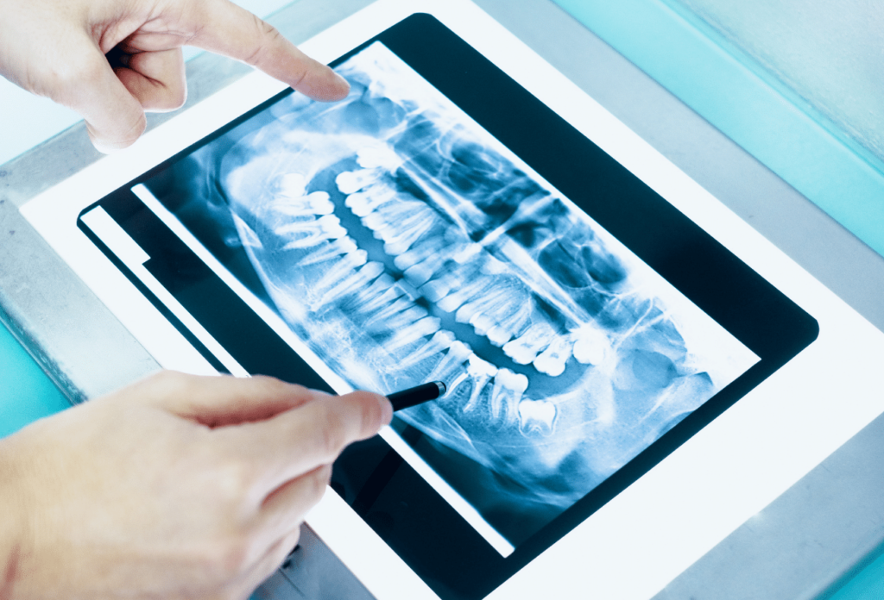
Virtual Patient Simulator for Skill Training in Dentistry ​
Group 16 :
E/16/086 Virajani Dharmathilaka
E/16/156 Tharushini Jayathilaka
E/16/223 Chanika Madushanki
Supervisors:
Prof. Roshan G. Ragel
Dr. Upul Jayasinghe
Dr. D Leuke Bandara

Slide 2
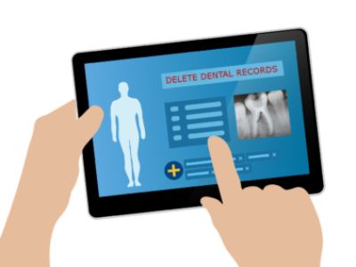
Background
Dental Students​
​
Appropriate patient assessment is a basic skill that would be required in any clinical discipline.​
This includes proper history taking, adequate examination of the patient and the decision on the required investigations.​
Manikin Patients​
​
Manikin patients are used for repetitive and deliberate practice​
Record keeping, reproducibility, assessment

Slide 3
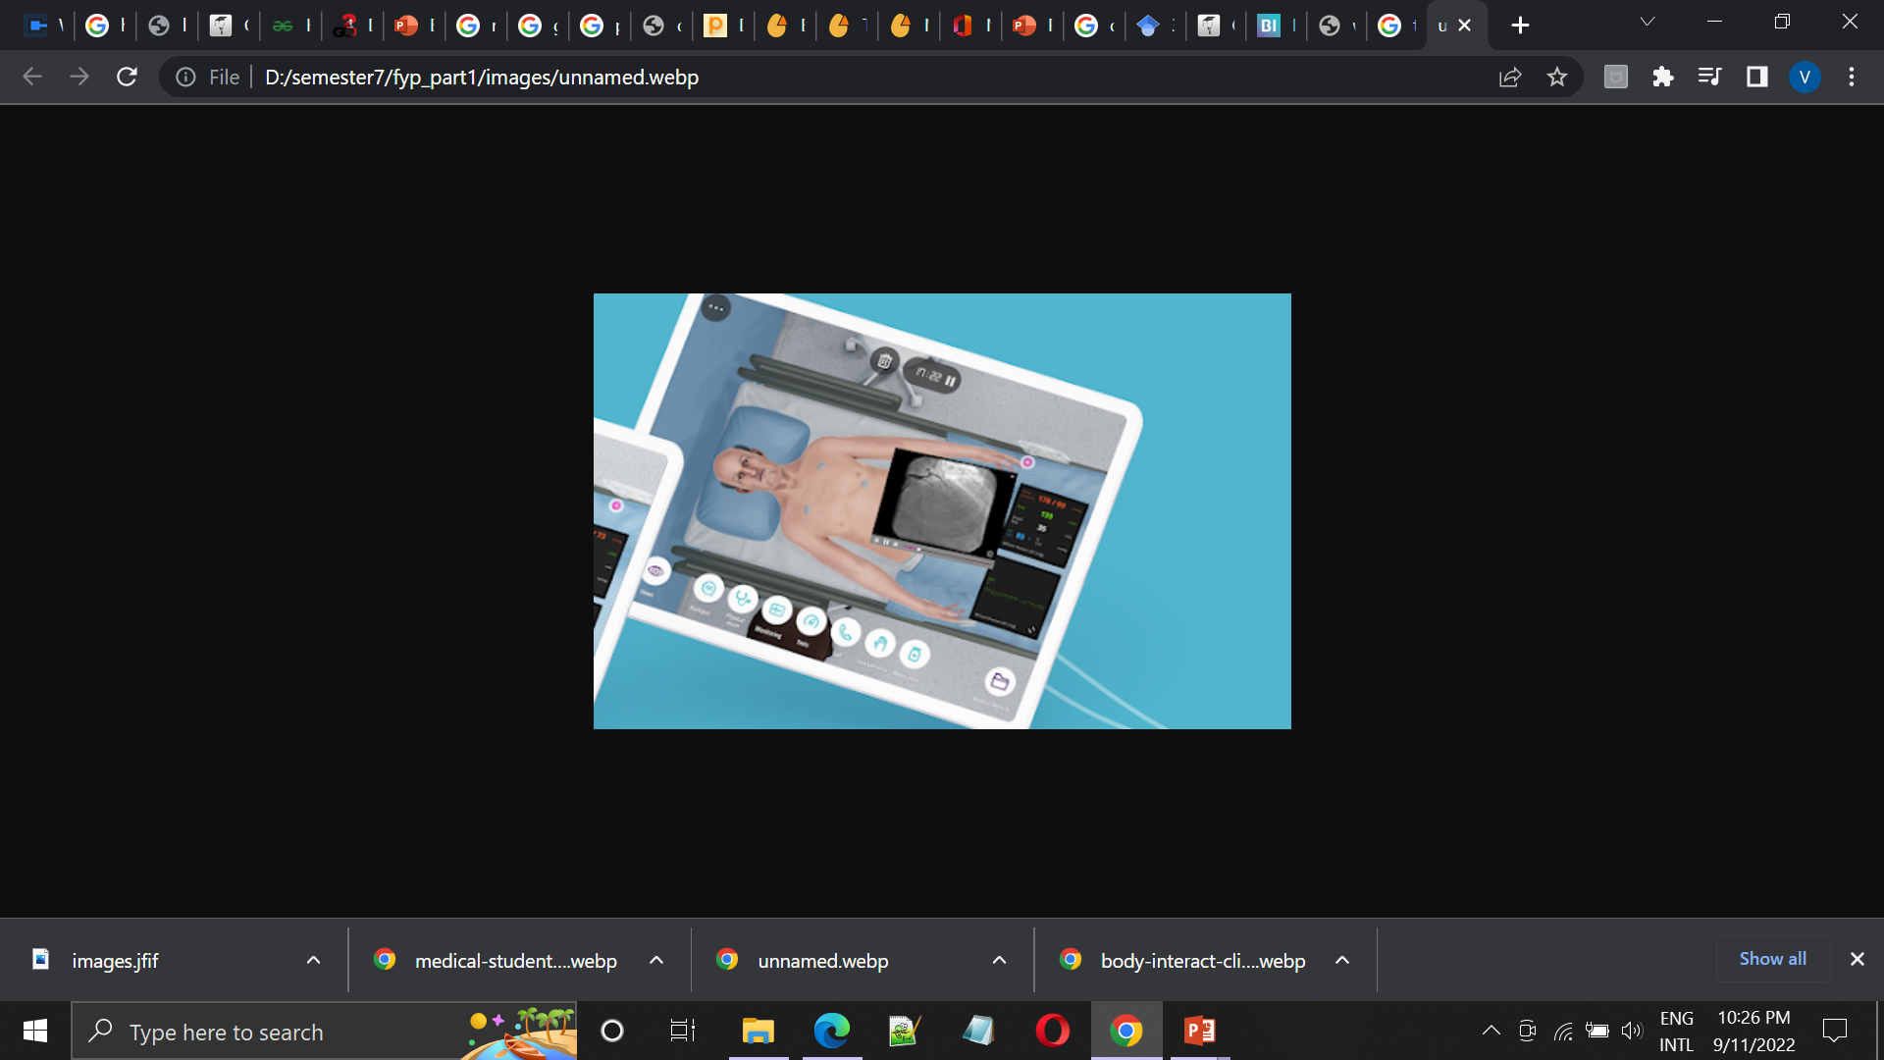
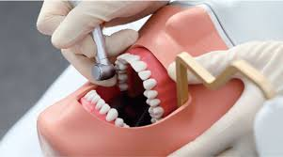
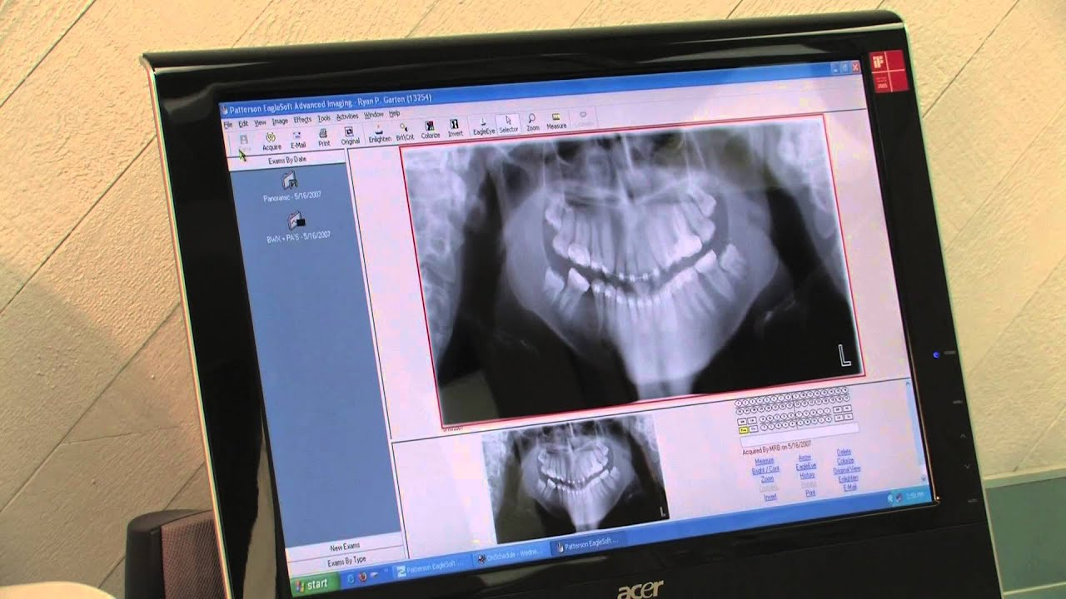
Motivation
Need for training in adequate
Patient assessment
Clinical reasoning methods
Problem based decision making
Less human resources
Less chances for a real time tutoring
system to improve skill training

Slide 4
Methodology
Virtual simulators were considered under different approaches
Haptic based devices and non-haptic based devices
Problem based learning(PBL) approach -> PBL+ Intelligence tutoring systems(ITS)
Medical related works -> Dentistry related works
Multimedia systems -> apply 3D graphics
Clinical training and clinical reasoning skills
Game engines -> use game engines in implementation of medical simulators
Key words
Problem-based learning, Dentistry, Virtual patients, Game engines, Virtual simulation
Resources from
Google scholar, PubMed

Slide 5
Related Work
Web-SP[1] - A system of Web-based Simulation of Patients
COMET[2] – Combination of ITS and computer-supported collaborative learning
Virtual World(VW)[3]- 3D environment for students to work collaboratively
Virtual Patient Collection(VPC)[4]- Analyse VP scenarios integrated into the combined internal medicine and surgery curriculum
Virtual reality training simulator(VRTS)[5] –Haptic based simulator for tooth preparation practise
Virtual Learning Environment (VLE)[6] - Diagnosis and treatment planning in dentistry
ALICE[7] - A Web-based immersive virtual patient, students can move around a virtual environment in the first person, much as in a video game
AI Chatbot[8] – A virtual patient with a conversational chatbot with AI

Slide 6
1. Urresti-Gundlach, M., Tolks, D., Kiessling, C., Wagner-Menghin, M., Härtl, A., & Hege, I. (2017). Do virtual patients prepare medical students for the real world? Development and application of a framework to compare a virtual patient collection with population data
5. Jung, H., Kim, H., & Moon, S. (2018). Virtual reality training simulator for tooth preparation techniques.
6. Janda, M. S., Mattheos, N., Nattestad, A., Wagner, A., Nebel, D., Färbom, C., & Attström, R (2004). Simulation of patient encounters using a virtual patient in periodontology instruction of dental students: design, usability, and learning effect in history‐taking skills.
2. Suebnukarn, Siriwan & Haddawy, Peter. (2007). COMET: A Collaborative Tutoring System for Medical Problem-Based Learning. Intelligent Systems​
7. Kleinert, R., Heiermann, N., Plum, P.S., Wahba, R., Chang, D.H., Maus, M., Chon, S.H., Hoelscher, A.H. and Stippel, D.L., 2015. Web-based immersive virtual patient simulators: Positive effect on clinical reasoning in medical education.
3. Jivram T, Kavia S, Poulton E, Hernandez AS, Woodham LA and Poulton T (2021) The Development of a Virtual World Problem-Based Learning Tutorial and Comparison With Interactive Text-Based Tutorials
4. Urresti-Gundlach, M., Tolks, D., Kiessling, C., Wagner-Menghin, M., Härtl, A., & Hege, I. (2017). Do virtual patients prepare medical students for the real world? Development and application of a framework to compare a virtual patient collection with population data. BMC medical education
8. Suárez, A., Adanero, A., Díaz-Flores García, V., Freire, Y., & Algar, J. (2022). Using a Virtual Patient via an Artificial Intelligence Chatbot to Develop Dental Students’ Diagnostic Skills.

Slide 7
Virtual Patient Classification
Class label | Predominant competency | Predominant technology | Related implementations
Case introductions | Knowledge | Multimedia systems | Web-SP
Interactive Patient Scenario | Clinical reasoning | Multimedia systems | VPC, VLE
Gaming environment | Clinical reasoning and Team training | Virtual worlds | Virtual World
High Fidelity Software Simulation | Procedural or basic clinical skills | Dynamic simulations or mixed reality | VTRS
High Fidelity Manikin | Procedural and basic clinical skills, /Team training | Manikins or Part Task Trainers | COMET, ALICE
Virtual Standardized Patient | Patient communication skills | Conversational characters | AI chatbot
Kononowicz, A. A., Zary, N., Edelbring, S., Corral, J., & Hege, I. (2015). Virtual patients-what are we talking about? A framework to classify the meanings of the term in healthcare education.

Slide 8
Analysis – Functional comparison
Features | Techniques | Web-SP | COMET | VW | VPC | VRTS | VLE | ALICE | AI Chatbot
Haptic-based |  |  |  |  |  | ✔
Introduction to the system | Instructions in text |  |  |  |  | ✔ |  |  | ✔
 | Instruction in video |  |  | ✔ |  |  |  | ✔
History taking | Textual | ✔ |  | ✔ | ✔ | ✔ | ✔ | ✔ | ✔
Examination and investigation | Textual |  | ✔ | ✔ | ✔ |  | ✔ | ✔ | ✔
 | Selecting from drop-down list | ✔
 | Providing resources with 3D images |  |  | ✔ |  | ✔
 | Providing resources with 2D images | ✔ | ✔ |  |  |  | ✔ | ✔
 | Proving resources with videos |  |  |  |  |  |  | ✔
PBL |  |  | ✔ | ✔

Slide 9
Analysis – Functional comparison
Features | Techniques | Web-SP | COMET | VW | VPC | VRTS | VLE | ALICE | AI Chatbot
Chat System (with the patient) | Textual |  |  | ✔ |  |  | ✔ |  | ✔
Tool Selection | 3D images |  |  | ✔ |  | ✔
Diagnosis | Only diagnosis |  | ✔ | ✔
 | Diagnosis with treatment instructions | ✔ |  |  |  | ✔ | ✔ | ✔
Feedback System | Textual | ✔ | ✔ | ✔ |  | ✔ | ✔ |  | ✔
 | Access to the previous diagnosis | ✔
 | Case feedback for the tutor |  |  |  |  |  | ✔
Individual Supervision | Tracking log | ✔ |  |  |  |  | ✔
 | Evaluation |  |  |  |  | ✔ | ✔ | ✔ | ✔

Slide 10
Analysis –Technical comparison
Chat system
System | Technology/Programming Language | Remarks
VW | virtual world Second Life (SL) by Linden Labs | Detection of keywords in the question. Text-chat and voice communication Use Standard Boolean operators Add alternative wordings identified from prior PBL experiences
VLE | PHP | Data calls are handled on server side over the Internet Searches a database for answers delivers response as text, sound, image or movie to the student
AI chatbot | Dialog flow application | Detection of keywords in the question Use natural language processing algorithms Capable of understanding the nuances of human language by learning through action and feedback

Slide 11
3D Images
Evaluation
System | Technology/Programming Language | Remarks
VW | virtual world Second Life (SL) by Linden Labs | Create avatars “holodeck” tool – For large variety of rooms or scenarios in limited space
VRTS | Unity3D | TC Vive Pro VR headset is used
System | Technology/Programming Language | Remarks
ALICE | SPSS software package version 20 | Analyse performance in the pre- and postquestionnaire data
COMET | Bayesian network, Conditional probability tables | BNs to model individual student knowledge and activity

Slide 12
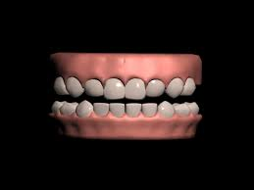
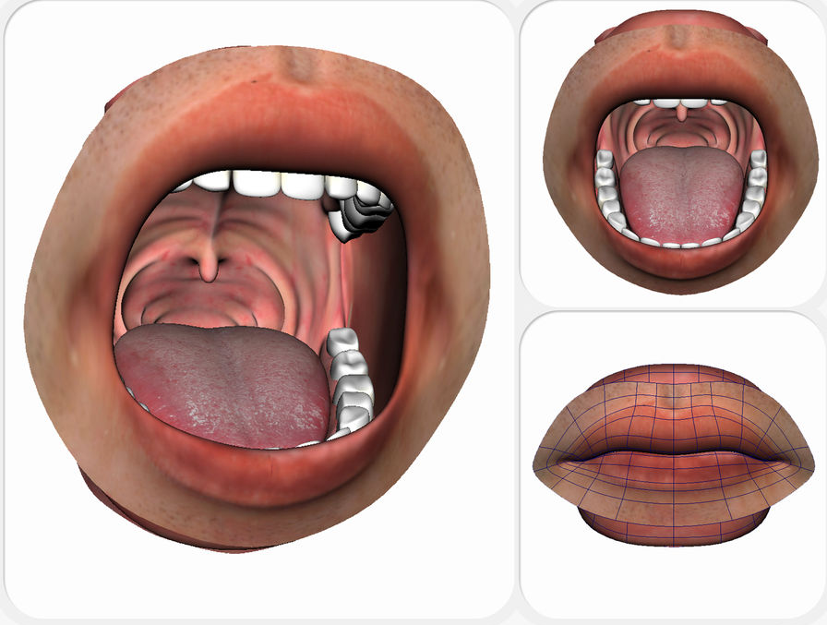
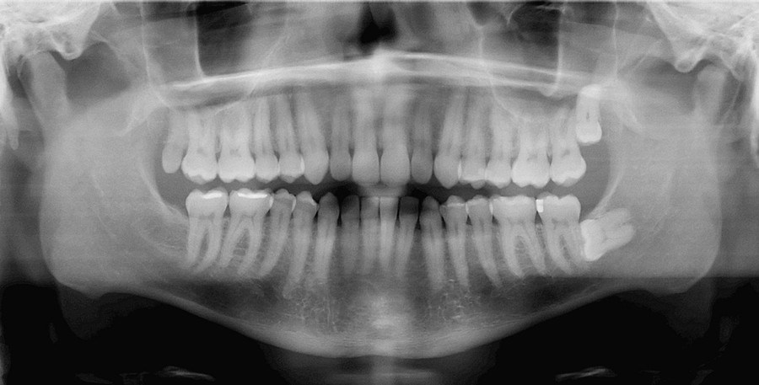
Research Gap 01.
When presenting the scenario with 2D images stored in a database, it limits the learning areas of the student.
3D images will give more sense in visual aids than 2D images in patient examination.
Generating 3D images, system by itself will be an advantage for the admin.
Proposed system:
Implementations of system generated 3D images, radiography, etc. for different cases to be referred by the student.
Use game engines

Slide 13
Game Engines
Unity 3D
Cross-platform integration
Assest store management
Use C#
Id Tech4
Normal Mapping and Specular Highlighting
Virtual Texturing
Source Engine
Large degree of mod-ability
Use C++
Unreal Engine
Ability to create hyper-realistic environments
Immersive virtual worlds
Use C++
Industry-leading facial expression technology
Use C++
Marks, S., Windsor, J., & Wünsche, B. (2007, December). Evaluation of game engines for simulated surgical training.​

Slide 14
Generating 3D images Unity 3D can be identified as the most efficient game engine
Create or generate the 3D model inside the Unity 3D | Create or generate the 3D model externally
Unity photogrammetry Authoring digital assets of original real-world objects | 3Ds Max A software purely used for 3D modeling Commercial Tool
Unity ProBuilder A unique hybrid of 3D modeling and level design tools | Maya Strong in animation Commercial Tool
Unity Terrain 3D terrain visualization of GIS data | Blender Free game development engine

Slide 15

Research Gap 02.
Student assessment system needs a detailed feedback than just giving an evaluation
Proposed System
Improved and efficient feedback systems with case by case feedback system for students.

Slide 16
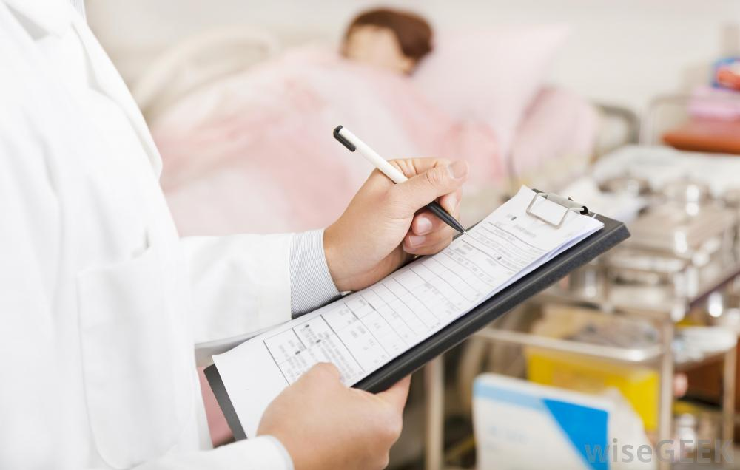
Research Gap 03.
For better analysis of the performance of students, keeping records is important.
Proposed System
Records of history of students including tracking logs, activity logs, evaluations, etc. for the admin.( ex: University, Institute)

Slide 17
Recaps
Virtual patient systems has been implemented using various approaches
Ex : haptic based, web-based, chat system, virtual patient
Systems for student skill training can be implemented with evaluation and feedback systems
Game engines can be utilized to design a manikin patient system including 3D graphics

Slide 18
Thank You

